Slide 1
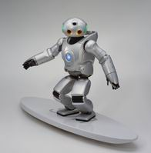
Unit 7 Will people have robots?

Slide 2
Revision: There will be 句型练习
1.将会有更多的树。
2. 将会有更少的车子。
3.将会有更少的污染。
4.我认为一年后将会有更少的空闲时间。
There will be more trees.
There will be fewer cars.
There will be less pollution.
I think there will be less free time in a year.

Slide 3
1.人们将不再使用钱，一切都将是免费的.
2. 人们将活到两百岁.
3.孩子们将不去上学，他们将在家里通过电脑学习.
4.人们会更少地使用电脑。
5.我认为家家都会有一台机器人.
6.书只会在在电脑上出现，而不会在纸上。
People won’t use money.
Everything will be free.
People will live to be 200 years old.
Kids won’t go to school.
They’ll study at home on computers.
People will use computers less.
I think every home will have a robot.
Books will only be on computers, not on paper.

Slide 4
Ask and answer
A: Where did Tom live ten years ago?
A: Where does he live now?
A: What will Tom be like in ten years?
B: He lived in a house in the country/Techville.
It was quite far from here.
B: He lives in an apartment across from
the road from here.
B: He will be a computer programmer. He will work
near here at Sisco Software Systems.
B: He will be an astronaut. He will live on the space
station on the moon.

Slide 5
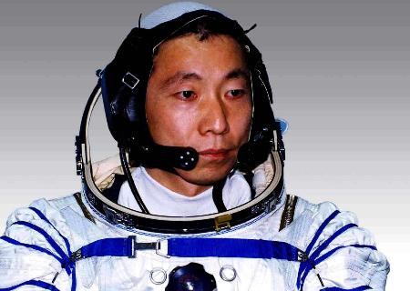
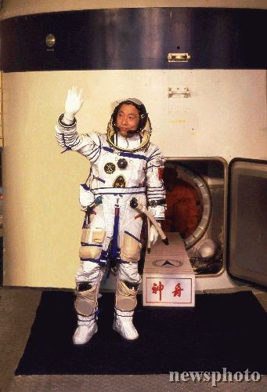
Learn some new words.
What’s his job?
An astronaut.

Slide 6
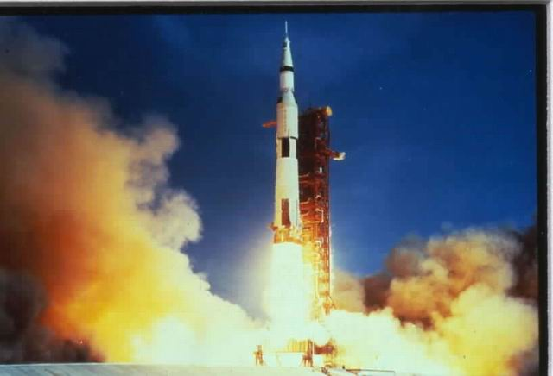
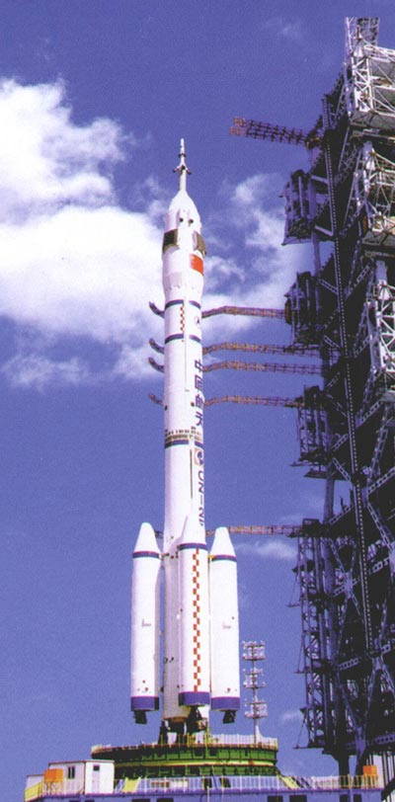
How does he go into space?
He flies rockets to the space.
He goes into the space by rocket.

Slide 7
1a Write each word in the correct column below.
astronaut house apartment computer programmer
train rocket space station
Jobs | Transportation | Places to live
 |  | space station
astronaut
train
house
computer
programmer
rocket
apartment

Slide 8
1b Brainstorm
Gather as many words as possible for jobs,transportation and places to live.
Jobs
doctor
cook
reporter
salesman
banker
manager
fashion designer
accountant
photographer
Transportation
plane
trolleybus
spaceship
subway
ferry
Places to live
The moon
The Mars
Antarctica
Ocean
Shanghai
America
Paris
South Korea

Slide 9
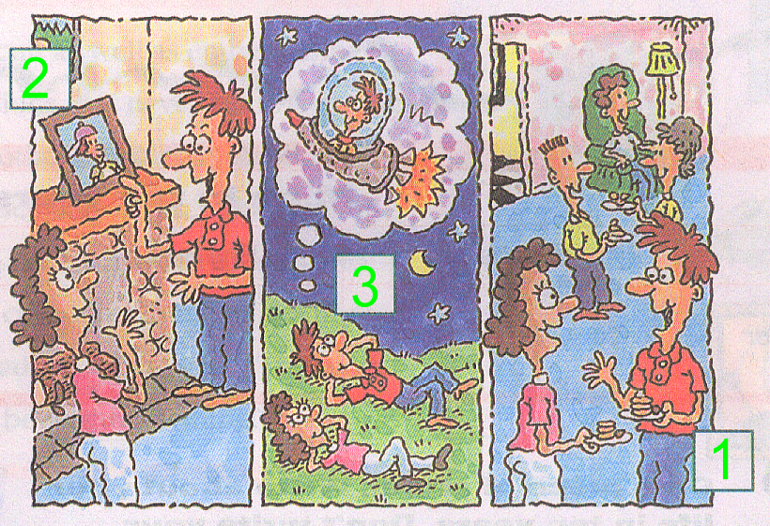
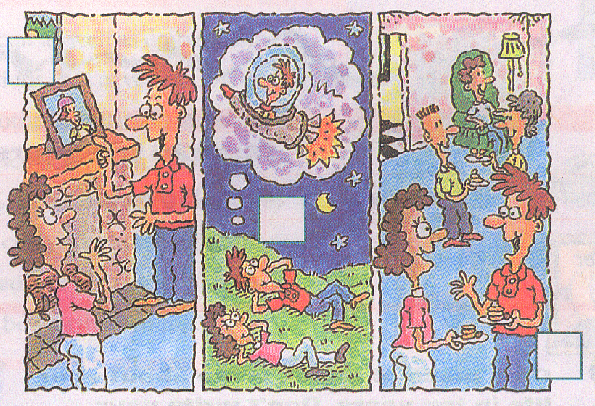
2a Listening
Listen and number the pictures

Slide 10
2b Listen again.
Fill in the blanks with the correct verbs.
1. I ________in an apartment. 2. I ________near here. 3. I ________a computer programmer. 4. We_______ in a house. 5. I _________ the train to school. 6. I _________ an astronaut. 7. I _________ rockets to the moon and Mars. 8. I _________ on a space station.
live
’ll live
’ll fly
work
lived
am
took
’ll be
live
work
am
lived
took
’ll be
’ll fly
’ll live

Slide 11
Conversation 1
Alexis: Hi, I’m Alexis.
Joe: Nice to meet you, Alexis, I’m Joe.
Alexis: Nice to meet you, Joe. Do you
live here in Techville?
Joe: Yes, I do. I live in an apartment
across the street from here.
Alexis: Oh, really?
Joe: Yes, I work near here too, at Sisco
Software Systems. I am a computer
programmer.
Alexis: A computer programmer? That sounds
interesting.
Joe: Well, actually it’s kind of boring. I do
the same thing every day.

Slide 12
Conversation 2
Alexis: Hey, Joe, is that a picture of you?
Joe: Yeah,that was me ten years ago.
Alexis: So, did you live here in Techville ten
years ago?
Joe: No, I lived with my parents in
Greenville. We lived in a house in the
country. I went to school here in
Techville, though.
Alexis: Really? That’s pretty far from here.
How did you get to school?
Joe: Oh, I took the train to school.

Slide 13
Conversation 3
Alexis: So, Joe, what do you think your
life will be like in ten years?
Joe: Oh, I think I’ll be an astronaut.
Alexis: An astronaut? Are you kidding?
Joe: No, I’m serious. I’ll fly rockets to
the moon. Maybe there will be
flights to other planets.
Alexis: Oh, and where will you live?
Joe: I’ll live on a space station.

Slide 14
Write a short passage about yourself.
Five years ago, I was in primary school,
I played football with classmates after class,
and I had a dog. Now I’m a middle school
student, I like playing tennis. I am good at
English and I have good grades. In five years,
I will be a doctor, I will make much money,
and I will travel around the world. I will play
the guitar. I will have a car.
five years ago
now
in five years

Slide 15
Write about your and your partner's life in ten years.
Then report it to class.
Jobs | Places to live | Transportation
I’ll be a businessman. I’ll live on a farm .
I’ll travel a lot by plane. He’ll be a doctor.
He’ll live in a city. He’ll walk to work.

