Slide 1

Unit 4

Slide 2

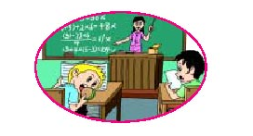
Unit 4
Don’t eat in class.

Slide 3
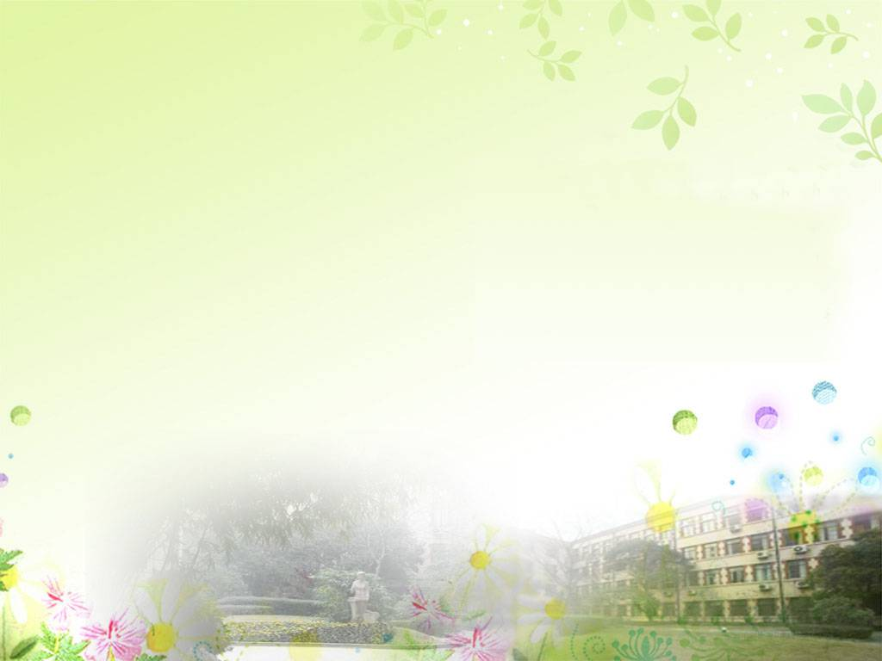
Section A1
1a-2d

Slide 4
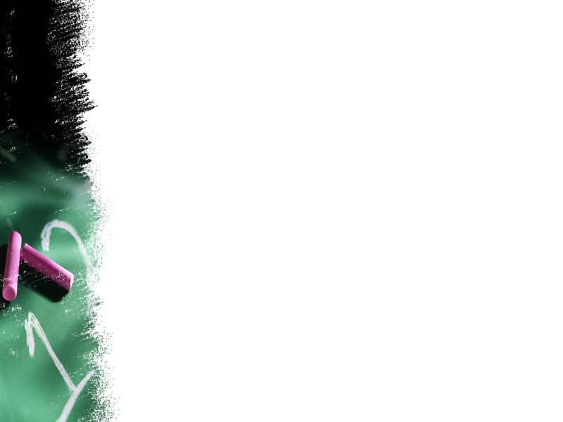
chant
Rain! Rain! Go away!
Come again another day!
Little Johnny wants to play.
Rain! Rain! Go away!
Come again another day!
It's mother's washing day.

Slide 5

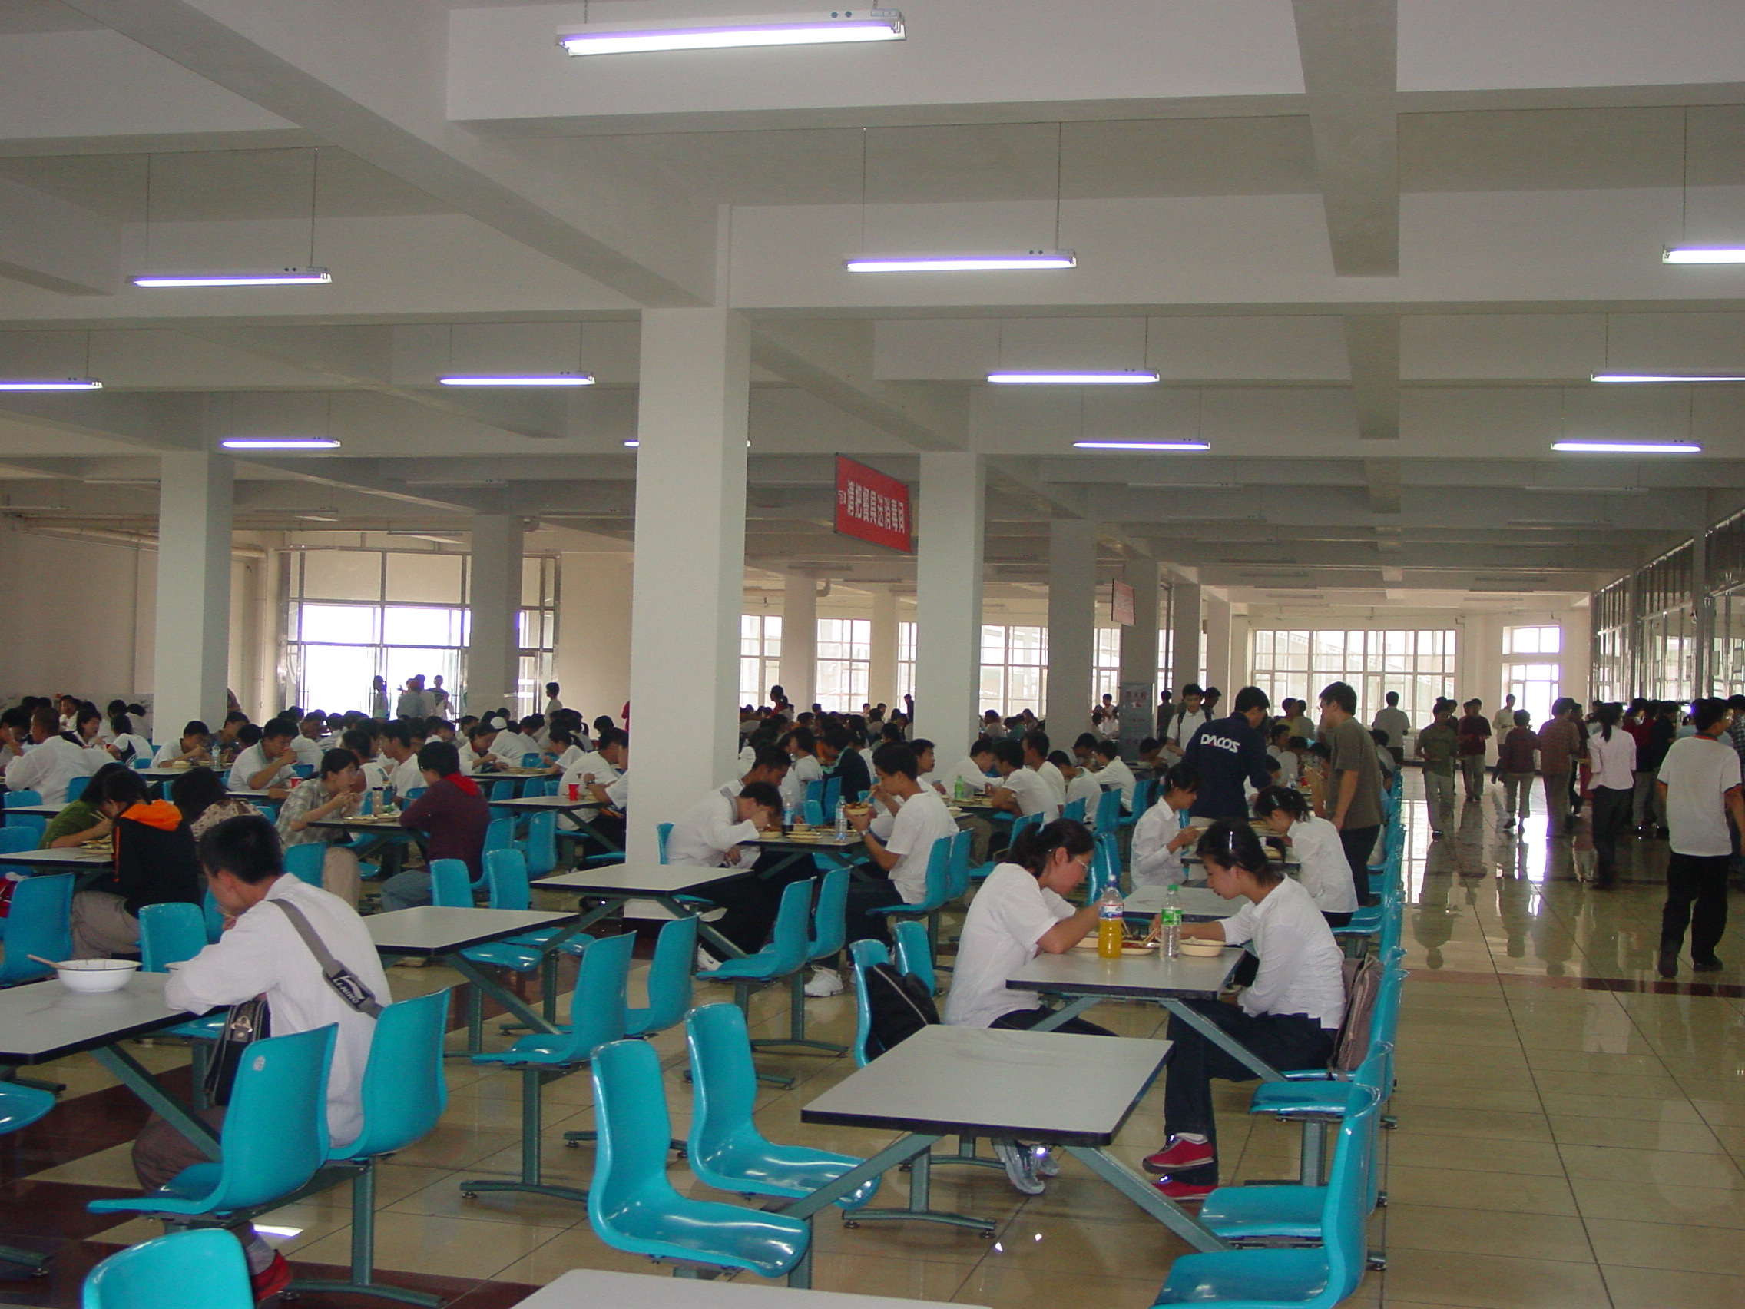
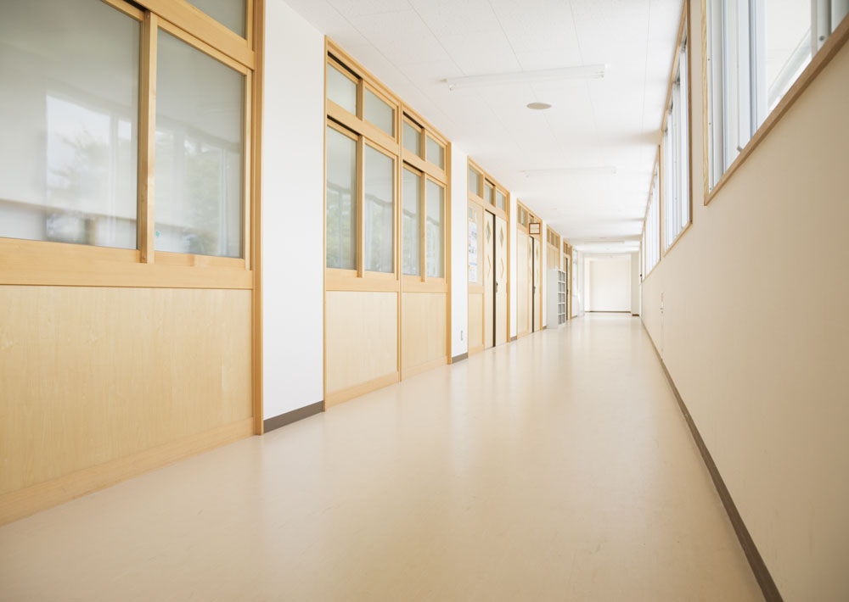
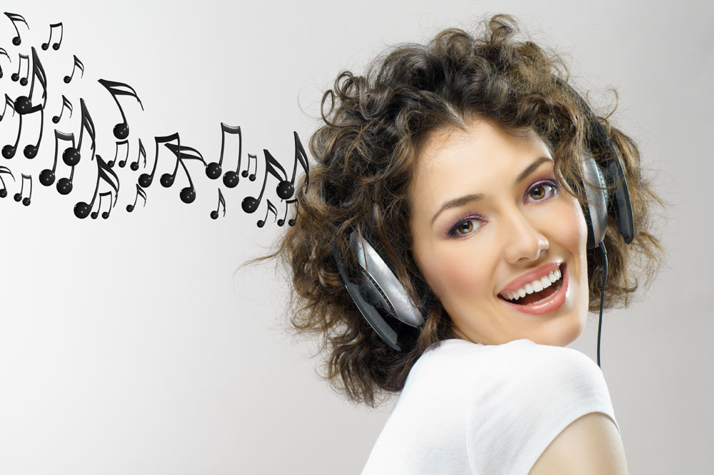
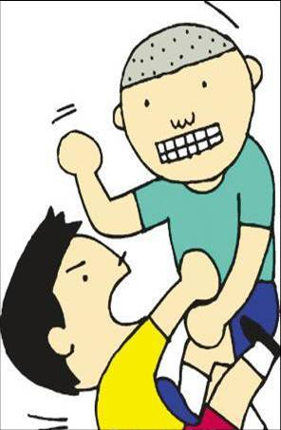
New words
dining hall 食堂
hallway n. 走廊
fight v. n.
打架
listen to 听…

Slide 6

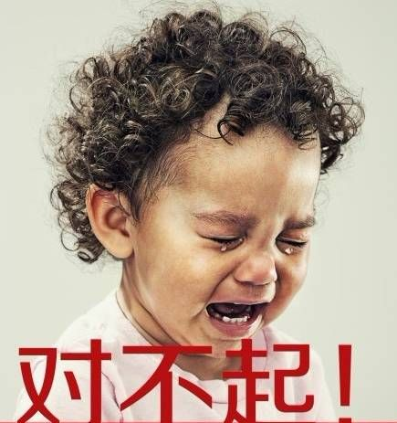
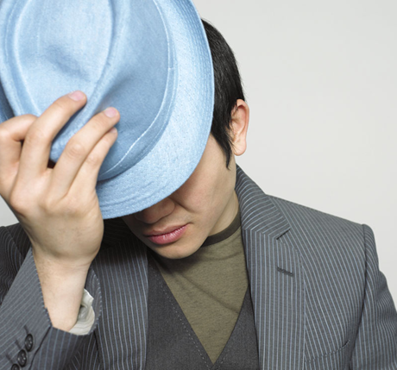
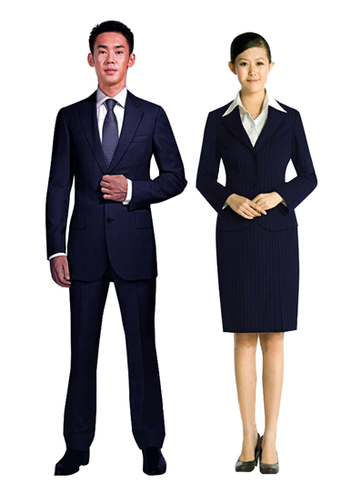
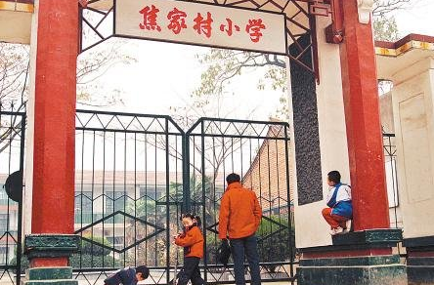
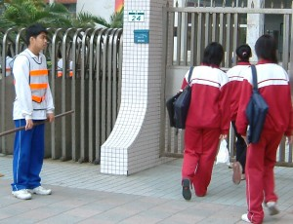
music player
wear a hat
戴帽子
sorry adj. 对不起
uniforms
n. 制服
outside adv. 外出
arrive v. 到达

Slide 7
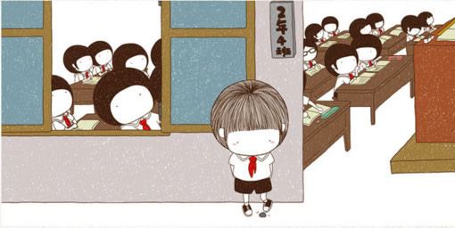
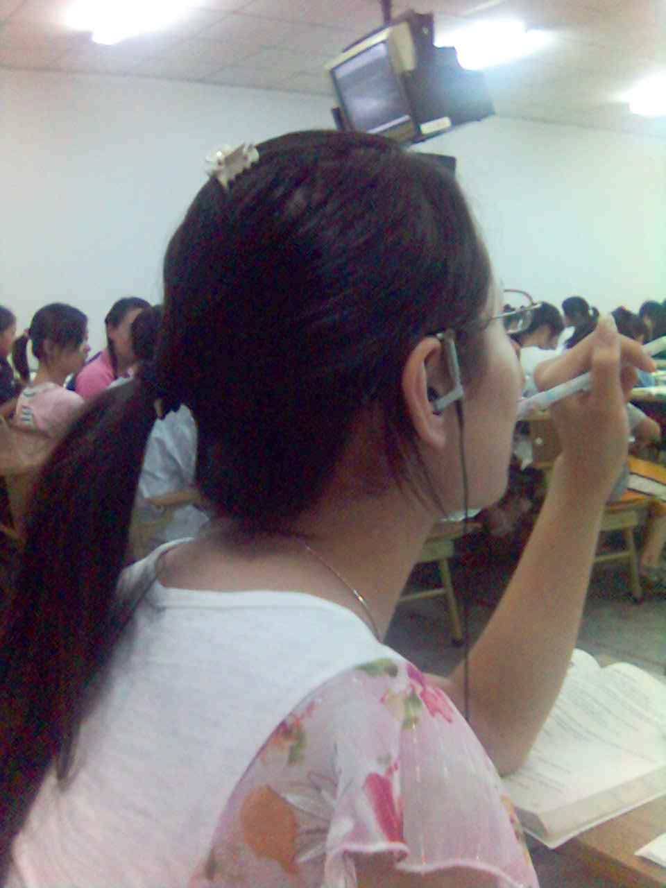
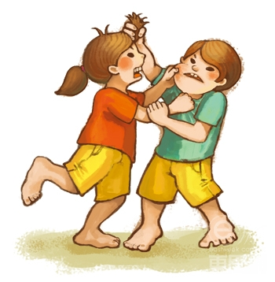
Presentation
Don’t arrive late for class.
You must be on time.
Don’t fight!
Don’t listen to music in class.

Slide 8

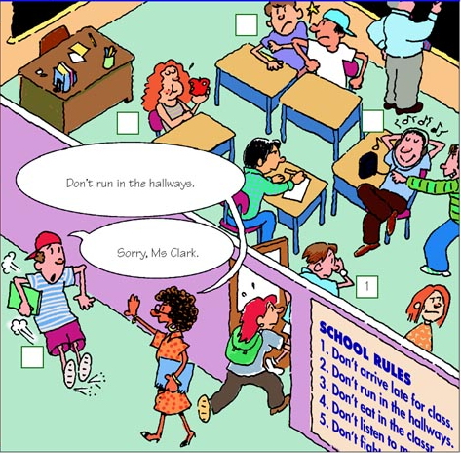
1a Which rules are these students breaking?
Write the number of the rule next to the student.
1. Don’t arrive late for class. You must be on time.
2. Don’t run in the
hallways.
5
3. Don’t eat in the
classroom. You must eat in the dining hall.
4
3
4. Don’t listen to
music in class.
2
5. Don’t fight.

Slide 9

Listening
1b Listen. What rules are these
students breaking? Write the
numbers after the names.
Peter ______ Amy ______ Mike ______
2
3
4

Slide 10
1. Don’t arrive late for class. You must be
on time.
2. Don’t run in the hallways.
3. Don’t eat in the classroom. You must
eat in the dining hall.
4. Don’t listen to music in class.
5. Don’t fight.

Slide 11
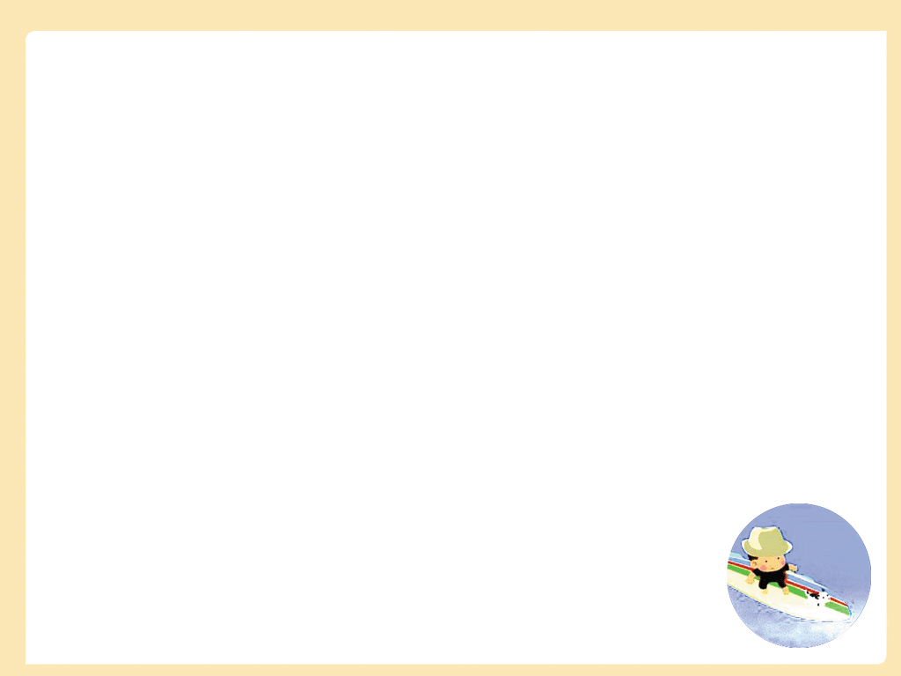
比眼力!
Tell your classmate what the rules should be.
Don’t fight with your classmates.

Slide 12
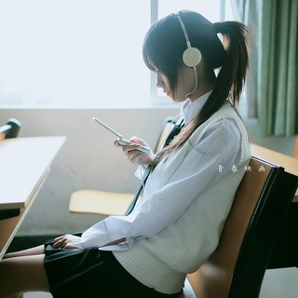
Don’t listen to music in the classroom.

Slide 13
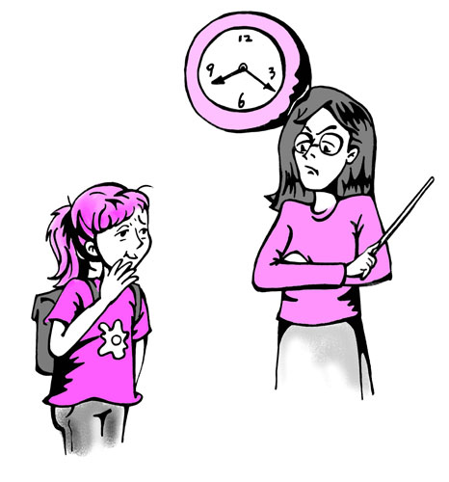
Don’t arrive late for school.

Slide 14
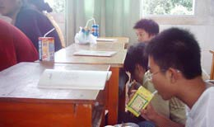
Don’t eat in the classroom. You must eat in the dining hall.

Slide 15
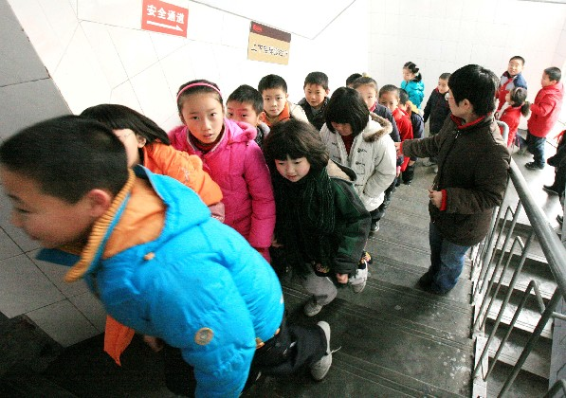
Don’t run in the hallways.

Slide 16
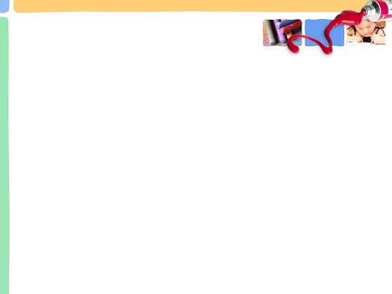
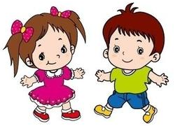
1c Student A is a new student. Student B tells Student A about the rules above.
Pairwork
What are the rules?
Well, we can’t arrive late for class. We must be on time.
Don’t run in the hallways.

Slide 17
What are the other rules?
Don’t eat in the classroom
You must eat in the dining hall.
Don’t listen to
music in class.
Don’t fight.

Slide 18

Listening
2a Listen check (√) the activities
Alan and Cindy talk about.
1. ___ listen to music in the classroom or
hallways
2. ___ listen to music in music room
3. ___ listen to music outside
4. ___ eat in the classroom
√
√
√
√

Slide 19
5. ___ eat in the dinning hall
6. ___ eat outside
7. ___ wear a hat
8. ___ fight
√
√
√

Slide 20
2b Listen again. Can Alan and Cindy do these activities? Circle can or can’t above.
listen to music in the classroom or hallways
listen to music in music room
listen to music outside
eat in the classroom
eat in the dining hall
eat outside
wear a hat
fight
can can’t
can can’t
can can’t
can can’t
can can’t
can can’t
can can’t
can can’t

Slide 21

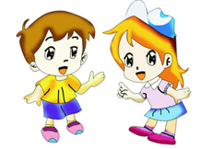
2c Student A is Alan. Student B is Cindy. Talk about the rules in 2a.
Pair work
Well, we can’t listen to music in the classroom or hallways.
But we can listen to music in music room.
What are the school rules, Alan?
We can’t eat in the classroom, but we can eat in the dining hall.
Uh-huh.

Slide 22
No, you can’t. What else? Oh, you can’t fight with your classmates. That makes the teachers really unhappy.
Oh, can we wear a hat in class?
I see.

Slide 23
Our Class Rules
Can or can’t
write or draw on the desks
use mobile phones
sit on the desks
speak or laugh loudly in the classroom
run around in the classroom

Slide 24
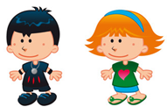
No, you can’t.
Can we write or draw on the desks?
Right. We can’t write or draw on the desks, but we can write or draw on paper or in notebooks.

Slide 25

Reading
2d Read the conversation in 2d and answer the questions.
1. Is John new at school?
___________
2. Are there many rules at school?
______________
Yes, he is.
Yes, there are.

Slide 26
3. Can he bright music players to school?
_______________
4. Do they have to always wear the school uniform?
_______________
No, he can’t.
Yes, they do.

Slide 27
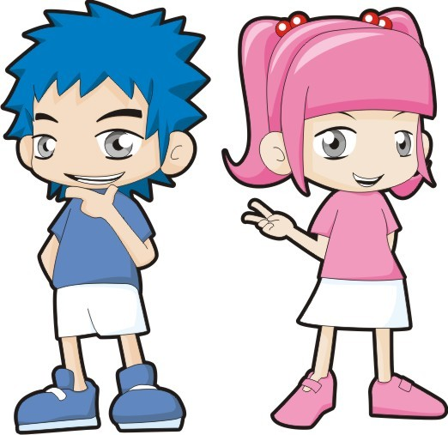
Role-play
2d Role-play the conversation.

Slide 28

Language points
1. arrive v. 到达= get (to)
1) arrive 后面可以不跟到达的地点。
e.g. Don’t arrive late for school.
不要上学迟到。

Slide 29
2) arrive后面也可以跟到达的地点。但后面必须要跟介词in （大地方）或 at（小地方）。
e.g. They arrived in Beijing at six.
他们六点钟到的北京。
We usually arrive at the village in
the morning.
我们通常在早上到那个小村庄。

Slide 30
Practice
选词填空: in, at, to
1. My mother usually get ___ school at 7:40 in the morning.
2. When do you usually arrive ____ the bus station?
3. Jenny’s uncle usually arrives ___ Shanghai in the evening.
to
at
in

Slide 31
2. listen 的用法:
1) listen v. 听；用来提醒某人注意，后面不跟事物。
e.g. Listen! Who’s singing in the
classroom? 听！谁在教室里唱歌？
2) 如果后面跟要听的事物，应跟介词to再跟事物。
e.g. Listen to our teacher carefully.
认真听老师讲。

Slide 32
3. fight 打架，争吵
1) 作动词用
e.g. Jack never fights with his brother.
杰克从不和他的弟弟打架。
2) 作名词，意为“打架；争吵”; 常用词组have a fight“打架；吵架”
e.g. Did you have a fight with her?
你和她吵过架吗？

Slide 33
4. wear v. 意为“穿、戴”
e.g. My aunt wears a blue skirt and a white T-shirt.
我姑姑穿着蓝色的裙子，白色的T恤。
Does he wear glasses?
他戴眼镜吗？

Slide 34
5. have to与must
have to着重于客观的需要，含有“不得不”的客观强制性；must着重于主观上自己认为有义务、有必要。如：
She has to clean the room every week.
她每周都得打扫房间。
I must go now.
我现在必须走。

Slide 35
含有have to的句子变一般疑问句或否定句时要借助助动词do / don’t或does / doesn’t；而含有must的句子变一般疑问句是直接将must提前至句首，变否定句是在must后加not。如：
He doesn’t have to do it. 他不必做那件事。
He mustn’t do it. 他不许做那件事。

Slide 36
Does he have to do it?
他不得不做那件事吗？
Must he do his homework?
他必须做他的作业吗？

Slide 37
在否定句中，don’t / doesn’t have to表示“没有必要”，must not / mustn’t表示“不允许”。如：
You don’t have to go there.
你不必去那儿。
You must not / mustn’t go there.
你不许去那儿。

Slide 38
练一练：用have to, must 填空
1. It’s cold outside. We ______ stay at
home.
2. We ____ be good with our parents.
have to
must

Slide 39
根据各题后括号内的要求完成下列各题。
1. He has to wear the school uniform at school. (改为一般疑问句)
_____ he ________ wear the school uniform at school?
2. They have to do too much homework every day. (改为否定句)
They ______________ do too much homework every day.
Does
have to
don’t have to

Slide 40
3. We must finish our work now. (改为一般疑问句)
______ we ________ our work now?
Must
finish

Slide 41

将下列句子译成英语。
Exercises
不要在上课时听音乐。
__________________________
2. 我们必须准时。
___________________________
3. 我们能把音乐播放器带到学校里来吗？
___________________________________
在图书馆里我们必须保持安静。
________________________________
不要在楼道里跑 。
_________________________________
Don’t listen to music in class.
We must be on time.
Can we bring the music player to school?
We must keep quiet in the library.
Don’t run in the hallways.

Slide 42
Homework
Write the rules in your school.
提示：
1. 上学不要迟到 2. 按时上课
3. 穿校服 4. 不在教室里吃东西
5. 不要在教室里戴帽子
6. 在餐厅吃东西

Slide 43

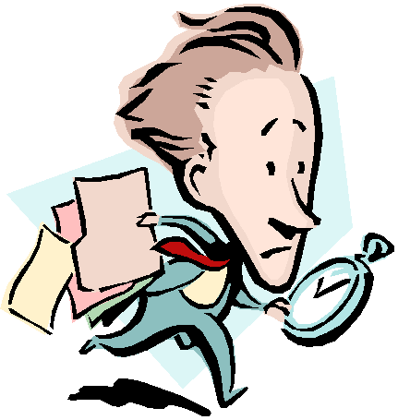
Follow the rules at school!

Slide 44

Thank you!

