Slide 1
Unit 3 Environmental protection
Period 2 Build up your vocabulary
选择性必修三
人教版（2019）

Slide 2
Think of a word that best fits each definition.Then fill in the blanks with the correct form of the word.
Task1
broadcast
v:to send out programmes on television or radio
The concert will__________
(broadcast) live tomorrow evening.
be broadcast

Slide 3
Task 1
Think of a word that best fits each definition.Then fill in the blanks with the correct form of the word.
____ adj:including all, or almost all, the items, details, facts, information, etc., that may be concerned
comprehensive
The Rough Guide to Nepal is _______ comprehensive guide to the region.
a

Slide 4
Task 1
Think of a word that best fits each definition.Then fill in the blanks with the correct form of the word.
n:the relation of plants and living creatures to each other and to their environment; the study of this
ecology
Development has been guided by a concern for ___ ecology of the area.
the

Slide 5
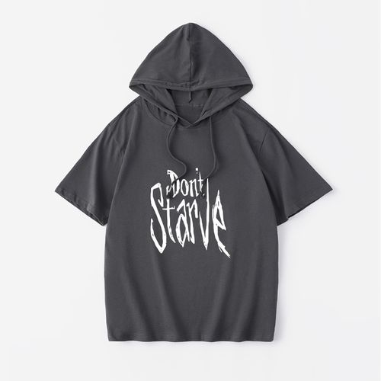
Task 1
Think of a word that best fits each definition.Then fill in the blanks with the correct form of the word.
v:to suffer or die because you do not have enough food to eat; to make sb suffer or die in this way
starve
The animals were left _________(starve) to death.
to starve

Slide 6
Task 1
Think of a word that best fits each definition.Then fill in the blanks with the correct form of the word.
v:to be quick to make use of a chance, an opportunity, etc.
seize
Parents should actively urge their children ________
(seize)the opportunity to join sports teams.
to seize

Slide 7
Task 1
Think of a word that best fits each definition.Then fill in the blanks with the correct form of the word.
v:to let sb/sth come out of a place where they have been kept or trapped
release
Becoming your own person _________(release) your creativity.
releases

Slide 8
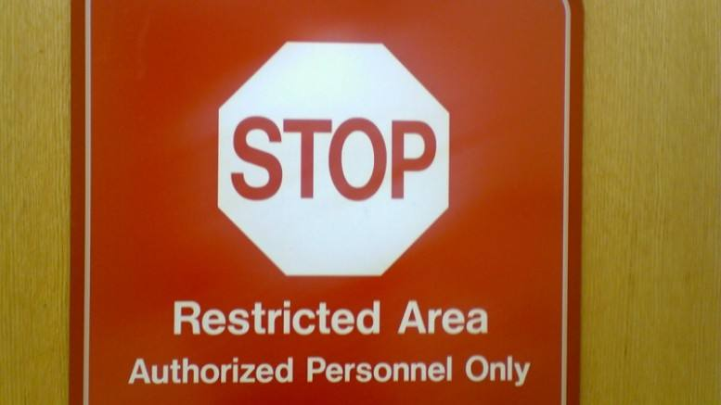
Task 1
Think of a word that best fits each definition.Then fill in the blanks with the correct form of the word.
v:to limit the size, amount or range of sth
restrict
Having small children tends _________(restrict) your freedom.
to restrict

Slide 9
Task 1
Think of a word that best fits each definition.Then fill in the blanks with the correct form of the word.
v:to provide enough of what sb/sth needs in order to live or exist
sustain
The love and support of his family _________(sustain) him during his time in prison.
sustained

Slide 10
Task 1
Think of a word that best fits each definition.Then fill in the blanks with the correct form of the word.
n:a general direction in which a situation is changing or developing
trend
The book provides valuable information on recent ________(trend).
trends

Slide 11
Read the text and find out the sentences of the following words
Task 2
broadcast,comprehensive,ecology,starve,seize
1.An expert who has studied polar bears for many years said that from the position of its dead body,the bear appeared to have starved and died.
2.This alarming case showed how the increase in temperature had an impact on Earth’s ecology.
3.There is strong and comprehensive evidence that the rise in temperature has led to an increase in extreme weather and natural diseasters worldwide...
4.In fact, news reports are frequently broadcast about extreme rainstorms and heatwaves causing deaths and economic losses.
5.It is our responsibility to seize every opportunity to educate everyone about global warming...

Slide 12
Task 2
Read the sentences and give the meanig of the red words.
broadcast,comprehensive,ecology,starve,seize
1.An expert who has studied polar bears for many years said that from the position of its dead body,the bear appeared to have starved and died.
挨饿
2.This alarming case showed how the increase in temperature had an impact on Earth’s ecology.
生态
3.There is strong and comprehensive evidence that the rise in temperature has led to an increase in extreme weather and natural diseasters worldwide...
全面的
4.In fact, news reports are frequently broadcast about extreme rainstorms and heatwaves causing deaths and economic losses.
广播
5.It is our responsibility to seize every opportunity to educate everyone about global warming...
抓住

Slide 13
Complete the sentences with the correct forms of the words in the box.
Task 3
broadcast,comprehensive,ecology,starve,seize
1.The Amazon basin, known as the"lungs of the world", not only provides some______________balance for the planet, but also food and resources for the local natives.
2. Thousands of baby penguins _______________to death because the changing climate forced their parents to leave them and travel long distances in search of food.
3. Many experts link China's economic success to the_______________reform that China has undergone since 1978.
4. The speaker said the media should make more______________that spread awareness of climate crisis and possible solutions.
5.To deal with climate change, we must_______________the initiative to do whatever is the necessary to protect our environment.
ecology
starved
comprehensive
broadcast
seize

Slide 14
Task 4
Use the key phrases to make up some sentences.
broadcast,comprehensive,ecology,starve,seize
1.The Amazon basin, known as the"lungs of the world", not only provides some______________balance for the planet, but also food and resources for the local natives.
2. Thousands of baby penguins _______________to death because the changing climate forced their parents to leave them and travel long distances in search of food.
3. Many experts link China's economic success to the_______________reform that China has undergone since 1978.
4. The speaker said the media should make more______________that spread awareness of climate crisis and possible solutions.
5.To deal with climate change, we must_______________the initiative to do whatever is the necessary to protect our environment.
ecology
starved
comprehensive
broadcast
seize

Slide 15
Task 5
Use the key words and make up some sentences.
provide ...for...
The soup kitchen provides free food for homeless people in the community.
starve to death
During the 1950s, thousands of seabirds starved to death due
to the severe marine oil pollution in North Atlantic Ocean.
the comprehensive reform
That far-reaching comprehensive reform of the English educational system has influenced a generation of students whose listening and speaking skills were greatly improved.

Slide 16
Task 5
Read the passage and mark the words that contain “habit”.
make broadcast
As a fan of history, she thought that the media should make more broadcasts that spread awareness of heritage conservation.
seize the invitation
This famous athlete says that the secret to his success is seizing the initiative in the competition and never losing heart when facing challenges.

Slide 17
Task 6
Complete the passage with the correct forms of the words in the box.
policy release fuel restrict sustain trend
released
Carbon dioxide is_________through human activities such as destroying forests and burning fossil___________as well as natural processes such as volcanic eruptions. The measurements by climate experts show a rising_____________of carbon dioxide emissions. If this continues, our planet will face further environmental disasters.
In response to this environmental issue, China is implementing significant______________and measures to address climate change, aiming to______________coal consumption, promote a harmonious relationship between man and nature build a_____________energy system, and advocate a moderate, green, and low-carbon lifestyle.
fuel
trend
policies
restrict
sustainable

Slide 18
Task 7
Read the passage and answer the following questions.
1.How is carbon dioxide released?
2.What is China doing to address the climate change?
Carbon dioxide is released through human activities such as destroying forests and burning fossil fuel as well as natural processes such as volcanic eruptions.
China is implementing significant policies and measures to address climate change, aiming to restrict coal consumption, promote a harmonious relationship between man and nature, build a sustainable energy system, and advocate a moderate, green, and low-carbon lifestyle.

Slide 19
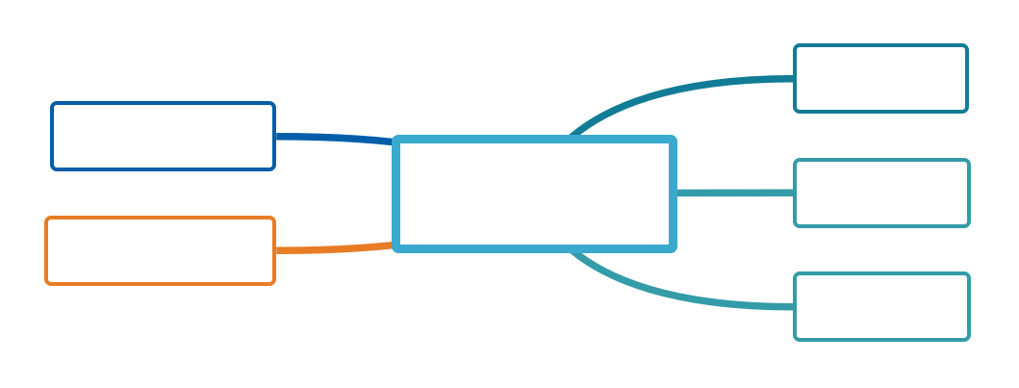
Task 8
Use an English-English dictionary to find the meaning of each word or phrase in Activity 3.
contribute to、
give rise to导致
to have sth as a result
to make sth happen, especially sth bad or unpleasant
cause
lead to
to make something happen
由...导致
bring
about
cause to happen, occur or exist
result from
result in
account for
对......负责
be responsible for
导致
to make sth happen
having the job or duty of doing sth or taking care of sb/sth, so that you may be blamed if sth goes wrong

Slide 20
Create sentences of your own using each of word or phrase.
Task 9
cause;be responsible for;bring about ;lead to;reult in
1.Most scientists believe climate change is caused by burning fossil fuels.
2.Every person should be responsible for their own waste when they are out and about.
3.It may seem hard to bring about real change, but we must not give up hope.
4.Smoking can lead to serious diseases such as cancer.
5.Charging customers for plastic bags has resulted in a 70% drop in their usage.

Slide 21
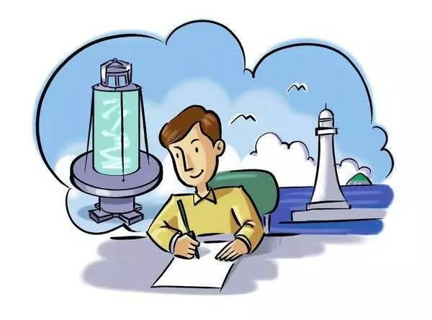
List as many words as you can that use the suffixes below.
Task 10
-able -ate
-ion -ism
-ive -ment
-ous

Slide 22
Task 10
Show time
-able:
habitable, sustainable, renewable
-ate:
appropriate, moderate, corporate
-ion:
radiation, emission, attention, eruption, consumption, extinction, position, expression, combination, pollution, reputation, action, population, production, construction, collection, regulation, conservation, inspection, organisation, generation, addition

Slide 23
Task 10
Show time
-ism:
tourism, environmentalism
-ive:
comprehensive, sensitive, negative, expensive
-ment:
environment, measurement, government, treatment, development
-ous: harmonious, autonomous, ambitious

Slide 24
language points
【词义】 vi & vt. 改革；(使)改正；改造n. 变革；改良
【例句】
Many experts link China's economic success to the comprehensive reform that China has undergone since 1978.
许多专家将中国经济的成功与中国自1978年以来进行的全面改革联系在一起。
【热点归纳】
reform oneself 改过自新
reformation n. 革新；改善
reformer n. 改革家；改革运动者；改良者
reform
[rɪˈfɔːrm]
Notes:
标题字号固定为黑体 34 加粗 白色，副标题字号固定为黑体 28 黑色，正文字号为黑体 24 黑色。版式仅供参考

Slide 25
language points
【例句】
They’ve reformed the education system to fit in with the new situation.他们改革了教育制度，以适应新的形势。
The reform in teaching methods is warmly welcomed by students.教学方法的改革受到了学生们的热烈欢迎。
【语法填空】
①Phone meetings get cancelled or ___________ (reform) and camera phones intrude (侵入) on people’s privacy.
②He who will reform __________ (he) must first reform society.
③We also need to actively advance the reform _____ the political system.
答案
（1）reformed (2)himself (3)in
reform
[rɪˈfɔːrm]
Notes:
标题字号固定为黑体 34 加粗 白色，副标题字号固定为黑体 28 黑色，正文字号为黑体 24 黑色。版式仅供参考

Slide 26
language points
【教材原句】
...promote a harmonious relationship between man and nature...促进人与自然的和谐关系……
【例句】
The sky and the sea make a harmonious picture.
天空和大海构成了一幅和谐的画面。
Relations with our neighbors are very harmonious at the moment.我们目前同邻居们的关系十分和谐。
【热点归纳】
harmony n. 协调；和睦；融洽
in harmony 协调一致
harmonious
[hɑːrˈmoʊniəs]
Notes:
标题字号固定为黑体 34 加粗 白色，副标题字号固定为黑体 28 黑色，正文字号为黑体 24 黑色。版式仅供参考

Slide 27
language points
【热点归纳】
out of harmony不协调
harmony among〔between〕……之间的协调，……之间的融洽
harmony with 与……协调，与……适应
【语法填空】
①His ideas were no longer in harmony _______ ours.
②After dealing with the art, they have a common sense of ___________ (harmony) music.
答案：with;harmonious
harmonious
[hɑːrˈmoʊniəs]
Notes:
标题字号固定为黑体 34 加粗 白色，副标题字号固定为黑体 28 黑色，正文字号为黑体 24 黑色。版式仅供参考

Slide 28
language points
【教材原句】
Thousands of baby penguins starved to death because the changing climate forced their parents to leave them and travel long distances in search of food. 成千上万只小企鹅饿死，因为气候变化迫使它们的父母离开它们，长途跋涉寻找食物。
【例句】
I looked everywhere in search of my glasses.
我到处找我的眼镜。
He went to the south in search of a better job.
他去南方寻找更好的工作。
in search of
寻找；搜寻
Notes:
标题字号固定为黑体 34 加粗 白色，副标题字号固定为黑体 28 黑色，正文字号为黑体 24 黑色。版式仅供参考

Slide 29
language points
【热点归纳】
in one’s search for 寻找
search for＝look for 寻找(某人/某物)
search… for… 为了找到……而搜查……
search sth. /sb. 搜查某物/搜身
【完成句子】
①The police __________ the house______
(正在搜查……找) more evidence.
②They removed the stones and bricks __________(寻找) some survivors in the earthquake.
答案：are searching, in search of/to search for
in search of
寻找；搜寻
Notes:
标题字号固定为黑体 34 加粗 白色，副标题字号固定为黑体 28 黑色，正文字号为黑体 24 黑色。版式仅供参考

Slide 30
Practice
写出单词或将词组补充完整
1．________ n. 流域；盆地；盆
2．__________ n. 企鹅
3．_________ vi. & vt. 改革；(使)改正；改造n. 改革；变革；改良
→______________ n. 革新；改善
→___________ n. 改革家；改革运动者；改良者
basin
penguin
reform
reformation
reformer

Slide 31
Practice
写出单词或将词组补充完整
4．__________ vt. 经历(变化、不快等) →过去式_________→过去分词 _______
5．_____________ adj. 和谐的→__________ n. 协调；和睦；融洽
6．___________ adj. 适度的；中等的；温和的 vi. & vt. 缓和；使适中→_____________ adv. 适度地；中庸地；有节制地
undergo
underwent
undergone
harmonious
harmony
moderate
moderately

Slide 32
Practice
写出单词或将词组补充完整
7．_________ vi. & vt. 提交；呈递；屈服
→_____________ n. 投降；提交(物)；服从
8．in search _____寻找；搜寻
9．as well _____和；也
10．be responsible ______对……负责
11．bring ________引起
submit
submission
of
as
for
about

Slide 33
Practice
单句语法填空
starvation
1．Millions will face _____________ (starve) next year as a result of the drought.
2．You can be released _______ prison early for good behaviour.
3．He broadcast the secret _____ the whole school.
4．Speed is restricted _____ 30 mph in towns.
5．He seized Mary by ______ arm when she wanted to leave.
6．The computer had made a great impact _____ modern life.
from
to
to
the
on

Slide 34
Practice
单句语法填空
7．The president spoke at the business meeting for nearly an hour without ____________ (refer) to his notes.
8．Scientists have obtained more evidence _______ plastic is finding its way into the human body.
9．The rainy weather lasted for a couple of days，thus __________ (ruin) our plan for a picnic.
10．Not only you but also he _____ (be) responsible for it.
referring
that
ruining
is

Slide 35
1.Review the words and phrases of this period.
2.Do the exercises of your workbook.

