Slide 1
What were you doing when the rainstorm came?
Unit 5
R 八年级下册
Section B 1a-1d

Slide 2
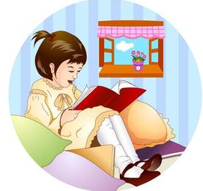
What was your sister
doing at the time of
the rainstorm?
She was reading
at home.

Slide 3
He was doing
his homework.
What was your brother
doing at the time of the
rainstorm?

Slide 4
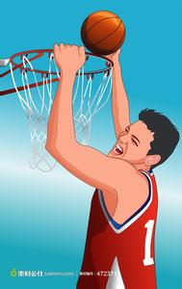
What was your father
doing at the time of
the rainstorm?
He was playing
basketball.

Slide 5
1a Think of a time when
you were late for or
couldn't go to an event.
What was the event?
What was the reason
why you were late or
couldn't go? Tell your
partner the story.

Slide 6
1b. Listen and write short answers to the
questions.
What event happened at the school yesterday?
_______________________________________
2. Who missed the event?
_______________________________________
3. Which team won at the event?
______________________________________
There was a basketball competition.
Kate missed the event.
John’s team won.

Slide 7
1c. Listen again. Number the events
[1-6] in the order they happened.
______Kate saw a dog by the side of the road. ______Kate got to the bus stop.
______Kate called the Animal Helpline.
______Kate left the house.
______Kate waited for someone to walk by. ______Kate realized her bag was still at home.
4
2
6
1
5
3

Slide 8
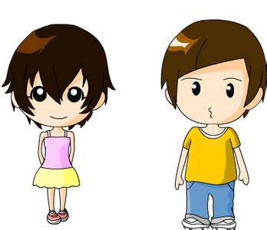
1d. Talk about why Kate missed the school
basketball competition. Student A begins a
sentence with while or when. Student B
completes the sentence.
When the school
basketball competition
started ...
When the school basketball
competition started, Kate was
still making her way to school.

Slide 9
Language points
What event happened at the school yesterday?
event的基本意思是“事件”,可指历史上的、国际的、国家的或社会的重大事件,也可指日常的小事件。event是可数名词,其复数形式events有时还可指“事态的发展”“时局”。还可作体育运动的“比赛项目”解,是可数名词。a team event团体赛; a target event射击比赛; field and track events田径比赛

Slide 10
Language points
如：The new book was the cultural
event of the year.
这本新书的出版是今年文化界的大事。
This is the place where all the important events take place.
一切重大的活动都在这儿举行。
He placed third in the men's singles event.
在男子单打(比赛)中他得了第三名。

Slide 11
用所给词的适当形式完成句子。
1. We ________________ (talk) about
the book when our teacher came in.
2. Can you guess what we
_____________ (do) from 5:00 to
6:30 this morning?
was talking
were doing

Slide 12
单项选择。
1. I was trying to draw a cat on the board
______ the teacher came in.
A. while B. when C. what time D. so
2. My best friend visited my house while I
______.
A. cooked B. cooking
C. was cooking D. cook
B
C

Slide 13
3. The teacher came in while Lucy ______ her purse in the classroom.
A. was looking for B. was finding
C. was finding out D. was seeing
4. I met a friend of mine _____ I was walking in the park.
A. before B. when
C. after D. if
A
B

Slide 14
翻译句子。
1. 上课铃响时, 你在干什么?
What _____ you ______ when the class bell rang?
2. 当我妈妈进来时我正在看书.
I _____ ________ when my mother came in.
3. 昨天晚上十点钟她正在做饭.
She ____ ________ at ten o’clock ______ _______.
were
doing
was reading
was cooking
last night

