Slide 1
Unit 7

Slide 2
Unit 7
It's raining!

Slide 3
Section A 2
Grammar focus-3b

Slide 4
Grammar focus
一、阅读Grammar focus部分，完成下列句子。
— 天气怎么样？
— _____________________
— 天气多云。/天气晴朗。/天在下雨。
— ________________________________
2. — 你在做什么？_________________
— 我在做饭。______________
How’s the weather?
It’s cloudy./ It’s sunny./ It’s raining.
What are you doing?
I’m cooking.

Slide 5
3. — 他们在做什么？
____________________
What are they doing?
— 他们正在公园里打篮球。
______________________________
______________________________
4. — 他在做什么？_______________
— 他在他朋友家里学习。
________________________________
They’re playing basketball in the park.
What’s he doing?
He’s studying in his friend’s home.

Slide 6
5. — 情况怎么样？
___________________
— 很好！/不错。/ 糟糕！
_________________________
How’s it going?
Great! / Not bad./ Terrible!

Slide 7
探究乐园
1. 疑问副词 how 用来询问天气。
今天天气怎么样？
_______ the weather today?
【拓展】询问天气还可以说：
_______ the weather _____?
How’s
What’s
like

Slide 8
2. how 用于问候，打招呼。
你好吗？________________
你那里情况如何？ _______________
How are you?
How’s it going?
3. how 用来询问方式或手段。
你怎样去上学？
_____ do you go to school?
How

Slide 9
4. how 用来询问年龄。
你弟弟多大年龄？
_____ ____ is your brother?
5. How 用于询问价格。
那件紫色的毛衣多少钱？
_____ _____ is the purple sweater?
How old
How much

Slide 10
Fill in the blanks with the correct forms of the verbs in the box. Then practice the conversations with a partner.
3a
be play study talk do make

Slide 11
1. A: What are you doing?
B: I _________ my homework. I always ___ my homework in the evening.
2. A: What’s John doing right now?
B: He _________ soccer. He ______
soccer every Saturday.
3. A: ___ Julie ________ English right now?
B: No, she isn’t. She __________ Chinese.

Slide 12
4. A: What are Susan and Jane doing?
B: They __________ soup. They can _____ very good soup.
5. A: ______ Lisa ________ on the
phone again?
B: Yes, she _________ on the phone for three hours every day!

Slide 13
指 导
根据上下文的问句和答语来确定空格处的意思，特别是每个空格后面的词汇。
根据上下文的时态及时间状语来确定句子的时态。如: right now 为现在进行时态的时间状语。而 usually，every Saturday 及 every day 是一般现在时态的时间状语。

Slide 14
现在进行时态的句子结构：be (am, is, are) + 动词的 ing形式；一般现在时态的句子用动词的原形或第三人称单数形式。如：第一题由问句可知答句为现在进行时。后一句为一般现在时。

Slide 15
Check the answers.
1. A: What are you doing?
B: I ________ my homework. I always ___ my homework in the evening.
2. A: What’s John doing right now?
B: He __________ soccer. He ______ soccer every Saturday.
3. A: __ Julie ________ English right now?
B: No, she isn’t. She __________ Chinese.
am doing
do
is playing
plays
Is studying
is studying

Slide 16
4. A: What are Susan and Jane doing?
B: They ___________ soup. They can _______ very good soup.
5. A: ___ Lisa ________ on the phone again?
B: Yes, she _____ on the phone for three hours every day!
are making
make
Is talking
talks

Slide 17
Yuan Yuan from CCTV is interviewing people in five different places. Fill in the chart below.
3b
How’s the weather? | What are they doing?

Slide 18
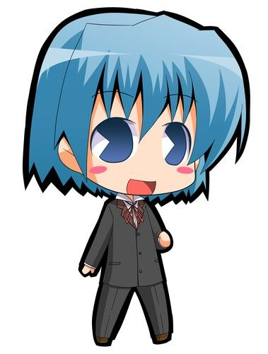
Pair work
How’s the weather?
It’s sunny and warm.
What’s he doing?
He’s playing the guitar.

Slide 19
How’s the weather?
It’s windy.
What are they doing?
They’re hiking.

Slide 20
How’s the weather?
It’s snowing.
What are they doing now?
They’re cooking.

Slide 21
How’s the weather?
It’s hot and humid.
What is he doing?
He’s writing.

Slide 22
How’s the weather?
It’s raining.
What are they doing?
They’re playing soccer.

Slide 23
Check the answers.
How’s the weather? | What are they doing?
It’s sunny and warm. He’s playing the guitar.
It’s windy. They’re hiking
It’s snowing. They’re cooking.
It’s hot and humid. He’s writing.
It’s raining. They’re playing soccer.

Slide 24
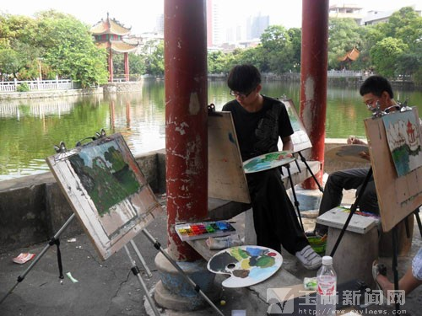
Practice
看图片，补全对话。
A: ______ the weather?
B: It’s ______.
A: What ____ they _____?
B: They ___ ________.
How’s
sunny
are doing
are painting

Slide 25
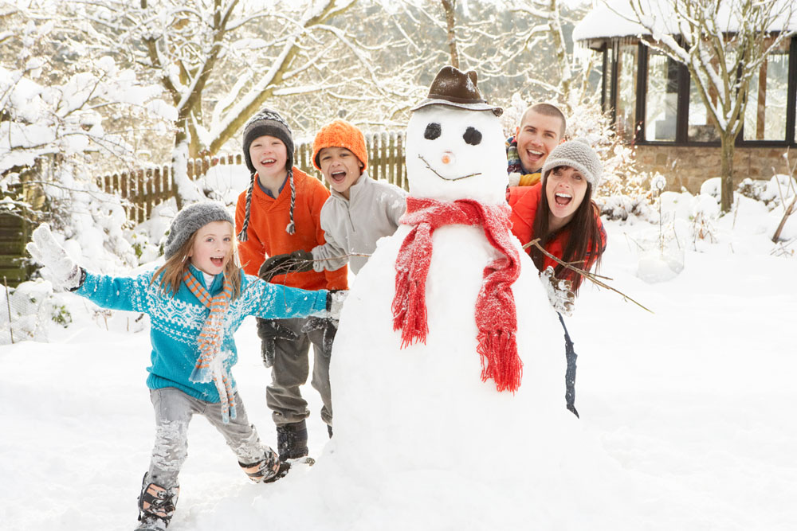
A: _______ the ________?
B: It’s ______.
A: _____ are _____ doing?
B: _____ are ________ a _________.
How’s weather
snowy
What they
They making snowman

Slide 26
用括号内动词的正确形式填空。
1. — What’s she doing?
— She __________ (play) the guitar.
2. I usually _____ (do) my homework in the evening.
3. It _________ (rain) hard now.
4. My sister ______ (walk) to school every day.
is playing
do
is raining
walks

Slide 27
is brushing
5. Mr. Wu ___________ (brush) his teeth right now?
6. Every Saturday, we _____ (visit) my grandparents.
7. Look! They ___________ (dance) in the classroom.
8. She never _______ (arrive) for school.
visit
are dancing
arrives

Slide 28
Homework
1. 背诵Grammar focus中的句子。
2. 将3b中的图片a、b、e编写成三个小对话。对 图片中所描述的天气及人物的活动进行问答。
A: __________
B: __________
A: __________
B: ___________

