Slide 1
英语教学课件
七年级 下册

Slide 2
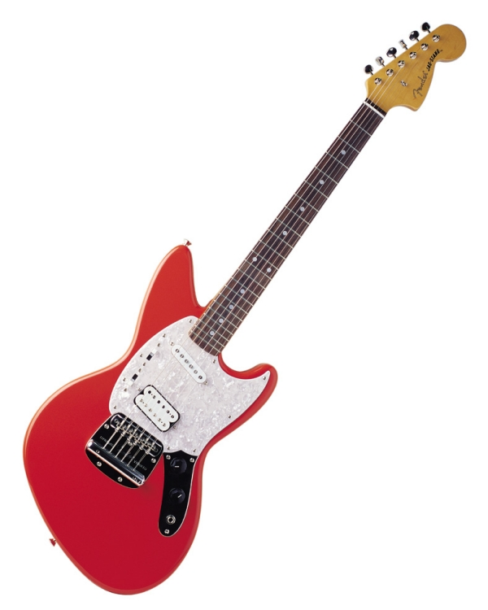
Unit 1
Can you play the guitar?

Slide 3
Section A
Period One

Slide 4
Review
Words and expressions

Slide 5
Read the words and expressions loudly.

Slide 6
Words and expressions
guitar
sing
swim
dance
draw
chess
play chess
n. 吉他
v. 唱歌
v.&n. 游泳
v. 跳舞
n. 舞蹈
v. 画
n. 国际象棋
下国际象棋

Slide 7
Words and expressions
speak
speak English
join
club
be good at…
tell
story
v. 说(某种语言)；说话
说英语
v. 参加；加入
n. 俱乐部；社团
擅长于……
v. 讲述；告诉
n. 故事；小说

Slide 8
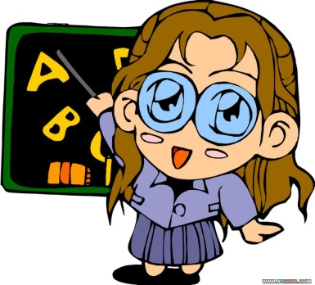
Objectives
To learn to use modal verb can
To learn to use Yes/ No questions and short answers
To learn to use What questions

Slide 9
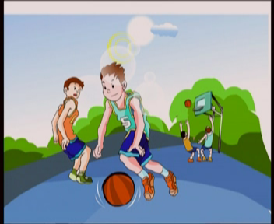
I can play basketball.
Can you play basketball?
Yes, I can.
No, I can’t. (can’t=can not)
basketball club
I want to join the basketball club.
He can play basketball.

Slide 10
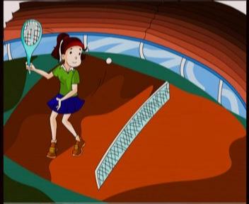
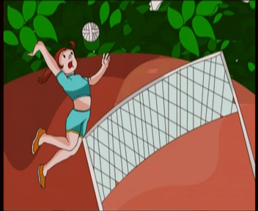
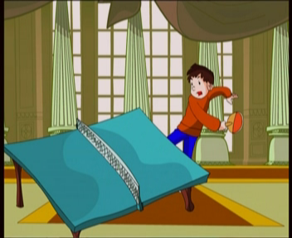
Make sentences with the sentences according
to the pictures.
He can…
She can …
Can you play…?
Yes, I can.
No, I can’t.
She can play tennis.
She can play volleyball.
He can play ping-pong.
He can play soccer.

Slide 11
Look and say.
I can play…
I want to join the …
tennis club
volleyball club
soccer club

Slide 12
dance
sing
dance and sing

Slide 13
paint
swim
I like English!
speak English

Slide 14
guitar
three guitars
play the guitar

Slide 15
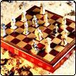
chess
play chess

Slide 16
Let's chant!
Dance\ I can dance. dance
Sing \ I can sing. sing
Swim\ I can swim. swim
Paint \ I can paint. paint
Speak \ I can speak English. speak
Chess \ I can play chess. chess
Guitar \ I can play the guitar. guitar

Slide 17
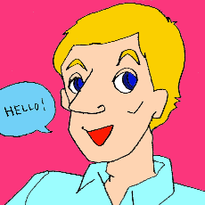
Guess
Can you …?

Slide 22
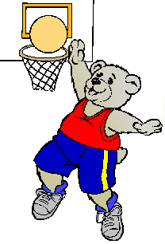

Slide 23
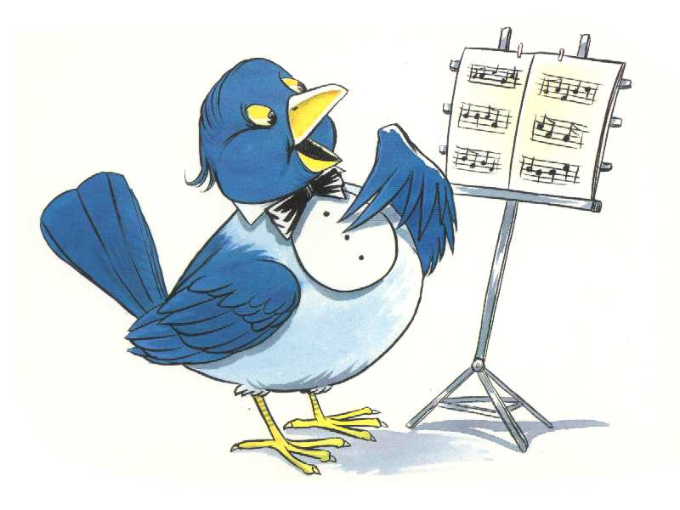

Slide 24
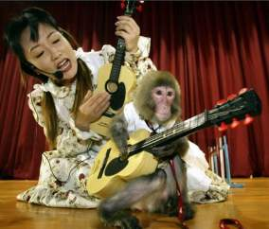

Slide 25
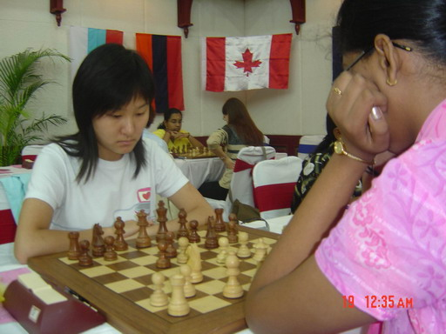

Slide 26
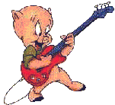
welcome to the clubs!
I want to join the …
English Club
Swimming Club
Chess Club
Music Club
Art Club
Guitar club

Slide 27
GUITAR CLUB
I want to join
the guitar club.
Can you play the guitar?
Yes, I can.

Slide 28
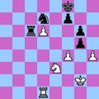
CHESS CLUB
I want to join the chess club.
Can you play chess?
Yes, I can.

Slide 29
MUSIC CLUB
I want to join the music club.
We are good friends.
Can you sing?
Yes, I can.

Slide 30
ENGLISH CLUB
I want to join the English club.
Can you speak English?
Yes, I can.

Slide 31
SWIMMING
CLUB
I want to join
the swimming
club.
Can you
swim?
Yes, I can.

Slide 32
ART CLUB
I want to join the
art club.
Yes, I can.
Can you paint?

Slide 33
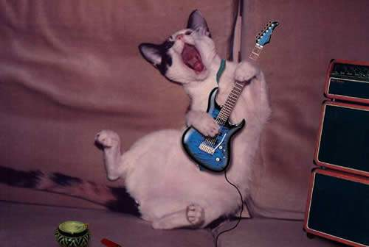
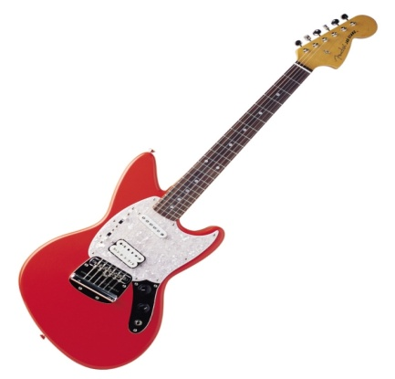
Look and say
A: I want to join the______ club.
B: Can you_____ or play _________?
A: Yes, _______.
music
sing
the guitar
I can

Slide 34
A: I_______ ____the _________club.
B: ____ you_____?
A: No, _______.
want to
join
swimming
Can
swim
I can’t

Slide 35
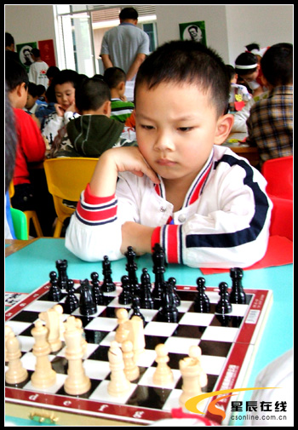
A: I _______________________.
B: _________________?
A: Yes, I can.
want to join the chess club
Can you play chess

Slide 36
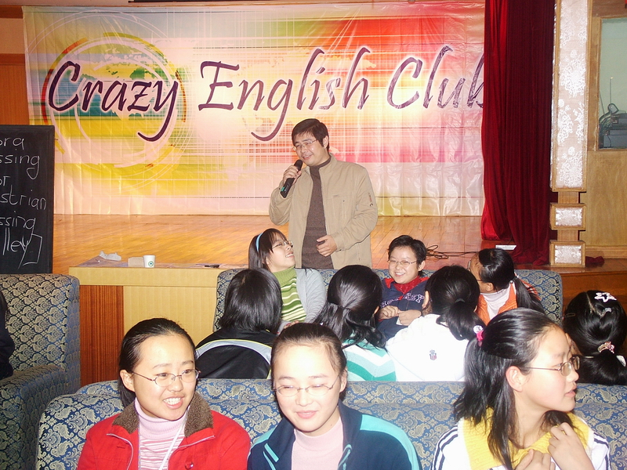
A: I __________________________.
B: _____________________?
A: Yes, I can.
want to join the English club
Can you speak English

Slide 37
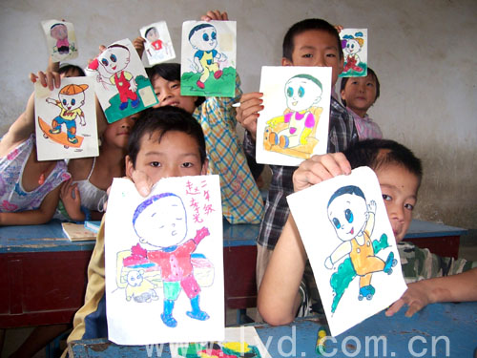
A: We ______________________.
B: ______________?
A: Yes, ________.
want to join the art club
Can you paint
we can

Slide 38
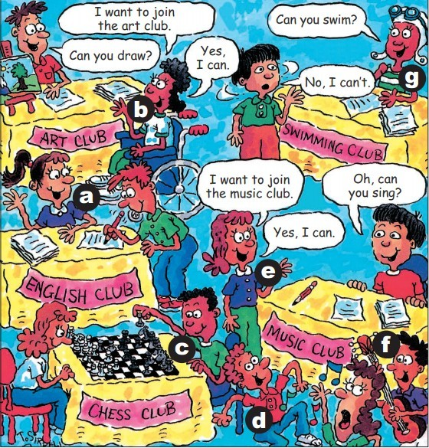
1a
What can these people do? Match the activities with the people.
1. sing __
2. swim __
3. dance __
4. draw __
5. play chess __
6. speak English __
7. play the guitar__
e
g
d
b
c
a
f

Slide 39
1b
Listen and number the conversations [1-3].
A: Can you swim?
B: No, I can’t.
2
A: I want to join the art club.
B: Can you draw?
A: Yes, I can.
3
A: I want to join the music club.
B: Oh, can you sing?
A: Yes, I can.
1

Slide 40
1c
Pairwork
Practice the conversations above. Then make your own conversations.
A: Can you swim?
B: No, I can’t.
A: I want to join the art club.
B: Can you draw?
A: Yes, I can.
A: I want to join the music club.
B: Oh, can you sing?
A: Yes, I can.

Slide 41
Free Talk
What club do you want to join?

Slide 42
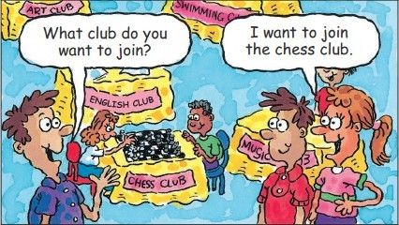
2a
Listen to these two conversations and circle the clubs you hear.
English club
art club
music club
chess club
swimming club

Slide 43
2b
Listen again. Complete the sentences.
Lisa wants to join the _____ club, but she can’t play ______.
Bob wants to join the ______ club. He likes to speak _______.
Mary likes music. She can _____ and ______. Bob likes music, too. They want to join the _____ club.
chess
chess
English
English
sing
dance
music

Slide 44
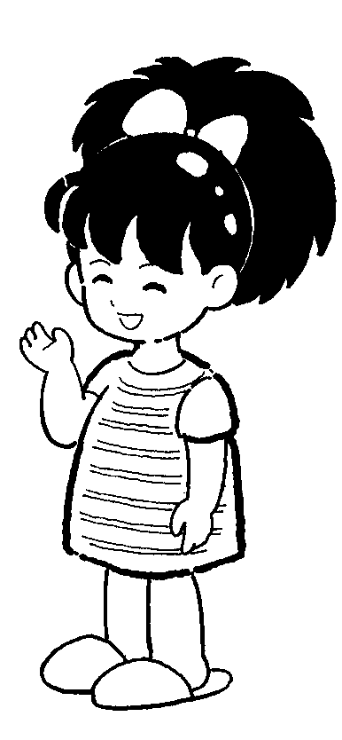
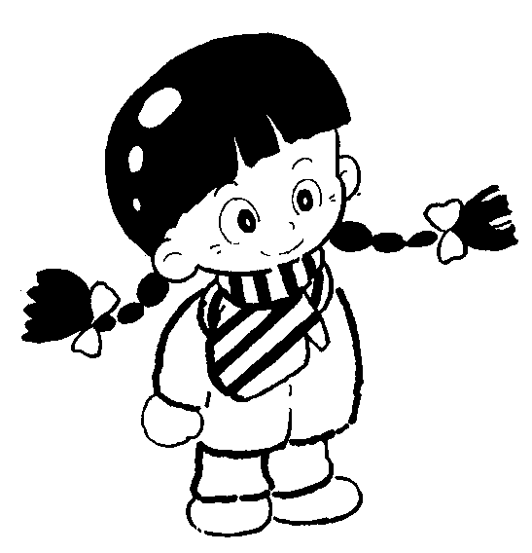
2c
Groupwork
Ask and answer questions in pairs. Look at 2b and talk about what the people can do and the clubs they want to join.
She wants
to join the ...
What club does Lisa want to join?

Slide 45
Pair work
2d
Role-play the conversation.
Jane: Hi, Bob. What club do you want to
join?
Bob: I want to join a sports club.
Jane: Great! What sports can you play?
Bob: Soccer.
Jane: So you can join the soccer club.

Slide 46
Bob: What about you? You are very
good at telling stories. You can
join the story telling club.
Jane: Sounds good. But I like to draw,
too.
Bob: Then join two clubs, the story
telling club and the art club!
Jane: OK, let’s join now!

Slide 47
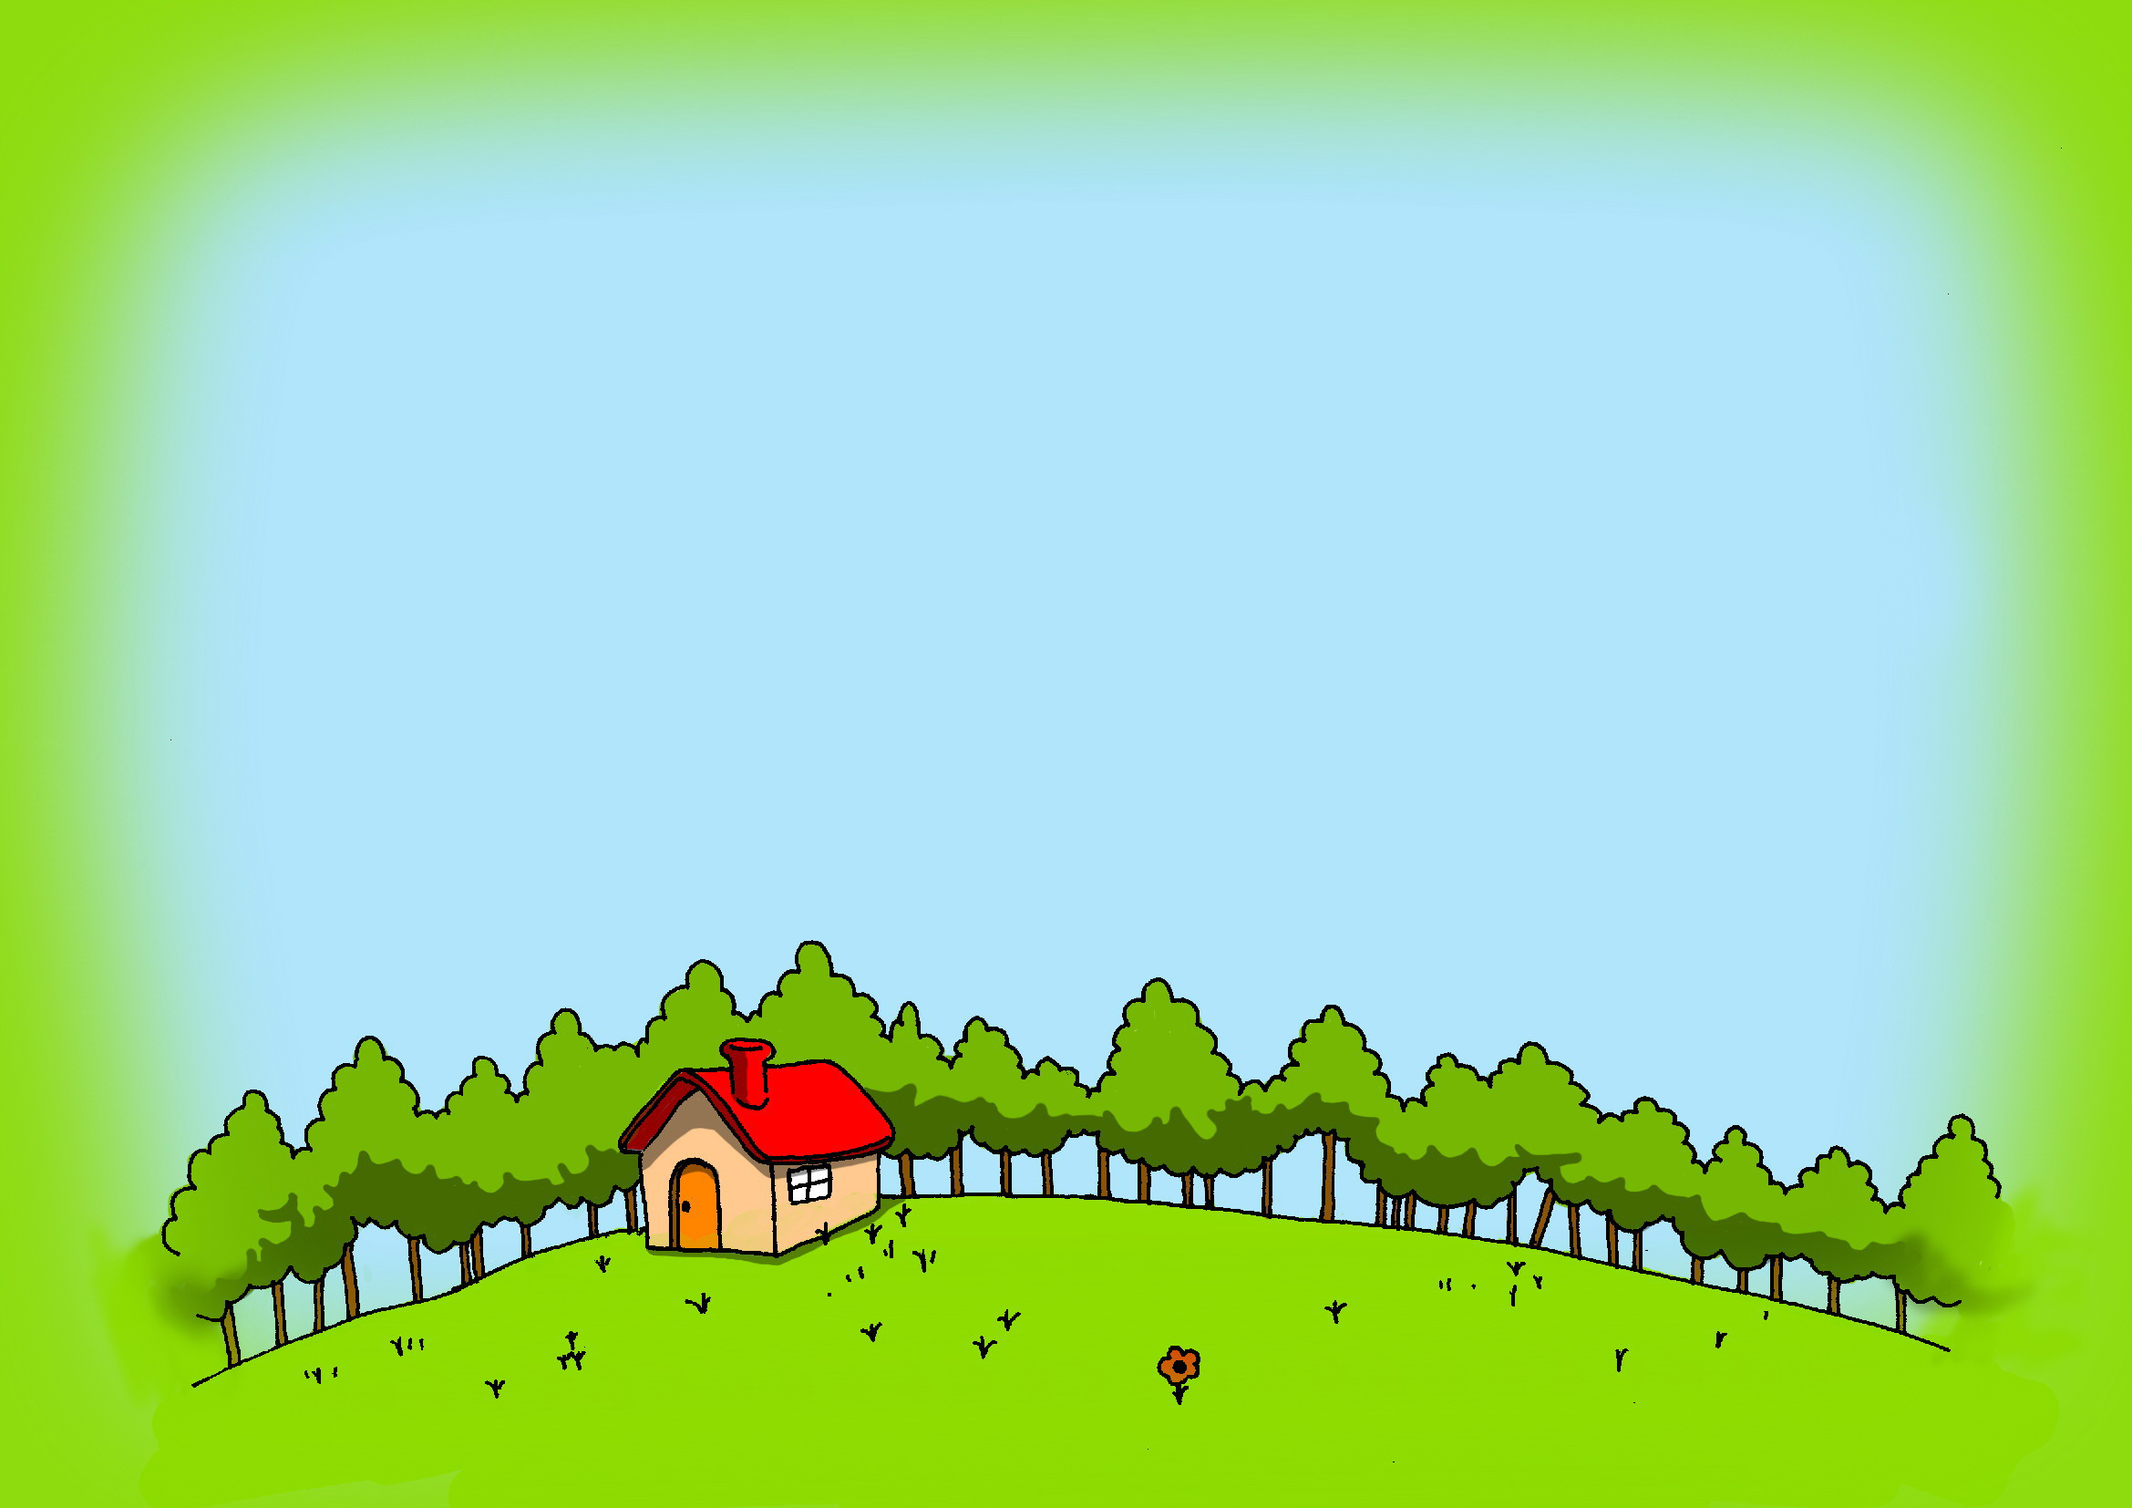
Survey
Show us your talent!!
（*才能展示*）
比一比 :
Who is the best(最棒)?

Slide 48
Group work
Survey your group members about what they can or can't do, then report it to your class.
1.Self-check
Name | swim | sing | dance | paint | speak English | Play chess | Play the guitar
×
√
×
√
√
×
×
Aileen

Slide 49
Group work
2. Ask your partner. Can you…? yes, I can.\No, I can’t.
Name | swim | sing | dance | paint | speak English | Play chess | Play the guitar
×
√
×
√
√
×
×
Aileen
3.Exchange information with another partner.
Can xxx…? Yes, he\she can. No, he\she can’t.
4.Report
In my group, xx is the best. He/she can…and…

Slide 50
Language points

Slide 51
I want to join the art club.
我想参加美术社团。
club表示“俱乐部”或“社团”。在英、美等国，中小学校会组织各类俱乐部来提高学生的兴趣及才能，丰富他们的文化生活。相当于我国中小学校中的“兴趣小组”。

Slide 52
2) join表示“参加；加入”，此处指加入社团或组织，成为其中的成员。 如：
join the army 参军
join the Young Pioneers 加入少先队
join the NBA
加入美国的全国篮球协会
join a dance company 加入一个舞蹈团

Slide 53
2. You are very good at telling stories.
你很擅长讲故事。
be good at sth/doing sth…表示“擅长于……；精通……”，后面可接名词或动词的ing形式。例如：
Mr. Gu is good at languages. He can speak eight languages.
顾先生精通多种语言，他会说八种语言。

Slide 54
Are you good with old people?
你善于跟老人打交道吗？
此处的be good with sth/sb表示“善于应付……的；对……有办法”。如
The teacher is very good with children.
这位老师对孩子很有一套。

Slide 55
Review
课时重点回顾
Words: guitar chess dance sing paint
speak swim join can’t=can not
Phrases: play chess play the guitar
swimming club speak English
join the music/art/chess/English club
Sentences: What club do you want to join?
I want to join the music club.
Can you play chess?
Yes, I can. / No, I can’t.

Slide 56
Quiz
注: 另附word文档。
点击此处链接

Slide 57
一、连词成句。
play, brother, the, your, guitar, can?
2. play, you, the, can, guitar?
3. guitar, sing, the, I, play, can, and.
4. to, club, music, join, want, do, you, our?
Can your brother play the guitar?
Can you play the guitar?
I can sing and play the guitar.
Do you want to join our music club?

Slide 58
二、补全句子和对话。
1. A: ____ you dance? B: Yes, I can.
2. What club does she_____ to join ?
3. We want to _____ the guitar club.
4. A: What club ___ you want ___join?
B: We_____ to join the chess_____.
A: Can you_____ chess ?
B: No , I ______.
5. She can speak English but she ______
speak it very well.
Can
want
join
do
to
want
club
play
can’t
can’t

Slide 59
Homework:
Make an interview
What can your father/mother/brother
/sister do? And write a report.

Slide 60
Preview
To preview the new words
and expressions
What can/can’t you do?

Slide 61
Thank you.

