Slide 1
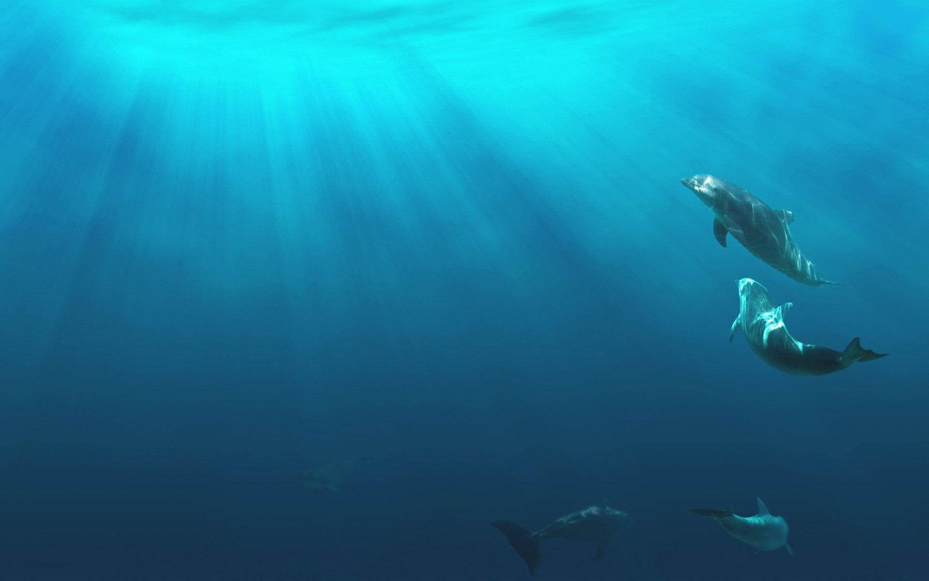
Unit 2
Iconic Attractions

Slide 2
内容索引
Period Five Writing—A description of an iconic animal
技法点拨 文体分析 把握写作动脉
写作训练 弄清文路 写作妙笔生花

Slide 3
技 法 点 拨
文体分析 把握写作动脉
写作指导
本单元的写作任务是标志性动物描写。这种类型的文章属于介绍类说明文，是对一种标志性动物进行说明或描述的写作。
它通常要求抓住该动物的主要特征进行描述，写作内容可以包括体态描述、栖息地、食物、现状等的说明，要求语言简明扼要，通俗易懂，描写详略得当。这种文体通常用第三人称，时态以一般现在时为主。

Slide 4
常用表达
1.Description：...is a mammal classified in the...family
2.Habitat：...native to central-western and southwestern China
3.Food：It has a diet which is...
4.Present situation：It is a conservation reliant endangered species.
返 回

Slide 5
写 作 训 练
弄清文路 写作妙笔生花
假如你是李华，请你给学校英文报纸的“动物世界”栏目写一篇80词左右的说明文，介绍一下我国特有的动物大熊猫。

Slide 6
审题谋篇
审题
1.确定文体：本文为说明文。
2.主体时态：本文应以一般现在时为主。
3.主体人称：本文的主要人称应为第三人称。

Slide 7
谋篇
第一段：开门见山，进入话题。
第二段：针对现状，进行描述。
第三段：展望未来，提出希望。

Slide 8
遣词造句
核心词汇
classified in the ... family
1.属于……动物 _______________________
2.原产于 ________
3.很容易被认出来 __________________
4.依赖保护的濒危物种 ____________________________________
5.上升 ____________
6.释放 _______
7.自由自在地生活在野外 ______________________
native to
be easily recognized
a conservation reliant endangered species
be on the rise
set free
live in the wild peacefully

Slide 9
连词成句
1.熊猫是一种属于熊科的哺乳动物。(classified in the ... family)
The Panda .
2.熊猫是一种原产于中国的中西部和西南部的哺乳动物。(native to)
The Panda central-western and southwestern China.
3.报告显示野生熊猫的数量正在上升。(be on the rise)
____________________________________________________
4.科学家们希望有一天，他们能有足够的熊猫自由自在地生活在野外。(live in the wild peacefully)
____________________________________________________________________________________________________
is a mammal classified in the bear family
is a mammal native to
Reports show that the number of wild pandas is on the rise.
Scientists hope that one day they will have enough pandas to be set free and let them live in the wild peacefully.

Slide 10
句式升级
1.请把第1句和第2句按括号内的提示词合成一句话。
(1) (简单句)
(2) (含有非限制性定语从句的主从复合句)
The Panda is a mammal classified in the bear family，native to central-western and southwestern China.
The Panda is a mammal classified in the bear family，which is native to central-western and southwestern China.

Slide 11
2.请把第3句和第4句按括号内的提示词合成一句话。
(1)
(with复合结构)
(2) (although引导让步状语从句)
With the number of wild pandas rising，scientists hope that one day they will have enough pandas to be set free and let them live in the wild peacefully.
Although reports show that the number of wild pandas is on the rise，scientists hope that one day they will have enough pandas to be set free and let them live in the wild peacefully.

Slide 12
组句成篇
用适当的过渡词语，把以上词汇和句式，再加上联想内容，组成一篇80词左右的英语短文。

Slide 13
参考范文
The Panda is a mammal classified in the bear family，native to central-western and southwestern China.It is easily recognized by its large，distinctive black patches around the eyes，over the ears，and across its round body.It has a diet which is 99% bamboo and it may eat honey，oranges，and bananas when available.It is a conservation reliant endangered species.Although reports show that the number of wild pandas is on the rise，scientists hope that one day they will have enough pandas to be set free and let them live in the wild peacefully.
返 回

Slide 14
本课结束

