Slide 1

Unit 4
Where's my schoolbag?
Section B (2a-2c)
人教版七年级(初中)英语上册
0

Slide 2
Learning objectives
1）To learn the key words：tidy; but; our; everywhere; always.
2）To learn the following sentence patterns:
① I’m tidy, but Gina is not.
② Gina’s books are everywhere— on her bed, on the sofa and under the chair.
③ “Where are my keys?”Gina always asks.
3）To read the passage to find where Kate’s things and Gina’s things are.
0

Slide 3
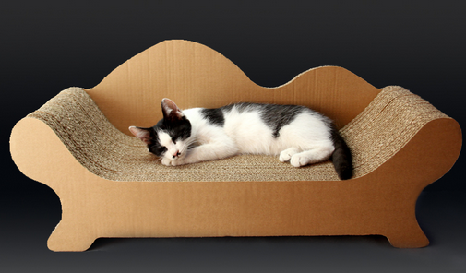
Lead in
A: Is the cat on the chair?
B: Yes, it is.
A: Is the baseball on the table?
B: No, it isn’t. It’s under the sofa.

Slide 4
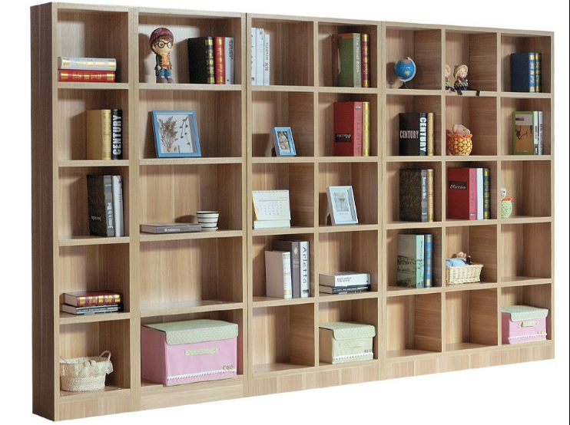
Lead in
A: Are the books in the dresser（梳妆台）?
B: No, they aren’t. They’re in the bookcase.
A: Are the books on the sofa?
B: Yes, they are.

Slide 5
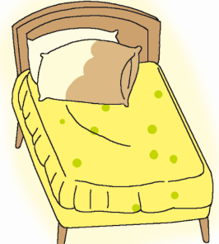
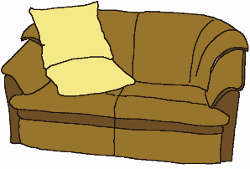



Presentation
Do you have a room? What things are in your room?
sofa
bed
my room
chair
bookcase
table

Slide 6








Presentation
tape player
clock
dictionary
tape
things
hat
model plane
keys
radio

Slide 7
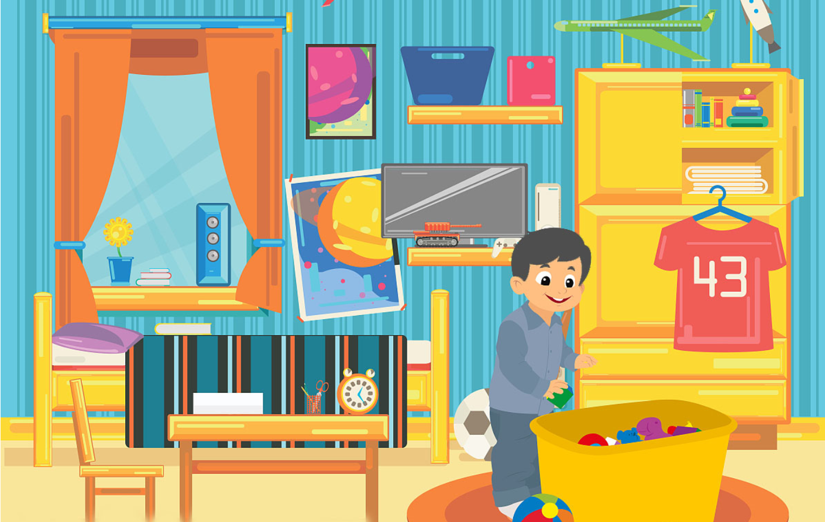
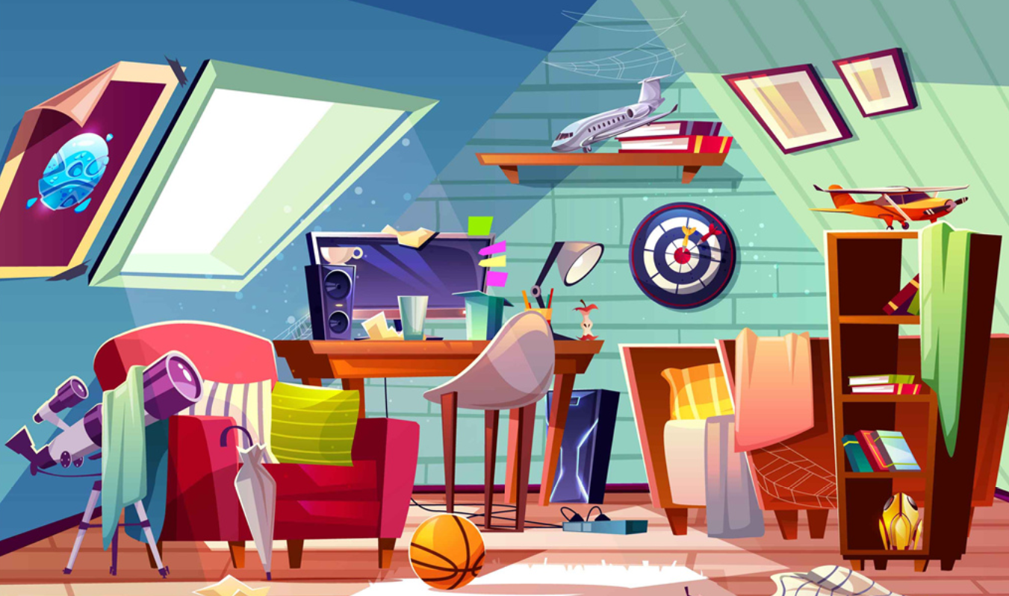
Presentation
Which room do you like? The tidy one or the untidy one?

Slide 8
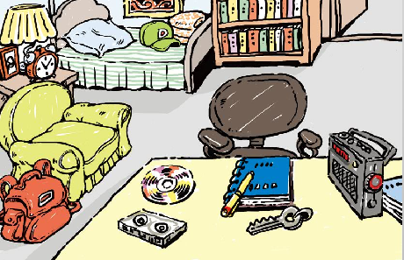
Presentation
Is the room tidy or untidy? What can you see in the room?

Slide 9
Presentation
2a Write the words you know for the things in the picture.
_________________________
__________________________________________________
_________________________
_________________________
notebook pen CD key
radio tape desk chair
schoolbag clock picture
bookcase books quilt
bed sofa hat…

Slide 10


Presentation
2b Listen to the passage and answer:
The main idea of the passage is ________.
A. about Kate and her sister Gina
B. about Kate and Gina’s room
C. that Kate is tidy, but Gina isn’t

Slide 11
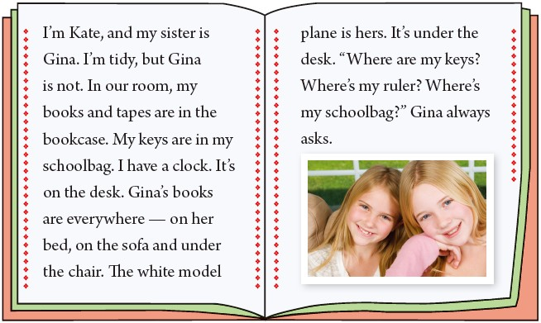

Presentation
2a Read the passage and answer the questions.
Is Kate tidy?
Yes, she is.
Is Gina tidy?
No, she isn’t.
Find out the topic sentence.

Slide 12
Presentation
Read the article and circle the things Kate and Gina have.

Slide 13
Presentation
2c Complete the chart about the things Kate and Gina have and where they are.
Kate |  | Gina
Things | Where | Things | Where
books and tapes | in the bookcase
books everywhere
white model plane | under the desk
keys in her schoolbag
clock on the desk
keys, ruler,
schoolbag
don’t know

Slide 14
Presentation
Read and choose.
1. Kate’s tapes are in the ________.
A. schoolbag B. desk C. bookcase
2. Kate’s clock is_________.
A. under the bed
B. on the desk
C. on the chair

Slide 15
Presentation
3. What color is Gina’s model plane?
A. yellow B. blue C. white
4. Where is Gina’s model plane?
A. on the bookcase
B. under the desk
C. on the desk

Slide 16
Presentation
True or false.
( ) 1. Kate and Gina are cousins.
( ) 2. Kate’s books and tapes are in the bookcase.
( ) 3. Gina has a clock.
( ) 4. Gina’s keys are in the schoolbag.
( ) 5. The white model plane is under the desk.
F
sisters
T
F
Kate
F
“Where are my keys?” Gina always asks.
T

Slide 17
Presentation
Let’s retell the passage.
books and tapes _____________
keys _______________
clock ___________
in the bookcase
Kate (tidy)
in her schoolbag
on the desk
books ___________ (on her ____, on the ____, under the _____)
model plane _____________
everywhere
chair
bed
Gina
(not tidy)
sofa
under the desk

Slide 18
Language points
1. I'm Kate, and my sister is Gina. I'm tidy, but Gina is not.
【易混辨析】并列连词 but, and 与 or
but | 表示转折的逻辑关系或两种情况的对比，意为“但是; 然而”。
and | 连接两个或几个并列的成分，常用于肯定句，意为“和; 而”。and 连接的并列成分作主语时，谓语动词用复数形式。
or | 在否定句中，连接并列成分要用 or 而不用 and，意为“也不”；or 表示选择关系时，常用于选择疑问句，意为“或, 还是”。

Slide 19
Language points
I like red but I don't like black. 我喜欢红色但不喜欢黑色。
Tom and Cindy are good friends. 汤姆和辛迪是好朋友。
She can't sing or dance. 她不会唱歌也不会跳舞。
Is he your father or your uncle? 他是你爸爸还是你叔叔？

Slide 20
Exercise
单项选择：
1. I am tidy, my brother .
A. but; is B. but; is not
C. and; is not D. and; are not
2. This is her tape player, ______ that’s her computer game.
A. and B. but C. too D. because
3. —Where _______ the English book?
—_______on the table.
A. is; It’s B. is; They are
C. are; It’s D. are; They are

Slide 21
Exercise
4. —Are the books in the bookcase?
—No, .
A. it isn’t B. it is
C. they aren’t D. they don’t
5. —Is his notebook on the bed?
—No, ________ .
A. they aren’t B. I’m not
C. it isn’t D. I don’t know
6. She can't speak English, _____ she likes English.
A.so B. until C. but D. that

Slide 22
Homework
1. Do the exercises in students’ book.

