Slide 1
Unit 4
What’s the best movie theater?
Section A (Grammar Focus)

Slide 2
用比较级和最高级填空：
cheap
big
close
friendly
popular
comfortable
good/well
bad/badly
cheaper
cheapest
bigger
biggest
closer
closest
friendlier
friendliest
more popular
the most popular
more comfortable
the most comfortable
better
best
worse
worst
much/many
more
most
farthest
far
farther

Slide 3
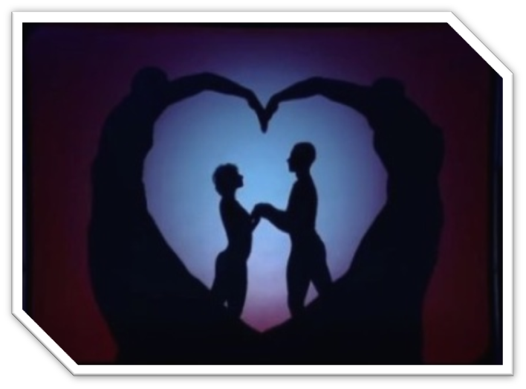
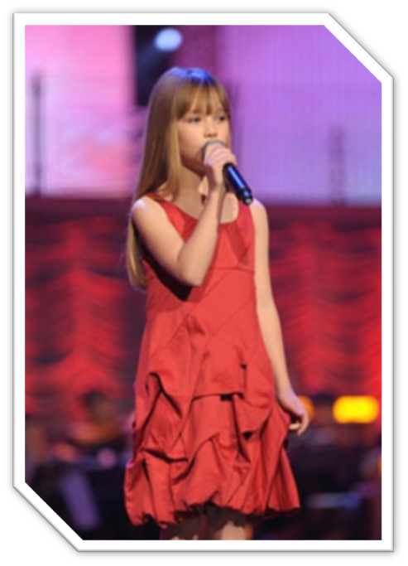
英国达人秀

Slide 4
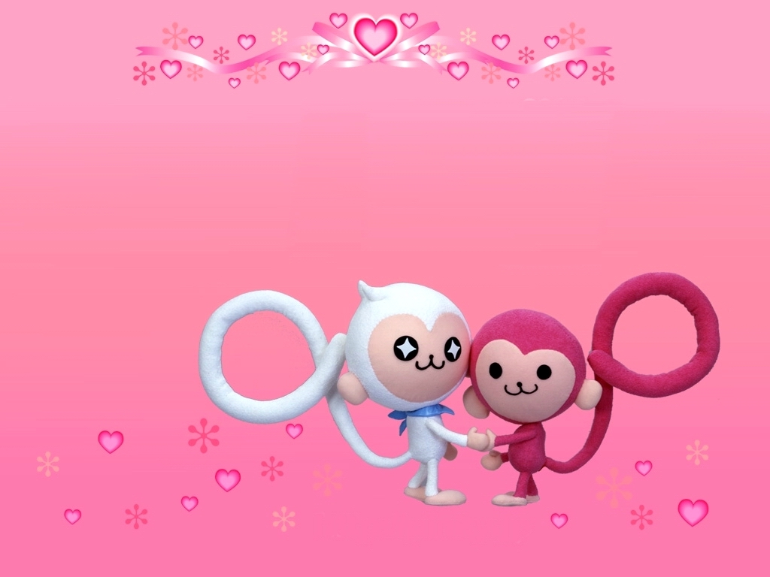
齐齐复习，齐齐笑：
你还记得下列词的比较级和
最高级吗？

Slide 5
A:
calm
thick
light
cool
warm
quiet
wild
+ -er / -est

Slide 6
B: heavy
easy
tidy
dry
busy
happy
healthy
hungry
early
+ -er
y→i
/-est

Slide 7
sunny
rainy
cloudy
foggy
snowy
y→i+
-er
/-est

Slide 8
C: large
late
nice
+-st
D: big
→bigger→biggest
hot
→hotter→hottest
thin
→thinner→thinnest
→wetter→wettest
wet
→fatter→fattest
fat

Slide 9
Adj. and Adv.
good
better best
well
bad
worse worst
ill
many
more most
much
far
farther farthest
little
less least

Slide 10
Adjective
delicious
dangerous
interesting
popular
beautiful
careful
friendly
more ~
most ~

Slide 11
写出下列单词的比较级和最高级。
1. good
2. comfortable
3. big
4. happy
5. cheap
6. many
7. difficult
8. little
9. friendly

Slide 12
1. good better best
2. comfortable more ~ most ~
3. big bigger biggest
4. happy happier happiest
5. cheap cheaper cheapest
6. many more most
7. difficult more ~ most ~
8. little less least
9. friendly friendlier friendliest

Slide 13
探究点
⑴没有比较用原级，两者相比比较级，
三者以上最高级。
very 词后原级， than句子比较级,
the字在前最高级, 碰上of 和in短语,
千万别忘最高级。
⑵ 名称+范围+标志词 原级 =1 very/so 比较级 =2 than 最高级 =3 in/of短语

Slide 14
Best In Our Class
Who is the most serious teacher in our class?
Who is the fastest runner in our class?
Who is the loudest singer in our class?
Who is the most interesting writer in our class?
Who is the most talented dancer in our class?
Who is the worst at P.E. in our class?
Who is the best chess player in our class?

Slide 15
一. 选择.
1. Paul is very _______ . He is ________ than his brother .
A. heavy; heavier B. heavy ;heavy
C. heavier ;heavier D. heavy;heavyer
2. It has the ________ clothes store in the town.
A. goodest B. good C. best D. better
3. This ruler is ____ than that one.
A. long B. longer C. the longest D. longest
4. This book is ____ of all.
A. cheapest B. cheap C. cheaper D. the cheapest
5. He is much ____ than his brother.
A. taller B. tall C. the tallest D. tallest
6. Li Lei is ____ older than Lucy.
A. quite B. very C. much D. more

Slide 16
7. This is onof ____ films of this year.
A. more exciting B. exciting
C. the most exciting D. most exciting
8. The weather in Beijing is colder than_____.
A. in Guangzhou B. Guangzhou
C. that in Guangzhou D. that from Guangzhou
9. Tom is ____ of the two boys.
A. taller B. tallest C. the taller D. the tallest
10. Of my parents, my father looks_____.
A.old B. older C. the oldest D. the older
11. This watch is ____ than that one.
A. much expensive B. expensiver
C. more expensiver D. more expensive

Slide 17
二. 用括号中形容词的适当形式填空。
1. I am very _______. But Tom is ____________
than I . Frank is ______________. （tired）
2.Which is _____________（difficult）,
physics or biology ?
3.This book is _______ than the other two .
It is ____________ of the three . （easy）
4.In summer it’s _______（hot） in Wu Han
than in Beijing .
5.The Chinese people have a much ______
（good）life now .
tired
more tired
the most tired
more different
easier
the easiest
hotter
better

Slide 18
三. 填空。
1. Lily gets up __________ (early) than Lucy.
2. Which goes ______________ (slowly), Tom or Jim?
3.This book is _____________________ (interesting) than than one.
earlier
more slowly
more interesting
4. She works ____________________ (careful) in her school.
5. Who goes to bed ____________ (late) Jim, Tom or Jack?
6. I think turkey is ______________________ (delicious) of all.
the most carefully
the latest
the most delicious

Slide 19
Homework
1. Write a passage about “Best In Our Class”.
2. Learn the English song “I could be the one”.

