Slide 1
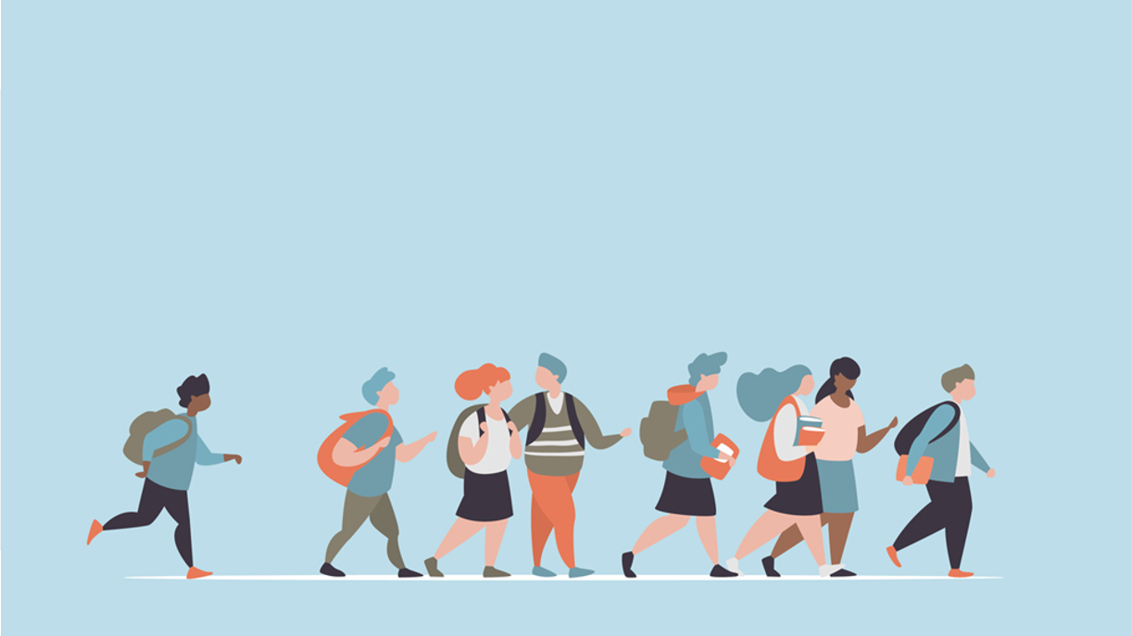
R·九年级全一册
Unit 7 Teenagers should be allowed to choose their own clothes.
第三课时

Slide 2
Lead in
What do you like doing?
Do your parents allow you to do it?
What do you think of it?

Slide 3
I think we should be
allowed to …
I don't think we should be
allowed to …
Have our own hair-style.

Slide 4
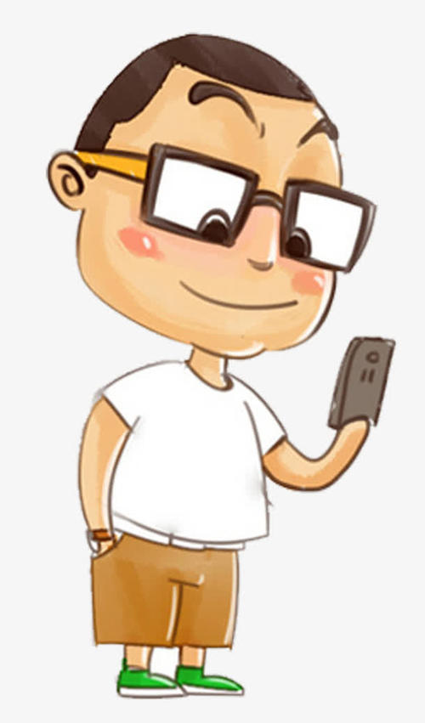
I think we should be
allowed to …
I think we should not be
allowed to …
Play with smartphone

Slide 5
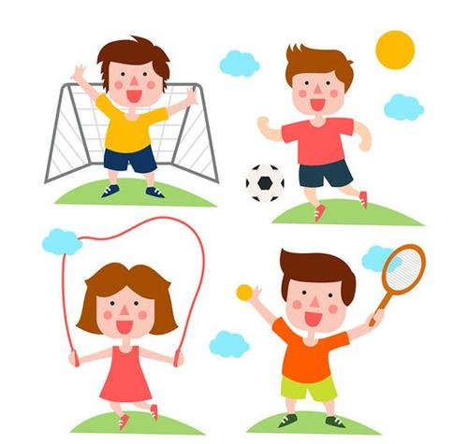
I think we should be allowed to …
Play sports & Do exercise

Slide 6
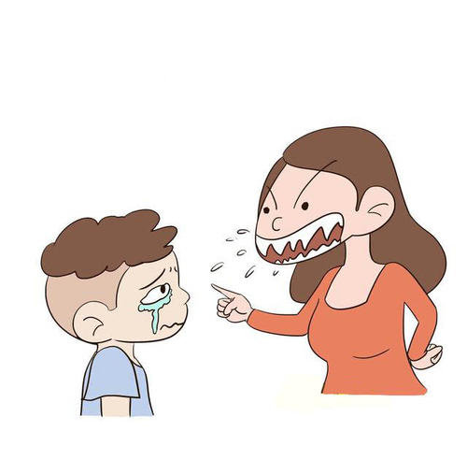
Language points
一、strict的用法
Parents should not be too strict with teenagers.

Slide 7
strict作形容词，意为“严厉的，严格的”；
be strict with sb. 对某人要求严格 be strict in sth. 对某方面要求严格

Slide 8
二、get in the way of...的用法
Sometimes your hobbies can get in the way of your schoolwork, and parents might worry about your success at school.

Slide 9
【短语解析】
get in the way是固定短语，意为“挡……的道；妨碍”，常与介词of连用。同义词组为“be in the/one’s way.”, 其反义词组为“get out of the/one’s way”，意为“让开”。

Slide 10
What is your dream job? Do your parents support your dream? Why are they against it?

Slide 11
三、against的用法
against是介词，表示“反对”，其反义词是for
（支持）。against还可以表示“紧靠；碰；撞”。
have sth. against sb./sth. 表示“不喜欢/不赞成某人/
某事”。

Slide 12
We have nothing against running!
we don’t have anything against running!

Slide 13
四、only then...的用法
Only then will I have a chance to achieve my dream.
直到那时我才会有机会实现我的梦想。
only then will/ would /do/did/can/could sb. do sth.是一个固定结构，表示“直到那时某人才会/才/才可以做某事”。

Slide 14
Practice
1. 玩电脑游戏会妨碍他的学习。
Playing computer games can get in the way of his study.
2. 我们支持和平，反对战争。
We are for peace and against war.

Slide 15
Let's write
Write a diary entry explaining which rule(s) you do not agree with at home and how you think the rule(s) should be changed.

Slide 16
Use the following expressions to help you:
I do not agree with …
I think I should be allowed to …
I would like to …
I could … if I …

Slide 17
Dear Mum and Dad,
I do not agree with the rule that I must be home for dinner every day. This is because the rule affects my social life. It takes away important opportunities for me to spend time with my friends. As a result, my life is quite uninteresting sometimes.
I think I should be allowed to have dinner with my

Slide 18
friends once in a while. For example, I would
like to hang out with my classmates after dinner on some Fridays. I wish you will allow me to do this if I promise not to stay out too late and if there is no important family activity on those days.
Best wishes to you.
Love you.

Slide 19
Summary
1. Parents should not be too strict with teenagers.
2. Sometimes your hobbies can get in the way of your schoolwork, and parents might worry about your success at school.
3. Only then will I have a chance to achieve my dream.

Slide 20
THANKS

