Slide 1
Unit 1 Teenage life
Reading for Writing
A Letter of Advice
新人教版（2019） 必修一

Slide 2
Teaching Objectives
To be able to use phrases to give advice.
To be able to grasp the writing style and the structure.
To be able to write a letter of advice.
1
2
3

Slide 3
Reading for Writing
Write a letter of advice

Slide 4
Before writing
Now let's read the pictures.
Describe the pictures with proper words or expressions.

Slide 5
two annoyed female/ladies/women
deeply annoyed
annoyed

Slide 6
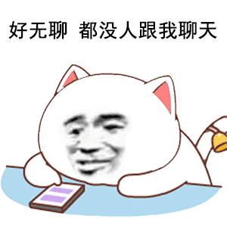
bored
a bit bored

Slide 7
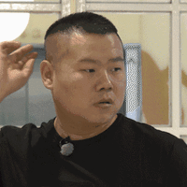
confused
a pair of confused eyes

Slide 8
depressed
a depressed look

Slide 9
extremely frightened
frightened

Slide 10
annoyed
bored
confused
输掉G2后的詹姆斯
欧锦赛葡萄牙1-2希腊 神情沮丧的菲戈
depressed
frightened

Slide 11
Reading for writing
Now let's read a letter.
How is Worried Friend? Why?

Slide 12
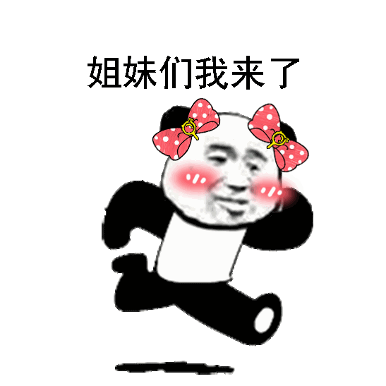
I'm coming!
worried
terribly worried

Slide 13
What do you think of Chen Lei?
Can you tell us the reasons?
Discover
bored
annoyed
01
02
Not knowing what to do every day
Often sleeping in class
worried
Friends
03
confused
06
Absent-minded
Playing computers too much
Always making troubles
05
04
frightened
depressed
Having a constant high fever
Usually be afraid to talk with parents

Slide 14
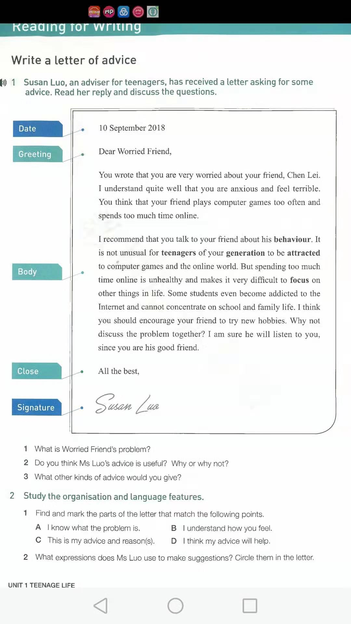
Passage
Center question
Discover
What is the passage mainly about?
(What is Worried Friend's problem?)
活动意图说明：提炼所学的结构化知识和语言信息并形成口头语言表达，进而内化目标语言知识和相关书面信息。

Slide 15
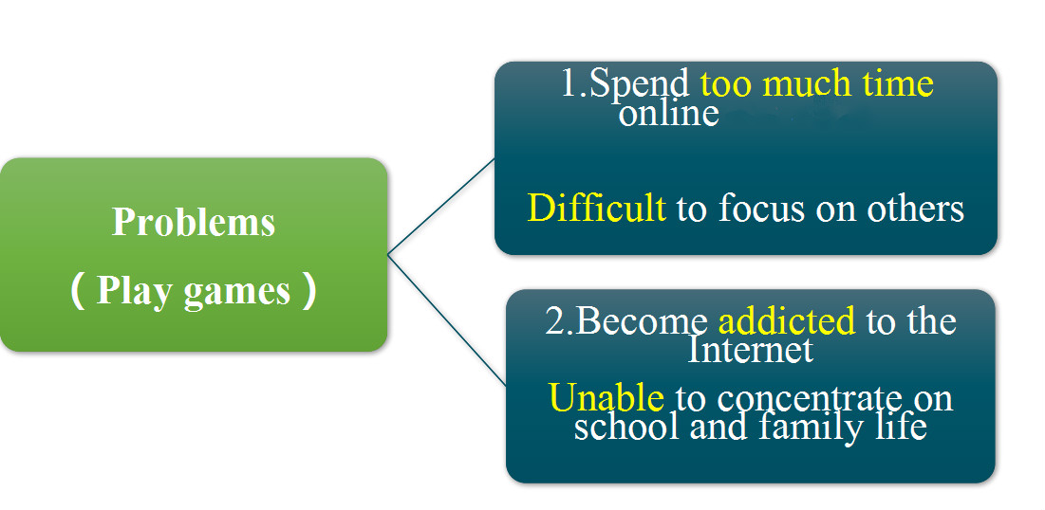

Slide 16
What is the passage mainly about?
(What are Susan Luo's suggestions?)
Discover
Problem
Play games
1.Spend too much time online
Difficult to focus on others
2.Become addicted to the Internet
Unable to concentrate on school and family life
anxious
unhealthy
1.Talk to your friend
responsible
Suggestions
As friends
2.Try to have a new hobby
friendly

Slide 17
Do students often meet with problems and need advice? Why?
Discover
Problem
Play games
1.Spend too much time online
Difficult to focus on others
2.Become addicted to the Internet
Unable to concentrate on school and family life
Suggestions
As friends
1.Talk to your friend
2.Try to have a new hobby
anxious
difficult
unhealthy
Challenge
responsible
new/fresh
friendly

Slide 18
Challenge Yourself
1.Do you think Ms. Luo's advice is useful? Why or why not?
Yes! Because as a good friend, we should encourage him to focus on other things in life, instead of concentrating on playing computer games constantly.
2. What other kinds of advice would you give?
I would offer other kinds of advice to some students who become addicted to the Internet and cannot concentrate on school and family life. We can make the team of five people to beat him. If he is always defeated, he will lose his interest in playing computer games. Then he will have no happiness because happiness can keep people going on, so having no happiness will stop people doing what they love.
活动意图说明：通过这项活动提高学生运用所学短语的能力，提升学生小组间成员的合作能力，提升学生的组织和展示能力。

Slide 20
Form a habit to learn them by heart!
If you are his friend, what's your advice to him?
From my point of view, “all play and no work makes Jack a mere boy”, because all play will make you lose attraction to other things. Instead, without all work, you will make it difficult to focus on school and family life. Actually, it is an unhealthy lifestyle for teenagers of our generation. Obviously, it is not only a bad behavior, but also an unhealthy lifestyle and unusual to us.
“If you have a dream to university, you must always prepare for a rainy day”. To be honest, our senior high school is really a short period. We are sure to meet with any problems like a rainy day jumping at us. We should try every Freshman Challenge with good preparations. Remember “Distance tests a horse’s strength. Time reveals a person's character!” As your good friend, I hope you can follow me and keep our word. Stop playing computers too much on the Internet and you will make a bigger difference.

Slide 21
I know what the problem is. | I understand quite well...
B. I understand how you feel. | You think that...
C. This is my advice and reason(s). | I recommend that...
D. I think my advice will help. | I'm sure he will listen to you.
I recommend that you talk to your friend about his behaviour.
I think you should encourage your friend to try new hobbies.
Why not discuss the problem together?

Slide 22
Develop Yourself
Role player
Susan Luo
Worried Friend
Chen Lei

Slide 23
Group work(three of you work together)
What're their problems?

Slide 24
Group work( three of you work together)
Now you have three friends, what's your advice to them?
problems
My parents won't listen.
I always feel lonely.
There is a girl I like in my class.

Slide 25
Group work(six of you work together)
What're their problems? Share your suggestions or reasons.
If I were you, I would't talk with my parents because I don't have time. I always go to school and devote myself to studying.
On the contrary，I won't talk with them until they have a better understanding of me，even though they are studying in their bedroom.

Slide 26
Group work(six of you work together)
What're their problems? Share your suggestions or reasons.
As far as I’m concerned, I recommend that you should go to after-school class for there are a lot of children like you in the class. You can discuss with them or play some computer games in the free time.
If you still feel lonely, I think you should arrange some study tasks for yourself. Why not make up for your courses? I'm sure you won't feel lonely then.

Slide 27
I understand quite well that anyone of us will like a girl to a certain degree. As a result, Someone who's quite self-confident will speak it out to her, then perhaps they will go on making friends. Maybe, more often, the girl will refuse him.
Anyone who is too shy to let out the secret will keep it to himself or herself alone. Actually, most people have already chosen to do so. I think such is very necessary to us young Chinese students, because we have to study hard at our lessons and do some more amusements or practical activities during the three-year precious period.
Group work(six of you work together)
What're their problems? Share your suggestions or reasons.

Slide 28
After reading for writing
Your friends | Work alone: since they are your friends, please offer one suggestion or reason to each of them.
 | ……
 | ……
 | ……

Slide 29
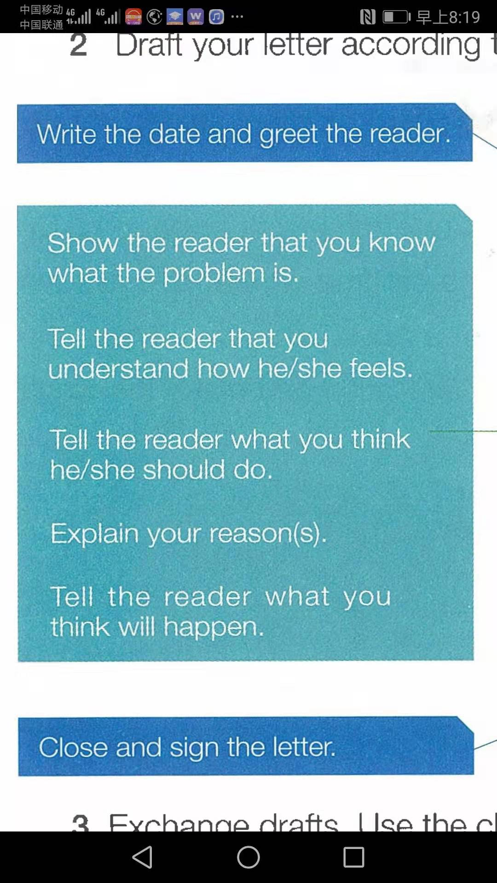

Slide 30
Evaluation | scores
1.Are all the parts of a letter included and organized in good order？ | 1 | 2 | 3 | 4 | 5
2.Does the writer give reasons for the advice？ | 1 | 2 | 3 | 4 | 5
3.Does the writer use proper expressions to give suggestions？ | 1 | 2 | 3 | 4 | 5
4.Does the writer use commas and stops correctly? | 1 | 2 | 3 | 4 | 5
5.Is the handwriting easy to read？ | 1 | 2 | 3 | 4 | 5

Slide 31
Writing with four levels
点击输入正文
Level A：Basic
Level B：Expanded
Level C：For competition
Level D：For reading
Level E：To be continued

Slide 32
A层：基础层
Dear Xu Ting，
You are worried that you feel very terrible about feeling lonely. I understand that how you feel.
To be honest, I think maybe you should join after-school class, because there are a lot of children like you. During the periods you can discuss anything with them or play some games.
If you still feel lonely, personally you ought to arrange some study tasks for yourself. Why not make up for your courses? I'm sure that you will feel more pleased instead of feeling lonely.
Best wishes!
Yours,
Li Hua

Slide 33
B层：拓展层
Dear Xu Ting,
You are worried that you feel very terrible about being lonely. I understand how you feel because you don't stay together with your parents who are working in another city.
To be honest, I think maybe you should join after-school activities because there are a lot of children like you. Of course, during the period you can focus on discussing anything with them even playing some games.
If you still feel lonely, personally you ought to arrange some study tasks for yourself and concentrate on it. Why not make up for your courses and you won't feel lonely. I'm sure you will be attracted to your study here. You should be responsible for yourself.

Slide 34
C 层：竞赛类
Do you agree or disagree with the following statements? Because modern life is very complex, it is essential for young people to have the ability to plan and organize. Use specific reasons and examples to support your answer.
Needless to say, the ability to plan and organize has always been essential, however, these days the methods used to plan and organize our daily lives have changed. Our world has become more business oriented and being late is unacceptable in most social environments.Whether you are young or old, there is no question that planning and organizing is essential. I completely agree with the above statement.

Slide 35
I was born in the late 80’s, and when I grew up I remember seeing a lot of people using small calendars to take notes. I also remember seeing a watch on almost everyone’s wrist. Those were the tools needed to stay organized in the past. No one would use their cell phone to plan anything because those functions were virtually non-existent.

Slide 36
Unfortunately, as our society has evolved into a more materialistic and developed version of our past society, people have become too reliant on technology. For example, it has become virtually impossible to keep a conversation going between friends without someone fiddling with their cell phone or someone answering a phone call. Alarm clocks and other devices with power cords are basically non-existent and the use of wireless devices are on the rise.

Slide 37
When we use our phone as our personal assistant, there are way too many potential problems. Being late because the alarm didn’t go off due to our phones running out of battery and missing a meeting because we put something in our calendar and forgot about it are just two examples. Compared to things in the past, I would say that we have become more disorganized. In order to solve this issue I believe that we need to start planning and organizing like we did in the past. Bring back the paper calendars with the big red circles marking important events and start using old-school alarm clocks that literally makes you jump out of bed at the moment it goes off!

Slide 38
To conclude, having the ability to plan and organize is definitely an essential skill. In order to improve our ability to do that, we should become less reliant on technology and start using less convenient but more effective methods, or at least make sure that our phones are fully charged (or charging) when we go to bed.

