Slide 1
R·九年级全一册
Unit 6 When was it invented?
第三课时

Slide 2
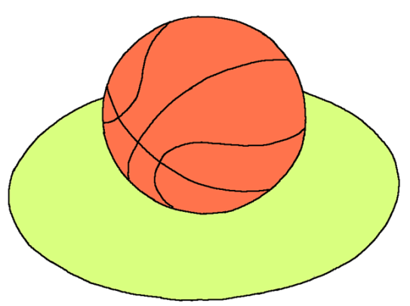
Lead in
How much do you know about the basketball?

Slide 3
Game
played on a hard _______
_______ teams
get __________ into the other team’s ______
floor
two
the ball
basket
played by ___________________ people
over _____countries
more than 100 million
200
Popularity

Slide 4
Development
invented by _______________
first game on __________________
became Olympic event in ______ in the
year _______
most famous games: __________
popular games in China: _________
James Naismith
December 21, 1891
Berlin
1936
NBA
CBA

Slide 5
Language points
Who was basketball invented by?
Basketball was invented by a Canadian doctor, named James Naismith, who was born in 1861.

Slide 6
一、定语从句
Basketball was invented by a Canadian doctor, named James Naismith, who was born in 1861.
这是一个含有定语从句的主从复合句。
who was born in 1861 修饰先行词 James Naismith。
另外，过去分词短语named James Naismith 作后置定语 ，修饰 doctor。

Slide 7
二、rise的用法
Today, the popularity of basketball has risen
around the world, with many young people
dreaming of becoming famous players.
1. rise不及物动词，意为“增加；提高;攀升；升起，站起来”。
2. 其过去式、过去分词分别为 rose 和 risen。

Slide 8
rise
raise
意为“升起，上升”，是不及物动词，不能用于被动语态。
状元成才路
状元成才路
状元成才路
状元成才路
状元成才路
状元成才路
状元成才路
状元成才路
状元成才路
状元成才路
状元成才路
状元成才路
状元成才路
意为“举起，提高，抚养”，是及物动词。

Slide 9
三、dream的用法
dream of 梦见；梦想；想象
dream作及物动词时，后接名词、代词或that
从句作宾语。
= dream about

Slide 10
Do you know any interesting inventions?

Slide 11
Color changing cup
状元成才路
As you pour in hot drink, the color changes.

Slide 12
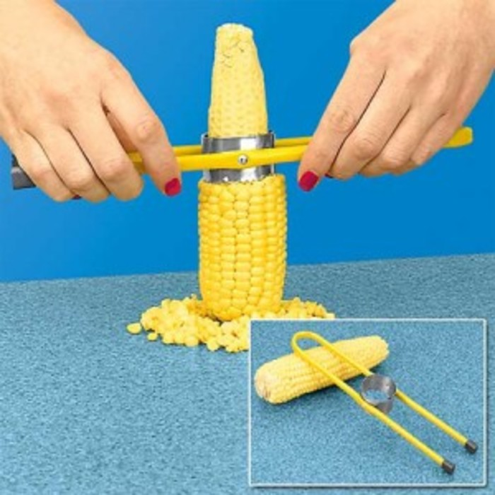
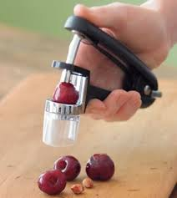
It’s safe for young children to eat the fruit.
It's convenient.

Slide 13
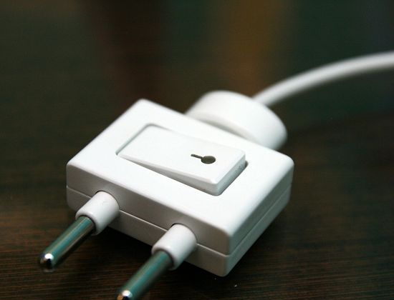
switch plug (断路插头) 2012年， 富超穎 (中国)

Slide 14
I can write
计算机在我们的生活、工作中的作用越来越大，你知道计算机的起源与发展吗？请结合计算机的发明时间(1946年）、外形、用途等方面，谈一下它的发展变化，并说明你对未来计算机的畅想。
要求：1.意思连贯，语句通顺；词数不少于80。

Slide 15
这是一篇事物介绍类的说明文，根据题目提示可考虑采用下面的模板。
引出话题
... important in our daily life.
时间:The computer was invented
in ...
外形：... was huge.
用途:send some messages ... open ...
计算机
介绍发明
畅想未来
I think computers are going to ...

Slide 16
Computer
Computers are becoming more and more important in our daily life. Do you know when the computer was invented? The computer was invented in 1946. At that time, it was huge. With the development of science and technology, the computer has grown smaller. Now there are many kinds of computers, such as personal computers and laptops. The computer is a very useful tool in our life.
【参考范文】

Slide 17
For example , we can send some messages to foreign friends by e-mail. What’s more, we can share information with others through the World Wide Web. We can also listen to music or play the game on computers. It makes us relax.
It’s hard to imagine what our life would be like without computers. I think computers will be more convenient and they are going to change our life completely in the near future.

Slide 18
Practice
1. He was seen to read a book in his room. (用I作主语,
改为主动语态)
___________________________________________
2. She was helped by all the people.(改成一般疑问句)
____________________________________________
I saw him read a book in his room.
Was she helped by all the people?

Slide 19
Summary
1. Basketball was invented by a Canadian doctor, named James Naismith, who was born in 1861.
2. Today, the popularity of basketball has risen around the world, with many young people dreaming of becoming famous players.

Slide 20
THANKS

