Slide 1
R·九年级全一册
Unit 9 I like music that I can dance to.
第三课时

Slide 2
Lead in
Why do you like listening to music?

Slide 3
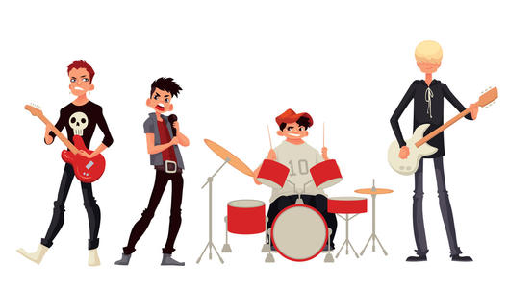
Because music can cheer us up.

Slide 4
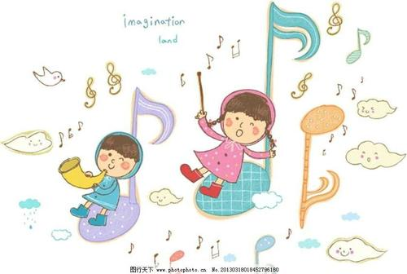
Because I can learn new knowledge from it.

Slide 5
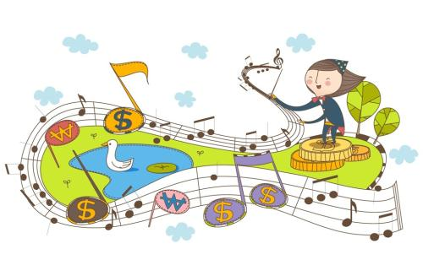
Because music can bring us different feelings.

Slide 6
Language points
What kind of music do you prefer?
I prefer the music that are unusual.

Slide 7
一、unusual的用法
unusual是形容词，意为“不寻常的；罕见的；独特的”。其反义词是usual(平常的），副词形式为unusually(异常地）。

Slide 8
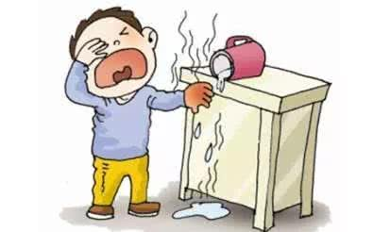
lucky
unlucky

Slide 9
fair
unfair

Slide 10
friendly
unfriendly

Slide 11
happy
unhappy

Slide 12
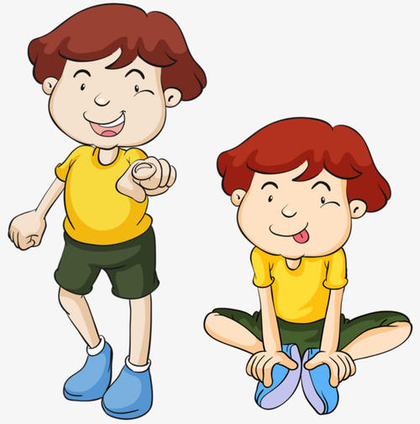
like
unlike

Slide 13
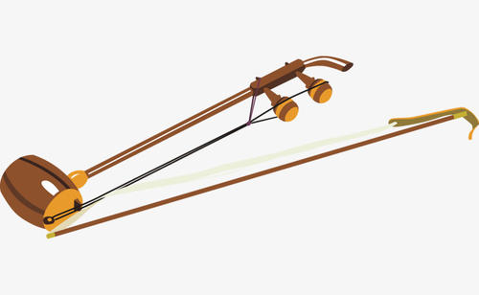
The erhu sounded so sad that I almost cried along with it as I listened.

Slide 14
二、as, when, while
as
when
“……的时候”，既表示一段时间，也可表示时间点，着重表示主、从句的动作同时发生，侧重动作的过程。
“当……时”表示主句动作发生的特定时间。when 引导的从句的谓语动词可以是延续性，也可以是非延续性。

Slide 15
while
“当……期间”，表示主句动作发生在从句动作进行的的过程中；while还可以表示“与……同时”，强调主、从句的动作是同时发生。while引导的从句谓语动词必须是延续性的。

Slide 16
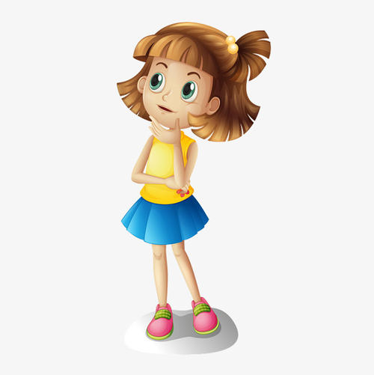
Yes, it is a pity that only six pieces of music in total were recorded for the future world to hear.
Do you know Abing's music?

Slide 17
三、pity的用法
1. It is a pity …意为“……真是遗憾”，it 在句子中做形式主语，后面由that 引导的从句是真正的主语，这类句子结构可以避免头重脚轻的情况。
句子结构：It +be+名词（词组）+that从句。

Slide 18
2. 常用于这种结构的名词（词组）有：
a pity（遗憾），a shame（耻辱），a good idea（好主意），a fact（事实），a wonder（奇迹），no wonder（难怪）。

Slide 19
3. pity 的用法
It is a pity (that)…
很遗憾
It’s a pity that you will leave.
It is a pity to do…
做某事真可惜
pity
It’s a pity to waste this food.
What a pity!
真可惜

Slide 20
Let's write
My favorite Music
kinds of music （音乐类型）
Key points
why （推荐的理由）
importance of music （音乐的重要性）

Slide 21
kinds: pop music, rock music, classical music,
folk music, jazz, dance music, rap, hip-hop,
quiet and gentle, loud, sing along with, dance to,
has great lyrics

Slide 22
why: relax ourselves, learn some knowledge, bring different feelings, cheer me up...
importance of music: Life without songs...

Slide 23
Practice
Complete the sentences about yourself.
1. I don’t like music ___________________________.
2. I enjoy spending time in places ________________
________________.
3. I have friends ____________________________.
4. I like movie stars ___________________________.
that is very loud and noisy
that are quiet
and peaceful
who are kind and active
who can act well

Slide 24
Summary
1. I prefer the music that are unusual.
2. The erhu sounded so sad that I almost cried along with it as I listened.
3. It is a pity that only six pieces of music in total were recorded for the future world to hear.

Slide 25
THANKS

