Slide 1
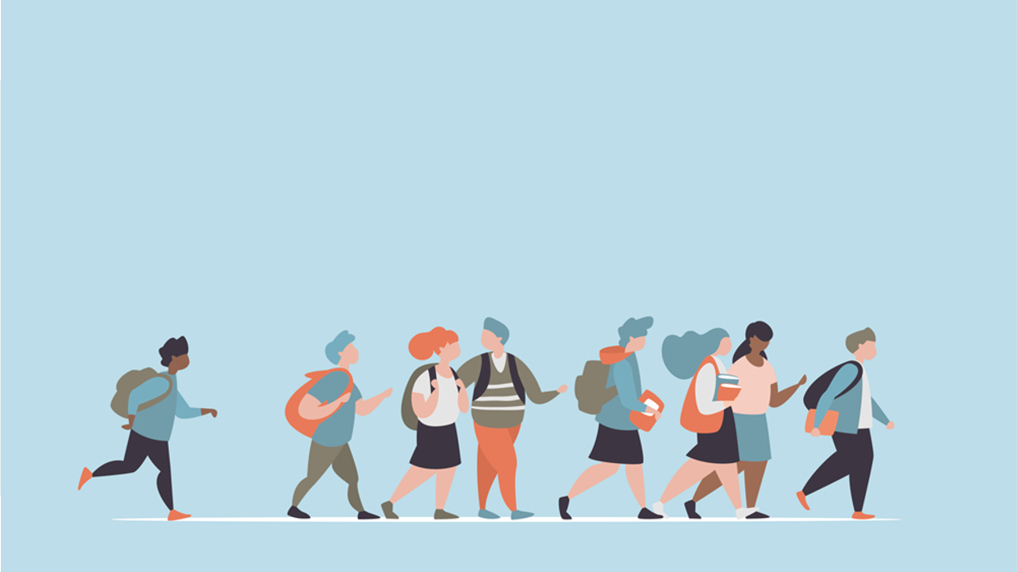
R·九年级全一册
Unit 4 I used to be afraid of the dark.
第三课时

Slide 2
Look and say
Jenny
Jenny used to play the violin.

Slide 3
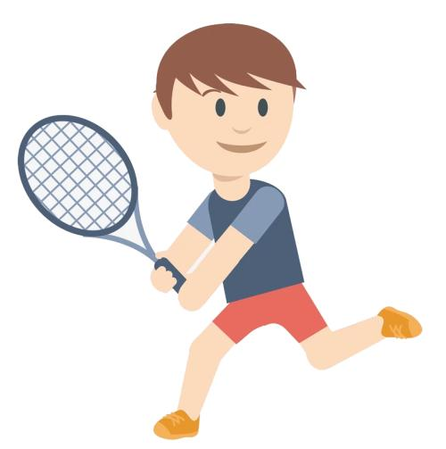
Jack
Jack used to play tennis.

Slide 4
Linda, football team
Linda used to be in the football team.

Slide 5
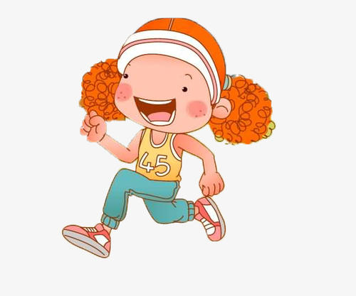
Amy, curly hair
Amy used to have curly hair.

Slide 6
A: Do you have colorful childhood?
B: Yes / No, …
A: What did you use to like to do?
B: I used to like …
play alone
read comics
play with toy cars
play with dolls
chat with my parents
play with balloons
play with the insects

Slide 7
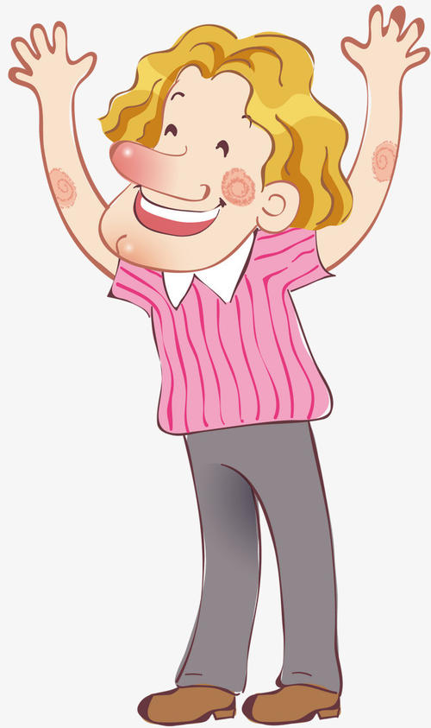
Language points
I used to worry about tests all the time. What about you?
Yes, me too.

Slide 8
一、worry的用法
worry about sb. /sth. 为某人/某事而焦虑、烦恼、担心；担心某人/某事

Slide 9
worry常见的三种用法：
1. worry可作及物动词， 意为“使烦恼， 使焦虑”，常接sb. 作宾语。
What worried you so much?

Slide 10
2. worry也可作不及物动词，意为“烦恼； 担
心”， 后常跟介词about。
Our teacher often worries about our safety.

Slide 11
3. worry后接从句时，也表示“为……担心”。
The teacher worried that the exam might be too difficult for her students.

Slide 12
二、辨析：always 与all the time
侧重于频率，表示周期性的规律，含有“每逢……都是”的意思
always
all the time
通常位于实义动词之前，助动词或连系动词之后
侧重于一段时间内连续的动作，或时间上的不间断， 表示始终如一、没有停止
通常位于句末

Slide 13
Let's write
Your changes
How I’ve changed
Your biggest changes
feelings

Slide 14
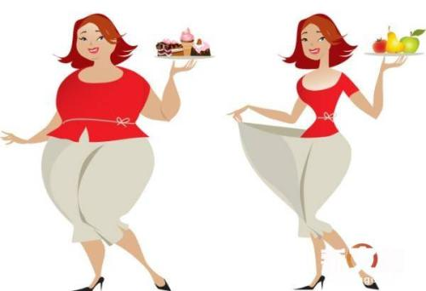
Changes in appearance
be heavy
am fit
I use to ___________. Now I _____________.

Slide 15
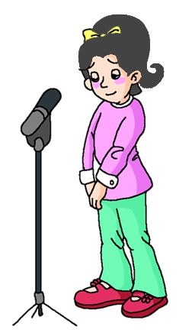
Changes in personality
be quiet
am outgoing
I use to ___________. Now I _____________.

Slide 16
Changes in hobby
like dancing
like drawing
I use to ___________. Now I _____________.

Slide 17
Changes in schoolwork
study harder than I used to
I ____________________________.

Slide 18
For example:
My life has changed a lot in the last few years. I used to be overweight but I’m not anymore. I lost a lot of weight after I started playing tennis. Playing tennis three times a week is very good exercise. Now I’m fitter and healthier.

Slide 19
The biggest change in my life was becoming much
better in English. Thanks to my English teacher, Mr Wang, he gave me an interesting book to read. I enjoyed it so much that I started to read other English books.
This is the most important change because I’m no longer afraid of English and I am doing better in my exams. This has made my parents even prouder of me. And I’m sure I can become better and better.

Slide 20
Practice
—How is Helen in the new school?
—She is doing very well. There is nothing to
worry______.
A. about B. of C. with D. /
A

Slide 21
Summary
1. worry常见的三种用法；
2. always 与all the time；
3. Writing：How I’ve changed.
Changes in appearance
Changes in personality
Changes in hobby
Changes in schoolwork

Slide 22
THANKS

