Slide 1
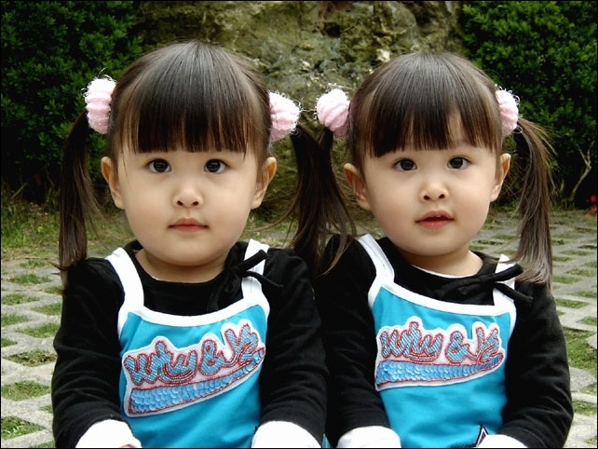
Unit 3
I’m more outgoing than my sister.
第三课时
Section B (1a-2e)

Slide 2
§自主学习方案
翻译下列短语
1.更加勤奋 _______
2.像一面镜子 ____________
3.关心，在意 ________
4.只要；既然 _________
5.使显现；使表现出 ________
6.取得更好地成绩 ____________
7.和……相同 ___________
8.事实上 ________
9.与……相像的___________
harder
like a mirror
care about
as long as
bring out
get better grades
the same as
in fact
be similar to

Slide 3
Step 1 准备与热身(Preparation)
Teacher: Everyone has friends. Who
is your best friend? Why?
Student:__________________
A. Linda. Because she is good at sports.
B. Tom. Because he is popular in our
school.
…

Slide 4
Step 2 呈现与输入 (Presentation)
What kind of things are important in a friend?
A good friend…
____ a. has cool clothes.
____ b. is popular in school.
____ c. likes to do the same things as me.
____ d. is good at sports.
____ e. is good at schoolwork.
____ f. makes me laugh.
____ g. is a good listener.

Slide 5
Group work
Interview your partners about what a good friend is.
A:What is a good friend?
B: I think a good friend makes me laugh.
C: For me, a good friend likes to do the
same things as me.
D: Yes, and a good friend is popular.
E: That’s not very important for me.
…

Slide 7
 | Like about their best friends | The same as their best friends | Different from their best friends
Molly | Peter likes to do the same things. |  | Mary studies harder.
Mary |  | They are both tall. | Lisa is quieter.

Slide 8
根据听力内容，判断正(T)误(F)。
( )1.Holly’s best friend is Pete. Because Pete
likes to do the same things as Holly does.
( )2.Holly is popular and he is good at sports.
( )3.Pete is more athletic than Holly.
( )4.Holly and Pete are both athletic.
( )5.Vera is Maria’s best friend, and she has
short hair.
( )6.Mara is more outgoing but Vera is smarter.
( )7.Maria is a good listener.
T
F
T
F
F
T
F

Slide 9
PAIR WORK
Talk about Holly and Mary and their best friends.
A: Holly’s best friend is funnier than
her.
B: Well, Mary and her best friend are
both tall.
…

Slide 10
Step 3练习与体验 (Practice)
popular _____ funny ____
quiet ___ _ hard-working ____
serious ____ friendly ___
outgoing _____ smart ______
shy _______

Slide 11
§课堂导学方案—Step 3
根据短文内容，判断正(T)误(F)。
( ) 1.Jeff is less serious than most kids.
( ) 2.Jeff and Yuan Li are both quiet.
( ) 3.Jeff thinks it is easy for him to make friends.
( ) 4.Huang Lei is taller than Larry.
( ) 5.Huang Lei isn’t as good at tennis as Larry.
( ) 6.Larry works harder than Huang Lei.
( ) 7.Mary thinks her friends should be the same as
her.
( ) 8.Carol broke her arm last year and Mary made
her feel better.
F
T
F
F
F
F
F
F

Slide 12
My mother told me a good friend is like a mirror. I’m quieter and more serious than most kids. That’s why I like reading books and I study harder in class. My best friend Yuan Li is quiet, too, so we enjoy studying together. I’m shy so it’s not easy for me to make friends. But I think friends are like books—you needn’t a lot of them as long as they’re good.
It is/ was+adj. +for sb. +to do sth.

Slide 13
与……不同
It’s not necessary to be the same. My best friend Larry is quite different from me. He is taller than me. We both like sports, but he plays tennis better, so he always wins. I’m getting better, though. As Larry often says, “My best friend helps to bring out the best in me.” However, Larry is much less hard– working, so I always get better grades. Maybe I should help him more.
修饰比较级

Slide 14
与……相同
I don’t really care if my friends are the same as me or different. My favorite saying is, “ A true friend reaches for your hand and touches your heart.” My best friend Carol is really kind and very funny. In fact, she’s funnier than anyone I know. I broke my arm last year but she made me laugh and feel better. We can talk about and share everything. I know she cares about me because she’s always there to listen.
在乎
make sb. do
sth.
事实上

Slide 15
Step 4 运用与生成 ( Production)
My mother told me a good friend （像） a mirror. I’m quieter and （更加严肃）than most kids. That’s （为什么） I like （读书）and I study harder in class. My best friend Yuan Li is quiet
too, so we （喜欢在一起学习）. I’m shy so
（对我来说交朋友并不容易）. But I think friends are like books—you needn’t a lot of them
（只要） they’re good.

Slide 16
（没有必要相同）. My best friend Larry （与……不同） me. He
is taller than me. We both like sports, but he plays tennis better, so he always wins. I’m getting better, though. As Larry often says, “My best friend helps to （展现）the best in me.” However, Larry is much less hard–working, so I always get better grades. Maybe （我应该更多的帮助他们）.

Slide 17
I don’t really （介意）if my friends are
（与……相同） me or different. My favorite saying is, “ A true friend reaches for your hand and touches your heart.” My best friend Carol is really kind and very funny. （事实上）, she’s funnier than anyone I know. I broke my arm last year but she （让我高兴并且感觉好多了）. We can （讨论）and
（分享） everything. I know she （在乎我）because she’s always there to listen.

Slide 18
Step 5 巩固与提高（Progress）
Let's compare our friends
I’m different from Jeff，because I’m louder than the other kids in class. My best friend is similar to Larry because she’s less hard– working than me…

Slide 19
1.A good friend is like a mirror.
2.Friends are like books —you don’t need a
lot of them as long as they’re good.
3.My best friend helps to bring out the best in me.
4.A true friend reaches for your hand and touches
your heart.

Slide 20
探究点（一）
It’s necessary to be the same. 有必要一致。
it’s necessary to do sth.意为“有必要做某事”。it 是形式主语，其句型是it is/was+ 形容词+ 动词不定式，常用来说明一般的情况或某一次具体的动作。
e.g.It’s necessary to study English well.
有必要把英语学好。
It’s necessary to make full use of the
waste we throw away every day.
充分利用我们每天扔掉的垃圾很有必要。

Slide 21
【拓展】it is/was+ 形容词+ 动名词，表示说话者在谈论某一特定的处境，并想给人以“某一动作在进行中”的概念。
e.g.It’s a waste of time talking about
such a thing.
谈论这种事情真是浪费时间。
It is no good/use complaining.
怨天尤人是没用的。
针对训练
（ ）It is important _____English well.
A. to learn B. to learning
C. learn D. learnt
A

Slide 22
探究点（二）
Huang Lei isn’t as good at tennis as
Larry.
黄磊没有Larry擅长网球。
(1) not as … as … 意为“不如……,和
……不一样”,也可以表达为not so …
as … 。not as/so … as … 中间要
用形容词或副词的原级。第二个as
后面接比较的另一方，可以是句子，
也可以是名词或代词（若为人称代
词，主格与宾格均可）。

Slide 23
e.g. I’m not as/so tall as you.
我不如你高。
I’m as tall as you.我和你一样高。
针对训练
（ ）—Why don’t you like winter in
Beijing ?
—Because it is _____ that in
Guangzhou.
A. as cold as B. much colder than
C. not so cold as D. not colder than
B

Slide 24
一、句型转换。
Exercise
Sam is fatter than Peter.
My sister is much smarter than me at study.
1. Peter is thinner than Sam.
(同义句转换)
2. My sister is smarter a lot at study than
me. (同义句转换)

Slide 25
3. I study science very well. (同义句转换)
4. Miss Li is popular in our class. Mr.
Wang is more popular.(同义句转换)
I am very good at science.
Mr. Wang is more popular
than Miss Li in our class.

Slide 26
二、用比较级形式填空。
newer
1.Tom’s bike is new, but John’s bike is ______.
2.Tom’s schoolbag is big, but John’s
schoolbag is _________.
3.Tom’s house is small, but John’s house
is even _________.
4.Tom’s coat is long, but John’s coat is
even _________.
5.Tom’s desk is good, but John’s is ______.
bigger
smaller
longer
better

Slide 27
6. He is ________ (young) than I am.
7. Mr. Smith is much _____ (old) than his wife.
8. Chicago is ______ (big) than Paris.
9. This book is ______ (good) than that one.
10. The weather this winter is _______ (bad)
than that of last winter.
younger
older
bigger
better
worse

Slide 28
三、单项选择。
B
1. Jeff ______ football and knows a lot about it.
A. is interested on B. is interested in
C. is interesting about D. is interesting with
2.—There ____ a lot of meat on the plate.
Would you like some? —Just a little, please. A. is B. are C. am D. be
A

Slide 29
Step 6 家庭作业(Homework)
1. Read the passages after class.
2. 完成本单元的练习。

Slide 30
Thank you for listening!

