Slide 1
R·九年级全一册
Unit 1 How can we become good learners?
第一课时

Slide 2
Lead in
How do they study for a test?

Slide 3
She studies for a test by making word cards.

Slide 4
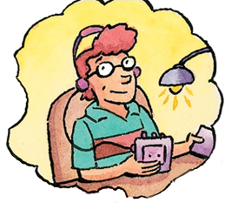
He studies for a test by listening to tapes.

Slide 5
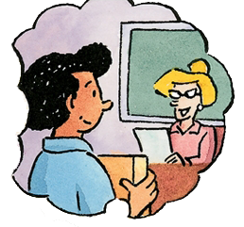
He studies for a test by asking the teacher for help.

Slide 6
He studies for a test by working with friends.

Slide 7
He studies for a test by reading the textbook.

Slide 8
Language points
by表示“通过……方法、手段”等。
by doing sth. 意为“通过……(方法、途径)做某事”
一、by的用法
how引导特殊疑问句，常用来提问by引导的方式状语。

Slide 9
拓展：by的其他用法
1. by+交通工具，意为“乘/驾/坐……”。
I went to Beijing by plane.
2. by+时间，意为“不迟于；在……之前”。
I must be in bed by ten o’clock.
3. by+地点，意为“在……旁边”。
We live by the sea.

Slide 10
by
in
with
表示“通过……方法、手段”等。by doing sth. 意为“通过……(方法、途径）做某事”
用某种材料（如用墨水、铅笔等）或用某种语言或者表示衣着、声调、特点等
使用工具、方法或人体部位等

Slide 11
Do you learn English by watching videos?
No. It’s too hard
to understand
spoken English.

Slide 12
What about reading aloud to practice pronunciation?
I do that sometimes. I think it helps.

Slide 13
二、征求建议
what about + V-ing/ n./ pron.
(征求意见)怎么样，如何
What about going out with me tomorrow?

Slide 14
三、近义词辨析
1. aloud 与 loudly
aloud 强调发出的声音能被听见，“大声地、出声地”；
Please read the words aloud.
loudly 意为“高声地”，但含有“喧闹”的意味 (放在动词前后均可)。
She spoke very loudly.

Slide 15
2. pronunciation n. 发音；读音
pronounce v. 发音；读音

Slide 16
Practice
1. — How do you study English?
— I study English ____ making word cards.
A. of B.by C.in D. on
2. If you have questions, you should ask the teacher ____help.
A. from B. on C. for D. to
B
C

Slide 17
Summary
1. -How do they study for a test?
-I study by ...
2. Do you learn English by doing sth.?
by working with friends
by making word cards
by reading the textbook
by listening to tapes
by asking the teacher for help

Slide 18
THANKS

