Slide 1
Unit 8

Slide 2
Unit 8
Is there a post office near here?

Slide 3
Section A 1
1a-2d

Slide 4
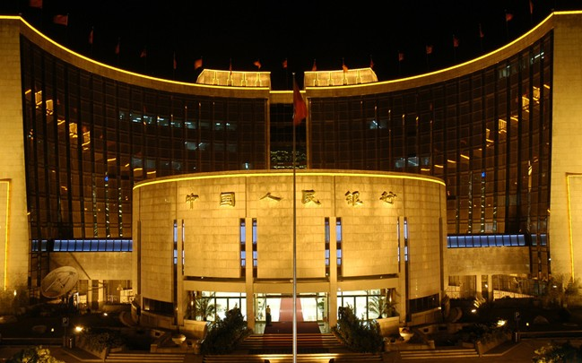
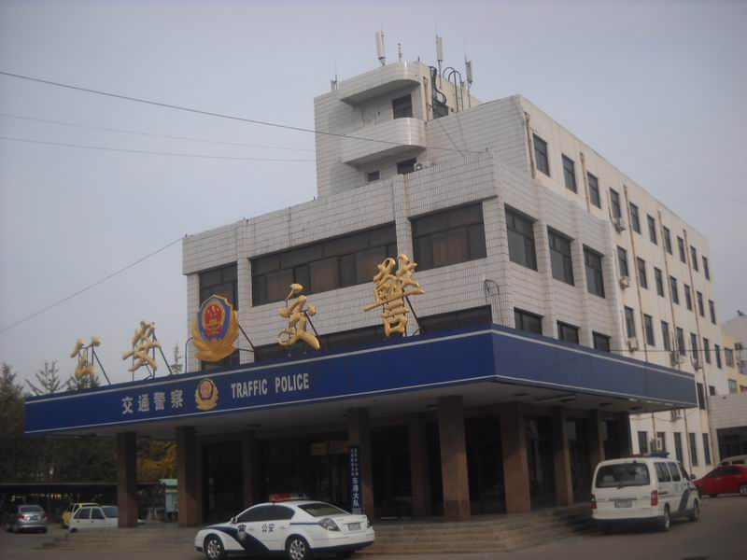
New words
post office 邮局
restaurant n. 餐馆
police station 警察局
bank n. 银行

Slide 5
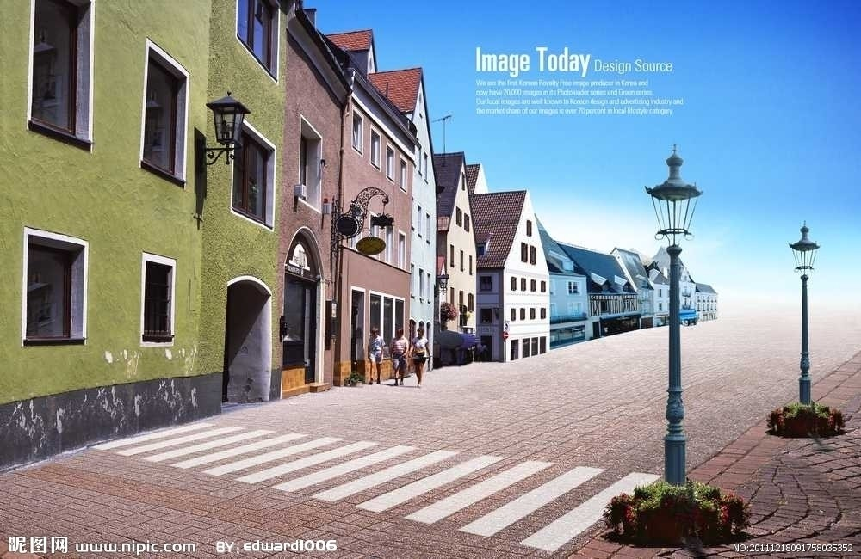
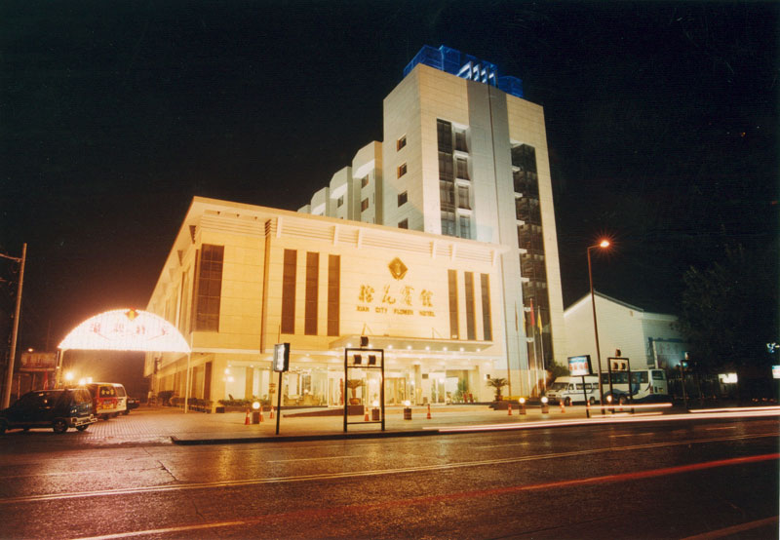
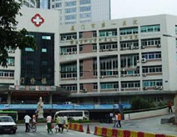
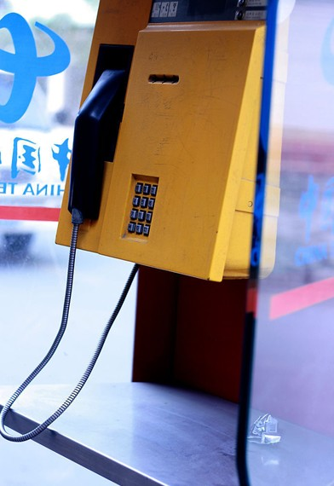
street n. 大街
hotel n. 旅馆
pay phone 付费电话
hospital n. 医院

Slide 6
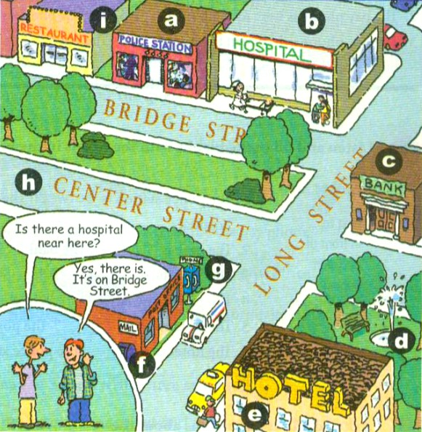
Match the activities with the pictures.
1a
f
1. post office __
2. police station __
3. hotel __
4. restaurant __
5. bank __
6. hospital __
7. street __
8. pay phone __
9. park ___
a
e
i
c
b
h
g
d

Slide 7
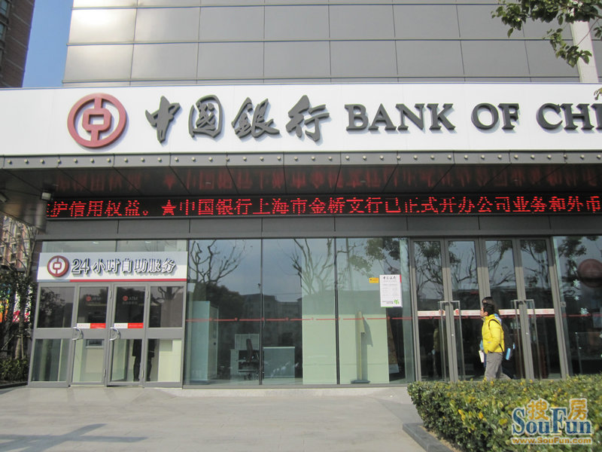
比眼力!
What’s this?
It’s a bank.

Slide 8
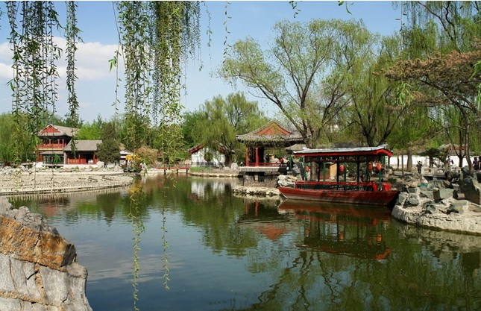
What’s that?
It’s a park.

Slide 9
What’s this?
It’s a restaurant.

Slide 10
What’s that?
It’s a hotel.

Slide 11
What’s this?
It’s a police station.

Slide 12
What’s this?
It’s a post office.

Slide 13
What’s this?
It’s a pay phone.

Slide 14
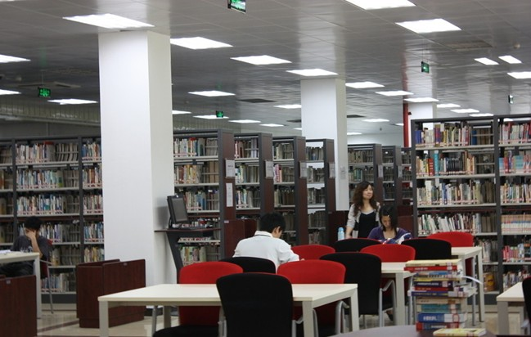
What’s that?
It’s a library.

Slide 15
Listen and circle the places you hear in 1a.
1b
post office __
police station __
hotel __
restaurant __
bank __
hospital __
street __
pay phone __
park ___

Slide 16
Pairwork
Make the conversations with your partner about the places in 1a.
1c
Yes, there is. It’s on Bridge Street.
Is there a hospital near here?

Slide 17
Is there a post office near here?
Yes, there is. It’s on Long Street.
Is there a restaurant on Bridge Street?
Yes, there is.

Slide 18
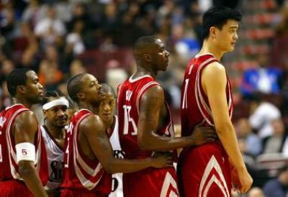
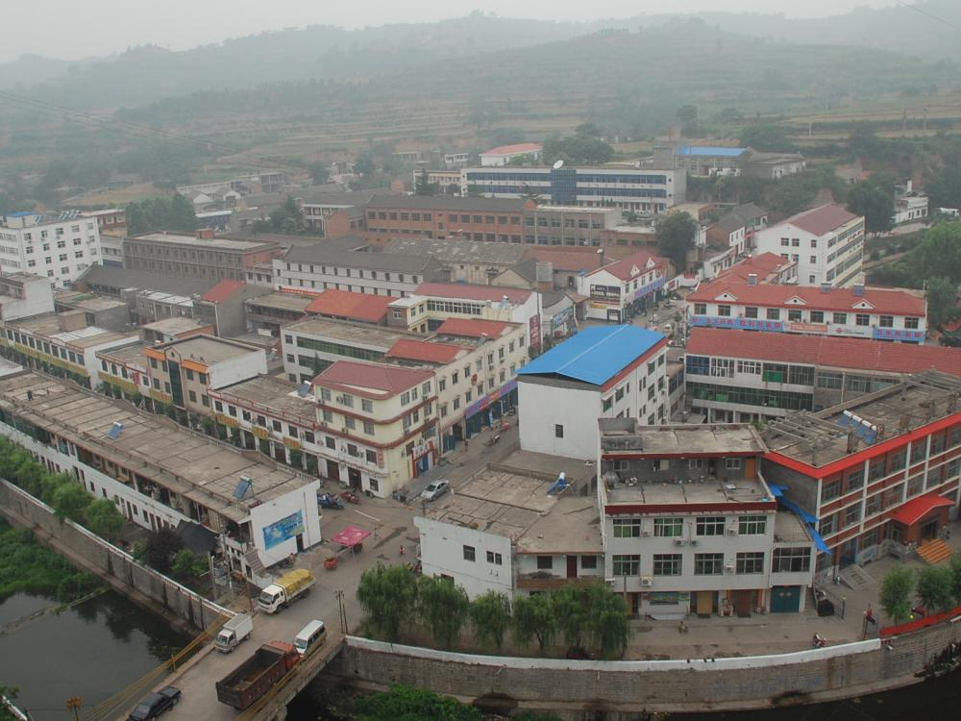
New words
town n. 镇；市镇
behind prep. 在……的后面

Slide 19
Match the sentences with the pictures. Write each number in the box.
2a
1. The pay phone is across from the library.
2. The pay phone is next to the library.
3. The pay phone is between the post office and the library.
4. The pay phone is on Green Street.
5. The pay phone is in front of the library.
6. The pay phone is behind the library.

Slide 20
4
6
2
3
5
1

Slide 21
Listening
Listen and fill in the blanks
with the words in the box.
2b
next to in front of between behind across from on
The police station is between the restaurant and the hospital.
The park is ___________ the bank.
The hospital is ___ Bridge Street.
The pay phone is _______ the post office.
The restaurant is _________ the post office.
The hotel is _______ the police station.
across from
on
next to
in front of
behind

Slide 22
Pairwork
Ask and answer questions about the places in 1a on page 43.
2c
A: Where’s the
hospital?
B: It’s next to the
police station.
A: Where’s the
restaurant?
B: It’s next to the
police station.

Slide 23
A: Where’s the bank?
B: It’s on Long
Street.
A: Where’s the hotel?
B: It’s across from
the post office.
A: Where’s the pay
phone?
B: It’s next to the
post office.

Slide 24
A: Where’s the park?
B: It’s behind the
hotel.
A: Where’s the post
office?
B: It’s across from
the hotel.

Slide 25
Reading
2d
Read the conversation and answer the questions.
Is there a bank near here?
_______________________
2. Where’s the bank? _________________________________
_________________________________
3. Is Center Street far from here?
_________________________________
Yes, there is.
It’s on Center Street, across from the park.
No, it isn’t.

Slide 26
Role-play the conversation.
Tony: Hi, excuse me.
Linda: Yes. How can I help you?
Tony: Well, I’m new in town. Is there a
bank around here?

Slide 27
Linda: Yes, there is. It’s on Center Street.
It’s across from the park.
Tony: Oh … where’s Center Street?
Linda: It’s not far from here. I can walk
with you.
Tony: Oh, that’s great! Thanks so much.
Linda: No problem.

Slide 28
Language points
1. It’s across from the park.
across from 意为“在……对面”
e.g. The bank is across from our school.
银行就在我们学校对面。
【拓展】 across 作介词，意为“从一边到另一边；横过”。
e.g. Can you swim across the river?
你能游过这条河吗？

Slide 29
2. The pay phone is in front of the library.
in front of 意为“在……前面”（在某范
围之外）
e.g. There is a car in front of the house.
在房子前一辆小汽车。
【辨析】in the front of “在……前面”（在
某范围之内）
e.g. There is a table in the front of the
classroom.
在教室的前面有一张桌子。

Slide 30
3. The pay phone is next to the post office.
next to 意为“紧靠着；紧挨着；贴近”
e.g. The little boy is next to his mother. 小男孩紧挨着他的母亲。
【辨析】next to与near的区别
从空间讲near 只表示“在……附近”；而next to有“紧挨着”之意；next to比near靠的更近。

Slide 31
如：Peter sits next to Mike.
彼特紧挨着迈克坐。
Peter sits near Tom.
彼特坐在汤姆附近。

Slide 32
4. How can I help you? 需要我帮忙吗？
表示向他人伸出援手，主动提出帮助的意思，此句还可说成：How can I help you?或How may I help you?
类似的句子还有：
May I help you?
Do you need any help?
Is there anything I can help (you) with?
What can I do for you?

Slide 33
5. I’m new in town. 我新来此地。
town 表示所居住的地方或城市里的“闹市区；城里”，为不可数名词。
e.g. Is there a good place to eat here? I’m
from out of town.
这儿有吃饭的好地方吗？我对这里
不熟。

Slide 34
小试身手
1. 图书馆在邮局的对面。
The library is ______ _____ the
____ ______.
2. 在公园附近有餐馆吗？
Is _____ a restaurant _____ the _____?
3. 紧挨着银行有一家旅馆。
There __ a hotel _____ __ the bank.
across from
post office
there near park
is next to

Slide 35
4. 投币电话应在医院后面。
The ___ phone is ______ the _______.
5. 在警察局前面有很多树。
There are many trees __ ____ ___ the police station.
pay behind hospital
in front of

Slide 36
Homework
总结记忆表示方位的介词。
用今天所学的介词（near, next to, in front of, behind, between…and）来写五个句子，描述一下你生活中常见的居住位置。

