Slide 1
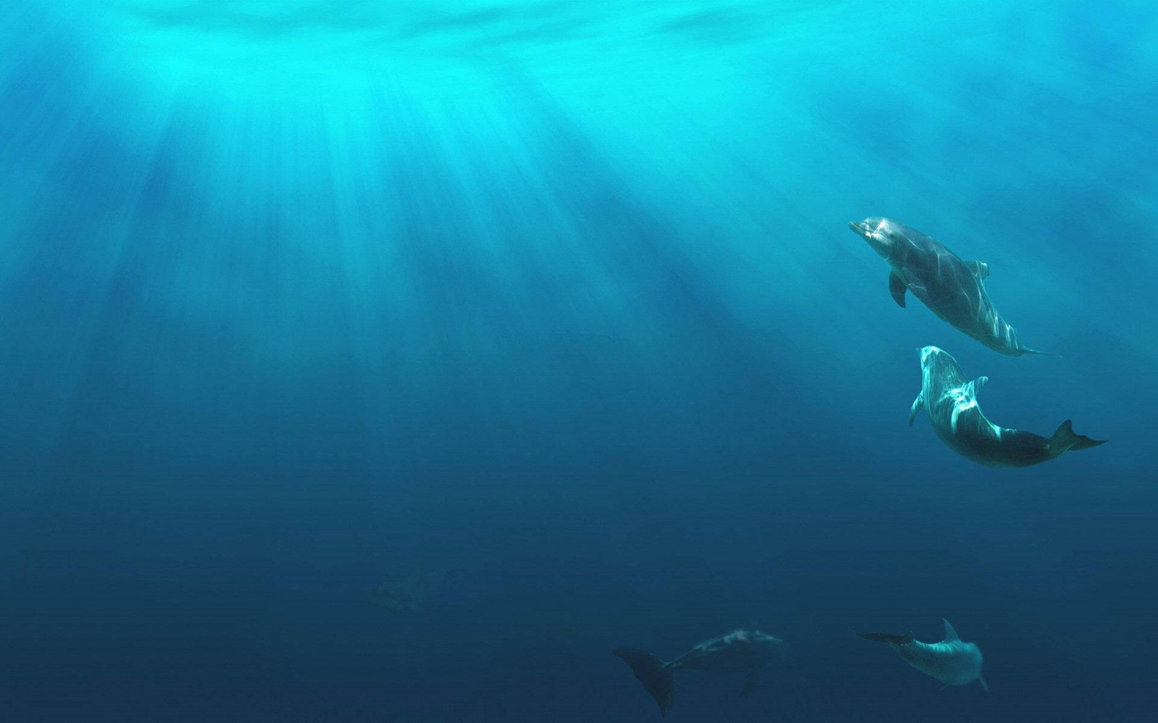
Unit 2
Iconic Attractions

Slide 2
内容索引
Period Two Reading and Thinking—Language Points
基础自测 自主学习 落实基础知识
互动探究 探究重点 互动撞击思维
达标检测 当堂检测 基础达标演练

Slide 3
基 础 自 测
自主学习 落实基础知识
重点单词
1. adj.符号的；图标的
2. n.创建；基础；地基
3. adj.政治的
4. vt.给……命名(或题名)；使享有权利
5. n.公共场所(尤指价格低廉的饮食和娱乐场所)；关节
adj.联合的；共同的
6. adj.最著名的；第一的；首要的
n.总理；首相
7. n.药草；香草；草本
iconic
foundation
political
entitle
joint
premier
herb

Slide 4
8. adj.中空的；空心的
9. adj.坦率的；简单的
10. vt.倡议；赞助；主办
n.(法案等的)倡议者；赞助者
11. adj.位于
→ vt.找出……的位置；把……设置(在)；使……坐落(于)
12. vi.&n.潜水；跳水；俯冲
→ n.潜水者；跳水运动员
13. n.自由；不受……影响的状态
→ adj.免费的；自由的，不受约束的
vt.使自由，解放；释放
hollow
straightforward
sponsor
located
locate
dive
diver
freedom
free

Slide 5
14. vt.&vi.(使)振动
→ n.振动
15. n.自由
→ vt.解放；释放
→ n.释放，解放
vibrate
vibration
liberty
liberate
liberation

Slide 6
掌握规律 巧记单词
free(adj.免费的；自由的，不受约束的 vt.使自由，解放；释放)＋
-dom(表名词，……状态或领域)→freedom n.自由；不受……影响的状态
例如：wise adj.智慧的→wisdom n.智慧
king n.国王→kingdom n.王国

Slide 7
核心短语
1. 做研究
2. 坐落于，位于
3. 提到，指的是
4. 例如
5. 迫不及待地做某事
6. 另一方面
7. 导致；通向
8. 原产于……；源于……的
9. 跟……有联系，和……接触
10. 参与；起作用；扮演角色
do some research
be located to
refer to
such as
can’t wait to do sth.
on the other hand
lead to
be native to
be in contact with
play a part in

Slide 8
经典句式
1.it作形式主语，that引导真正的主语从句
now nearly half of all Australian citizens were either born overseas or have parents who were born overseas.
据说，现在近一半的澳大利亚公民要么是在海外出生的，要么父母是在海外出生的。
2.what引导主语从句
Personally speaking， is the people themselves.
就我个人而言， 我最喜欢的是澳大利亚人。
It is said that
what I like most about Australia
返 回

Slide 9
互 动 探 究
探究重点 互动撞击思维
重点词汇
Located to the south of the equator，below many other countries on the globe，it’s often informally referred to as “down under”.它位于赤道以南，并在地球上许多其他国家的下方，通常被非正式地称为“down under”。
1
located adj.处于，位于；坐落的
※be located in/on/at位于；坐落于
※locate vt.找出……的位置；把……设置(在)；使……坐落(于)

Slide 10
(1)The company located its branch office in the suburbs.这家公司在郊区设立了办事处。
(2)One of the world’s largest art galleries，the Louvre， (locate) in Paris.
作为世界上最大的艺术博物馆之一的卢浮宫坐落在巴黎。
(3) (locate) at the west end of Singapore，the park has a lot of room for visitors to walk around.
这座公园位于新加坡的西端，有很大的空间供游客漫步。
(4)Mark Twain was four years old when his family moved to Hannibal，Missouri， (locate) on the west bank of the Mississippi.
马克·吐温四岁时，全家搬到了位于密西西比河西岸的密苏里州的汉尼拔。
is located
Located
located

Slide 11
We’re here to learn about the life and customs of the Aborigines，who are native to Australia.我们在这里学习澳大利亚土著居民的生活和习俗。
2
be native to原产于……；源于……的
native adj.本国的；本地的 n.本地人；本国人
native-born adj.土著的；土生土长的
one’s native country/land/language某人的祖国/故乡/母语
be a native of...出生于某地的人；原产于某地的动物或植物

Slide 12
(1)The kangaroo is a native of Australia.
袋鼠是产于澳大利亚的动物。
(2)The researcher says the tiger is native India.
研究人员说这种虎原产于印度。
(3)Is her uncle a native Shanghai，or just a visitor?
她叔叔是上海本地人，还是只是一名游客？
to
of

Slide 13
They have a straightforward and free-and-easy attitude towards life，and their friendliness and warmth made me feel at home wherever I went.他们对生活有一种直率、洒脱的态度，无论我走到哪里，他们的友好和温暖都让我感到宾至如归。
3
straightforward adj.坦率的；简单的

Slide 14
(1)The researchers say that the keyboard should be pretty straightforward to commercialize and is mostly made of inexpensive，plastic-like parts.
(2019·全国Ⅰ)
研究人员说，键盘应该很容易商业化，主要由廉价的塑料类部件制成。
(2)In order to be understood，you’d better write it
.
为了让人能明白你的意思，你最好用浅显易懂的文字写。
(3)Speer of all the students.
在所有这些学生中，斯佩尔给人以最直率的印象。
in straightforward
language
made the most straightforward impression

Slide 15
Visitors to the beaches can enjoy many activities，including diving，kayaking，and rock climbing.到海滩的游客可以享受许多活动，包括潜水、皮划艇和攀岩。
4
dive vi.& n.潜水；跳水；(飞机或鸟)俯冲，奔，扑；突然下降，暴跌；迅速将手伸入
[一词多义] 写出下列句子中dive的汉语意思
(1)The seagulls soared and then dived. ____
(2)We dived into the river to cool off. ____
(3)The goalie dived for the ball，but missed it. __________
(4)The share price dived from 49p to an all-time low of 40p. ______________
俯冲
跳水
冲，奔，扑
突然下降，暴跌

Slide 16
※dive into投入；钻研；把手伸入
※diver n.潜水者；跳水运动员
(5)She dived her bag and took out a couple of coins.
她立即将手伸进包里拿出几枚硬币。
into

Slide 17
Unfortunately，elephants are endangered in Thailand，but special parks have been set up to protect their safety and freedom.不幸的是，泰国的大象正濒临灭绝，但为了保护它们的安全和自由，人们建立了专门的公园。
5
※freedom n.自由；不受……影响的状态
freedom of expression 言论自由；表达自由
freedom of speech 言论自由
freedom from 免于
※free adj.免费的；自由的，不受约束的 vt.使自由，解放；释放

Slide 18
(1)That freedom to choose is one reason more people like to eat alone.
(2019·全国Ⅱ)
选择自由是越来越多的人喜欢独自吃饭的原因之一。
(2)Lately，his painting has shown .
最近，他的绘画展示出一种新的自由表现形式。
(3)Thanks to the automobile，Americans soon previously unknown.
由于有了汽车，美国人很快就获得了前所未有的行动自由。
a new freedom of expression
had a freedom of movement

Slide 19
Visitors can see these amazing creatures in their natural domain，and also sponsor an elephant to preserve its health and liberty.游客们可以在自然环境中看到这些神奇的动物，还可以认养(赞助)一头大象来保护它的健康和自由。
6
liberty n.自由；许可
※take the liberty of doing sth. 冒昧地做某事
※liberate vt.解放；释放；冒失
※liberation n.释放，解放
※liberalism n.自由主义；开明的思想或见解

Slide 20
(1)The bird flew from the cage and got liberty.
这只鸟飞出了鸟笼得到了自由。
(2)There was no schools in the village before (liberate).
解放前村里没有学校。
(3)We you with a view of building up business relations with your company.
我们冒昧地写信以期和贵公司建立贸易关系。
liberation
take the liberty of writing to

Slide 21
[易混辨析] freedom，liberty
freedom和liberty都含“自由”的意思，区别如下：
※freedom系常用词，指“没有强制、压迫且能充分按自己意志行事”，强调“个人的自由”；
※liberty 在表示民族、国家争取或获得自由时，可与freedom互换，但它强调“从过去所受的压制或束缚中解放出来”，强调“集体的自由”。

Slide 22
经典句式
It is said that now nearly half of all Australian citizens were either born overseas or have parents who were born overseas.据说，现在近一半的澳大利亚公民要么是在海外出生的，要么父母是在海外出生的。
1
It is said that ...据说……。在此句型中it为形式主语，that引导的句子是真正的主语。常用于这种结构的形容词有：strange，certain，important，possible，natural，surprising，interesting，likely，unusual等。
注意：在英语中，形式主语或形式宾语只能用it，不能用this，that或其他代词。

Slide 23
(1) Peter will have a chance to travel abroad next month.
据说彼得下个月将有机会出国旅行。
(2) he didn’t come yesterday.
很奇怪，他昨天没来。
(3) we should set a good plan.
我们制定一个好的计划非常重要。
(4) the film The Wandering Earth was a great success in 2019.
很显然，电影《流浪地球》在2019年取得了很大的成功。
It is said that
It was strange that
It is important that
It was obvious that

Slide 24
[一句多译]
(5)毫无疑问，他会出席明天的会议。
① he will be present at the meeting tomorrow.(doubt)
② he will be present at the meeting tomorrow.(certain)
There is no doubt that
It is certain that

Slide 25
Personally speaking，what I like most about Australia is the people themselves.就我个人而言，我最喜欢的是澳大利亚人。
2
本句中what引导主语从句，且在从句中作宾语。what是连接代词，引导的从句还可作宾语或表语；what本身在从句中可作主语、宾语或表语。
注意：that引导名词性从句只起连接作用，在从句中不作任何成分，无意义，在宾语从句中通常省略，但在主语从句、表语从句和同位语从句中均不能省略；what除引导从句外，还在从句中作成分，意为“所……的(东西)”，在含义上等于“名词＋that”。

Slide 26
(1)What she offers to her fans is happiness.
她带给粉丝的是快乐。
(2)It also gives people a chance to see .
(2020·全国Ⅲ)
它也给人们一个去看看新房子的样子的机会。
(3)This is my father has taught me—to always face difficulties and hope for the best.
这就是我父亲教给我的——总是直面困难，并且抱最大的希望。
what the new home looks like
what
返 回

Slide 27
达 标 检 测
当堂检测 基础达标演练
Ⅰ.单句语法填空
1. I am afraid of is their taking him to Portugal.
2.I’m old enough to have the (free) to do what I like.
3.The ground shook and the cliffs seemed (vibrate).
4.Pat had earlier made dive of 80 feet from the Chasm Bridge.
5.The actor Wu Jing played a leading part the film Wolf Warriors.
6. is said that some leaders are outspoken in their support for the political reform in Kenya.
What
freedom
to vibrate
a
in
It

Slide 28
7.The museum， (locate) next to the Wuzhen scenic spot，covers an area of 5,000 square meters.
8.There are six spoken languages that are considered to be native the British as well as two local accents.
located
to

Slide 29
Ⅱ.完成句子
9.我迫不及待地想和他进行一次面对面的交流。
I with him.
10.你不在时我冒昧借用了你的词典。
I while you were absent.
11.他应该了解整件事是必要的。
he should learn about the whole matter.
12.为河水增色的是水里的荷花。
are the lotus plants growing in the water.
can’t wait to have a face-to-face communication
took the liberty of borrowing your dictionary
It is necessary that
What makes the river more beautiful
返 回

Slide 30
本课结束

