Slide 1
Unit 2
How often do you exercise?
(Grammar Focus~3c)

Slide 2
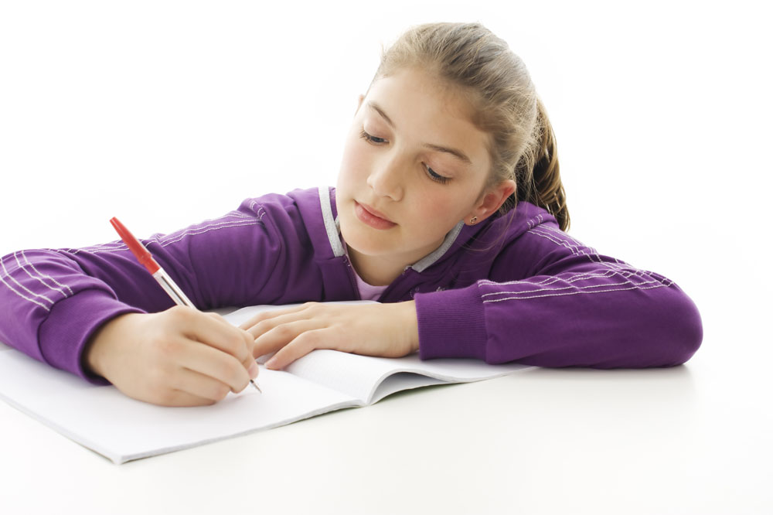
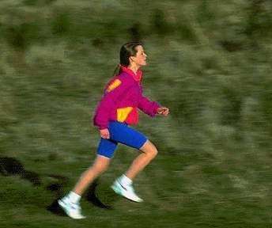
Work in pairs and ask your partners what they usually do on weekends.
do homework
exercise

Slide 3
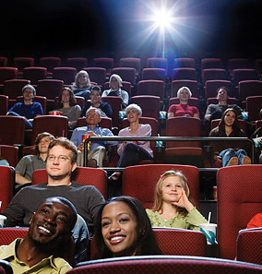
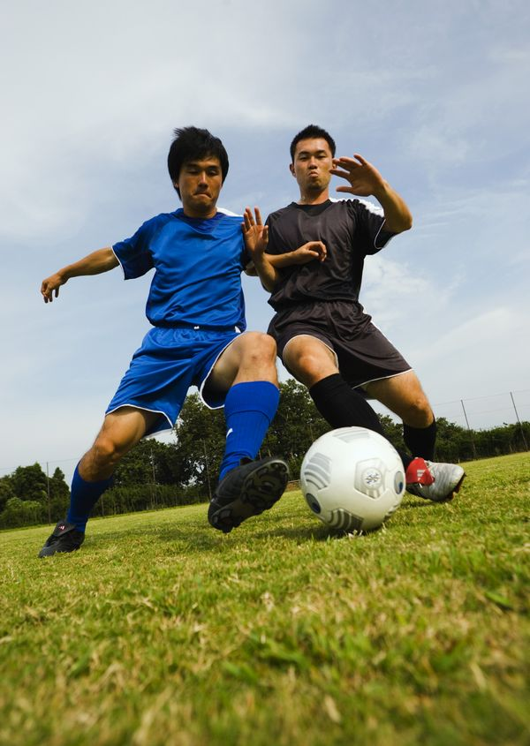
play football
go to the movies

Slide 4
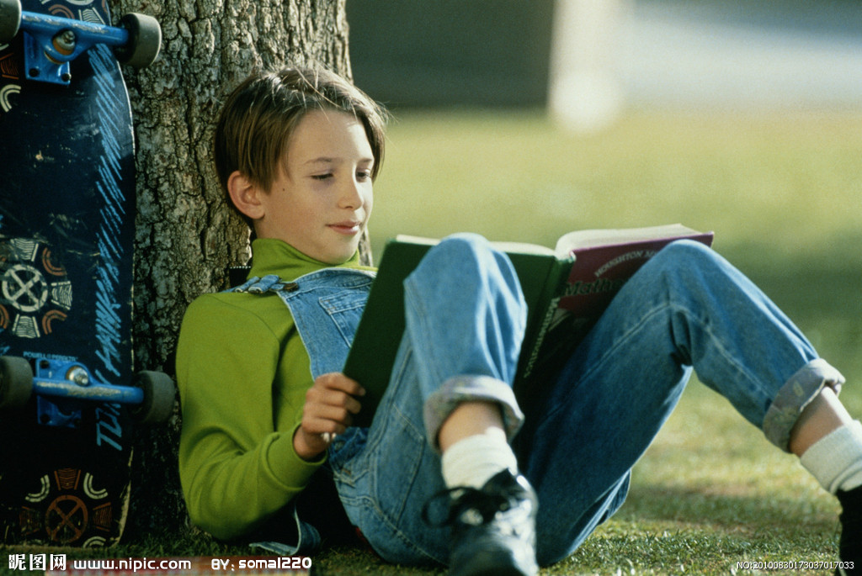
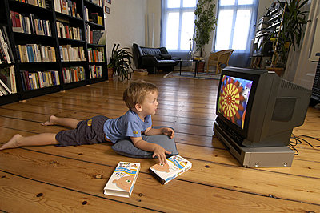
watch TV
read

Slide 5
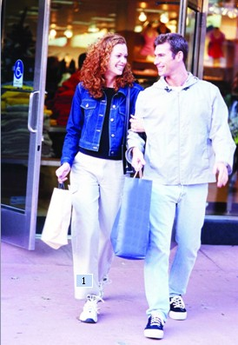
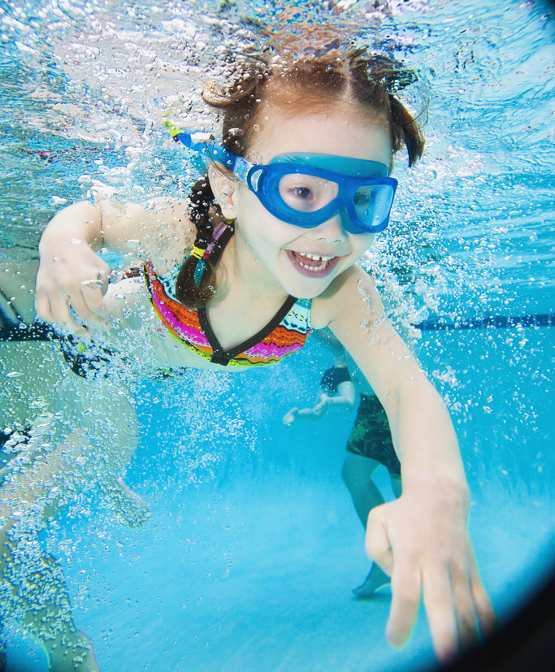
swim
shop

Slide 6
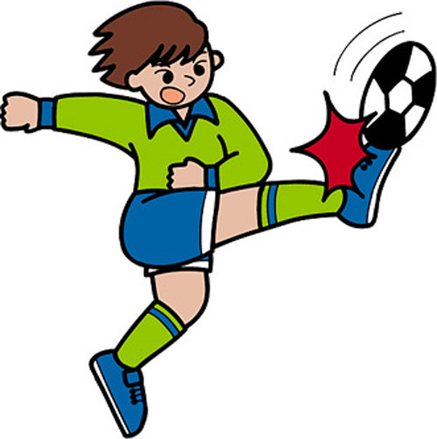


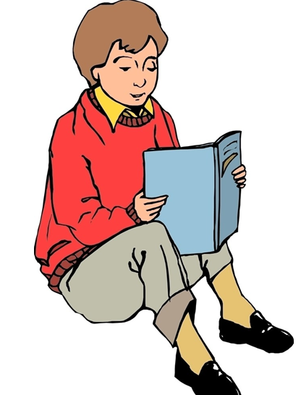
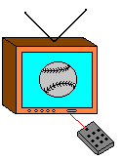
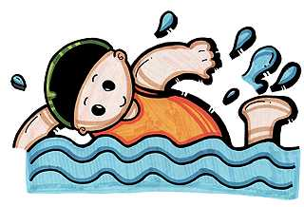
Li Ming/ twice a week
Tony/ 3 or 4 times a week
Jim / once a week
Bob /every day
Peter/ never
Li Lei/ hardly ever

Slide 7
Read
Read the conversation and match the activities with the right time.
2d
Wednesday and Friday
dance lesson
piano lesson
Tuesday
play tennis
Monday

Slide 8

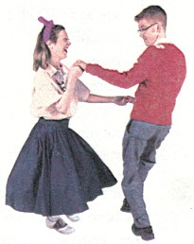
2d Role-play the conversation.
Jack: Hi, Claire, are you free next week?
Claire: Hmm…next week is quite full for me, Jack.
Jack: Really? How come?
Claire: I have dance and piano lessons.
Jack: what kind of dance are you learning?
Claire: Oh, swing dance. It’s fun! I have class once a
week, every Monday.
Jack: How often do you have piano lessons?
Claire: Twice a week, on Wednesday and Friday.
Jack: Well, how about Tuesday?
Claire: Oh, I have to play tennis with my friends.
But do you want to come?
Jack: Sure!
学科网，zxxk.fenghuangxueyi

Slide 9
How come ? 为什么呢？
这是英语中的一个口语，相当于汉语的“为什么，怎么会”等，既可以独立使用，也可在后接句子，来询问事情的缘由或状况。
e.g.How come the sky is blue today?
今天天怎么会这么蓝？
—I didn’t even eat lunch today.
我今天甚至没吃午饭。
—Really? How come?
是吗？怎么会呢？

Slide 10


Role-play the conversation
Hi, Claire, …
Hmm, ...

Slide 11
Look at Grammer Focus.
Read it by yourself.

Slide 12

Explanation
maybe意为“大概；或许；可能”，是副词，常位于句首或句中。
e.g. 或许他们将去海滩度假。
______ they are going to the beach
for vacation.
Maybe

Slide 13
【辨析】 maybe与may be
maybe是副词，在句子做状语。may be 是情态动词, may与动词原形be一起构成句子的谓语动词意为“可能是”，它们有时也可互换。
e.g. 或许它们在你的书包里。
_______ they are in your schoolbag.
They _______ in your schoolbag.
Maybe
may be

Slide 14

Practice
Complete the questions with do or does. Then match the questions and answers.
3a
How often _____ he play soccer?
_____ you drink milk?
How often ____ they stay up late?
_____ Sue eat a healthy breakfast?
How often ____ you eat apples?
____ your parents play cards?
does
Do
do
Does
do
Do

Slide 15
a. Yes. She usually does.
b. Hardly ever. I don’t like them.
c. He plays at least twice a week.
d. No, they don’t. They’re too busy.
e. Never. They always go to bed early.
f. Yes, I do. Every day.

Slide 16
Then match the questions and answers.
a. Yes, she usually does.
b. Hardly ever. I don’t
like them.
c. He plays at least
twice a week.
d. No, they don’t.
They’re too busy.
e. Never. They always
go to bed early.
f. Yes, I do. Every day.
1. How often dose he play soccer？
2. Do you drink milk?
3. How often do they stay up late?
4. Dose Sue eat a healthy breakfast?
5. How often do you eat apples？
6. Do your parents play sports?

Slide 17
Practice
Use the words given to write questions. Then ask and answer them with a partner.
3b
Questions:
__________________________________?
(how often/ help with housework)
2. _________________________________?
(what/ usually / do/ weekends)
How often do you help with housework
What do you usually do on weekends

Slide 18
How often does your best friend exercise
3. ___________________________________?
(how often / best friend /exercise)
4. ________________________________?
(what/ usually /do /after school )
What do you usually do after school

Slide 19
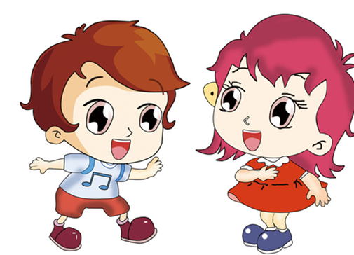
Ask and answer
I…
How often do you help with housework?
What do you usually do on weekends?
I …

Slide 20
How often does your best friend
exercise, Alice ?
She ...
What does your cousin do after school?
He ...

Slide 21
Then ask and answer them with a partner.
My partner’s answers：
1. I always help with housework.
2. I usually surf the Internet.
3. He does exercise everyday.
4. He usually does my homework after school.

Slide 22


3c What can you do to improve your
English?
read English books
sing English songs

Slide 23
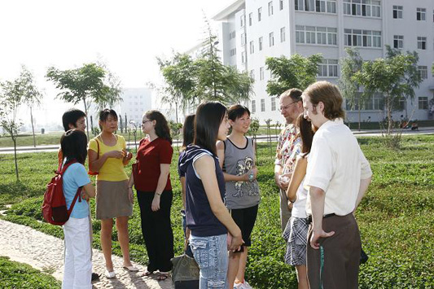
speak English with foreigners

Slide 24
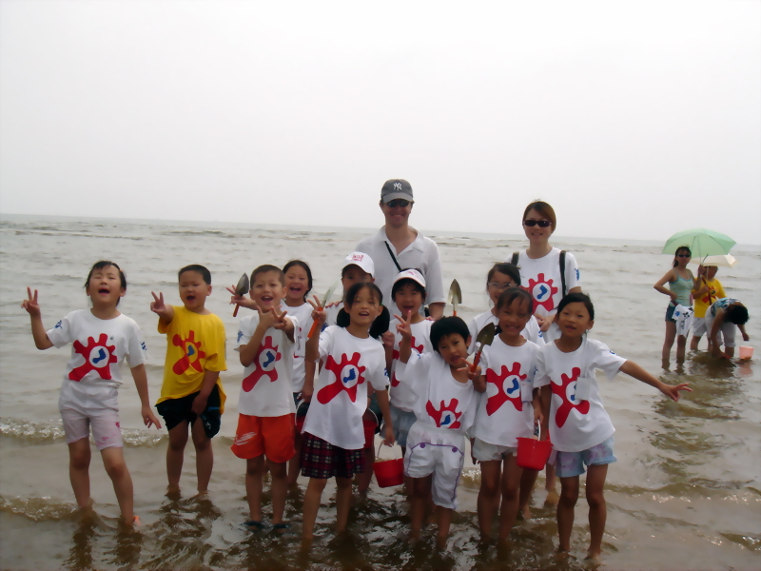
join the summer camp

Slide 25

watch English movies

Slide 26

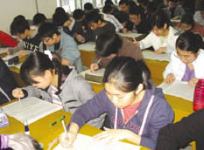
read English
newspapers
do some English
exercise

Slide 27
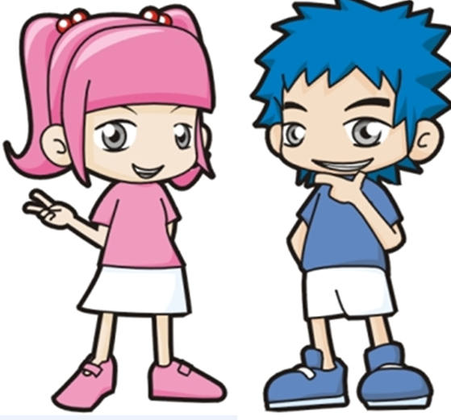
How often do you read English books, Lin Ying?
I read English books about twice a week.
How often do you …?
...

