Slide 1
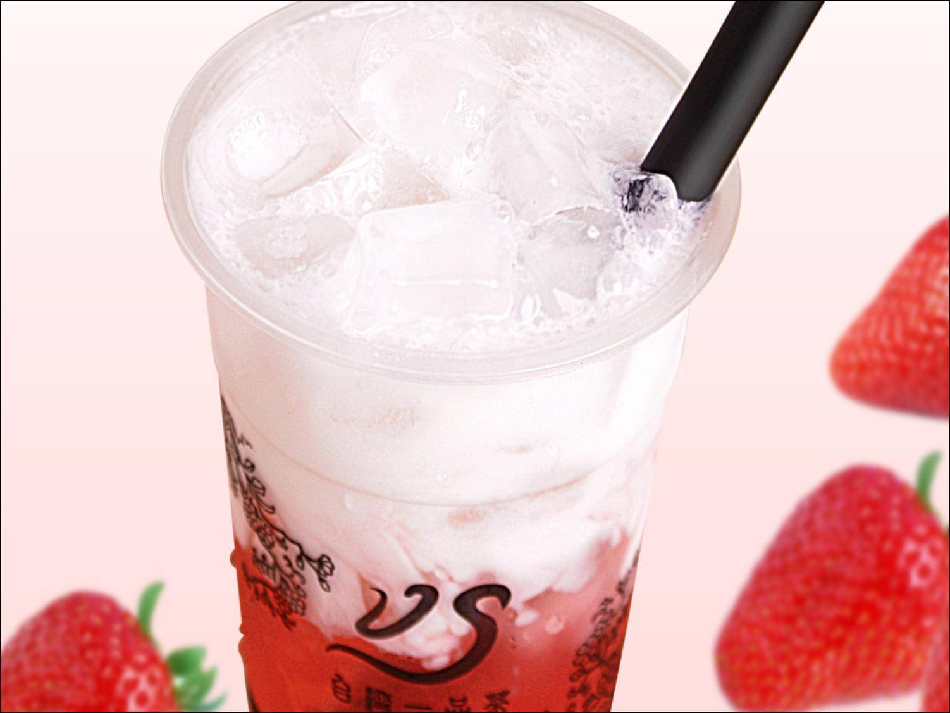
Unit 8
How do you make a banana milk shake?

Slide 2
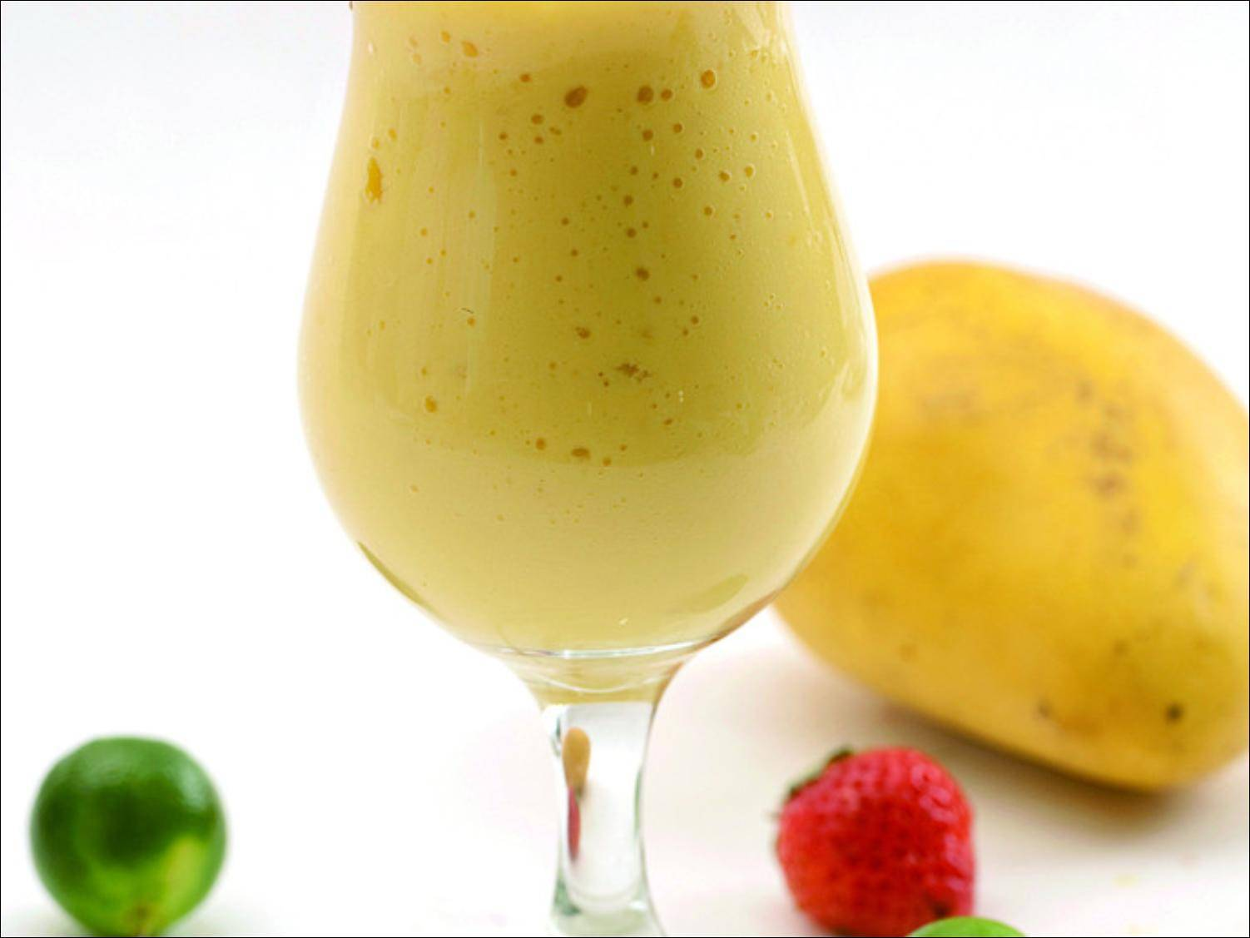
Section B
(2e-Self Check）

Slide 3

Revision
Fill in the blanks with the right words.
Thanksgiving is a s_____ holiday in the U.S.A. It always on the f_____ Thursday in November. There are many r______ for this special day. For some people, it is a time to give thanks for food in the a______. At this time people also remember the first t_______ from E______ about 500 years ago. These days most Americans still have a big meal at home to c_______ it. The main dish of this
pecial
ourth
easons
utumn
raveler
ngland
elebrate

Slide 4
urkey
meal is almost always t_____.
How to make a turkey dinner?
First, m__ together some bread pieces, onions, salt and pepper. F__ the turkey with this bread mix.
Next, put the turkey in a hot oven and c____ it for a few hours. Then, place the turkey on a large plate and c____ it with gravy.
F_____, serve it to your friends with some other food.
ix
ill
ook
over
inally

Slide 5
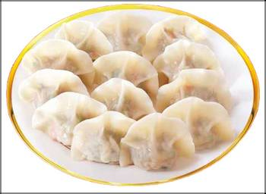
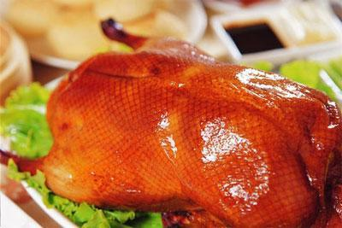
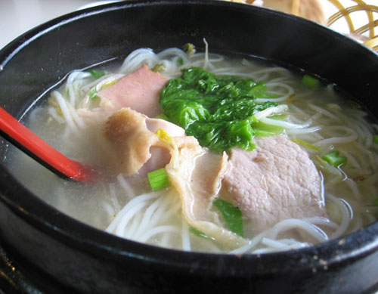
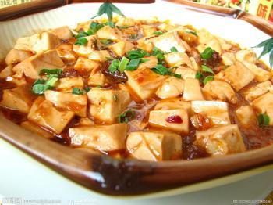
Lead-in
Do you know the traditional food in your city? Can you list some of them?
dumplings
Beijing Duck
Yunnan Rice Noodles
mapo tofu

Slide 6
Discussion
2e
What do you think is the most special day in China? Answer the following questions.
1. When is this special day?
It’s Dragon Boat Day.
2. What are the reasons for this special day?
Do people give thanks for anything on this
day?
Do people remember anything or anyone
on this day?

Slide 7
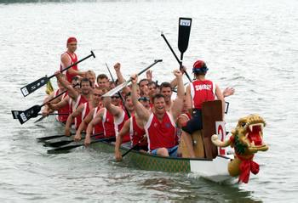
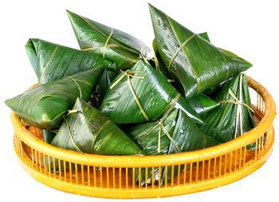
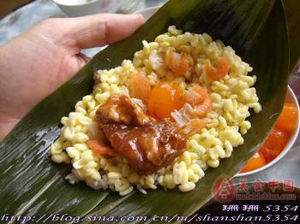
In order to remember the famous poet
Qu Yuan.
3. How do most people celebrate
this day?
People eat zongzi and
have boat races.
4. Is there any traditional food?
What are the main dishes?
Yes, there is. The main
dishes are zongzi.
5. Can you make these dishes?
Yes, I can.

Slide 8
3a
Reading
Read the recipe below and fill in the blanks with the words in the box.
写作指导：
首先，掌握方框中单词的含义；并阅读短文，整体把握短文大意。
其次，分析有空格的每个句子，根据上下文意及固定搭配来确定空格处的意思，从而确定空格处所用的单词。
最后，再通读一遍短文，检查是否正确。

Slide 9
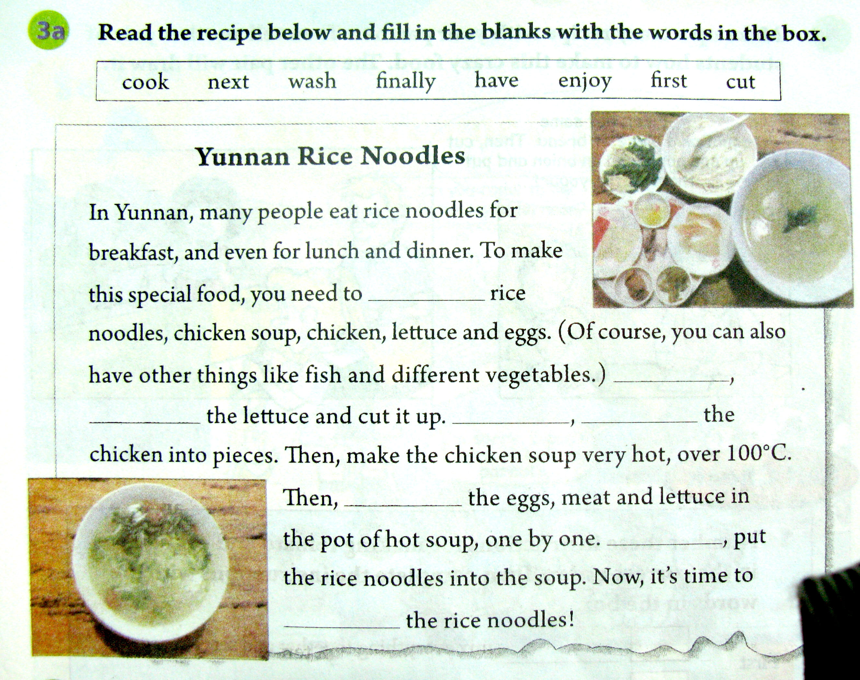
have
First
wash
Next
cut
cook
Finally
enjoy

Slide 10
3b
Think of a favorite food in your hometown. Make a list of ingredients.
For example: Beijing Duck
pieces of ducks
sauce and green onion
调味汁;酱汁
some lettuce
some pancakes

Slide 11
Write a recipe for your favorite food. Use 3a and 3b to help you.
3c
写作指导：
本文为写自己所喜欢的食物的食谱。因此，时态应用一般现在时态；
先根据3b中的所列的原料清单，说明做此食物所需的原料。
然后，描述一下制作此食物的过程。注意使用first, next, then, finally等表示做事情的次序的副词来使描述更清晰明确。

Slide 12
Example
We need some pieces of Beijing Duck, sauce and green onion, some lettuce and some pancake.
First, put the green onion and some sauce on the pancake.
Next, put some pieces of duck on it.
Then role the pancake and eat it.

Slide 13

4
Group work
Make up a crazy recipe with your partner. Then tell another pair of students how to make this crazy food. The other pair will draw it.
First, put some yogurt on a piece of bread. Then, cut up one apple and an onion and put them on the yogurt…

Slide 14
Self Check
1. Number these instructions for
making tomato and egg soup in
the correct order. Then complete
the instructions with the words in
the box.
First Next Then Finally

Slide 15
3
_______, mix everything together and
serve it.
______, cook for five minutes and add
two eggs.
______, cut up three tomatoes and put
them into a pot.
______, add some water, sugar and salt.
Finally
4
Then
1
First
2
Next

Slide 16
理解句意：
将所有东西搅合在一起然后可以吃了。
煮五分钟后放入两个鸡蛋。
将三个西红柿切碎，并将其放入锅内。
加入一些水、糖和盐。
由生活常识可知做西红柿汤的过程为：4，3， 1 ，2
因此，空格处应填：
Finally, Then, First, Next

Slide 17
2. Write questions and answers
using the words in brackets.
指导
1. 根据要求可知第一句为疑问句，特殊疑
问句的结构为“特殊疑问词+ 一般疑问
句？”故应先看其有没特殊疑问词。
2. 如没有特殊疑问词，则为一般疑问句，
则应根据句子的谓语动词来确定将 be动词还是助动词放在句首。

Slide 18
1. 特殊疑问词how many；谓语动词need。
make cake前加不定式做目的状语。
Q: How many eggs do we need to make
cake?
A: We need two.
2. 特殊疑问词how much；谓语动词need。
Q: How much milk do we need?
A: We need three cups.

Slide 19
3. 无特殊疑问词；谓语动词have to add。
因此应将助动词do提前。
Q: Do we have to add sugar or honey?
A: We can add two spoons of sugar.

Slide 20
Exercises
翻译。
1 剥,削 ________
2 倾倒________
3 打开________
4 一份香蕉奶昔 ________________________
5 一杯酸奶 ____________________
peel
pour
turn on
a banana milk shake
a cup of yogurt

Slide 21
下面是制作香蕉奶昔的过程,按先后顺序填入
正确的动词或短语。
1 ___________ three bananas.
2 ________ the bananas.
3 ________ the bananas and ice cream into
the blender.
4 ________ the milk into the blender.
5 ________ the blender for about three
minutes.
Peel
Cut up
Put
Pour
Turn on

Slide 22
Fill in the blanks.
1. —_______ _______ bananas do you buy?
—Three kilos.
2. —_______ _______ bread do we need?
—Three pieces.
3. _______ _______ (not play) computer
games, Jack!
How many
How much
Don’t play

Slide 23
4. There is an orange on the table.
(对画线部分提问)
_______ _______ oranges are there
on the table?
5. _______ _______ tomato sauce is
there in the bottle?
How many
How much

Slide 24
Homework
想一想，你在家里最喜欢吃的一道菜。了解一下它的做法，用英语将做这个菜所需的材料以及简单的过程用英语描述出来。

Slide 25
Thank you!

