Slide 1
R·九年级全一册
Unit 9 I like music that I can dance to.
第一课时

Slide 2
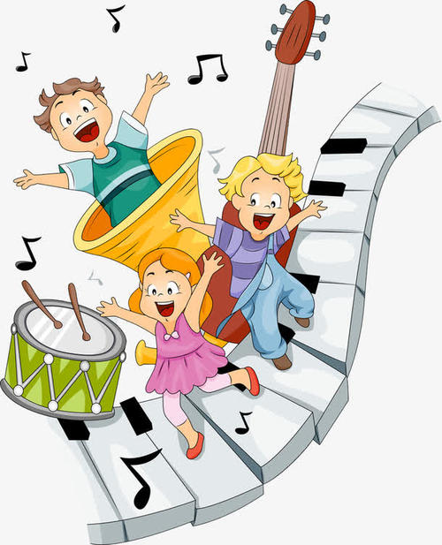
Lead in
What kind of music do you like?

Slide 3
lyrics
song

Slide 4
Language points
一、prefer的用法
I like elegant music better.
I prefer elegant music.
1. prefer = like…better，意为“更喜欢”。

Slide 5
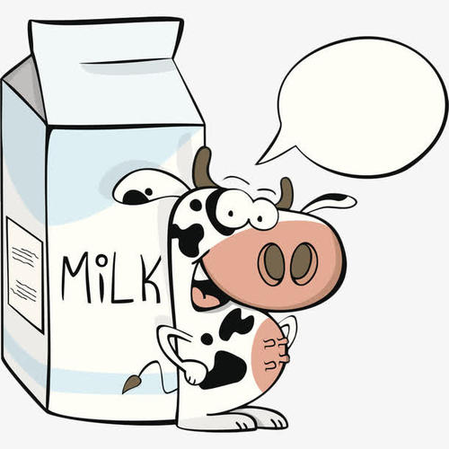
2. prefer A to B. / prefer doing A to doing B.
与（做）B 相比更喜欢（做）A。
I prefer water to milk.

Slide 6
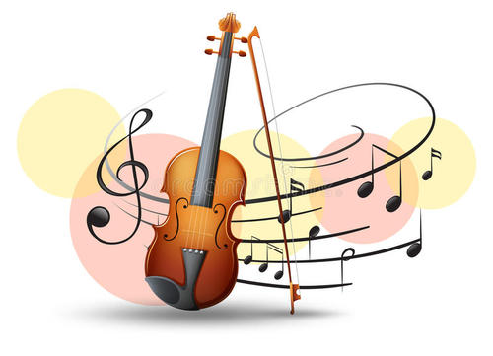
3. prefer to do sth. 更喜欢/宁愿做某事。
He prefers to listen to gentle music.

Slide 7
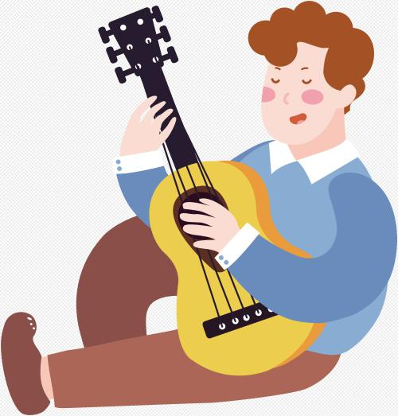
4. prefer sb to do sth.宁愿/更希望某人做某事。
We prefer you to play the guitar.

Slide 8
5. prefer to do A rather than do B
= would rather do A than do B.
宁愿做A而不愿做B。
I prefer to read rather than write.
= I would rather read than write.

Slide 9
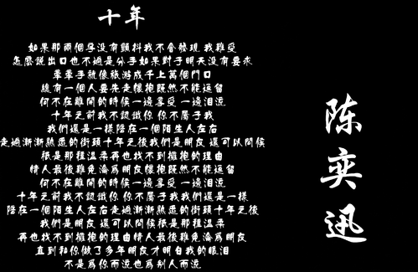
has great lyrics
I prefer music that __________________.

Slide 10
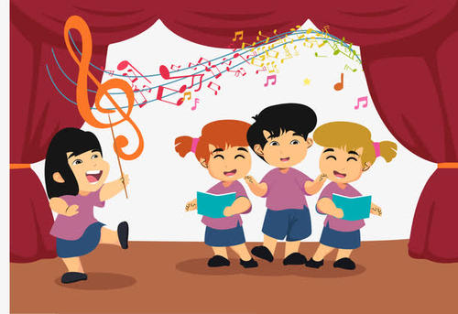
I can sing along with
I prefer music that ______________________.

Slide 11
isn’t too loud
I prefer music that ________________.

Slide 12
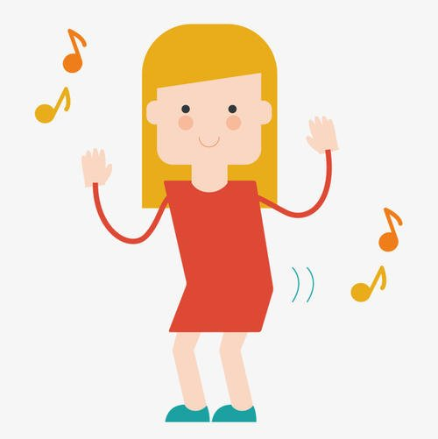
I can dance to
I prefer music that __________________.

Slide 13
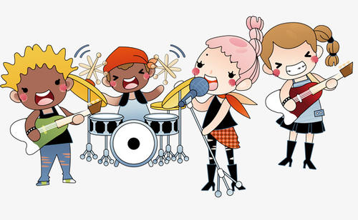
makes me excited
I prefer music that ________________.

Slide 14
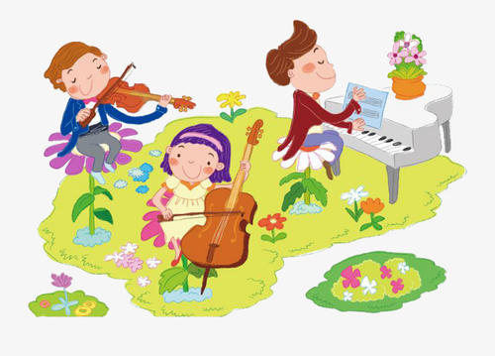
is elegant
I prefer music that __________________.

Slide 15
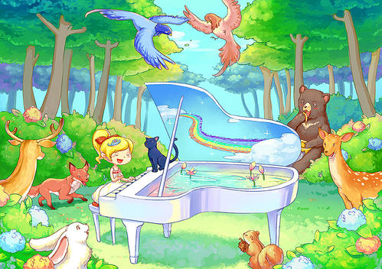
is natural and plain
I prefer music that ________________.

Slide 16
二、定语从句
这是一个定语从句。
作定语，修饰music
I prefer music that has great lyrics.
先行词
引导词
引导定语从句
在从句中作主语

Slide 17
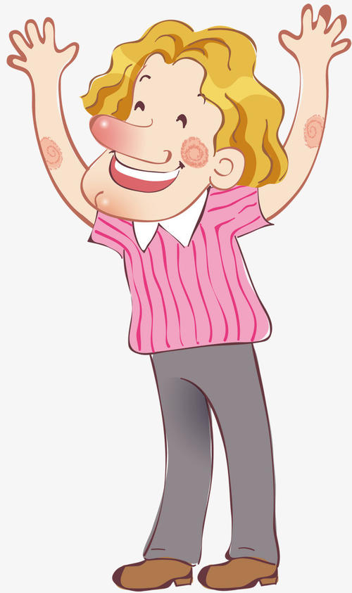
What kind of music do you like?
I like music that I can sing along with. What about you?
I prefer music that has great lyrics.

Slide 18
Carmen likes musicians who play different kinds of music.
作定语，修饰 musicians
different kinds of 意为“不同种类的”。后面接复数形式的名词。

Slide 19
【拓展】
kind
of
all
kinds of
What
kinds of
a
kind of
kind
有点儿；稍微
各种各样的
什么种类
一种

Slide 20
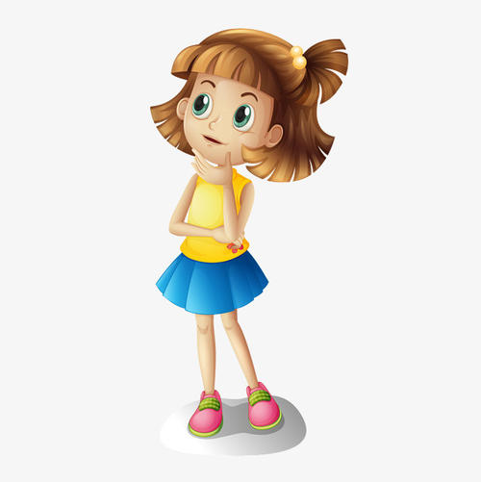
What kind of movies do you like?
I prefer movies that give me something to think about.

Slide 21
三、think about的用法
think about 意为“考虑；思考”，是固定短语，其后可跟名词、代词或动词-ing形式作宾语。

Slide 22
【拓展】
think about 与think of 这两个短语表示“考虑，对……有某种看法”时，可以互换。
think of 表示“想出（主意、名字、建议等）、想起、关心”时，一般不和think about 换用。

Slide 23
Practice
1. —I prefer sports shows _____ soap opera.
What about you?
—Me, too.
A. at B. than C. to D. of
C

Slide 24
Summary
1. prefer = like…better
prefer A to B. / prefer doing A to doing B.
prefer to do sth.
prefer sb to do sth.
prefer to do A rather than do B= would rather do A than do B.
2. different kinds of
3. think about

Slide 25
THANKS

