Slide 1
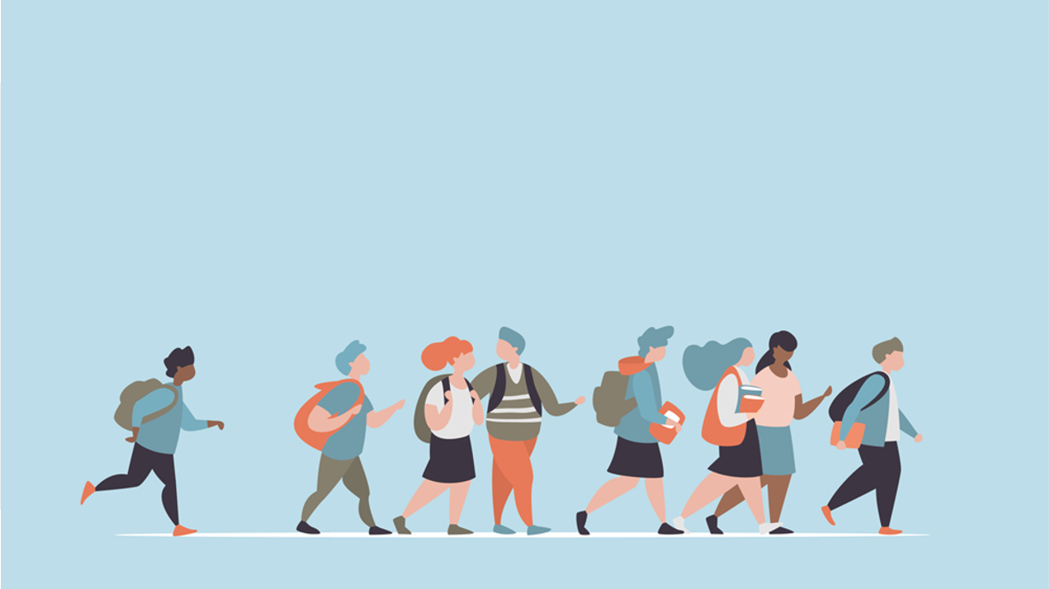
R·九年级全一册
Unit 4 I used to be afraid of the dark.
第一课时

Slide 2
Lead in
How do you describe yourself or others?

Slide 3
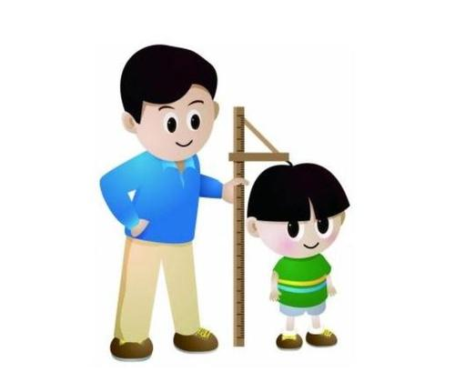
short
tall

Slide 4
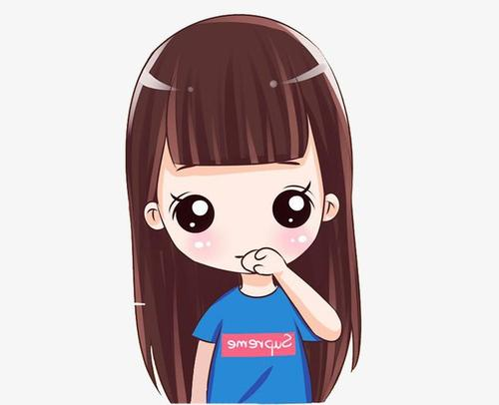
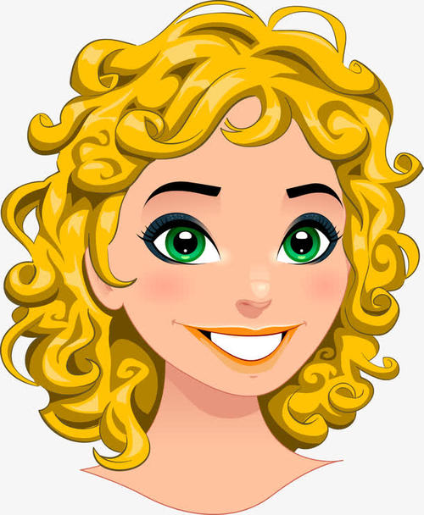
straight hair
curly hair

Slide 5
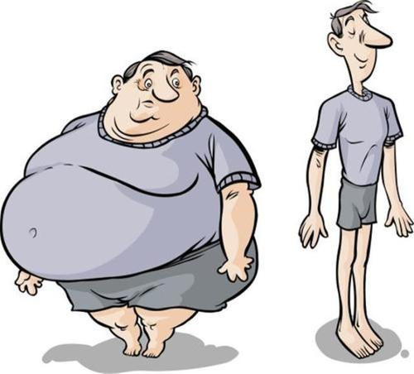
thin
fat

Slide 6
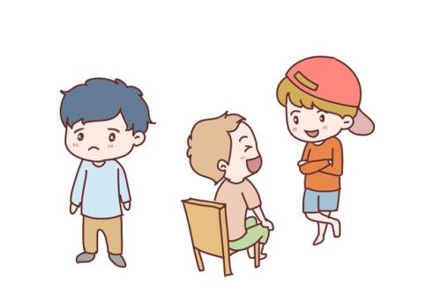
outgoing
shy

Slide 7
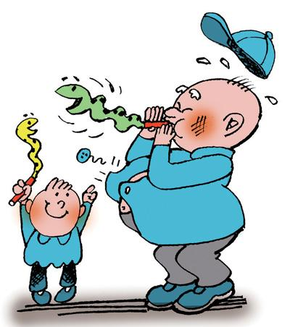
young
old

Slide 8
Classify
short
tall
young
old
状元成才路
straight hair
funny
fat
shy
状元成才路
状元成才路
状元成才路
状元成才路
serious
outgoing
friendly
状元成才路
状元成才路
状元成才路
状元成才路
状元成才路
状元成才路
状元成才路
thin
smart
curly hair
状元成才路
long hair
a medium body
unfriendly
Appearance
Personality

Slide 9
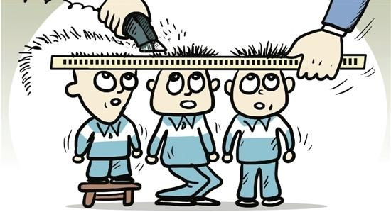
Language points
I used to have long hair.
Now I have short hair.

Slide 10
一、used to 过去经常、以前常常
表示__________________ 或者______________ ____________的______或者_____，并意味着
这种动作 _______________，所以它只能用
____________，不能用现在时态。
used to + 动词原形。
过去存在某种状态
过去的某种经常
状元成才路
状元成才路
状元成才路
状元成才路
行为
动作
状元成才路
性、习惯性
状元成才路
状元成才路
状元成才路
状元成才路
状元成才路
状元成才路
状元成才路
目前已经不存在
状元成才路
一般过去时

Slide 11
1. 肯定句式
主语＋ used to ＋动词原形...
I used to go to the cinema, but I never have time now.
sb. used to do sth.

Slide 12
2. 否定句式
used当作实义动词
A) 主语＋did not use to ＋动词原形……
He did not use to wear glasses, but he wears now.

Slide 13
B) 主语＋ used not to ＋动词原形……
used not 可以缩写成 usedn’t
used当作情态动词
He used not to wear glasses.

Slide 14
3. 疑问句式
A) Did＋主语＋use to＋动词原形...？
B) Used＋主语＋to＋动词原形...？

Slide 15
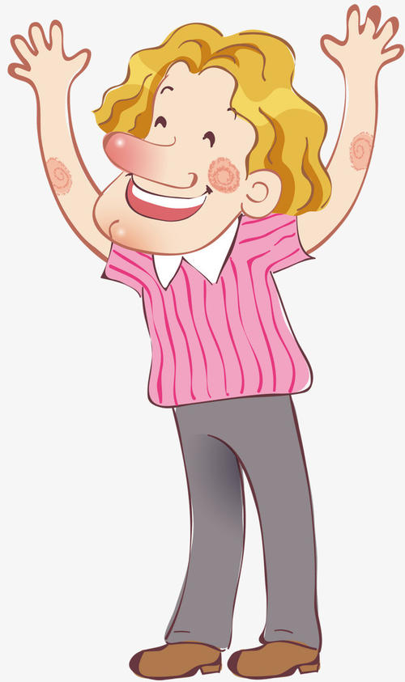
American Style
Did you use to be short?
Yes, I did. I used to be short, but I'm tall now.

Slide 16
English Style
Used you to be short?
No, I usedn't. I used to be tall.

Slide 17
4. 反意疑问句
主语+used to do sth, didn’t +主语?/ used not+主语?
You used to be a teacher, didn’t you?/ used not you?
He used to watch a lot of TV, didn’t he?/used not he?

Slide 18
American Style
You used to be a teacher, didn't you?
Yes, I did. I used to be an English teacher.

Slide 19
English Style
He used to play the piano, usedn't he?
Yes, he used to. And he still plays the piano now.

Slide 20
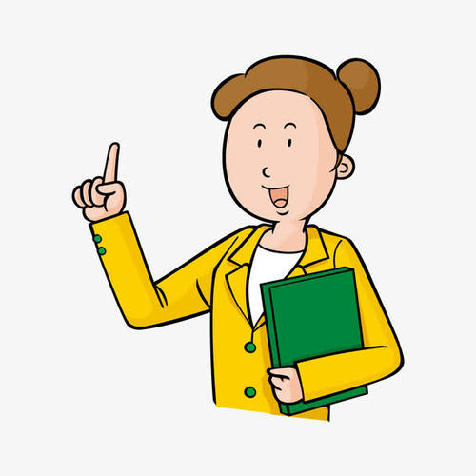
Let's talk
How about you? Talk about what you used to be like.
I used to _____________.

Slide 21
Practice
1. —_____ your father _____ take you to concerts?
—Yes, he did.
A. Did; used to B. Did; used for
C. Did; use for D. Did; use to
D

Slide 22
2. —______ you ______ to play the guitar?
—Yes. But now I play the piano.
A. Did; used B. Did; use
C. Are; used D. Were; use
B

Slide 23
Summary
I/ He/ She/ They used to _________,
I/ He / She / They _________.
but now
appearance
personality
interest
outgoing
sing
height
quiet
dance
hair
build
shy...
draw...

Slide 24
THANKS

