Slide 1
Unit 11

Slide 2
Unit 11
How was your school trip?

Slide 3
Section A 1
1a-2d

Slide 4
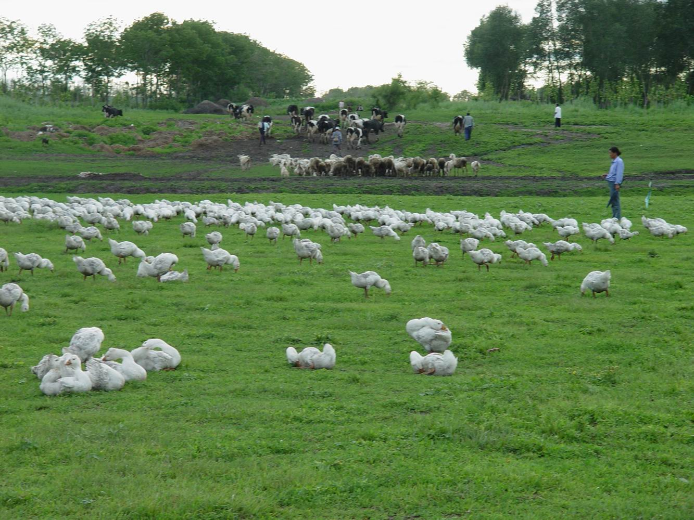
Look at the picture.
This is a farm. Last week Carol and his classmates had a school trip. They went to the farm.
What did they do on the farm?
How was their school trip?

Slide 5
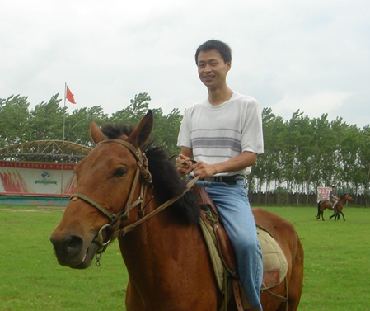
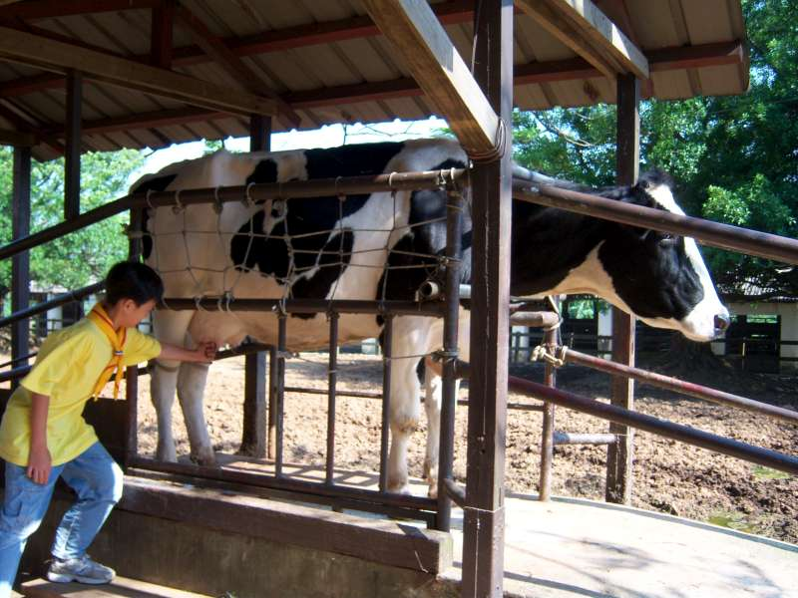
What did he do on the farm?
He rode a horse.
Did he ride a horse?
Yes, he did.
Did he milk a cow?
Yes, he did. He milked a cow.

Slide 6
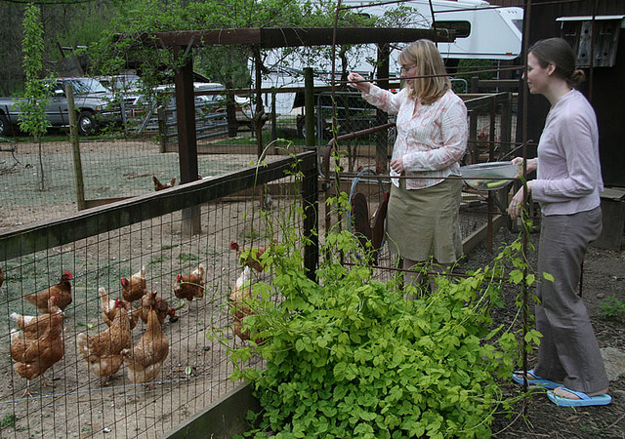
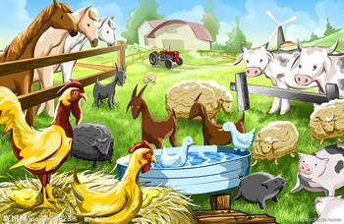
Did she ride a horse?
No, she didn’t.
Did she feed chickens?
Yes, she did. She fed chickens.
Did they go to the zoo?
No, they didn’t. They went
to a farm.
Did they see any cows?
Yes, they did. They saw quite a lot.

Slide 7
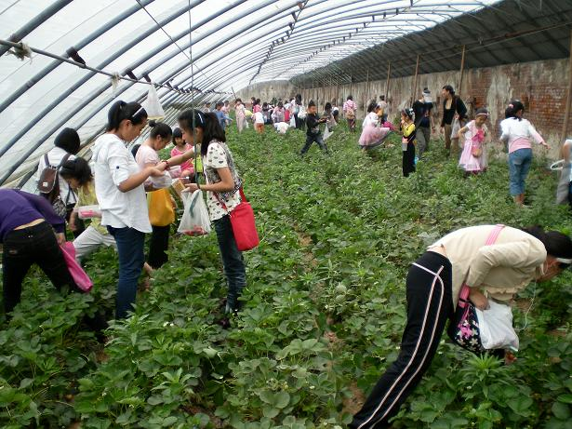
Did they pick any strawberries on the farm?
Yes, they did.
How were the strawberries?
They were delicious.
Were the strawberries good?
Yes, they were.
No, they weren’t.
How was their school trip?
It was great.

Slide 8
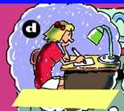
A: What ___ she do
yesterday?
did
B: She _____ to the movie.
went
A: What ____ she do last
night?
did
B: She ___ her homework.
did

Slide 9
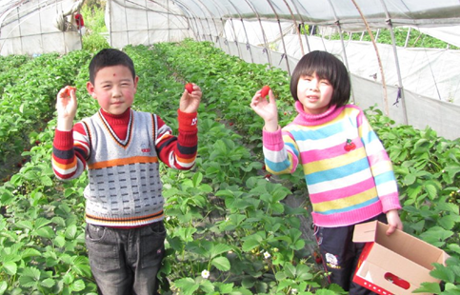
What did you ___ last weekend?
do
We ____________________
visited the fire station.
How ___ your trip last weekend? It was boring.
was
What did they ___ last weekend?
do
They ______________________
picked some strawberries.
How ____ the strawberries?
They were delicious.
were

Slide 10
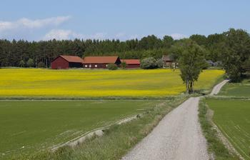
What did you do last month?
I _____ to the countryside.
How ____ the countryside?
It was beautiful.
____ you go to the zoo?
No, I didn’t.
went
was
Did

Slide 11
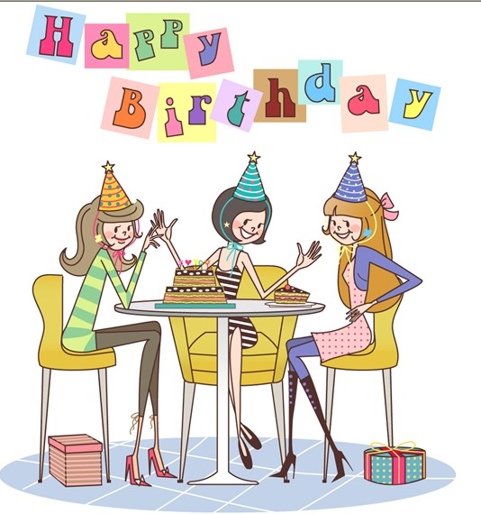
What ___ they do 3 days ago?
did
They __________ with their friends.
How ___ their party?
It was exciting.
had a party
was

Slide 12
Past 过去
Present 现在
rode a horse
fed chickens
did homework
went to the movie
picked strawberries
milked a cow
ride a horse
feed chickens
do homework
go to the movie
pick strawberries
milk a cow

Slide 13
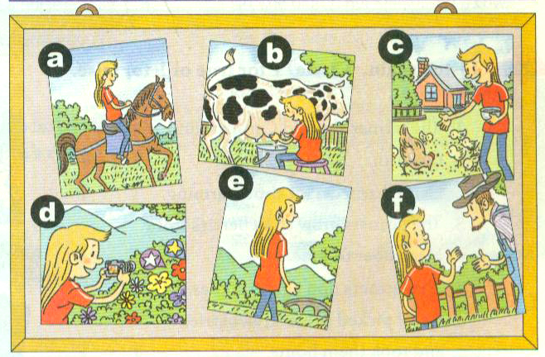
1a Match the phrases with the pictures.
went for a walk milked a cow
rode a horse fed chickens
talked with a farmer took some photos
e
b
a
c
f
d

Slide 14
1b Listen to the tape and answer the
question.
Where did Carol go on her school trip?
She went to a farm.

Slide 15
1b Listen and circle the three things
Carol did on her school trip in 1a.
went for a walk milked a cow
rode a horse fed chickens
talked with a farmer took some photos

Slide 16
1c Ask and answer questions
about Carol’s school trip.
A: Did Carol take any photos?
B: Yes, she did.
A: Did Carol ride a horse?
B:
A: Did Carol talk with the farmer?
B:

Slide 17
Language points
1. Did you see any cows? Yes, I did. I saw quite a lot.
quiet a lot + of + 可数或不可数, 也可以单独使用。 quite a little “相当多, 不少” + 不可数名词 quite a few “相当多, 不少” + 可数名词

Slide 18
e.g. We drank quite a lot of wine.
我们喝了不少酒。
I saw quite a lot of cows.
我看到了相当多的奶牛。
I play tennis quite a lot in the summer.
夏天我经常打网球。
Quite a few students were late.
不少学生迟到了。

Slide 19
2. Did Carol take any photos? 卡罗尔拍照片了吗？
take与photo, picture等词搭配时，表示“拍摄，摄影”。表示“拍摄某物或人”，就要在短语后面接介词“of”引入所拍摄的对象。
e.g. The girl likes to take photos of herself
with her cell phone.

Slide 20
We know that Carol and her classmates went to the farm for their school trip. Do you want to know more about her trip and do you have more questions about the trip? Try to give your questions.
1) Did she have a good time?
2) Was she happy?
3) What did she see?
4) Did she ride a horse?

Slide 21
2a Listen and check the questions
you hear.
What did the farmer say?
Did you grow any apples?
What did you see?
Do they grow apples?
Did you learn anything?
Did you eat them?
Did you ask him any questions?
Were they good?
√
√
√
√

Slide 22
注意：
Do they grow apples? 农民是否通常种植苹果，属于经常性的情况。其他问句都是问发生在过去的农场之行的所见所闻。

Slide 23
anything
◆anything作不定代词，可意为“某事；某东西”，常用在疑问句或否定句中。something作不定代词，也可意为“某事；某东西”，常用在肯定句中。如：
I didn’t see anything in the room.
我在屋子里什么也没看见。
I saw something in the room.
我在屋里看见了个东西。

Slide 24
◆anything作不定代词，还可意为“任何东西；任何事”。如：
I’m hungry. I’ll eat anything.
我饿了，随便吃什么都行。

Slide 25
将下列句子翻译成汉语。
1. The teacher didn’t say anything in the
class.
老师在班里什么也没说。
2. I want to eat something. Anything is
OK.
我想吃点东西，什么都行。
3. We can do something to help him.
我们可以做点事帮助他。

Slide 26
Phrases of 2b
show (showed) sb. around 带…...四周转转
grow (grew) strawberries 种草莓
from… to…从……到……
pick (picked) strawberries 摘草莓
take (took) sth. home 带……回家

Slide 27
2b Listen again. Circle T for true or F
for false.
1 The farmer showed Carol around the farm. T F
2 Carol learned a lot about farming. T F
3 The farmers grow strawberries from December
to June. T F
4 The farmers don’t grow apples. T F
5 Carol picked some strawberries
and took them home. T F

Slide 28
2c Ask and answer questions about
Carol’s visit to the farm.
A: What did Carol do?
B: She picked some strawberries.
A: Was the farmer friendly?
B:
A: What did Carol see?
B:

Slide 29
Practice
A: How was your school trip?
B: It was … (boring/interesting/good/great…)
A: What did you do on the school trip?
B: I went for a walk with my classmates.

Slide 30
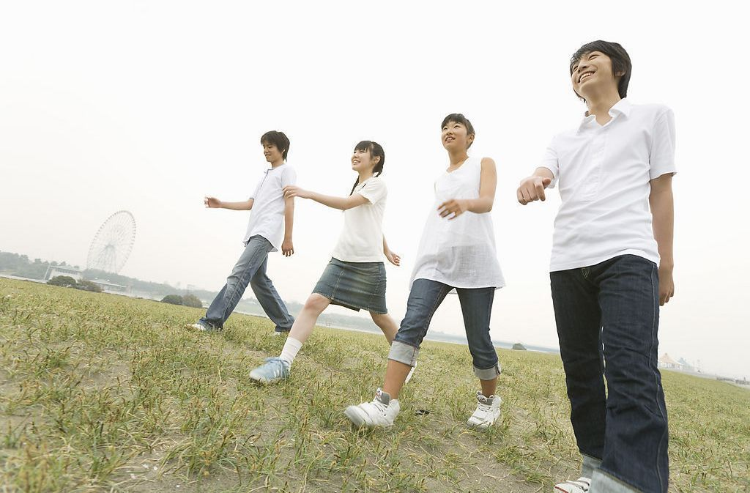
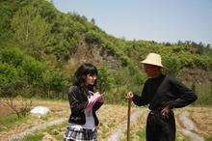
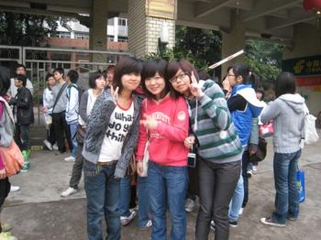
went for a walk
milked a cow
rode a horse
fed chickens
talked with a farmer
took some photos

Slide 31
2d Read the conversation and
answer the questions.
Where did Eric go last weekend?
He went to the countryside.
Why did he go there?
He visited his grandparents.
What did he do?
He went fishing and fed the chickens.
How was the weather there?
It was great and the air was so clean.

Slide 32
What did he do at night?
He watched the stars.
How did Eric feel about the trip?
It was excellent.

Slide 33
2d Role-play the conversation.

Slide 34
Groupwork
Make a survey. Ask your partners what they did last week. Then give a reporter.
A: Hi, Lin Fei. What did you do last
weekend?
B: I watched TV, and then I went fishing
with my father.
A: How was your last weekend?
B: It was great.

Slide 35
In my group, A watched TV and went fishing. His weekend was interesting. B…

Slide 36
Language points
1. I visited my grandparents in the
countryside.
名词country和countryside都有“乡下；农村”的意思，往往与限定词“the”搭配连用，尤其是country。
e.g. We spent a pleasant day in the country.
但country可用作形容词，置于名词前做定语，而countryside一般不这么用。如：
country music, country road。

Slide 37
2. It was so much fun.
fun表示“有趣的事情”，为不可数名词。
e.g. Look, Peter. The children are having
so much fun.
3. Lucky you! 你真幸运！
这是一句非正式口语，相当于You’re so lucky.
Lucky之后的人称还可以改为me, him。

Slide 38
小试身手
I. 用适当的词填空。
1. How ___ your school trip? It was great.
2. How _____ you yesterday?
3. Today is Monday. Yesterday ____ Sunday.
4. What ___ you do the day before yesterday?
____ you ride a horse last week?
was
were
was
did
Did

Slide 39
6. ____ he see any cows on the farm? Yes, he did.
7. Did he milk a cow on the farm? No, he ______.
8. Were the strawberries good? Yes, they _______.
9. Did you see any cows?
Yes, I did. I ___ quite a lot.
10. I ___ the chickens last week.
Did
didn’t
were
saw
fed

Slide 40
根据汉语意思完成下列英语句子或对话，每空一词(含缩略形式)。
1. 杰克昨天在公园里散步了。
Jack ____ __ __ ____ in the park yesterday.
2. 你和那位农民谈话了吗？
____ you ____ ____ that farmer?
3. 我们在农场上看到许多猪。
We saw ____ __ ___ __ pigs on the farm.
went for a walk
Did talk with
quite a lot of

Slide 41
4. —约翰午饭吃面条了吗？
—不，他没有。
—____ John _____ noodles for lunch?
—No, __ ______.
5. —你买了一些苹果吗？
—是的，我买了。
—____ you ____ ____ apples?
—Yes, __ ____.
Did have
he didn’t
Did buy any
I did

