Slide 1
Unit 4
Everyday economics

Slide 2
内容索引
Period Five Writing—Writing an argumentative paper
技法点拨 文体分析 把握写作动脉
写作训练 弄清文路 写作妙笔生花

Slide 3
技 法 点 拨
文体分析 把握写作动脉
写作指导
议论文以说理为主要表达方式，针对某个问题、某种现象或某个事件进行分析、评论，从而剖析事物、论述事理、发表见解、提出主张。写作步骤一般为：
1.确定时态、人称
议论文中的时态较为统一，多用现在时；人称多为第一、三人称。
2.构思提纲
文章可分为三段，即：呈现现象、阐述理由、从正面总结观点。
(1)呈现现象：注意要开门见山，不要拖泥带水。
(2)表明观点并阐述理由。就题目中的问题表明观点，提出若干理由，增强说服力。

Slide 4
(3)从正面总结观点。结论段可用一两句话来结束文章，同时要注意与上文呼应，但不能在句式及用词方面照搬前文。
3.拓展提纲，充实内容
运用准确的词汇和正确的句式来拓展主题，组织篇章。行文时层次要清楚，多使用有辩论、推理等含义的连接和过渡性词汇，以便增强文章的条理性和逻辑性。

Slide 5
常用表达
1.引入：
(1)With the development of ...
(2)I agree with...
(3)I am in favor of...
(4)I can’t agree more.
(5)I’m against it.

Slide 6
2.阐述：
(1)As far as I’m concerned，...
(2)For one thing...，for another thing...
(3)Moreover.../What’s more...
(4)However.../Instead...
(5)...is of great value...
(6)As a matter of fact...

Slide 7
3.总结：
(1)In my opinion...
(2)If everyone...，we can....
(3)It’s good to...
(4)Only by...can we...
返 回

Slide 8
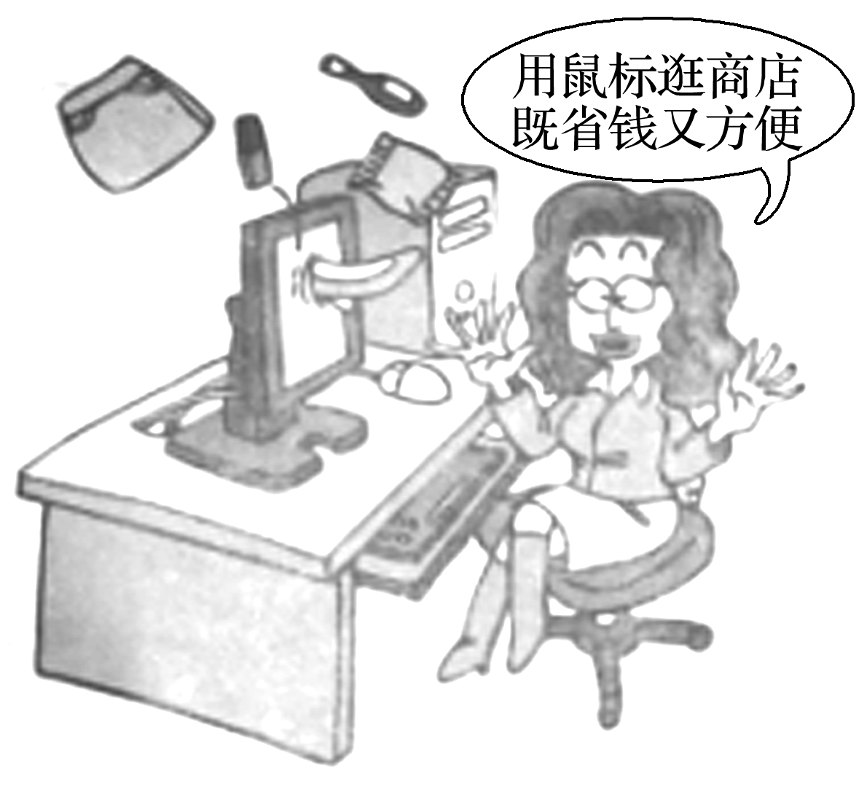
写 作 训 练
弄清文路 写作妙笔生花
下面这幅图片反映了现在日渐盛行的一种购物方式——网上购物，请你结合图片内容，写一篇80词左右的英语短文，谈谈你对网上购物的看法，并陈述自己的理由。

Slide 9
审题谋篇
审题
1.确定文体：议论文；
2.主体时态：一般现在时；
3.主体人称：第一人称和第三人称。

Slide 10
谋篇
第一段：提出话题或现象；
第二段：通过科学的分析，合理的论证，剖析自己的观点并陈述理由，达到说服读者的目的；
第三段：总结论点。

Slide 11
遣词造句
核心词汇
1.随着……的发展
2.对……非常有益
3.说实话
4.在网络上
5.上网
with the development of
be of great benefit to
to tell the truth
on the Internet
surf the Internet
_____________________
__________________
______________
_____________
_______________

Slide 12
连词成句
1.通过互联网人们不必出门就可以购买自己想要的东西。(what宾语从句)
People can buy through the Internet without going out.
2.这给他们带来了更多的便利。(bring sb. sth. )
This .
3.他们可以通过上网购买顶级品牌。(by doing...)
They can shop for the top brands .
4.在互联网上，新品牌一登广告，他们就可以选择自己需要的产品。(immediately)
On the Internet，they can choose what they need
.
what they want
brings them more convenience
by surfing the Internet
immediately the new brands
are advertised

Slide 13
5.说实话，我现在几乎是在网上购买所有我需要的东西。
To tell the truth， on the Internet now.
I buy almost everything I need

Slide 14
句式升级
1.将句1和句2用定语从句连接起来
2.将句3和句4用定语从句连接起来
3.用强调句型改写句5，强调地点状语
People can buy what they want through the Internet without going out, which
brings them more convenience.
They can shop for the top brands by surfing the Internet，where they can
choose what they need immediately the new brands are advertised.
To tell the truth，it is on the Internet that I buy almost everything I need now.

Slide 15
组句成篇
用适当的过渡词语，把以上词汇和句式，再加上联想内容，组成一篇80词左右的英语短文。

Slide 16
参考范文
With the development of the Internet，shopping on the Internet is becoming more popular.People can buy what they want through the Internet without going out，which brings them more convenience.
Shopping on the Internet is of great benefit to the customers.First，they can shop for the top brands by surfing the Internet，where they can choose what they need immediately the new brands are advertised.Second，they can get the goods at the best prices.
In my opinion，it is good to shop on the Internet.To tell the truth，it is on the Internet that I buy almost everything I need now.
返 回

Slide 17
本课结束

