Slide 1
Unit 7
Will people have robots?

Slide 2
Grammar Focus
People will have robots.
will 表示将要发生的动作。
否定式： will not = won’t
一般疑问句： Will people have robots?
回答： Yes, they will . No, they won’t.

Slide 3
Grammar Focus
fewer less more
fewer 更少的 修饰可数名词
less 更少的 修饰不可数名词
more 更多的 可以修饰可数和不可数名词

Slide 4
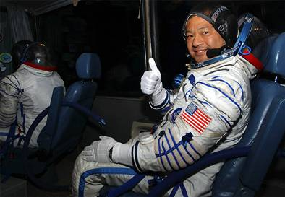
New words
astronaut 宇航员

Slide 5
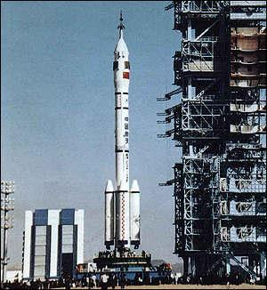
New words
rocket 火箭

Slide 6
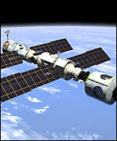
New words
space station 太空站

Slide 7
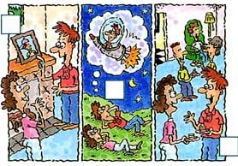
Listen to Alexis and Joe. Number the pictures 1-3.
2
3
1

Slide 8
’ll live am ’ll fly took
work ’ll be lived live
I in an apartment.
I near here.
I a computer programmer.
We in a house.
I the train to school.
I an astronaut.
I rockets to the moon.
I on a space station.
live
work
am
lived
took
’ll be
’ll fly
’ll have

Slide 9
In ten years, I think I’ll be a reporter. I’ll live in
Shanghai, because I went to Shanghai last year and
fell in love with it. I think it’s really a beautiful city.
As a reporter, I think I will meet lots of interesting
people. I think I’ll live in an apartment with my best
friends, because I don’t like living alone. I’ll have pets,
I can’t have any pets now because my mother hates
them, and our apartment is too small.

Slide 10
So in ten years, I’ll have many different pets. I
might even keep a pet parrot! I’ll probably go
skating and swimming every day. During the week
I’ll look smart, and probably will wear a suit. At the
weekends, I’ll be able to dress more casually. I think
I’ll go to Hong Kong on vacation, and one day I might
even visit Australia.

Slide 11
New words
suit
able
be able to
dress
casually
which
even
一套衣服
能够，有能力的
能够……；得以
穿衣
非正式的；随意的
哪个；哪几个
甚至
落下；跌落
孤独地；单独地
宠物
鹦鹉
可能，也许
去滑冰
fall
alone
pet
parrot
probably
go skating

Slide 12
In ten years
Job | Pets | Sports | Places | Clothes
parrot
smart
clothes
skating
swimming
Shanghai
HongKong
Australia
reporter
suit

Slide 13
Game
This paper says “ I’ll be an engineer in
ten years.”
I think Lin Wei wrote that.
Yes, I wrote it.

Slide 14
SELFCHECK
wear work look fly keep
I want to for myself when I’m older.
My friends a pet pig in their house.
I need to smart for my job interview.
We have to a uniform to school.
One day people will to the moon for
vacations.
work
keep
look
wear
fly

Slide 15
SELFCHECK
Predicting the future can be difficult. There are many
famous predictions that never came true. Before 1929,
there was no sound in movies. The head of one of the
biggest movie companies in the United States predicted
that no one would want to see actors talk. Of course, he
he was wrong! In 1977, the head of the largest computer
company in the United States said, “No one will want to
have a computer in his or her home.” He thought that
computers would never be used by most people.
predict 预报，预测
come true 实现；达到
future 未来；将来
company 公司
thought think的过去式

