Slide 1
Unit 4
What’s the best movie theater?
Section A (2a-2d)

Slide 2

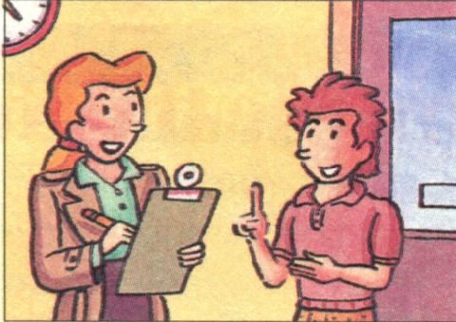
2a Listen to a reporter interviewing a
boy. Circle the boy’s answers.
Green City Survey
1.Which is the best clothes store?
Miller’s
Blue Moon
c.Dream Clothes
2.Which is the best radio station?
a.970 AM
b.97.9 FM
c.107.9 FM

Slide 3
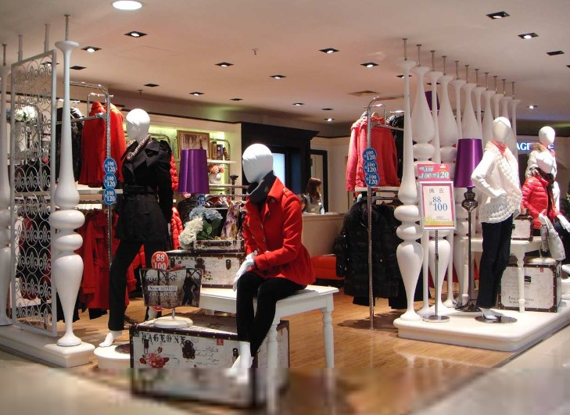
2b Listen again. Write the correct store or
radio station next to each statement.
Miller’s
Blue Moon
Dream Clothes
Clothes stores
_____________It’s the most expensive.
_____________ It has the best clothes.
_____________ It’s the worst store.
________You can buy clothes the most
cheaply there.
Blue Moon
Miller’s
Dream Clothes
Miller’s

Slide 4
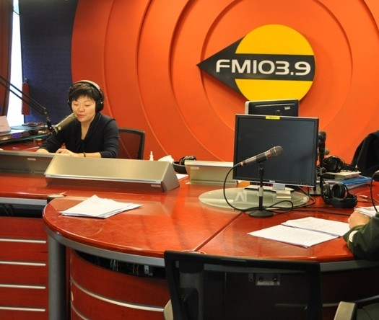
970 AM
97.9 FM
107.9 FM
Radio stations
___________ It has the worst music.
___________ They play the most boring songs.
___________ The DJs choose songs the most carefully.
___________ It’s the most popular.
790 AM
97.9 FM
107.9 FM
97.9 FM

Slide 5
2c Pair work : Role-play
A: Hello! I’m a reporter. Can I ask you some questions?
B: Sure.
A: What’s the best / the worst clothes store in town?
B: I think Miller’s is the best / the worst.
A: Why do you think so?
B: Well, Miller’s has …

Slide 6
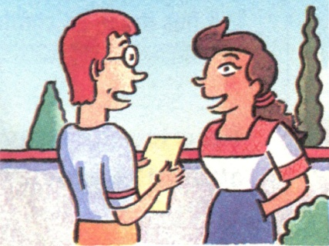
2d Role-play the conversation.
Greg: Hi, I’m Greg. I’m new in town.
Helen: Hi, I’m Helen. Welcome to the neighborhood! How do
you like it so far?
Greg: It’s fantastic, but I still don’t really know my way around.
Helen: Well, the best supermarket is on Center Street. You can
buy the freshest food there.
Greg: Oh, great. Is there a cinema around there? I love
watching movies.
Helen: Yes, Sun Cinema is the newest one. You can sit the most
comfortably because they have the
biggest seats.
Greg：Thanks for telling me.
Helen: No problem.

Slide 7
Language points
1.Tom is the tallest in our class.
This apple is the biggest of all.
1）形容词最高级：
用于三者或三者以上的人或物相比较。
2）标志词：表比较范围时用in/of。
3）形容词最高级前须加the。

Slide 8
2.观察句子：
Which one do you like best, Chinese, English or math?
Tom is one of the tallest boys in his class.
The Yellow River is the second longest river in China.
常用句式：
1) Who/ Which…+ 最高级…, A, B or C ?
2) one of +the +形容词最高级 +名词复数形式,
意为“最……之一”。
3)序数词后跟形容词最高级。

Slide 9
3.形容词的比较等级
(1)大多数形容词有三个等级:
a. 原级即原形。
e.g. big(大的)
b. 比较级, 表示 “ 较…… ; 更……一些 ”
的意思。
e.g. bigger（更大的）
c.最高级表示 “最……”的意思。
e.g. biggest（最大的）

Slide 10
(２) 形容词的比较级用法:两种人或事物进
行比较时, 用“形容词比较级 + than”。
e.g. The sun is bigger than the moon.
This cake is more delicious than
that one.
形容词比较级可用much, still, a little,
even等词来修饰。

Slide 11
(３)形容词最高级的用法:表示三者或三者以
上（人或物 ）的比较, 用最高级。最高
级前面一般加定冠词the, 后面可带短语
来说明比较的范围。
e.g. Mary is the youngest of the three
girls.
English is one of the most important
subjects in our school.

Slide 12
4. 形容词最高级的构成
A: cheap
short
quick
thick
light
cool
warm
quiet
wild
calm
加- est

Slide 13
B: heavy
easy
tidy
dry
busy
happy
healthy
hungry
early
变y为i，再加-est

Slide 14
C: large
late
nice
加-st
D: big
hot
thin
wet
fat
biggest
双写末尾的辅
音字母,再加
-est
hottest
thinnest
wettest
fattest

Slide 15
E. delicious
dangerous
interesting
popular
beautiful
careful
friendly
前面加most

Slide 16
F. good
well
better best
bad
ill
worse
worst
many
much
more
most
far
little
farther farthest
less least

Slide 17
Exercise
1. good better best
2. comfortable more ～ most ～
3. big bigger biggest
4. happy happier happiest
5. cheap cheaper cheapest
6. many more most
7. difficult more ～ most ～
8. little less least

Slide 18
根据所给词的适当形式填空。
1. Lily gets up ______ (early) than
Lucy.
2. Which goes __________ (slowly),
Tom or Jim?
3.This book is _______________
(interesting) than that one.
earlier
more slowly
more interesting

Slide 19
4. She works ________________
(careful) in her school.
5. Who goes to bed _________ (late)
Jim, Tom or Jack?
6. I think turkey is ________________
(delicious) of all.
the most carefully
latest
the most delicious

Slide 20
Homework:
Preview Grammar Focus in page 27.

Slide 21
Thank You!

