Slide 1
R·九年级全一册
Unit 13 We’re trying to save the earth!
第三课时

Slide 2
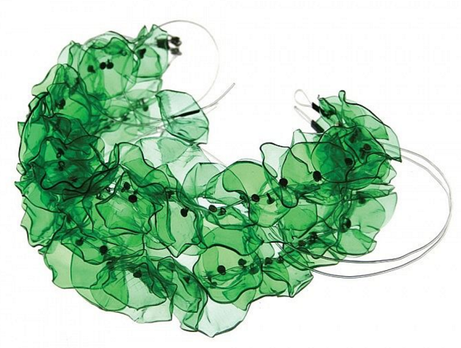
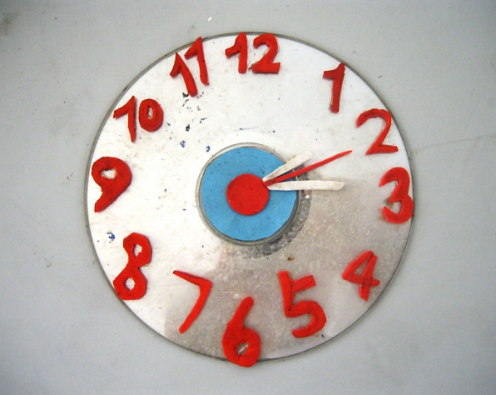
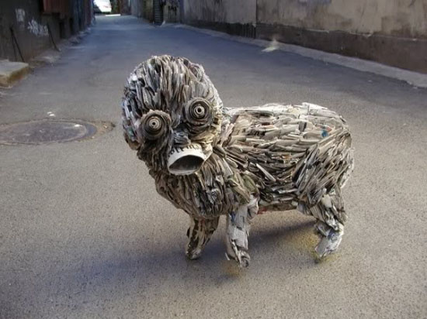
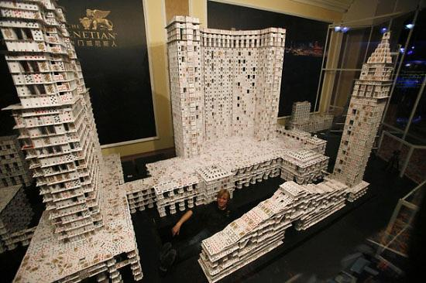
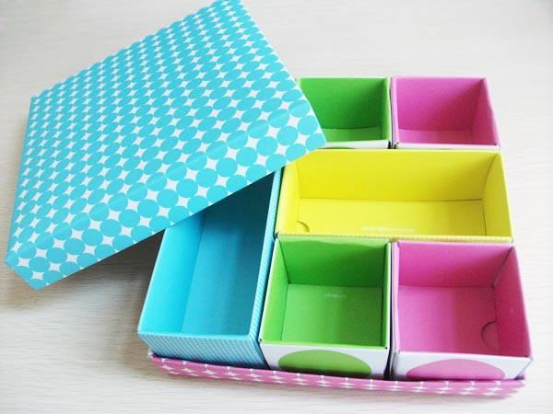
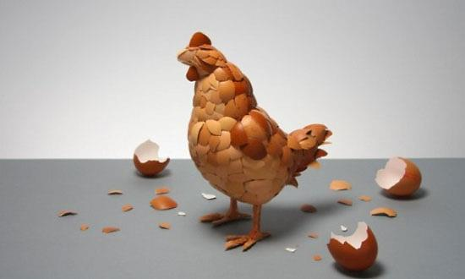
Lead in
What are they made of?
Creative mind
colourful shoe boxes
colourful shoelaces
old CDs
pokers
egg shells
plastic bottles
old newspapers

Slide 3
Language points
一、put相关短语
Have you ever thought about how these things
can actually be put to good use?
put sth. to good use 好好利用；充分利用
I have ever thought about how to put these
things to good use.

Slide 4
【拓展】与put有关的短语：
put off 推迟
put away 收拾起来
put down 写下；记下
put on 穿上；上演
put out 扑灭；熄灭
put aside 储存；保留

Slide 5
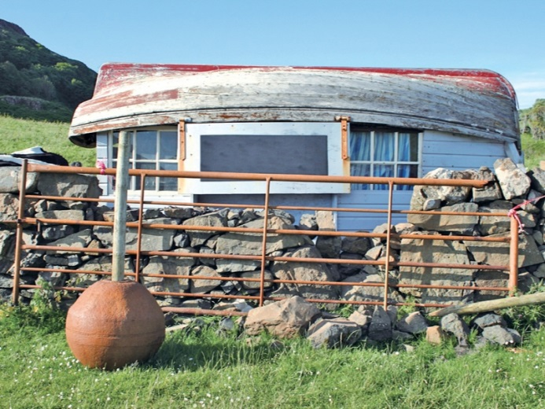
She lives in a house in the UK that she built out of rubbish.

Slide 6
二、out of 的用法
out of… 由……制成；用……做成
build sth. out of… 用……修建某物
例句：金字塔(Pyramid)是由石头建成的。
The Pyramid was built out of stones.

Slide 7
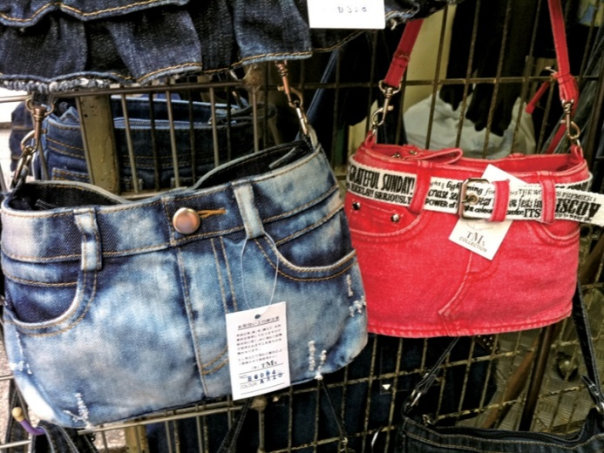
He is known for using iron and other materials from old cars to make beautiful art pieces.

Slide 8
三、“以……为名”的表达
be known for意为“因……而闻名”，可与be famous for互换，for后面接名词或动词-ing形式。
He is famous for using iron and other materials from old cars to make beautiful art pieces.

Slide 9
【拓展】be known as与be famous as同义，意为“作为……而出名”。
例句：他是作为一个歌手而出名的。
He is known/famous as a singer.

Slide 10
Let's write
To protect the environment

Slide 11
water pollution
noise pollution
Environmental problems
air pollution
…

Slide 12
What caused these problems?
…
Black smoke and poisonous gas
Black smoke and waste
throw rubbish everywhere
…
cars
factories
individual

Slide 13
1.开篇点题，说明环境污染问题的严峻性。
Environmental problems are…
2.说明环境污染的原因
With the …, there are too many…
Cars have made…
Black smoke and…by factories.
Factories also…

Slide 14
3.给出建议和可行方案
I think that governments should…
I suggest everyone in…
We should call on…
4.结尾：寄予期望
I hope the…

Slide 15
Practice
Kinds of pollution | Ways to cut down
water pollution
land pollution
noise pollution
air pollution
Stop factories from throwing waste into rivers.
Try not to use plastic bags when shopping.
Cut down the number of cars.
Reduce the number of factories that burn coal.

Slide 16
Summary
1. put sth. to good use
2. out of…
3. be known for = be famous for
Unit 13 We’re trying to save the earth!

Slide 17
THANKS

