Slide 1
Unit 4 Adversity and Courage
Period 4 Learn how to handle challenges
选择性必修三
人教版（2019）

Slide 2
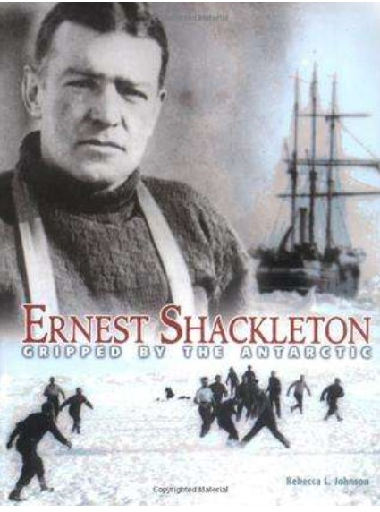
Lead-in
Look at the following picture and discuss the questions.
Who was Ernest Shackleton?
Sir Ernest Henry Shackleton was an Irish-born British explorer who was one of the giants of Antarctic exploration in the Heroic Age in the early years of the 20th Century.

Slide 3
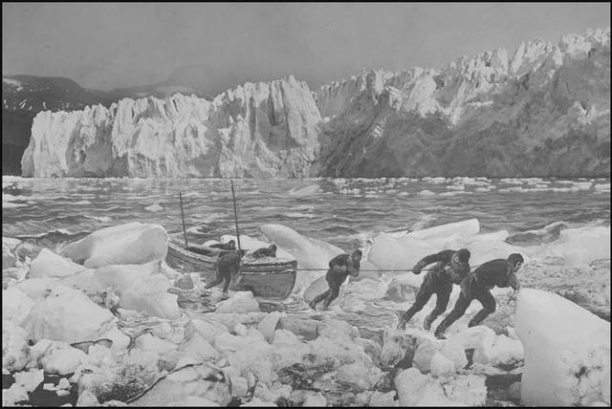
Task 1
Look at the following picture and discuss the questions.
What challenges may adventurers face on this island?

Slide 4
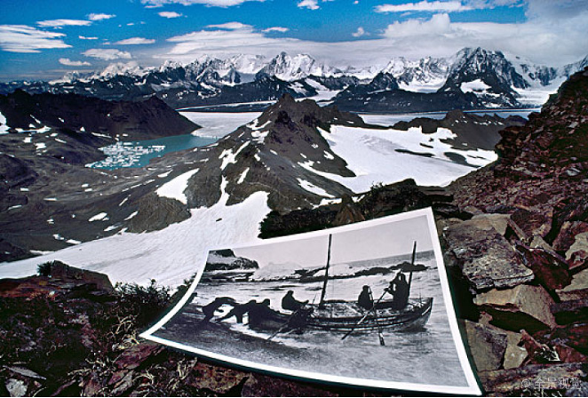
What challenges may adventurers face on this island?
Task 1
1. It was very cold and there was snow and ice everywhere.
2.The area is very mountainous, so they had to climb with their essentials.
3.It would be hard to know where they were going as the place is very large and all looks the same.
4.Not knowing what to expect and whether they would succeed,they would have great mental challenges.
3. look the same
3. look same
1. snow
1. snow and ice
2. mountains
4. mentally

Slide 5
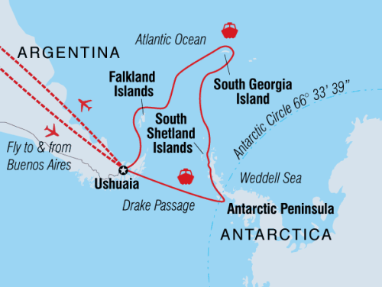
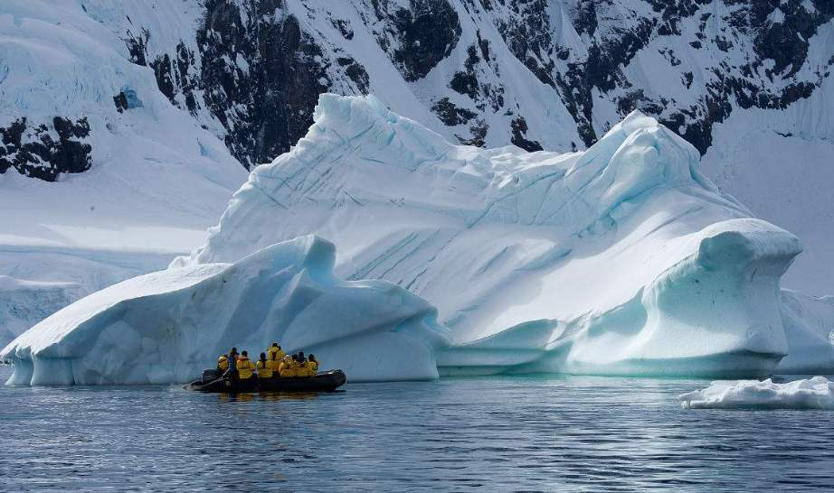
What is South Georgia Island like?
Task 2
South Georgia Island is a sub-Antarctic island administered by the United Kingdom as part of South Georgia and the South Sandwich Islands.

Slide 6
Listen to one of the team members talk about the rescue plan and their journey. Complete the summary.
Task 2
The team consisted of _______ members. They sailed on rough seas for days before they landed on the ________ side of South Georgia Island. Later they climbed over the mountains and _________ the whaling station. Later, Shackleton arranged for a rescue boat to return to __________ Island. Luckily, everyone was ____________.
six
wrong
arrived at
Elephant
still alive

Slide 7
Task 3
Listen again and answer these questions.
1. Why was it necessary for Shackleton to travel to South Georgia Island?
2. Why was it important to include a navigator in the team?
3. Why did Shackleton choose the most difficult and unfriendly man to join the rescue mission?
4. Why did Shackleton look extremely old?
cause or effect

Slide 8
Tips
A mind map
Due to …
The reason for this is…
because…
cause
cause or
effect
effect
That’s why…
This means …
...so as to …
...so that …

Slide 9
Task 3
Listen again and answer these questions.
1) Why was it necessary for Shackleton to travel to South Georgia Island?Because he realized that many of us were______________
_______________________________________.
2) Why was it important to include a navigator in the team?
Because he could _______________________________________.
3) Why did Shackleton choose the most difficult and unfriendly man to join the rescue mission?
Because he wanted the group ___________________________ to stay ________________________ until we returned.
4) Why did Shackleton look extremely old?
Because he ________________________. He was very ___________.
too ill to survive very long without rescue
guide us across the dangerous sea
remaining on the island
cheerful and positive
cheerful and positive
worried about the men
anxious
anxious
worried about the men

Slide 10
Task 4
Listen again and fill in the blanks.
We had stayed on Elephant Island for only a day, but Shackleton was already _________. He realised that many of us were too ill to survive very long without __________. He decided to go to South Georgia Island for _______. He chose ________ members to join him on the trip and I was one of them. I have been ____________on ships for my whole life and my strong navigation(导航) skills could ______ us across the _________ sea. However, to my surprise, Shackleton also ______ the most difficult and unfriendly member to _____ us on the trip. I later learnt that he did this because he ______the group remaining on the island to stay cheerful and _______until we returned.
worried
rescue
help
five
working
guide
dangerous
picked
join
wanted
positive

Slide 11
Task 4
Listen again and fill in the blanks.
We siled on very rough(汹涌的) seas for days. The sea was so _______ that it was almost impossible for me to ______ our position. I was only able to use my ____________three times during the trip. It _______ me to think that we might sail past South Georgia Island. This would mean that we might ______ into the open sea and there would be no rescue!
_______________,we did sail off-course(偏离航向) for a while, meaning we landed on the wrong side of South Georgia Island. We had to climb over the ___________to get help. The mountains looked so steep that I thought we might have to ________ _______ them on our bottoms!
strong
check
instruments
scared
sail
Unfortunately
mountains
slide
down

Slide 12
Task 4
Listen again and fill in the blanks.
When we arrived at the whaling station(捕鲸站), Shackleton _____________ arranged for a rescue boat to return to Elephant Island. However, due to the _______ seas, we could not get near to the island. Shackleton became worried about the men. He was very anxious and began to look _________old. We tried for three months to rescue the 22 men. Finally,we were able to reach Elephant Island and luckily find everyone still _______!
They were overjoyed to see us and everyone began to _____.
immediately
rough
extremely
alive
cry

Slide 13
Task 5
Suppose you are Shackleton and you are going to choose two sailors to join the rescue team, who would be your first choice?

Slide 14
Who should join the rescue team?
Task 6
Skills
Qualities
Name
* good leader
* experienced in exploring the Antarctic
1. Frank Wild
2. Frank Worsley
3. Tom Crean
4. Hubert Hudson
5. Thomas Orde-
Lees
loyal, kind,
and calm
*excellent navigator
*experienced sailor
odd behavior at times,
but liked by crew
*second officer
*experienced in living in the Antarctic
strong, energetic, and brave
*navigator
*best at catching penguins
friendly and lively
*efficient store keeper
*motor expert
*excellent skier
selfish, lazy, and bad-tempered

Slide 15
The expressions in the box below may help you with your discussion.
Task 6
Exploring options
What do you think (about) …?
What do you feel (about) …?
Let’s look at …
What / How about …?
Any ideas?
What are the alternatives?
Let’s move on to the next candidate.
Should we move on to the next one?

Slide 16
Show time
Task 7
A: We have to decide on which two sailors Shackleton chose for his rescue team. Let’s look at Frank Wild.
B: He is good leader and is experienced in exploring the Antarctic. So, I think he’s suitable to join the rescue team.
C: Hmm, I think we should move on to the next sailor. According to Perce’s diary entries, Frank Wild was left with the other crew members on Elephant Island.
A: I agree. Let’s move on to the next candidate. What do you think about Frank Worsley?
B: Well, he is ….
候选人，申请人

Slide 17
Show time
Task 7
A: OK, we need to choose the two sailors that joined Shackleton’s rescue team. Let’s look at our choices.
B: So how about Frank Wild and Tom Crean? They were both experienced in exploring and living in the Antarctic, and they also had many good qualities, such as being kind and strong.
C: Yes, but look at Perce’s diary. Frank wild stayed on Elephant Island with the others. So we can cross him off our list.

Slide 18
Show time
Task 7
B: Oh, yes, well spotted. Then what about Tom Crean? Anyone have any ideas?
A: Well, he was good at living in the Antarctic, so maybe he stayed on the island to help, but I think his strength and bravery meant that Shackleton would have chosen him for the dangerous mission.
B: Agreed, so one choice is Tom Crean. OK, let’s move on to another candidate. How do you feel about Frank Worsley?

Slide 19
Show time
Task 7
A: I think he is a good choice because he was an excellent navigator.
C: I agree. The rescue team needed a good navigator. He could be our second choice.
B: But what about Hubert Hudson? He was also good at navigating.
A: Yes, but he was also the best at catching penguins, so I think he would have stayed on the island with the others so they had enough to eat.

Slide 20
Show time
Task 7
C: Sounds reasonable. But we should also look at Thomas Orde- Lees. He was an excellent skier, so maybe he could be helpful on the mission.
B: Hmm… maybe, but I think he didn’t have as much to offer as Frank and Tom. Besides, Perce complained about him in his diary, so I think he probably stayed on the island.
A: I agree, so let’s choose Frank and Tom.

Slide 21
Language points
motor 考查热度★★
【热点品味】 n. 发动机；马达adj. 有引擎的；机动车的
【教材原句】
Thomas Ordelees is selfish, lazy, bad temperedand a motor expert.托马斯·奥德利斯自私、懒惰、脾气坏，还是个汽车专家。
【实例品读】
If the battery is dead, the motor won’t turn over.
电池要是用完了，马达就转不起来了。
Last year was really bad for the motor industry in Europe.
去年，欧洲的机动车市场很不景气。

Slide 22
Language points
【热点归纳】
start a motor 开动发动机
turn off a motor 关掉发动机
motor inn 汽车旅馆
motorist n. 汽车驾驶员
【考点精练】 单句语法填空
①The ___________(motor)was charged with failing to stop at a red light.
②This lawn mower is driven by ____ small electric motor.
motorist
a

Slide 23
Exercises
重点单词和短语
rough
1．________ adj. 汹涌的；粗糙的；粗略的
2．________ adj. 忠诚的；忠实的
3．________ n. 发动机；马达
adj. 有引擎的；机动车的
→___________ n. 汽车驾驶员
4．____________ n. 候选人；应试者
1．He worked as a ________(机动车的)mechanic.
2．They knocked together a ________ (粗糙的) box with wooden boards.
3．I may say in all sincerity that you have been my most ________ (忠实的) friend.
loyal
motor
motorist
candidate
单句填词
motor
rough
loyal

Slide 24
Homework
Do the Exercises
of the workbook.

