Slide 1
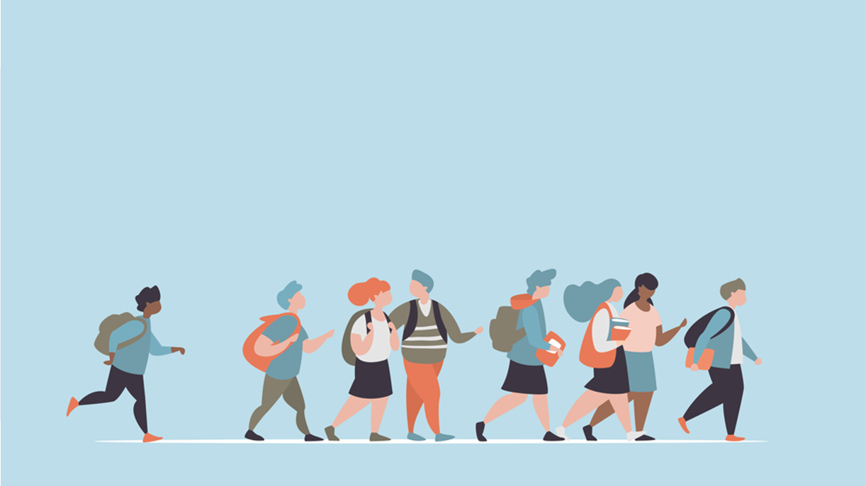
R·九年级全一册
Unit 13 We’re trying to save the earth!
第一课时

Slide 2
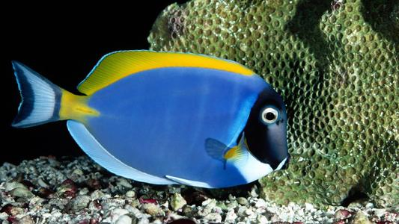
Review
The fish live at the _______ of the sea.
bottom

Slide 3
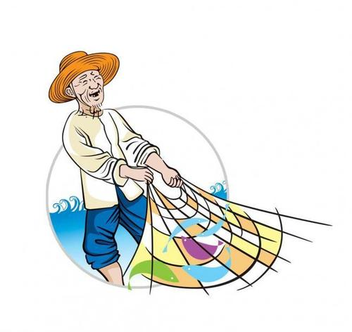
fisherman

Slide 4
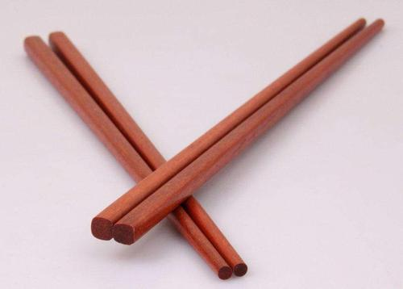
wooden
_________ chopsticks

Slide 5
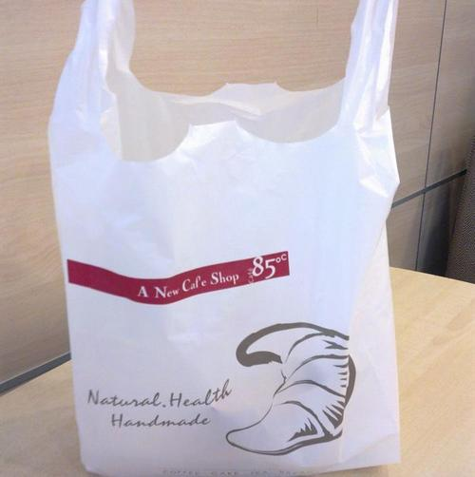
plastic bag

Slide 6
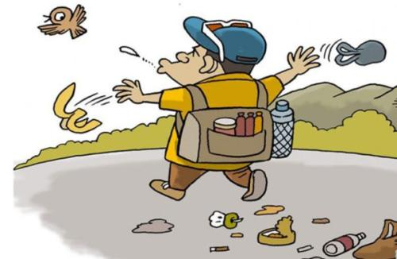
litter
Don’t ________!

Slide 7
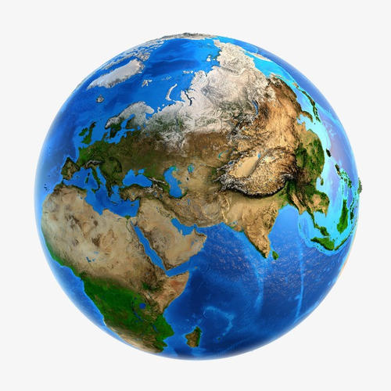
Language points
The earth is polluted.

Slide 8
The air was dirty. The
smoke from factories
was black.
But it used to
be so clean!

Slide 9
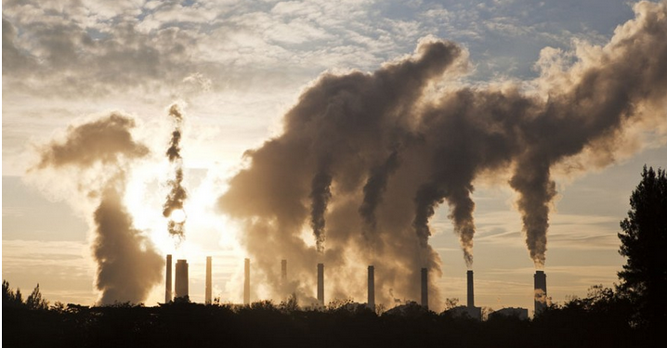
cars
factories
smoking
building houses
burning
power plants
air
_______ pollution

Slide 10
The river was dirty. Even
the bottom of the river
was full of rubbish.
But it used to
be so clean!

Slide 11
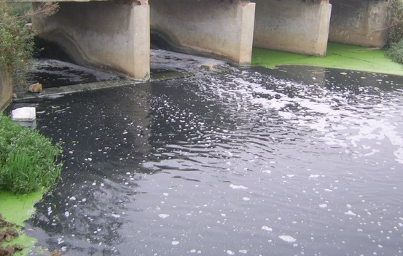
rubbish
littering
ships
factories
sewage
water
_______ pollution

Slide 12
There is too much noise
around us. Everywhere is
too noisy to live.
But it used to
be so quiet!

Slide 13
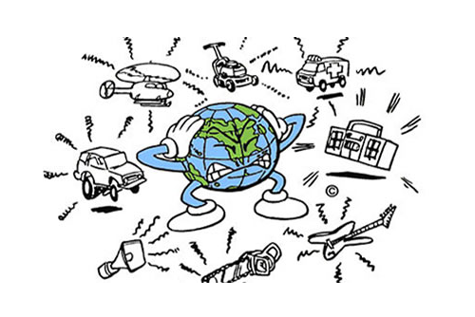
loud music
planes
building houses
mobile phones
machines
crowds
vehicles
noise
_______ pollution

Slide 14
一、used to 的用法
used to为固定结构，意为“曾经；过去常常”，表示过去存在或经常发生但现在已经停止的行为或习惯，后接动词原形。

Slide 15
1. 否定结构: 主语+ didn’t + use to + 动词原形
主语 + usedn’t to + 动词原形
2. 一般疑问句: Did + 主语 + use to + 动词原形 + 其他？
Used+主语+to+动词原形+其他？

Slide 16
It didn't use to be so dirty!
It used to be so clean!

Slide 17
Used it to be so dirty?
No, it usedn't to be so dirty.

Slide 18
【拓展】
be/get used to sth. /doing sth.
表示“习惯于/适应于某事/ 做某事”。
例句：我习惯早起。
I am used to getting up early.

Slide 19
二、away相关短语
Yes, but people are throwing
away things they don’t need
anymore into the water.
throw away 扔掉，丢弃
not … anymore意为“不再”，在句中作状语，相当于no more（不再）。

Slide 20
【拓展】away作副词时，常见短语有：
get away 逃脱；（使）离开
go away 离去；出去
run away 逃走；离开
stay away 不在家；外出
take away 拿走；带走，夺去
move away 搬到别处去住；离开

Slide 21
Practice
He ___ go out with his parents, but now he ____
staying at home alone.
A. used to; is used to B. is used to; used to
C. used to; used to D. is used to; is used to
A

Slide 22
Summary
1. used to
2. be/get used to sth. /doing sth.
3. throw away
Unit 13 We’re trying to save the earth!

Slide 23
THANKS

