Slide 1
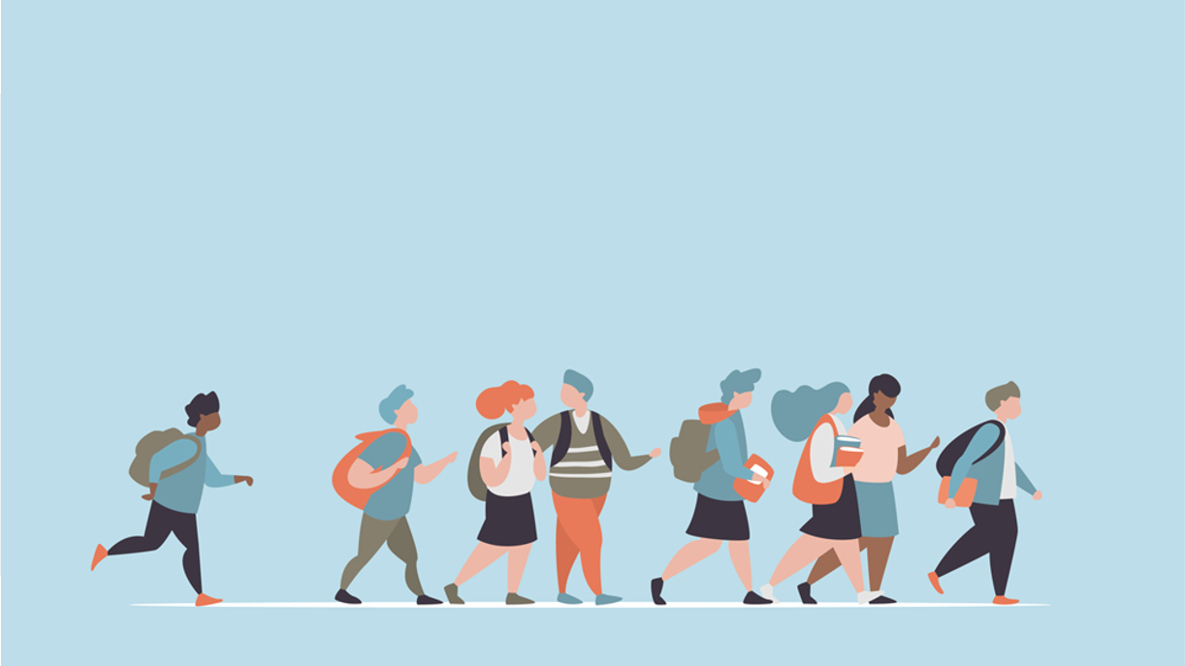
R·九年级全一册
Unit 4 I used to be afraid of the dark.
第二课时

Slide 2
Lead in
Our appearance
Time can change...
Our personality
Our interest

Slide 3
What did you use to be afraid of?

Slide 4
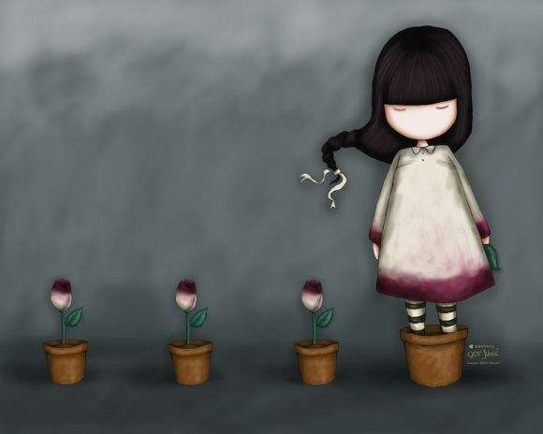
being alone?
I used to be afraid of being alone.

Slide 5
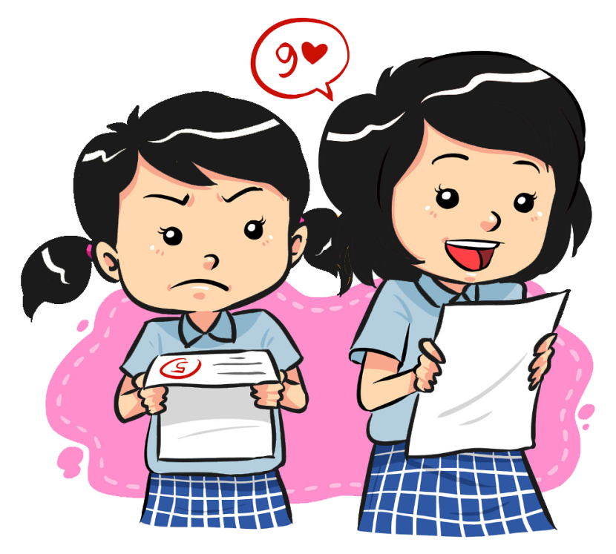
getting bad grades?
I usedn't to be afraid of getting bad grades.

Slide 6
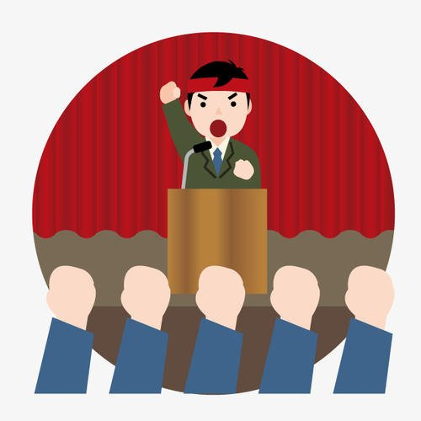
talking in front of people?
I didn't used to be afraid of talking in front of people.

Slide 7
Language points
Yes, she did. She used to be afraid of talking with others.
Candy used to be shy, didn't she?
Yes, she took up singing to deal with her shyness.
But she is really outgoing now.

Slide 8
一、固定搭配
1. take up 此处意为“开始从事”。
take up的其他用法：
①“占用” The table takes up too much room.
②“继续” We took up our journey the next day.

Slide 9
2. deal with 相当于do with “对付；处理 ”
deal with
do with
常与how连用，强调处理问题的方式、方法
常与what连用，侧重于对某事物的利用
注意：动词不定式短语 to deal with 后必须带宾语。

Slide 10
3. shyness 名词，意为“害羞；腼腆”。
是形容词shy 加后缀-ness 构成的名词。
拓展：sad — sadness happy— happiness
ill — illness kind — kindness

Slide 11
I didn’t use to be popular in school.
But now you get tons of attention everywhere you go.

Slide 12
4. tons of 意为“很多的；大量的”，是英语中一种夸张的表达方式。ton的本义为“吨”。
例：他上学屡次迟到。
He has been late for school tons of times.

Slide 13
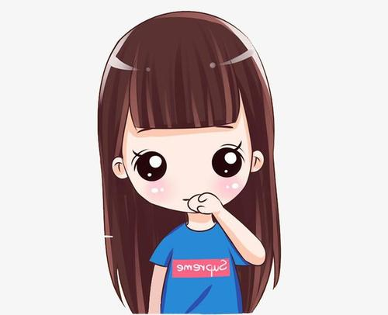
二、句型辨析
1. used to do 过去常常做……，只用于过去时态。
She used to have long hair.

Slide 14
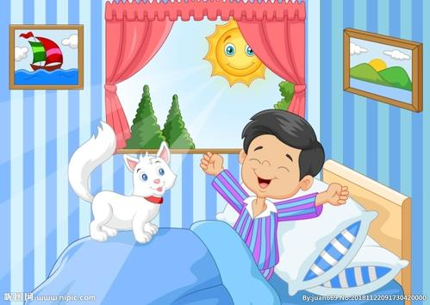
2. get(be) used to doing 习惯于……，
可用于现在、过去、将来等多种时态。
He is used to getting up early.

Slide 15
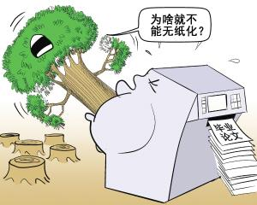
3. be used to do 被用来做……，是被动语态，不定式表示目的，用于多种时态。
Wood is used to make paper.

Slide 16
Let's talk
Which of these things did you use to be afraid of?
Which ones are you still afraid of?
Check the boxes and then ask your partner.

Slide 17
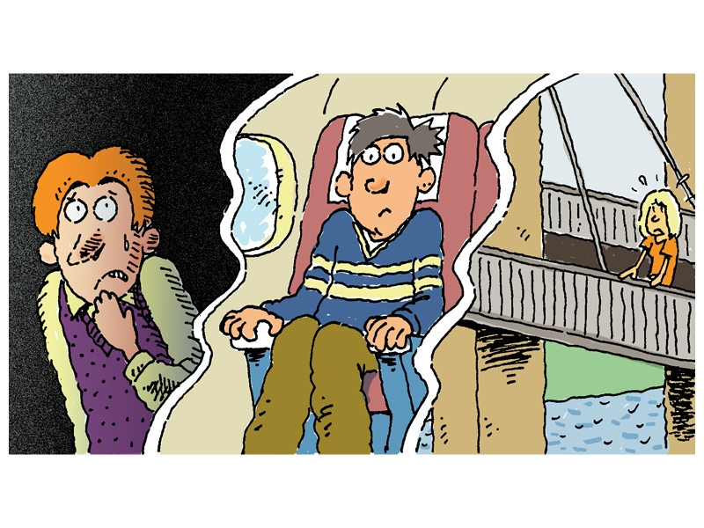
 | Me
 | I used to be afraid of… | I’m still afraid of…
the dark
being alone
flying
high places
giving a speech in public
状元成才路
状元成才路
状元成才路
状元成才路
状元成才路
状元成才路
状元成才路
状元成才路
状元成才路
状元成才路
状元成才路
状元成才路
状元成才路

Slide 18
The road to success is difficult.
Where there is a will, there is a way.
有志者事竟成。

Slide 19
Practice
用 used to 和 be used to 的适当形式填空。
1. My uncle _________ live in a big city but he ___________ living in a village now.
2. The child ___________ watch too much TV at night. So he has poor eyesight now.
used to
is used to
used to

Slide 20
Summary
某人过去常常做
/过去是……
sb. used to do /be
sb. be (get) used to doing sth.
某人习惯于做……
sth. be used to do/for doing sth.
某物被用于做……

Slide 21
THANKS

