Slide 1
Unit 1
Where did you go on vacation?

Slide 2
Section A
(Grammar Focus-3c)

Slide 3
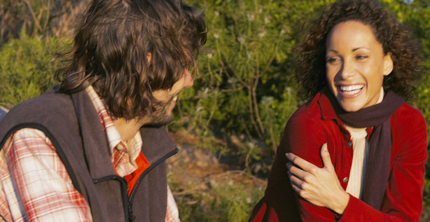
Role-play the conversation in 2d.
Review
Hi, Helen. Long time no see.
Hi, Rick. Yes, ...
...
…

Slide 4
Grammar Focus
根据课本内容，完成下列句子。
1. 你去了什么地方去度假？
______ _____ you go on ________?
2. 我去了纽约市。
I _____ ____ New York City.
3. 你和别的什么人一起去的吗？
______ ______ go out with _______?
Where did
vacation
went to
Did you
anyone

Slide 5
4. 不，没有别人在这儿。每个人都在度假。
No. ____ _____ was here.
________ was on ________.
5. 你买了什么特别的东西了吗？
_____ you buy ________ _______?
6. 是的，我为我爸爸买了些东西。
Yes, I _______ _________ for my father.
7. 不，我没有买什么东西。
No, I _______ _________.
No one
Everyone
vacation
Did
anything special
bought something
bought nothing

Slide 6
8. 吃的怎么样？____ ____ the food?
9. 所有的东西尝起来都很好。
__________ _______ really good.
10. 每个人都玩得很开心吗？
_____ ________ have a good time?
11. 哦，是的。一切都很棒。
Oh, yes. ____________ was excellent.
How was
Everything tasted
Did everyone
Everything

Slide 7
Grammar
复合不定代词小结：
1. some, any, no, every与-one, -thing可以
组成八个不定代词，他们分别是：
某人 |  | 某事
任何人 |  | 任何事
没有人 |  | 没有东西
每人 |  | 一切
someone
something
anyone
anything
no one
nothing
everyone
everything

Slide 8
2. 带some的复合不定代词常用于肯定句
中；带any的复合不定代词常用于否定
句或一般疑问句中。
e.g. 我想吃点东西。
I’d like ___________ to eat.
今天有人给我打电话吗？
Did ________ call me today?
something
anyone

Slide 9
3. 当形容词修饰不定代词时，应放在其
后面。
e.g. 这本书里有什么新东西吗？
Is there _________ _____ in this
book?
今天没有什么特别的事。
There’s _________ _______ today.
anything new
nothing special

Slide 10
4. 由some, any, no, every构成的复合不定
代词作主语时，都作单数看待，其谓
语动词用单数第三人称形式。
e.g. Something is wrong with my watch.
Well, everyone wants to win.
Nobody knows what the future will be
like.
There is something for everyone at
Greenwood Park.

Slide 11
5. 除no one以外，其他复合不定代词都写成一个词。

Slide 12
Practice
Fill in the blanks with the words in the box and practice the conversation.
3a
anyone, something, anything, everything, nothing

Slide 13
Linda: Did you do _________ fun on your
vacation, Alice?
Alice: Yes, I did. I went to Sanya.
Linda: How did you like it?
Alice: Well, it was my first time there, so
__________ was really interesting.
Linda: Did you go with ________?
Alice: Yes, I did. I went with my sister.
Linda: Did you go shopping?
anything
everything
anyone

Slide 14
Alice: Of course! I bought _________
for my parents, but ______ for
myself.
Linda: Why didn’t you buy ________ for
yourself?
Alice: I didn’t really see _________ I like.
something
nothing
anything
anything

Slide 15
Explanation
1. myself (我自己) ，yourself (你自己)是反
身代词。表示“某人自己的词”叫反身代
词。见下表：
myself | yourself | himself | herself | itself
我自己 | 你自己 | 他自己 | 她自己 | 它自己
ourselves | yourselves | themselves
我们自己 | 你们自己 | 他们自己

Slide 16
(1) Did you buy anything for yourself?
你为你自己买什么东西了吗?（做介词宾语）
(2) The old man taught himself English.
那位老人自学英语。（做动词宾语）
(3) The thing itself is not important.
事情本身并不重要。 （做同位语）
(4) I myself visited my aunt last weekend.
上周我自己去拜访了姑姑。 （做同位语）

Slide 17
Practice
3b
Fill in the blanks in the e-mail message with the words in the box.
anything, everything, nothing, everyone, no one

Slide 18
Dear Bill,
How was your vacation? Did you do ________ interesting? Did _______ in the family go with you? I went to a friend’s farm in the countryside with my family. __________ was great.
anything
anyone
Everything

Slide 19
We fed some hens and saw some baby pigs. They were so cute! The only problem was that there was _______ much to do in the evening but read. Still ______ seemed to be bored. Bye for now!
nothing
no one

Slide 20
Ask your group questions about their last vacation. Then tell the class your results.
Group work
3c
Did you… | Everyone | Someone (name) | No one
eat anything at a restaurant?
read anything interesting?
visit anyone in your family?
buy anything?
keep a diary?

Slide 21
Report
In our group, everyone ate something at a restaurant. No one read anything interesting. Li Lei visited his grandparents in the town. Liu Xue bought something interesting. Xu Li kept a diary.
Now work by yourselves. Then give your own report on your group.

Slide 22
Exercise
选词填空。
something, anyone, everything, anything, nothing, someone, no one, every one
_________ found Mr. Li’s keys and gave them back to him yesterday.
2. ─Did you see _________ in the big box?
─No, I didn’t. There’s _______ in it.
_______ helped the little boy. He did it himself.
Someone
anything
nothing
No one

Slide 23
4. My watch doesn’t work. ___________ is wrong with it.
5. ─Hello, ___________!
─Hello, Mr. Smith!
6. ─How’s it going, Jack?
─Great! ____________ is going well.
7. ─Did you go to the beach with _______?
─Yes. I went there with my cousin.
Something
everyone
Everything
anyone

Slide 24
Homework
背诵Grammar Focus部分。
复习复合不定代词及反身代词的用法。

