Slide 1
R·九年级全一册
Unit 14 I remember meeting all of you in Grade 7.
第一课时

Slide 2
Lead in
Junior high school days are going to be over.
Do you have any special memories?

Slide 3
remember doing sth.
记得做过……事(已做过)
Well, junior high school days are over. Do you have any special memories?
I remember meeting all of you in Grade 7.

Slide 4
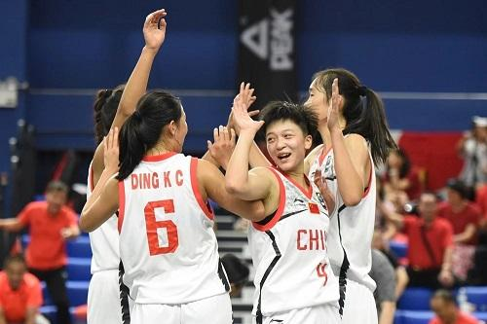
What do you remember doing?
I remember winning a prize.

Slide 5
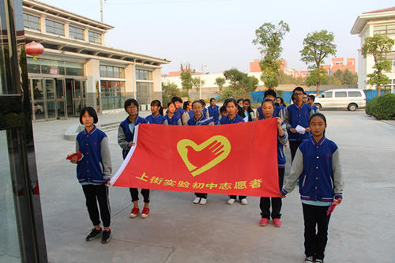
What do you remember doing?
I remember being a volunteer.

Slide 6
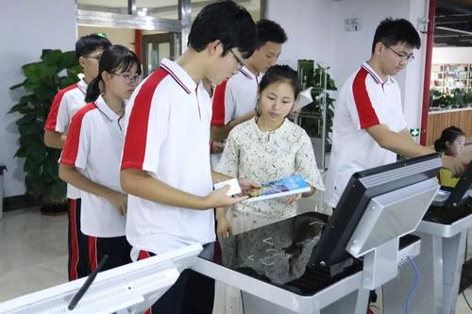
What do you remember doing?
I remember a friend helping me with a problem.

Slide 7
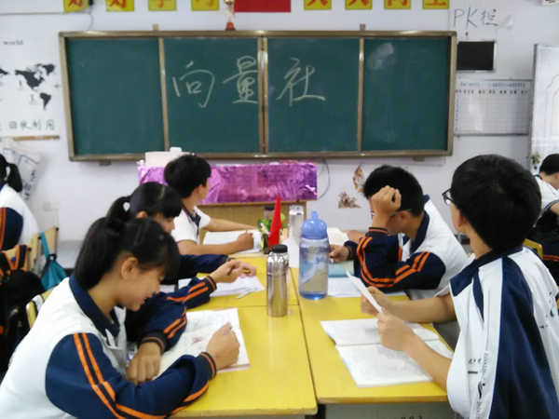
What do you remember doing?
I remember doing a school survey.

Slide 8
Language points
一、survey的用法
survey还可作动词，意为“测量土地；调查；勘测”。
过去式
过去分词
现在分词
第三人称单数
surveyed
surveyed
surveying
surveys

Slide 9
Which teacher impressed you most? Why?
patient
strict
knowledgeable
kind
cool
friendly

Slide 10
I did homework carefully to meet the standards of a strict teacher.

Slide 11
二、standard的用法
standard 意为“标准；水平”。
常用短语： high/low standard 高/低标准
meet/reach a standard 达到某一标准
I did homework carefully to reach the standards of a strict teacher.

Slide 12
三、宾语从句的复合句
主语
可省略
谓语
谓语
主语
1. I know that Ms. Lee was always patient with you
in math class.
宾语从句
从句谓语动词时态常常受到主句谓语动词时态的影响。

Slide 13
be patient with sb. 对某人有耐心
be patient to do sth. 有耐心地做某事
你要对你的母亲有耐心。
You should be patient with your mother.

Slide 14
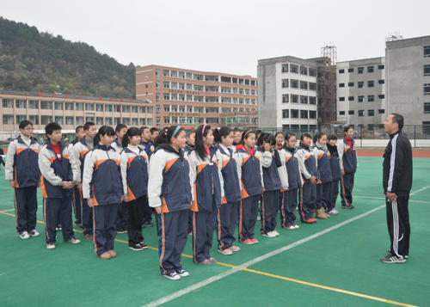
Mr Lin gave really clear instructions during P.E. Class.

Slide 15
可数名词
不可数名词
instruction
instructions
instruction
意义
指示；命令
讲授，指导，教学
常可接动词不定式或that
从句作定语或同位语
其后常与介词in
搭配使用
用法

Slide 16
相关短语：
(1) follow the instructions 遵守指示
(2) ignore/carry one’s instruction 忽视/执行某人的命令
(3) on/under sb.’s instructions 遵照某人的指示

Slide 17
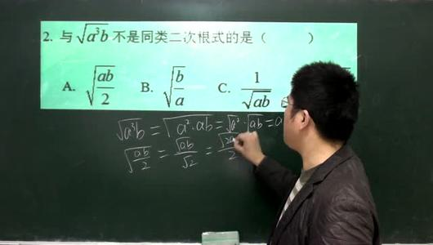
Mr Wang helped you to work out the answers no matter how difficult they were.

Slide 18
三、no matter...
no matter意为“无论；不管”
与疑问词连用构成“no matter+疑问词”结构
引导让步状语从句，可以和“疑问词+-ever”结构互换。

Slide 19
I’ll never forget them no matter where I go.
I’ll never forget them wherever I go.

Slide 20
Practice
___ difficult they are, we can work hard to solve them.
A. No matter what B. Whatever
C. Whenever D. No matter how
D

Slide 21
Summary
1. survey的用法
2. standard的用法
3. 宾语从句的复合句
4. be patient with sb.
5. instruction的用法
6. no matter的用法
Unit 14 I remember meeting all of you in Grade 7.

Slide 22
THANKS

