Slide 1
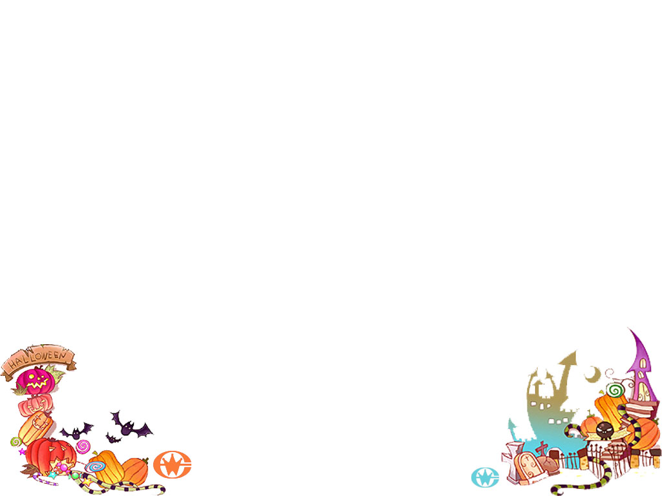
Unit 7
Will people have robots?

Slide 2

My life in the future:
In 10 years, I am going to be older, and I am going to do more sports and eat more vegetables and be healthier. By then I am going to have enough money. I am not going to live in China and I am going to travel all over the world…

Slide 3
My life in the future:
In 10 years, I will be older, and I will do more sports and eat more vegetables and be healthier. By then I will have enough money. I won’t live in China and will travel all over the world…
What will you be in the future?

Slide 4


Task 1：未来不是梦
Your predictions(预言)
试一试预测你的未来
I will be a reporter.
I won’t live in LuZhou.
I will…
I won’t…
Predict(预言)

Slide 5

Task 2：预测未来世界
What will life in the future be like, 100 years from now?
100年后，未来生活是什么样的？
There will be…
People will…
There will be more cars.
People will live in the moon.
Cars will fly in the sky.
People will see the doctor at home on computers.

Slide 6


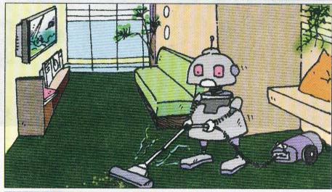
In the future
robots
People will have robots in their homes.

Slide 7
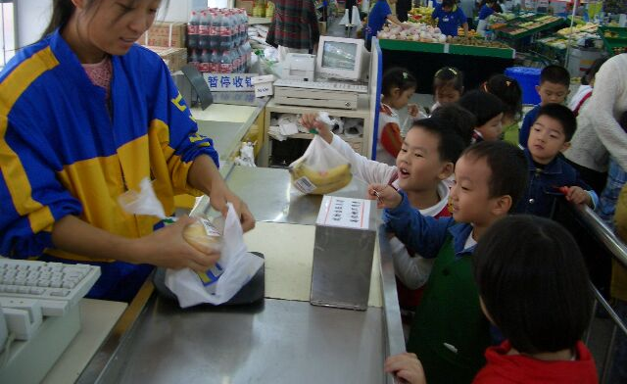

In the future
People won’t use money.
Everything will be free(免费).

Slide 8


In the future
Books will only be on computers, not on paper.

Slide 9

In the future
A B. C dfaoptj.
12 + =？
？。。。
Kids won’t go to school.
They’ll study at home on computers.

Slide 10
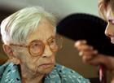
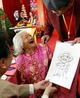

In the future
People will live to be 200 years old.
活到……岁

Slide 11
Will people have robots
in their homes？
Picture 1
robot
Yes, they will. I think people will have robots.

Slide 12

Picture 2
Will kids go to school?
No, they won’t. Kids won’t go to school. They’ll study at home.

Slide 13
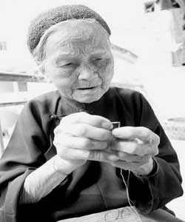
Picture 3
Will people live to be 200 years old?
live to be+数字+ years old
（活到……岁）
Yes , they will. They will live more longer than now.

Slide 14

Pair work:
A:Will people have robots in their homes?
B:Yes,they will.
No, they won’t …

Slide 15

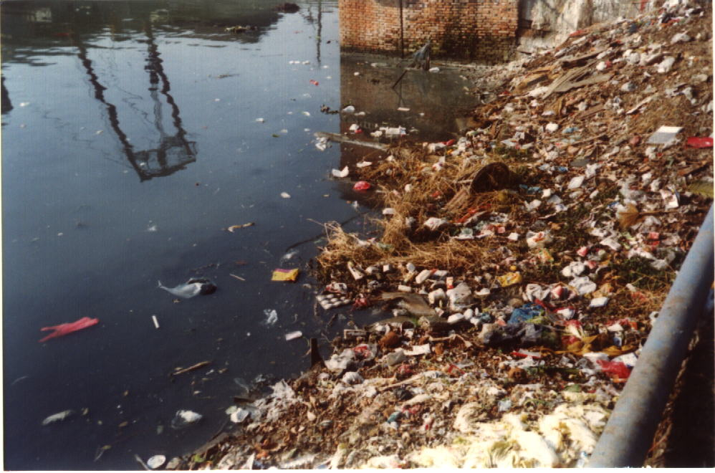
pollution
污染
There will be more pollution.

Slide 16
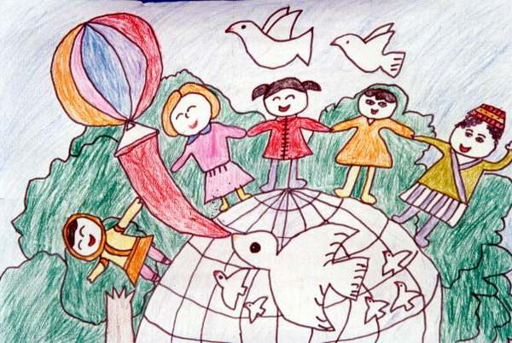
Picture 4
There will only be one country.

Slide 17

In the future
There will be more cars.
A:Will there be more cars?
B:Yes,there will. / No, there won't.

Slide 18
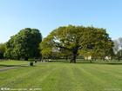
In the future
There will be fewer trees.
A:Will there be fewer trees?
B:Yes,there will. / No, there won't.

Slide 19

In the future
There will be
fewer people.
A:Will there be fewer people?
B:Yes,there will. / No, there won't.

Slide 20

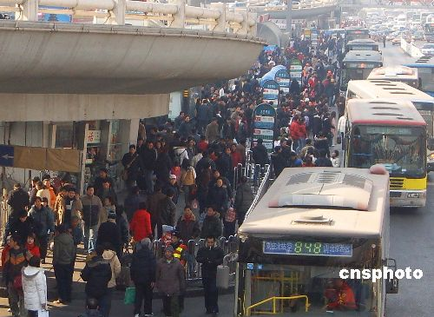
changes
What can you see in this picture?
There will be…将会有
50 years later
There will be more people.
There will be fewer trees.
There will be more pollution.
There will be more buildings.
There will be more cars.
There will be less fresh air.

Slide 21
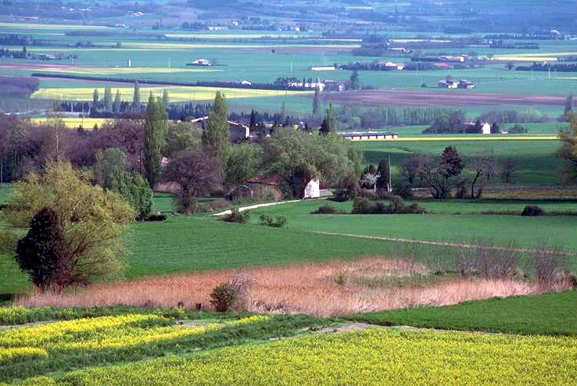
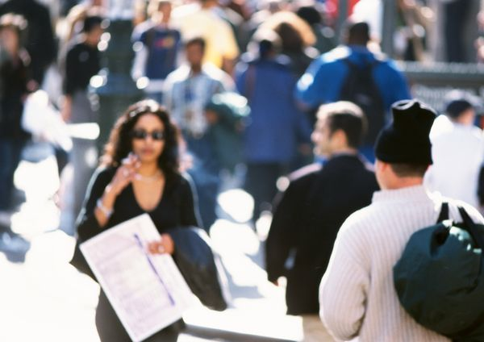
Discuss some more predictions
in one hundred years.
There will be…将会有
100 years later
There will be more people.
There will be fewer trees.
There will be more pollution.
There will be more buildings.
There will be more cars.
There will be less fresh air.

Slide 22
Let’s read these predictions. Check (√) A (for agree) or D (for disagree).
A D 1. People will have robots in their homes.
A D 2. People won’t use money. Everything will be free.
A D 3. Books will only be on computers, not on paper. （不可数 a piece of paper一张纸）
A D 4. Kids won’t go to school. They’ll study at home on computers.
A D 5. There will only be one country.
A D 6. People will live to be200 years old.
= will not
= they will

Slide 23
1b Listen and circle the predictions you hear in activity 1a.
1. People will have robots in their homes.
2. People won’t use money. Everything will be free.
3. Books will only be on computers, not on paper.
4. Kids won’t go to school. They’ll study at home on
computers.
5. There will only be one country.
6. People will live to be 200 years old.

Slide 24
Read loudly loudly loudly!!!
1. People will have robots in their homes.
2. People won’t use money. Everything will be free.
3. Books will only be on computers, not on paper.
4. Kids won’t go to school. They’ll study at home on
computers.
5. There will only be one country.
6. People will live to be200 years old.

Slide 25

2a
Listen and circle more, less, or fewer you hear.
1. There will be more / less / fewer people.
2. There will be more / less / fewer free time.
3. There will be more / less / fewer cars.
4. There will be more / less / fewer pollution.
5. There will be more / less / fewer trees.

Slide 26
2b
Listen and check the predictions.
1. There will be fewer people.
√
2. There will be less free time.
3. There will be more pollution.
√
4. Cities will be very big and crowded.
5. People will use the subways less.

Slide 27

Explanation
Read the words.
many/much
more
adj. 更多的
most
可修饰可数或不可数名词。
few
fewer
adj. 更少的
fewest
只修饰可数名词。
little
less
adj. 更少的
least
只修饰不可数名词。

Slide 28

Practice
Choose from more, fewer and less to fill in the blanks.
1. There is _____ air pollution than before. So our city is much cleaner and clearer.
less
2. High school students have ________ free time than middle school students.
less

Slide 29
3. There are ________ people in the city than before.
more
4. There were ________ cars 10 years ago.
fewer
5. There are much ________ people in Japan than in China.
fewer

Slide 30
be
1. I won’t ______________(be) free tomorrow.
2. The students _____________(have) a meeting this weekend.
3.Lily______________________(stay) with me tonight.
4. It’s _________________________(rain) this evening.
5. We _____________________(visit) uncle Lee next week.
6. There _______________(be) a football match in our school.
7. _________you_________ (be) free tomorrow?
8. My sister _____________( not move )to France this year.
9. There will be fewer factories in Qian’an.(变一般疑问句)
will have
will stay
going to rain
will visit
will be
Will be
won’t move
Will there be fewer factories in Qian’an?

Slide 31

将来时
will+动词原形,“将……”。
1. 10 年后我们学校将有更多建筑物。
2. 50年后泸州将有更少的污染。
3. 下周一我们将不上课。
4. 我的衣服将会很干净。
Our school will have more buildings in ten years.
LuZhou will have less pollution in 50 years.
We won’t have classes next Monday.
My clothes will be clean.

Slide 32
Language Focus
I think there will be more pollution.
否定句
I don’t think there will be more pollution.
一般疑问句
Do you think there will be more pollution?

Slide 33
Language Focus
There will be…句型。
There will be…是There be句型的拓展，作“将有；将会有”解。
其中will是情态动词。
那么该句型的否定式和疑问式是什么样子呢？

Slide 34
SUM UP
时态：
一般将来时
构成：
Will+动词原形/
标志词： tommorrow；next week/year…
the day after tomorrow；in+一段时间
一般将来时“There be”句型中的will
肯定句：
否定句：
一般疑问句：
There will be +名词+其他成份
在will后面加not。
把will提到there之前。

Slide 35
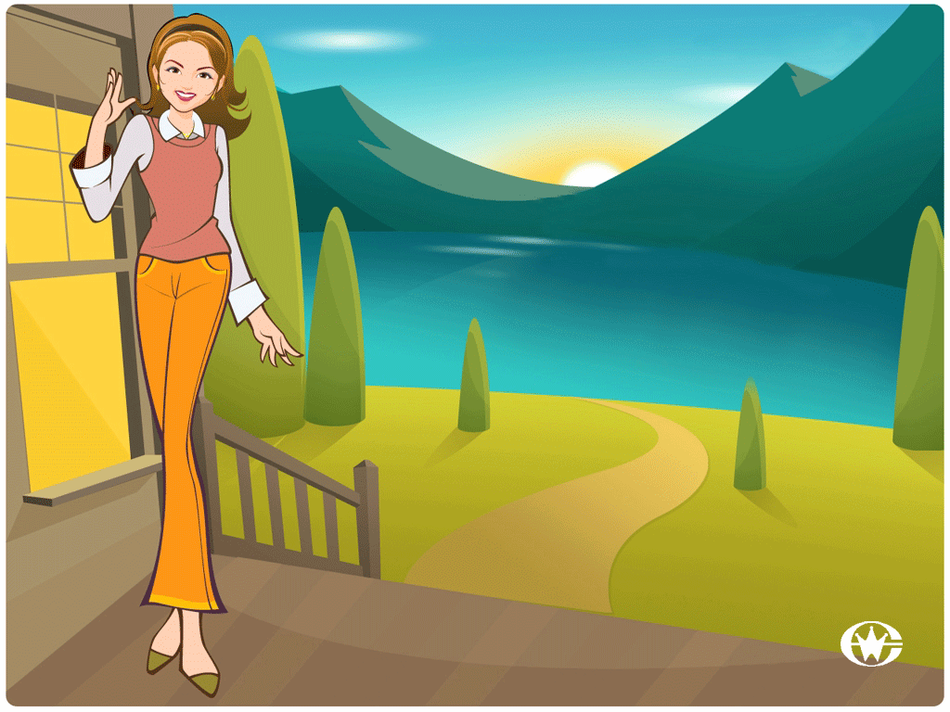
Thank you for listening!

