Slide 1
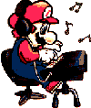

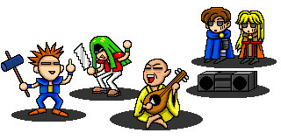
Unit 10
If you go to the party,
you'll have a great time!

Slide 2


happy
A:What will you do if you are happy?
B:I will… if I am happy.

Slide 3

angry
A:What will you do if you are angry?
B: I will… if I am angry.

Slide 4
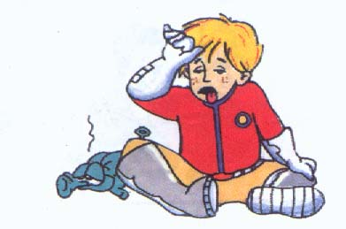
tired
A:What will you do if you are tired?
B: I will… if I am tired.

Slide 5

excited
Ａ: What will you do if you are excited?
B: I will…if I am excited.

Slide 6
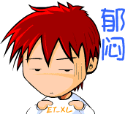
sad
Ａ: What will you do if you are sad?
B: I will… if I am sad.

Slide 7

A: If you have a robot, what will you do?
B: If I have a robot, I will let it
help with the housework.
babysit my daughter.
wake me up in the morning.
…

Slide 8




主句
从句
* What will you do if you are happy?
I will sing a song if I am happy.
* What will you do if you are sad?
I will cry if I am sad.
What will you do if you are tired?
I will have a rest if I am tired.
主句时态:
一般将来时
从句时态:
一般现在时

Slide 9

Grammar
if “如果, 假如”, 引导一个条件状语从句。要求主句用一般将来时态，从句用一般现在时态。
主 将 if 从 现
e.g. If it (rain), he (stay) at home.

Slide 10

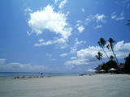


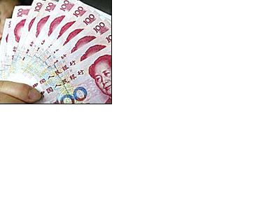

tomorrow
If it is sunny tomorrow,
I will play soccer.
be sunny
play soccer
If it is rainy tomorrow,
I will play the piano.
be rainy
play the piano
in the future
If I have much money,
I will buy a big house.
have much money
buy a big house

Slide 11



Competition
VS

Slide 12










if will
she, call me, I, tell her about it
If she calls me, I will tell her about it.
加
油

Slide 13
he ,come, next weekend, I ,tell you
If he comes next weekend, I will tell you.

Slide 14
not rain , go hiking ,this afternoon
If it doesn’t rain,
I will go hiking this afternoon.

Slide 15
no war, the world, more beautiful,
If there is no war,
the world will be more beautiful.

Slide 16
she, not exercise enough, heavier
If she doesn’t exercise enough,
she will be heavier.

Slide 17
he,have free time, go to Shanghai ,
If he has free time,
he will go to Shanghai.

Slide 18
you,eat too much, have a stomachache
If you eat too much,
you will have a stomachache.

Slide 19
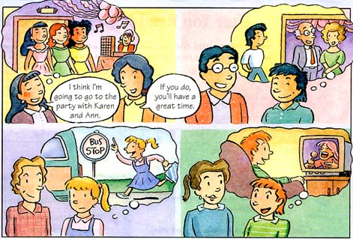
competition

Slide 20
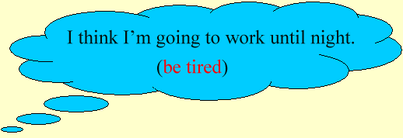
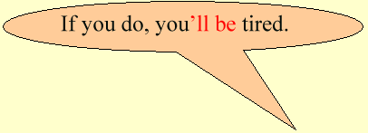


Patterns

Slide 21
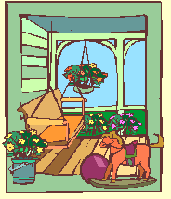


Patterns

Slide 22
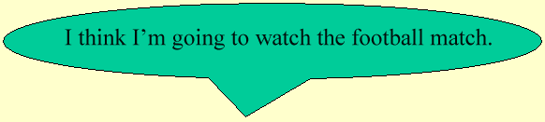
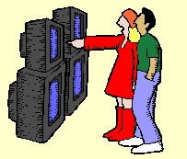


Patterns

Slide 23



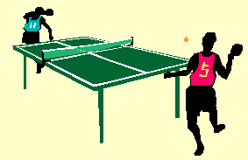
Patterns

Slide 24

Match the statements with responses.
1. I think I’m going to go to the party with Karen and Ann.
2. I think I’m going to wear jeans to the party.
3. I think I’m going to take the bus to the party.
4. I think I’m going to stay at home.
a. If you do, the teachers won’t let you in.
b. If you do, you’ll be late.
c. If you do, you’ll be sorry.
d. If you do, you’ll have a great time.

Slide 25
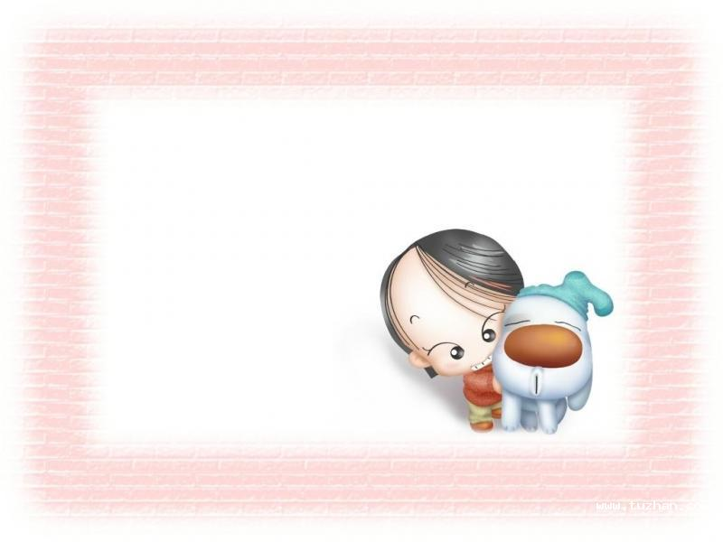
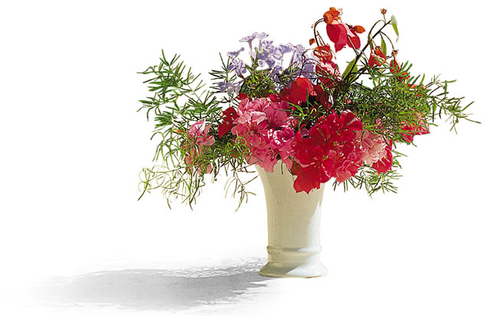

2a Listen and number these phrases in
the order you hear them.
3
a. study for the test
b. help me organize it
c. too early
d. make some food
e. Saturday afternoon
f. play party games
1
2
6
4
5

Slide 26

2b Listen again and answer the questions.
What will happen if they have the party today? | Half the class won’t come.
What will happen if they have the party tomorrow?
What will happen if they watch a video at the party?
What is Mark going to organize?
What is Andrea going to do?
Students will leave early to study for their tests.
Some students will be bored.
Mark is going to organize the party games.
Andrea is going to make some food.

Slide 27
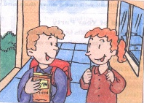
Pair work
OK, when is a good time to have the party?
Let’s have it today.
If we have it today, half the class won’t come.

Slide 28
Rules
Our Class Rules
1.Don’t wear your own clothes to school. If you do, we won’t let you in.
2.Don’t bring snacks or drinks to class.If you do, the teachers will call your parents to school.
3.Don’t bring your mobile phones to school. If you do ,the teachers will take them away.
4.Don’t talk in class. If you do, you’l l have to stay in the classroom after school .
5.Please clean the classroom every day.If you don’t , you will be laughed at.
6.Please work hard! If you don’t do this, you won’t pass the exams.
7.Please don’t be late.If you are late, you’l l have to ask your parents to come to school.
——Please love your class and your teachers!

Slide 29

Exercise
( )1.I think I’m going to stay at home. If you ______, you’ll be sorry.
will do B. do C. did D. does
( )2.I’ll go with you if I____ free.
will be B. would be C. am D. was
( )3.We____ go to the park if it doesn’t rain.
A./ B. will C. should D. can
B
C
B

Slide 30
Exercise
( )4.If he ___ fishing tomorrow, I’ll go with him.
A.go B. going C. goes D. went
( )5.Have a rest____ you are tired.
A. if B. unless C. where D. whether
C
A

Slide 31
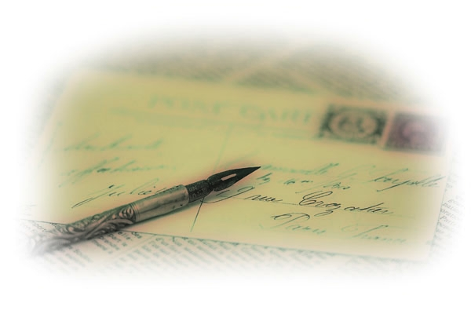
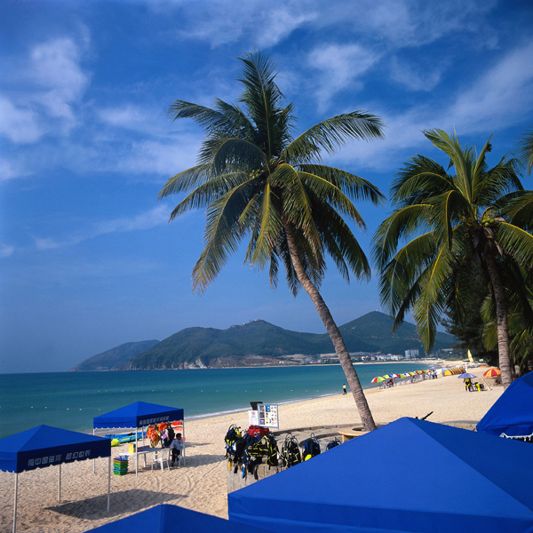

Homework
What are you doing for vacation ?
Write a short passage.
If I am a teacher,I will…

