Slide 1
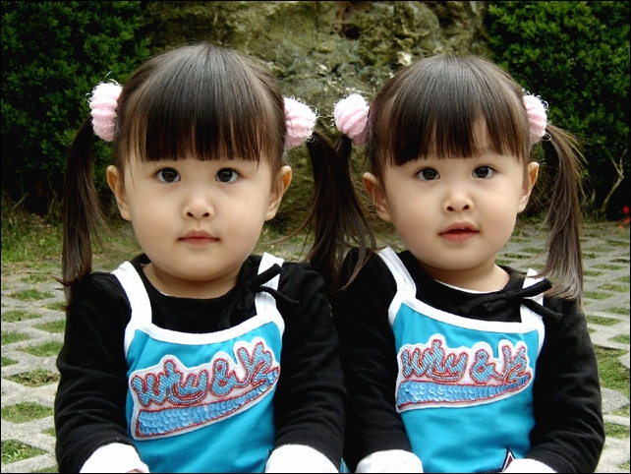
Unit 3
I’m more outgoing than my sister.
第一课时
Section A (1a-2d)

Slide 2
§自主学习方案
一、写出下列词的比较级形式。
（1）tall _______
（2）thin _________
（3）heavy __________
（4）outgoing __________
（5）fat _________
（6）long _________
（7）funny __________
（8）quiet _________
（9）loudly ___________
（10）quietly ______________
（11）good/well _________
taller
thinner
heavier
more outgoing
fatter
longer
funnier
quieter
more loudly
more quietly
better

Slide 3
二、翻译下列句子。
（1）——那是Tara，不是吗？
——不，不是。
_____ ?
____________.
（2）Sam的头发比汤姆的长。
.
（3）Sam和Tom两人都会打鼓。
.
（4）Sam比Tom打鼓打得好。
.
（5）她也比Tara唱的更大声。
.
—That’s Tara，isn’t it
—No ，it isn’t
Sam has longer hair than Tom
Both Sam and Tom can play the drums
Sam plays the drums better than Tom
She also sings more loudly than Tom

Slide 4
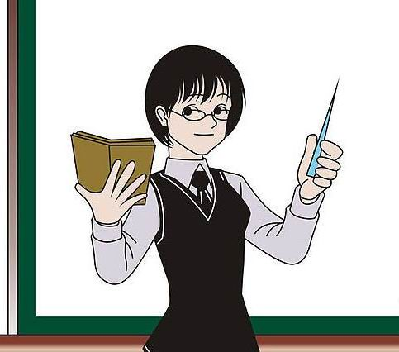
Step 1 准备与热身(Preparation)
How old are you?
You are younger
than him.
I am 15 years old.
I am 14 years old.
He is older than her.

Slide 5
Step 2 呈现与输(Presentation)
1a
Match each word with its opposite.
tall wild
thin short hair
long hair heavy
calm short

Slide 6
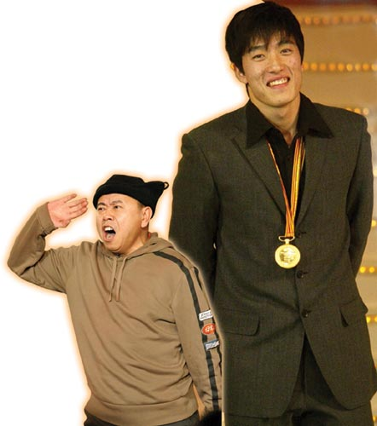
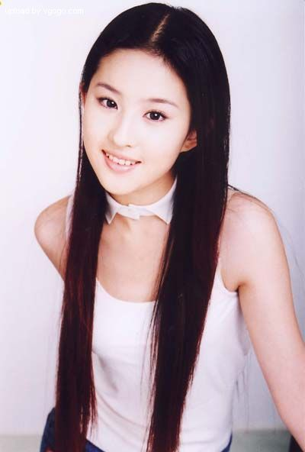
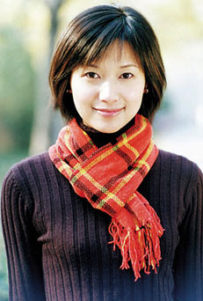
long hair
short hair
short
tall
has longer
Liu ____ ______ hair than Xu.
Xu ______ _______ hair than Liu.
has shorter
is taller than
Liu __ _____ ____ Pan.
is shorter than
Pan __ ______ ____ Liu.

Slide 7
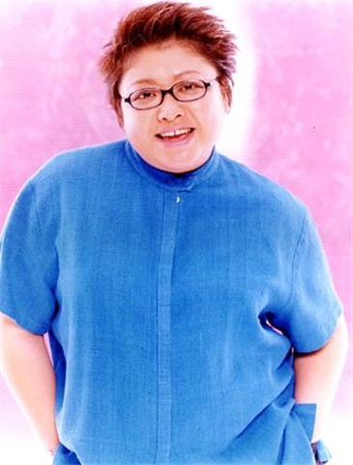
heavy
thin
is heavier than
Han ___ ________ ____ Lin.
is thinner than
Lin ___ _______ _____ Han.

Slide 8
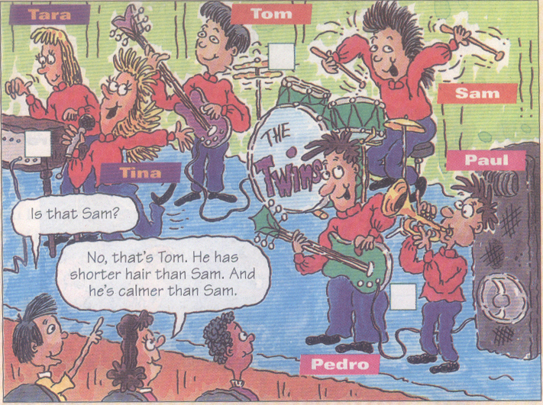
1b
Listen and number the pairs of twins in the pictures [1~3].
1
2
3

Slide 9
Can you compare the people in the picture?
Tom has shorter hair than Sam.
① Tom has shorter hair
than Sam.
② Tina is more outgoing
than Tara.
③ Paul is shorter than
Tom.
…

Slide 10
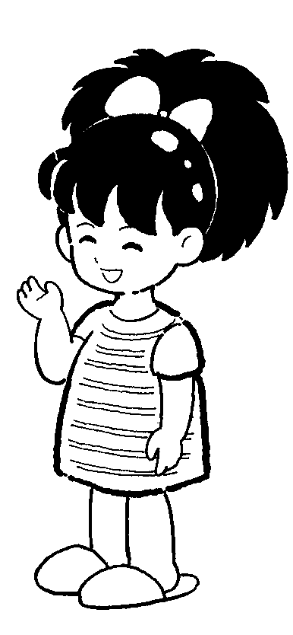
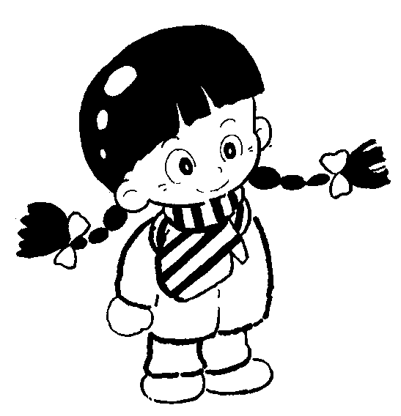
Pair work
No, it isn’t. It’s Tina. Tara’s shorter than Tina.
Is that Tara?

Slide 11
用所给词的适当形式填空。
1.Her twin sister is ___________than her.
(athletic)
2.Dave looks a little ______ than before.
(calm)
3.This piece of paper feels much _____(thin)
than that piece.
4.These pants are ______(new) than those .
5.It seems ____________(serious)than you
thought.
more athletic
calmer
thinner
newer
more serious

Slide 12
Step 3练习与体验 (Practice)
2a Listen. Are the words in the box used
With -(i)er or more? Complete the chart.
funny
(run) fast
friendly
(jump) high
hard-working
(get up) early
smart
lazy
-er/ier more
hard-working
friendly
funny
higher
earlier
smarter
lazier

Slide 13
2b Listen again. How are Tina and Tara
different? Fill in the chart.
Tina is …
funnier r
____________
____________
Tara is …
____________ r
____________
____________
smarter
more outgoing
quieter
more athletic
more serious

Slide 14
判断正(T)误(F)。
( )1.Tina thinks she is very different
from Tara.
( )2.Tara is more serious than Tina.
( )3.Tina is more athletic and smarter
than Tara.
T
T
F

Slide 15
Pair work
*** means Sam is taller than Tom.
Sam
Tom
A: Is Tom smarter
than Sam?
B: No, he isn’t.
smart
tall
athletic
quiet
thin
funny
***
*
*
***
***
*

Slide 16
Step 4 运用与生成 (Production)
Julie: Did you like the (sing) competition yesterday, Anna?
Anna: Oh, it was fantastic! Nelly sang so (good)!
Julie: Well, I think Lisa (sing) (well) than Nelly.
Anna: Oh, (哪一个)is Lisa?
Julie: The one shorter hair. I think she sang (clearly)
than Nelly.
Anna: Yes, but Nelly (dance) (well) than Lisa. Did you do
last month?
Julie: But you can tell that Lisa practiced (非常) more and
really wanted (win).
Anna: Well, everyone wants to win. But the (important)
thing is (learn) something and have fun.

Slide 17
A. Why do you think so
B. Did Lucy do well
C. Which one is Mary
D. Yes, I did. It was fantastic
E. Is she in Class One
A: Hello, did you go the singing competition?
B: .
A: ?
B: Yes, she did well. But Mary did better than her.
A: ?
B: I think Mary sang more loudly and clearly.
A: Yes. But Lucy dances better than Mary. She practises every day. And
she won the last dancing competition last week. ?
B: That girl in the red dress and with long hair.
A: I see. ?
B: Yes, she is. And she is my classmate.
D
B
A
C
E

Slide 18
Step 5 巩固与提高（Progress）
探究点（一）
Both Sam and Tom can play the drums.
both 表示“两者（都），两个（都）”，放在行为
动词之前，be动词、助动词或情态动词之后。
e.g. They both like playing basketball.
他们俩都喜欢打篮球。
The two students are both from Class 5.
这两个学生都是5班的。
【注意】
all 表示“（三者或者三者以上）都……”。
e.g.There are five children in the room. They are
all Mr. Green’s children.

Slide 19
【拓展】 关于both的短语：
(1) both of 后接名词、代词的复数形式，接名词
时，名词前要有定冠词the或是形容词性物主代
词（my，your … ）。
(2) 用作副词，常用于both … and … 结构中，意
为“既……又……，……和……都”。
跟踪训练
（ ）1. I have two children，and _____ of them
are working in the west of China.
A. all B. both C. neither D. either
（ ）2. There are a lot of colorful flowers on
_____ sides of the streets.
A. each B. both C. either D. all
B
B

Slide 20
探究点（二）
Sam has longer hair than Tom.
这是一个含比较级的句子，用于两者或两部分之
间的比较，意为“更……，较……一些”。通常用
than 连接另一方，单音节形容词或副词在词尾加
-er，但要注意比较对象的对等。
e.g. My book is newer than hers.
我的书比她的新。
Tom is shorter than Paul.
Tom比Paul矮。

Slide 21
跟踪训练
1. My hair is longer than Tara’s.（同义句）
Tara’s mine .
Tara _____________________ .
2. He is _________ （outgoing）than
me.
3.我比他胖。 _________________.
他比我瘦。 __________________.
hair is shorter than
has shorter hair than me
more outgoing
I am fatter than him
He is thinner than me

Slide 22
Exercise
一、按要求写出下列各词的正确形式。
1 easy(比较级)：___________
2 different(名词)：_________
3 many(比较级):______
4 serious(比较级):_____________
5 friendly(比较级):_________
easier
difference
more
more serious
friendlier

Slide 23
6 funny(比较级)_________
7 outgoing(比较级)_______
8 quiet(反义词)_________
9 tall(反义词)____________
10 beautiful(比较级)______________
easier
more outgoing
loud
short
more beautiful

Slide 24
二、同义句转换。
This picture looks beautiful, but that one
looks more beautiful.
That picture looks ______ _________ _______ this one.
2. She has longer hair than Emma.
Her hair is ______ _______ _______.
3.Helen studies hardest in her class.
Helen studies ________ than ______ _______ student in her class.
more beautiful than
longer than Emma's
harder any other

Slide 25
4. My father is two years older than my mother.
My mother is _______ _______ _______ than
my father.
5. Li Lei is taller than his twin brother.
Li Lei is _______ ________ of the twins.
6. Dave is heavy, but he can run fast.
________ Dave is heavy, he can run fast.
two years younger
the taller
Though

Slide 26
Step 6 家庭作业(Homework)
1. Write about the things that are the
same and different between you
and your best friend.
2. 完成本单元的练习。

Slide 27
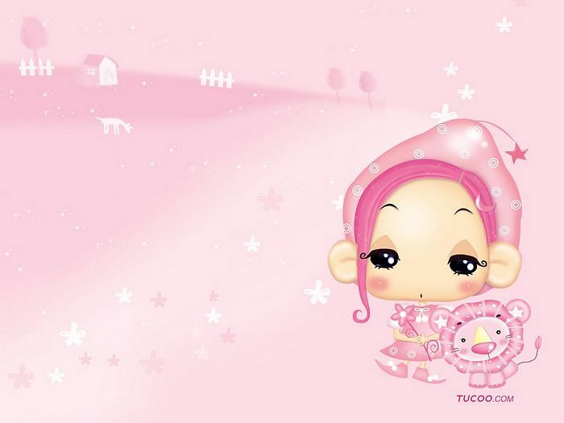
Thank you for listening!

