Slide 2
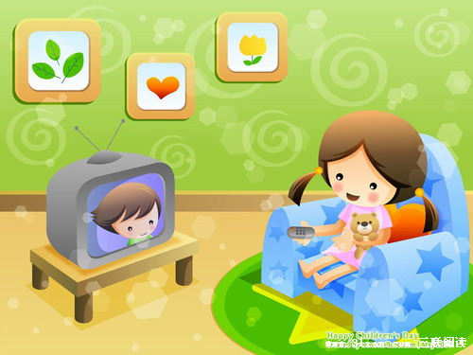
I'm watching TV.

Slide 3
Section A 1
1a-2d

Slide 4
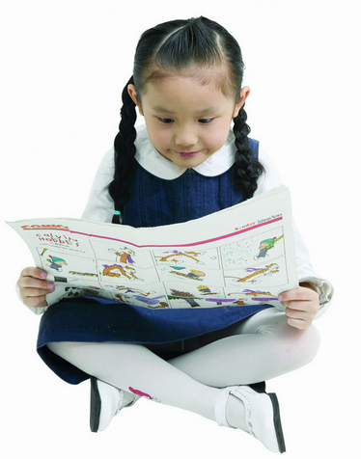
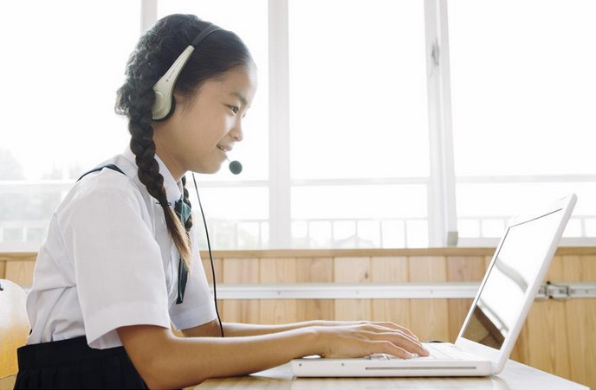
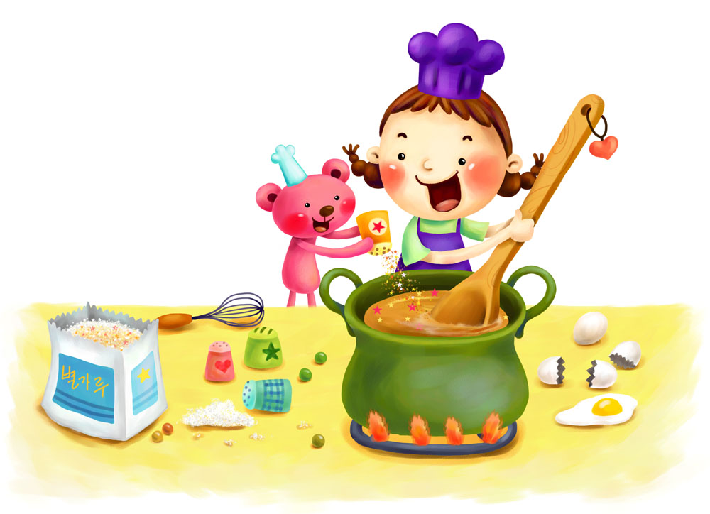
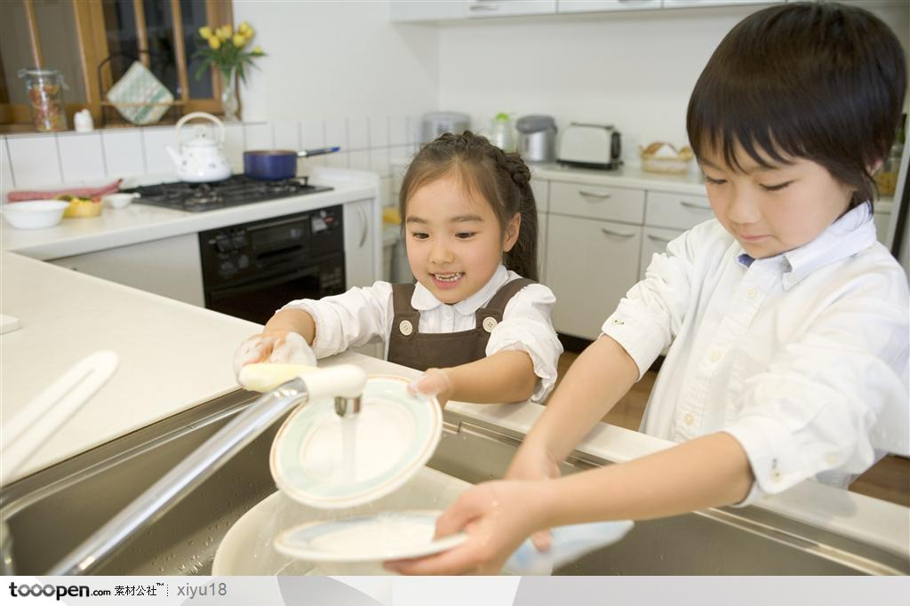
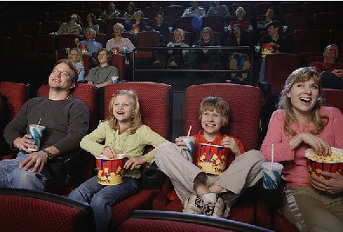
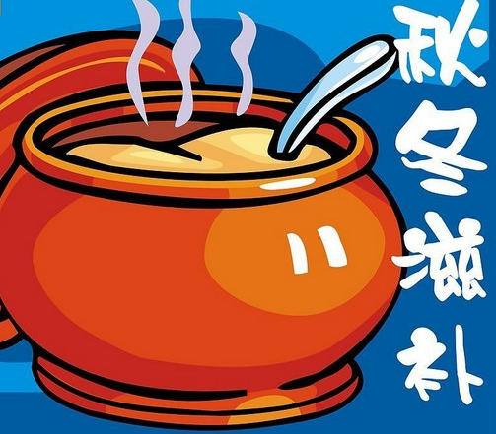
New words
newspaper
n. 报纸
read a newspaper 看报纸
use the computer 用电脑
make soup 做汤
wash the dishes 洗碗
go to a movie 看电影
soup n. 汤

Slide 5
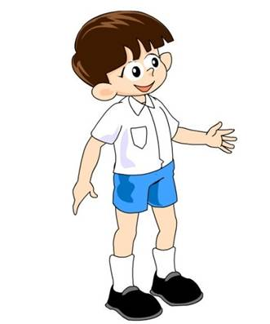
What are you doing now?
I’m watching TV.

Slide 6
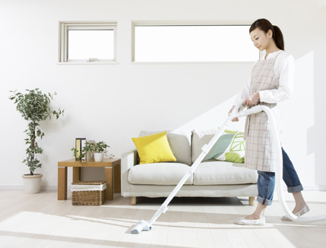
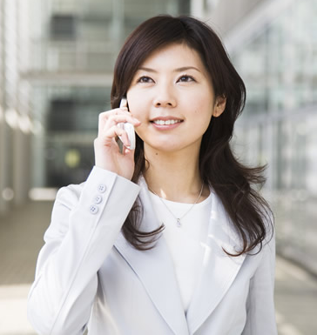
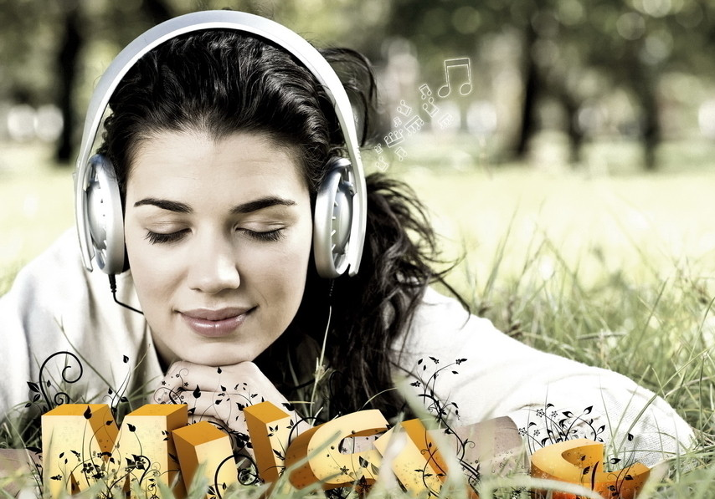
cleaning
reading a newspaper
talking on the phone
listening to a CD

Slide 7
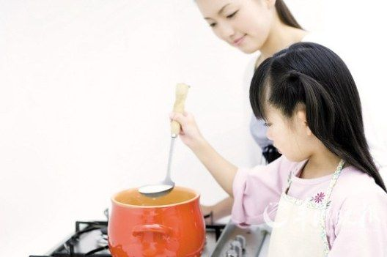
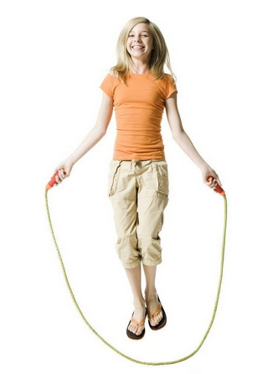
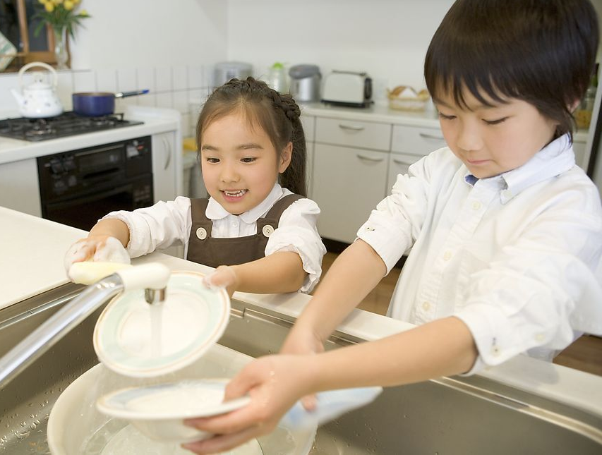
using the computer
making soup
washing the dishes
exercising

Slide 8
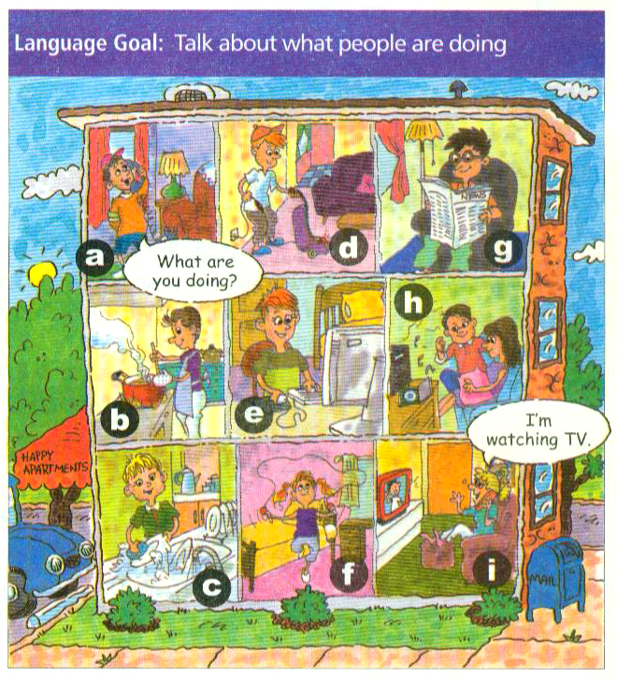
Match the activities with the pictures.
1a
i
1. watching TV __
2. cleaning __
3. reading a newspaper __
4. talking on the phone __
5. listening to a CD __
6. using the computer __
7. making soup ___
8. washing the dishes __
9. exercising ___
d
g
a
h
e
b
c
f

Slide 9
Listen. What are these people doing? Write the numbers from 1a.
1b
a. Jenny ___
b. John ___
c. Dave and Mary ___
1
8
5

Slide 10
What’s she doing?
She’s using the computer.

Slide 11
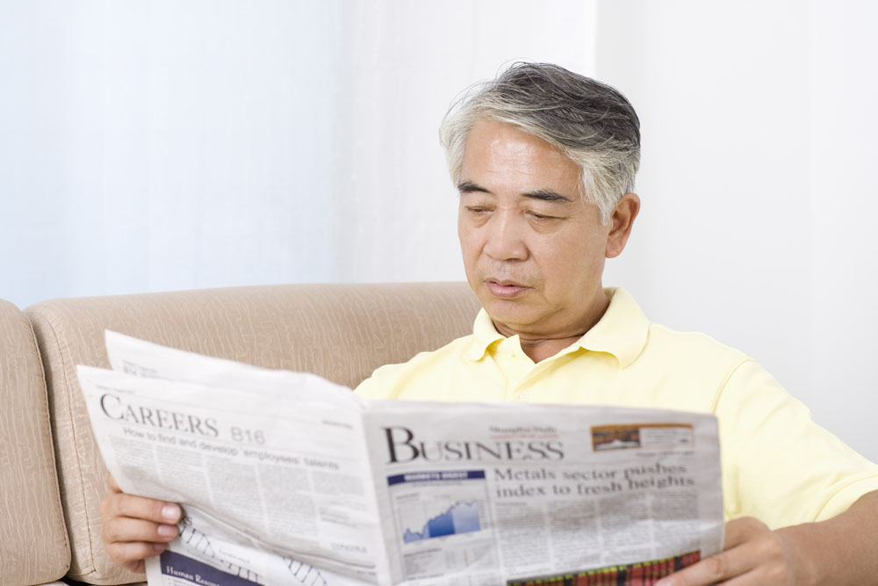
What’s he doing?
He’s reading a newspaper.

Slide 12
What’s she doing?
She’s exercising.

Slide 13
What’re they doing?
They’re washing the dishes.

Slide 14
What’s she doing?
She’s cleaning.

Slide 15
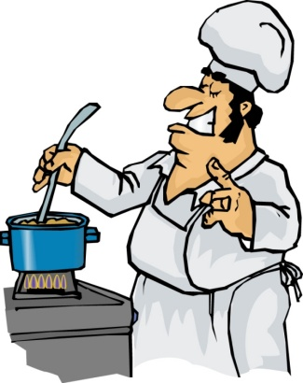
What’s he doing?
He’s making the soup.

Slide 16
What’s she doing?
She’s talking on the phone.

Slide 17
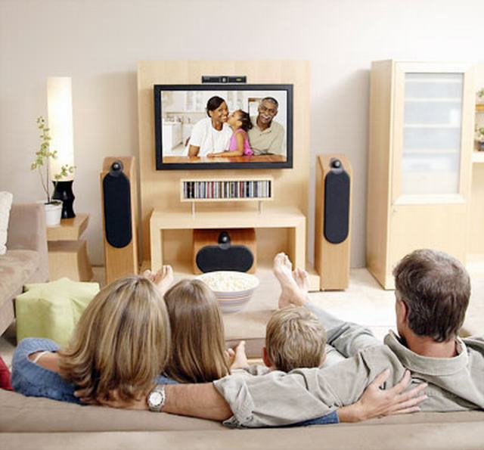
What are they doing?
They’re watching TV.

Slide 18
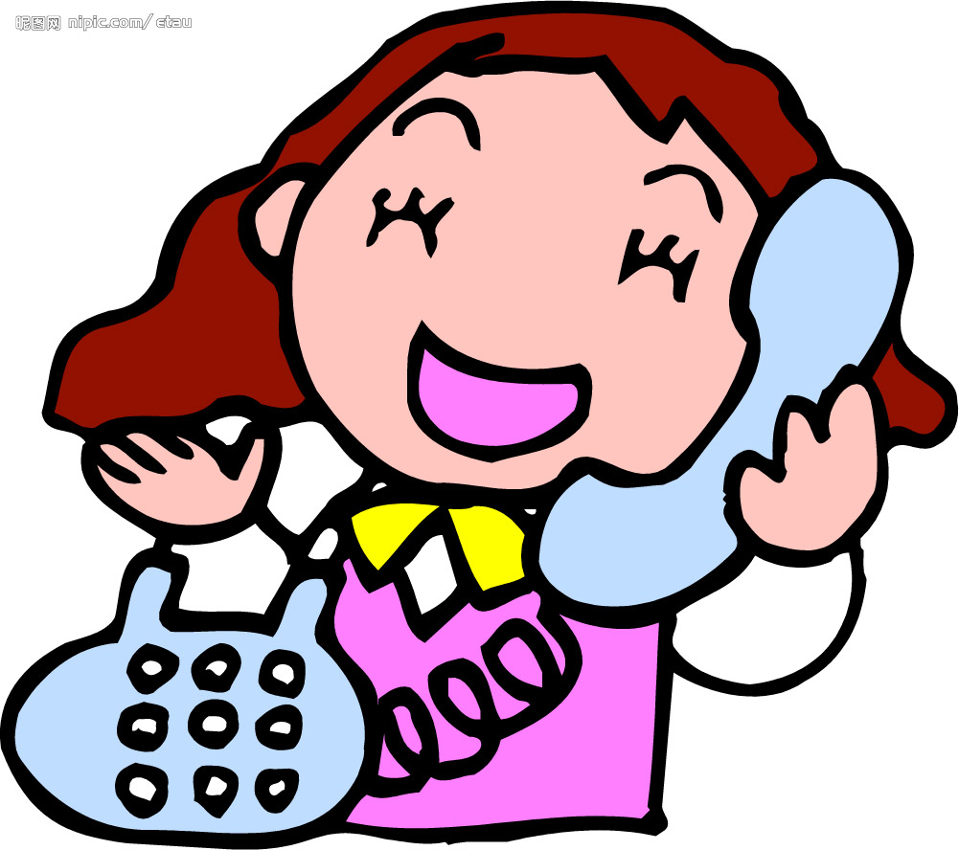
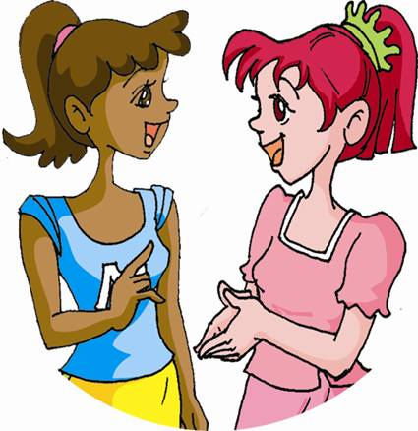
Ask and answer questions about what people are doing in 1a.
1c
She’s talking on the phone.
What’s she doing?

Slide 19
What’s he doing?
He’s making the soup.
What’re they doing?
They’re washing the dishes.

Slide 20
What’s she doing?
She’s cleaning.
What’s she doing?
She’s using computer.

Slide 21
What’s she doing?
She’s exercising.
He’s reading a newspaper.
What’s he doing?

Slide 22
What’s she doing?
She’s listening to a CD.
They’re watching TV.
What’re they doing?

Slide 23
Listening
Listen and match the answers
with the questions.
2a
1. What is Steve
doing?
2. What is Jack
doing?
a. He is watching TV.
b. He is listening to a
CD.

Slide 24
2b
Listen again. Fill in the blanks.
Jack: Hello, Steve.
Steve: Hi, Jack.
Jack: What _____ you ______, Steve?
Steve: I’m ___________. What about you?
Jack: I’m _______________, but it’s kind of
_______.
Steve: Yeah, my TV show is also not very
__________. Do you want to _____ the movies?
Jack: That sounds good.
are doing
watching TV
listening to a CD
boring
interesting
go to

Slide 25
2c
Role-play the conversation in 2b.

Slide 26
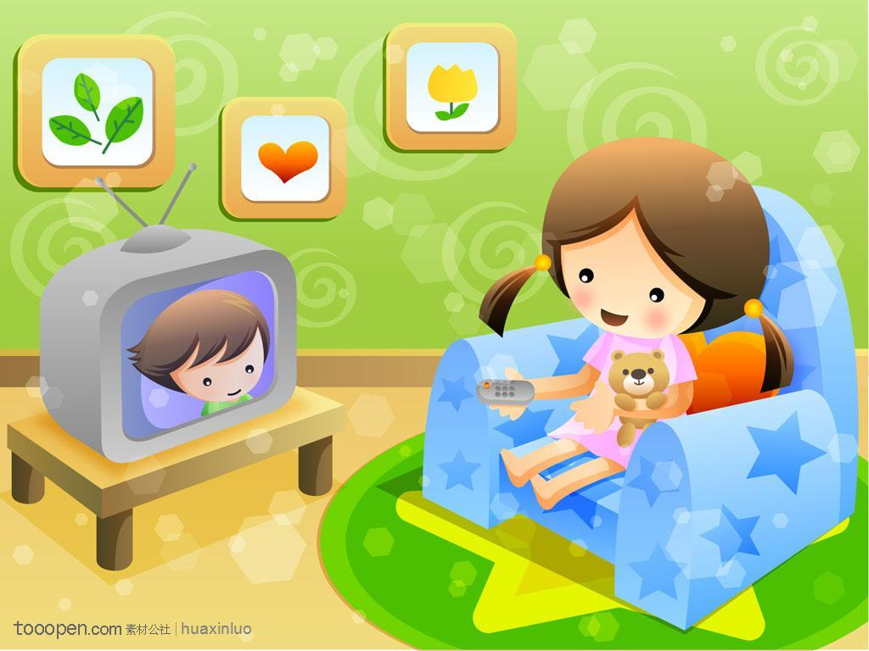
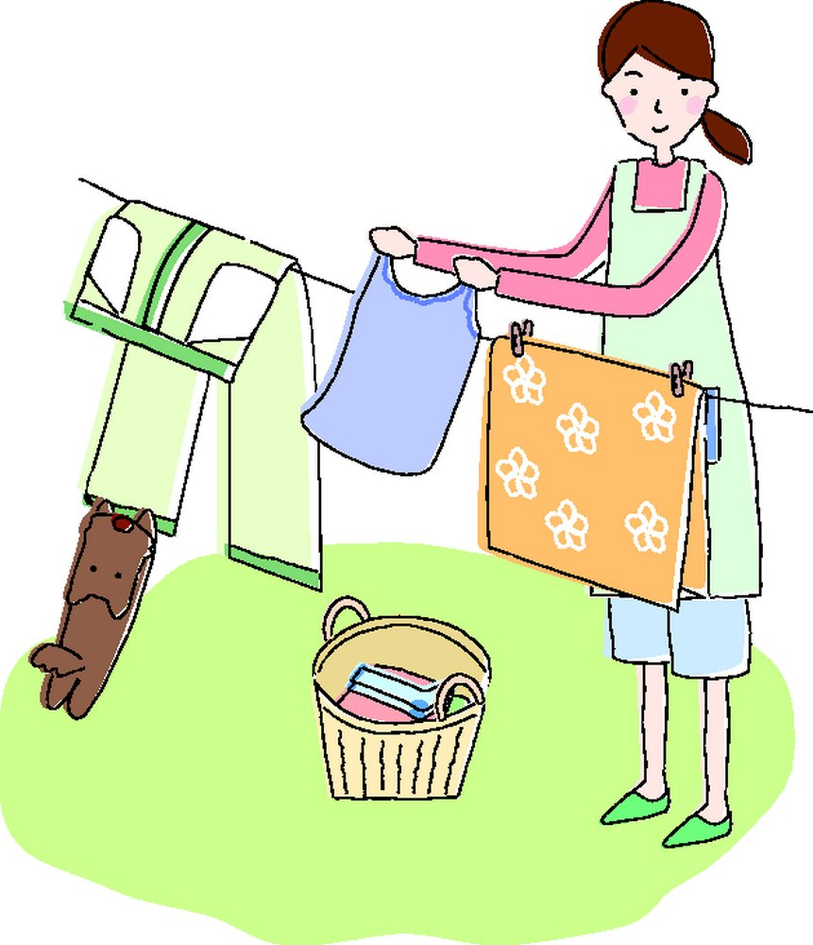
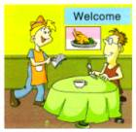
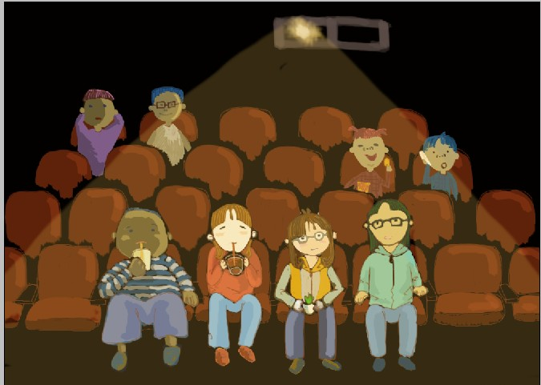
Read the conversation in 2d and match.
2d
Laura
Jenny
eat out
go to a movie
want to

Slide 27
Role-play
Role-play the conversation in 2d.

Slide 28
Language points
1. This is Jenny. 我是詹妮。
这是打电话用语。当打电话时，介绍自己时用“This is…”或“It’s…”；问对方用“Is that…?”或“Who’s that?”。例如：
— Hello? This is Bob, who’s that? 喂？我是鲍勃，你是谁？
— Hi, Bob. It’s Mike here. 你好，鲍勃。我是迈克。

Slide 29
2. Not much. （口语）没什么大事。也可说成Nothing much，表示自己有空。 例如：
A: What are you doing, Linda? 你在做什么事，琳达？
B: Not (Nothing) much. I’m just reading a
book.
没什么事。我在读一本书。

Slide 30
3. Do you want to join me for dinner?
你想和我一起吃个饭吗？
join somebody for something表示“与某人一起做某事；参与或加入到某人的行列中一起做某事”。例如：
Would you come and join us for a cup of coffee? We need to talk to you.
你来跟我们喝杯咖啡好吗？我们有事要跟你谈。

Slide 31
4. I’d love to. 我很乐意。
1) 交际用语，用于礼貌地接受他人邀请，还可以说成I’d like to，但语气比较弱。例如：
—Would you like to come with us to the
show? 你愿意跟我们一起去看表演吗？
—Thanks. I’d like to. 谢谢，我愿意。

Slide 32
2) 当委婉拒绝他人邀请时，多用I’d love to, but...或Sorry, I’m afraid I can’t because...等。例如：
—I’m going to town. Would you like to join
me? 我进城去，你想跟我一同去吗？
—Sorry, I’m afraid I can’t because I still have
lots of homework to do. 真抱歉，怕是不成
了，我还有好多作业要做呢。

Slide 33
小试身手
1. 你好！我是李明。___________________
你好，李明。我是杰克。 _________________________
2. 你在做什么王芳？_______________________________
没什么。我在看报纸。 _______________________________
3. 你想和我们一起去吃晚饭吗？______________________________
Hello. This is Li Ming.
Hi, Li Ming. It’s Jack here.
What are you doing, Wang Fang?
Not much. I’m reading a newspaper.
Do you want to join us for dinner?

Slide 34
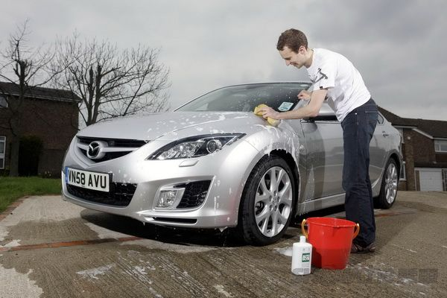
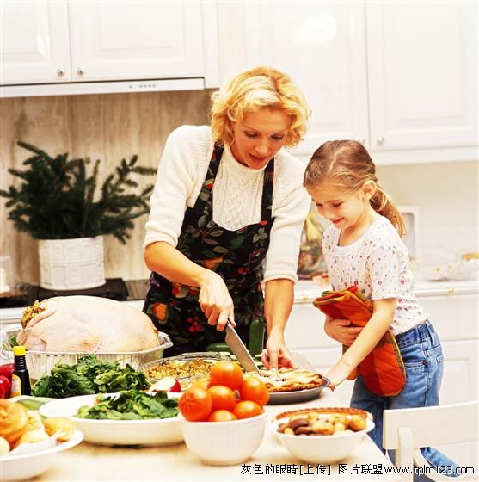
Exercise
看图补全对话。
—Hi, Li Xue. What _____
you _____?
— I’m __________.
— What ___ your dad ______?
— He’s ________ his car.
— What __ your mom _____?
— She is _________ in the kitchen.
— What about your sister?
— She’s _______ my mom.
are
doing
exercising
is doing
cleaning
is doing
cooking
helping

Slide 35
Homework
总结所学过的活动，用英语写出来。
在家里打个电话询问一下你的某个好朋友正在做什么？然后用英语编写成对话。

