Slide 1
Unit 8
How do you make a banana milk shake?

Slide 2
Section A
(1a-2b)

Slide 3
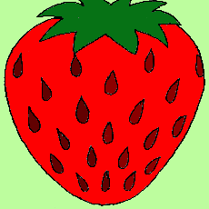
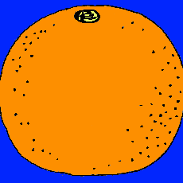
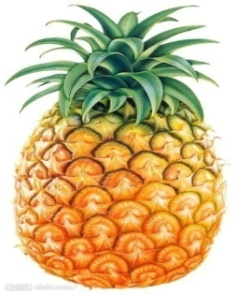
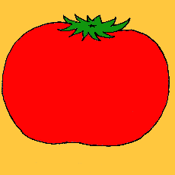
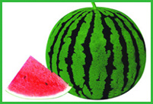
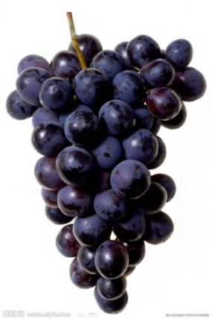
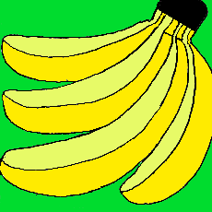
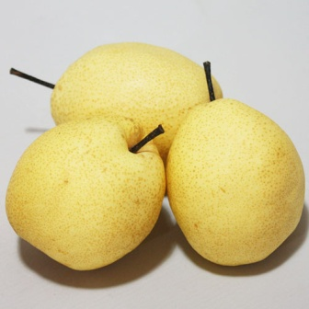
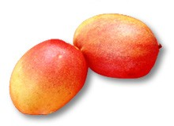
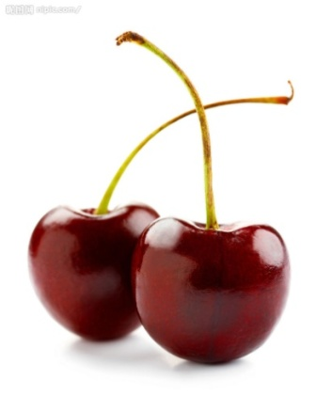
What’s your favorite fruit?
tomatoes
strawberries
oranges
pineapple
bananas
watermelon
grapes
pears
mangoes
cherries
apples

Slide 4
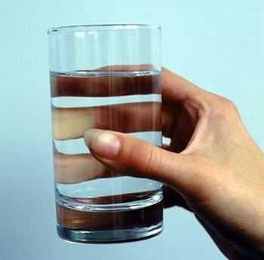
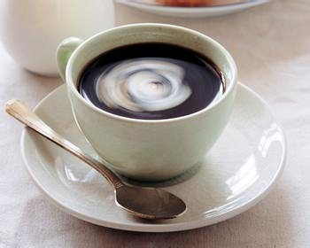
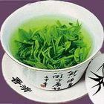
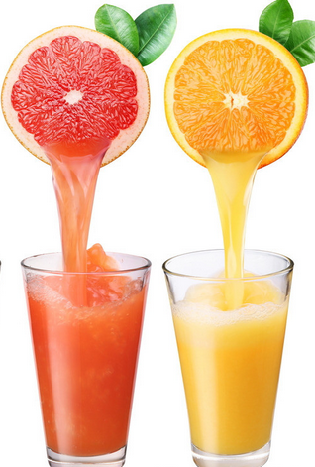
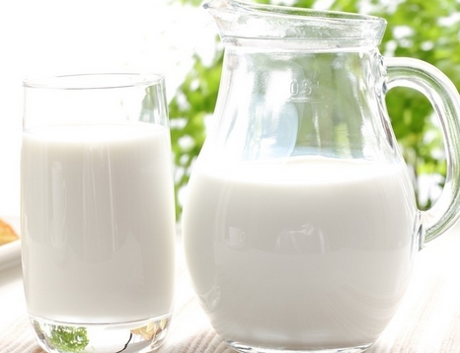
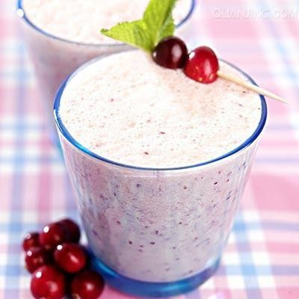
What’s your favorite drink?
water
tea
coffee
milk
juice
milk shake

Slide 5
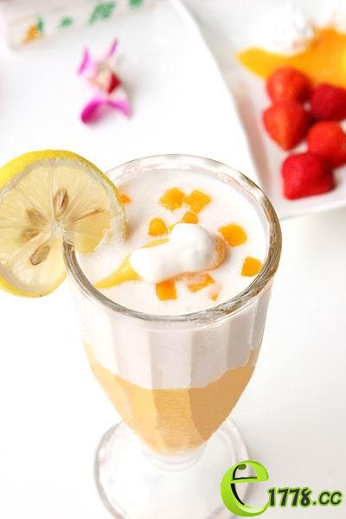
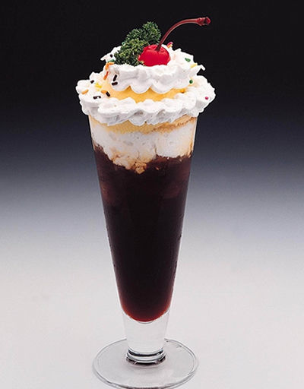
milk shark
将牛奶或冰激凌与水果或香料混合或搅拌至起泡的饮料。

Slide 6
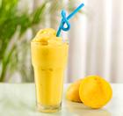
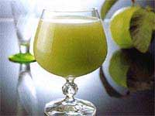
What kind of the shake do you like?
apple shake
mango shake
strawberry shake

Slide 7
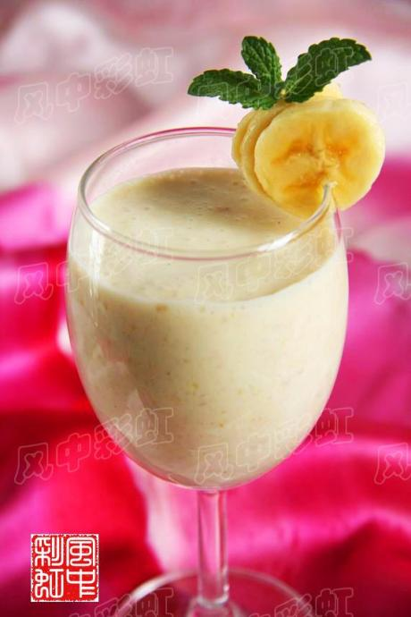
Lead-in
Do you like milk shake?
Can you make a banana
milk shake?
So today I want to teach you
how to make
a banana milk shake.

Slide 8
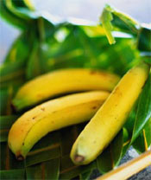
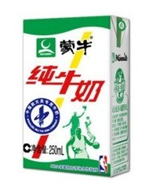
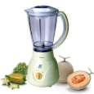
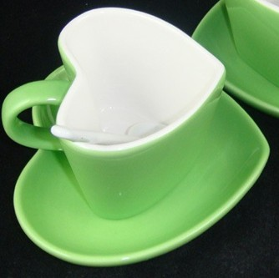
What do we need?
bananas
ice-cream
milk
blender
knife
cup

Slide 9
How do you make a
banana milk shake?
First, …
Next, …
Then, …
Finally, …

Slide 10
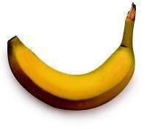
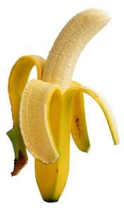
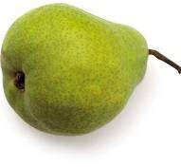
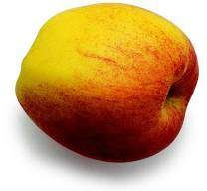
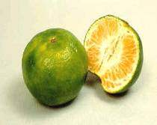
peel
peel a banana
peel a pear
peel an apple
peel some oranges
剥，削

Slide 11
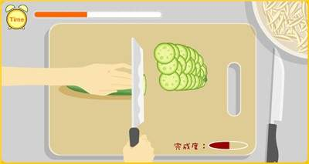
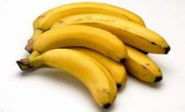
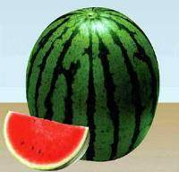
cut up
cut up the bananas
cut it up
切

Slide 12
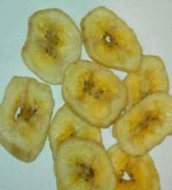
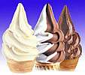
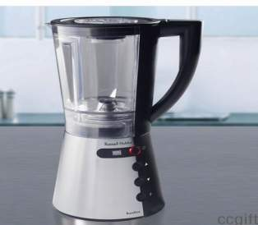
put
in
放在……里面
put the bananas and ice-cream in the blender

Slide 13
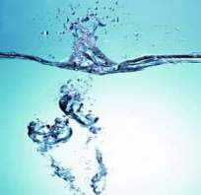
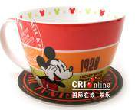
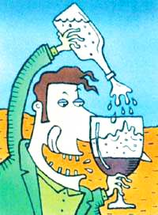
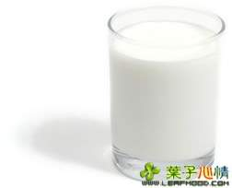
pour…into…
pour the water into the cup
pour the milk into the blender
倒

Slide 14
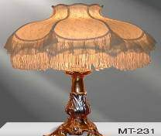
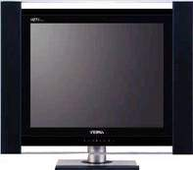
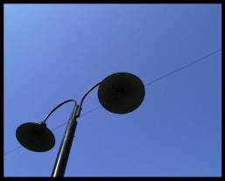
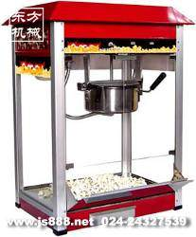
turn on
turn on/off the blender
打开
turn it on/off
turn on/off the popper
turn off
关上

Slide 15
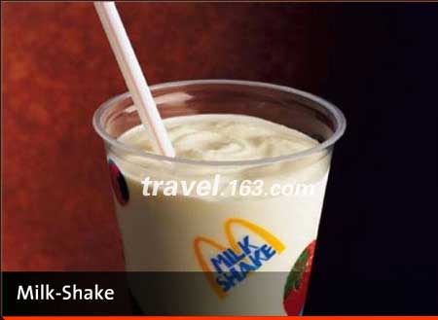
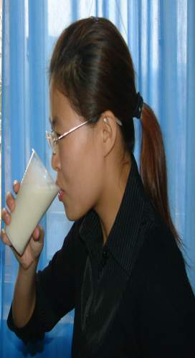
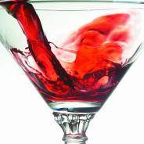
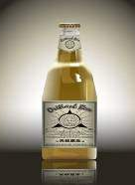
drink
a
cup glass bottle bowl
of
milk shake water milk tea
喝

Slide 16
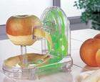
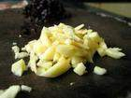
Read the new words
peel
cut up
put…in…
pour..into…
turn on
drink

Slide 17
How do you make a banana milk shake?
Step 1
Peel the bananas.

Slide 18
Step 2
Cut up the bananas.

Slide 19
Step 3
Put the bananas and ice-cream
into the blender.

Slide 20
Step 4
Pour the milk into the blender.

Slide 21
Step 5
Turn on the blender.

Slide 22
Step 6
Drink it.

Slide 23
Game
Tell me what you see.

Slide 24
How do we make it?
Write these words in the blanks in the picture above.
1a
turn on cut up drink peel pour put

Slide 25
turn on | cut up | drink | peel | pour | put
drink
pour
peel
cut up
put
turn on

Slide 26
Listening
Listen and put the instructions in order.
1b
_____ Turn on the blender.
_____ Cut up the bananas.
_____ Drink the milk shake.
_____ Pour the milk into the blender.
_____ Put the bananas and ice-cream
in the blender.
_____ Peel three bananas.
5
2
6
4
3
1

Slide 27
Retell the process(过程)
A: I’m hungry! Let’s make a banana milk shake.
B: How do you make a banana milk shake?
A: Well, first peel three bananas.
B: Three bananas?
A: Yes. Then cup up the bananas.
B: OK, I’m finished.
A: Now put the bananas and ice cream in the blender. Then pour the milk in the blender.
B: Is this enough milk?
A: I guess so. Next, turn on the blender. Finally, pour the milk shake in a glass and drink it.

Slide 28
Translation
First,…
首先……
接下来……
然后……
最后……
Next,…
Then,…
Finally,…

Slide 29
How to make a banana milk shake?
First, peel…
Next, cut up…
Next, put… into…
Then,
pour…into...
Next, turn on…
Finally drink…

Slide 30
Tell your partner how to make a banana milk shake.
Pair work
1c
How do you make a banana milk shake?
First, peel the bananas…

Slide 31
New words
yogurt
honey
watermelon
spoon
pot
salt

Slide 32
Do you like fruit salad?

Slide 33
How do you make fruits salad?
If you want to make a fruit salad, what do you need?

Slide 34
Clean and put the fruit in a bowl.

Slide 35
Peel the fruit.

Slide 36
Cut up the fruit.

Slide 37
Pour one cup of yogurt into the bowl and mix it all up.

Slide 38
Eat the fruit salad.

Slide 39
Listening
2a
Listen and complete the chart.
How many | bananas
How much | yogurt
apples
watermelons
oranges
honey

Slide 40
2b
Listen again. Write the ingredients under the correct amount in the chart.
one | watermelon
two
three
one cup
two spoons
apples
bananas
yogurt
honey

Slide 41
Exercises
I. Complete the sentences.
peel
1. Please ______(剥) an orange for
your grandma.
2. I want some ________(蜂蜜) in my water。
3. My mother puts ______ ___________(两勺)
of honey in it.
4. How do you ________ (做) the fruit salad?
honey
two teaspoons
make

Slide 42
II. Write these words in the blanks.
finally then next first
A: How do you make fruit salad?
B: _______ cut up three bananas, three
apples and a watermelon. _______
put the fruit in a bowl. _________
put in two teaspoons of honey and a
cup of yogurt. __________ mix it all up.
First
Next
Then
Finally

Slide 43
Homework
做自己喜欢的水果奶昔，并简要说明过程。
可以用下列表示过程的词汇来让你描述更加清晰明了。
first, next, then, finally…

