Slide 1
Unit 3
Is this your pencil?
Section A (1a-1c)
人教版七年级(初中)英语上册
0

Slide 2
Learning objectives
1）Key words & phrases：pencil, pen, book, eraser, ruler, pencil box, schoolbag, dictionary. 2）To learn the following sentence patterns:
① —Is this your pencil?
—Yes, it is. It’s mine.
② —Are these your books?
—No, they aren’t. They’re hers.
3）To learn to use Yes/No question and short answers.
0

Slide 3
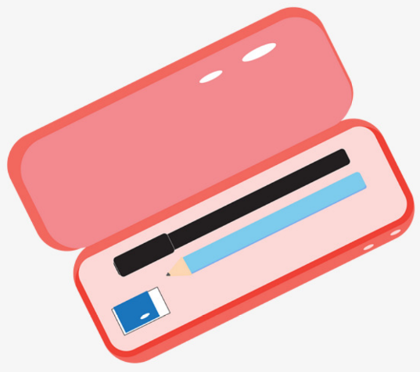
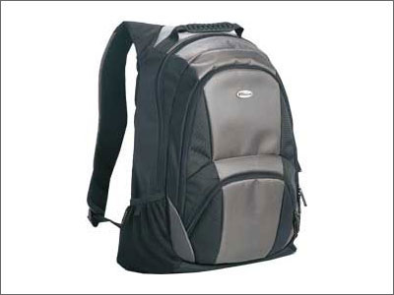
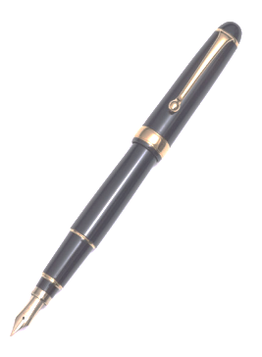
Lead in
—What’s this in English?
—It’s a/an…
a pen
a pencil
a pencil box
a schoolbag

Slide 4
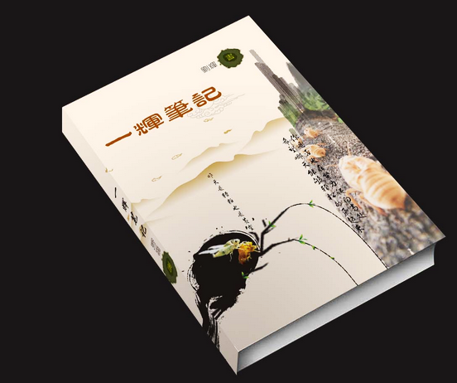
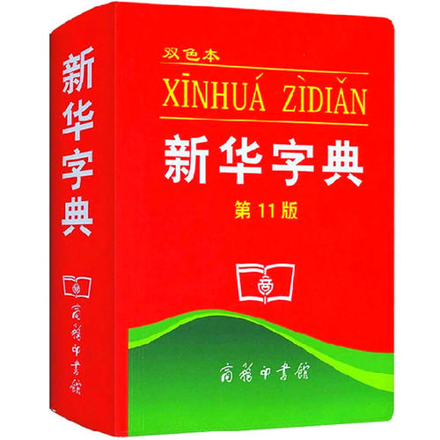
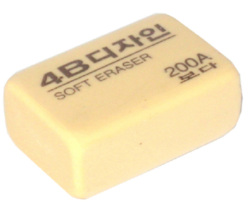
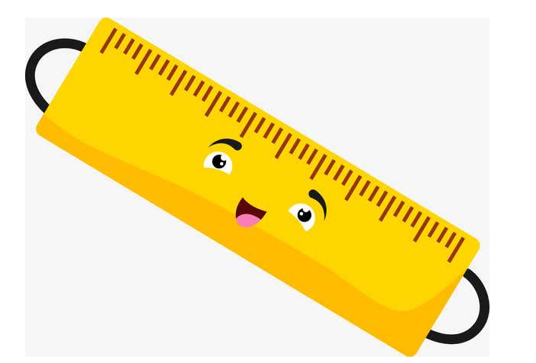
Lead in
—What’s this in English?
—It’s a/an…
a book
a dictionary
an eraser
a ruler

Slide 5
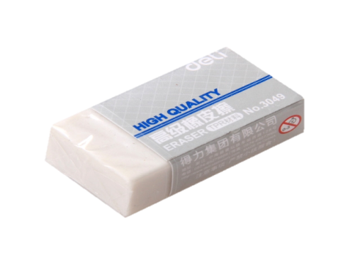
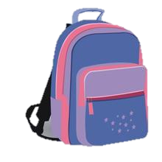
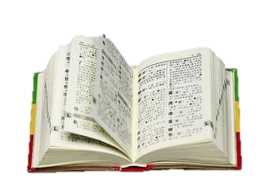
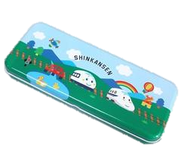
Presentation
—What’s this/that? —It’s a/an … .
—Is this/that your ...? —Yes, it is mine./No, it isn't. It's his/hers.
a pencil
a pen
a notebook
an eraser
a ruler
a pencil box
a schoolbag
a dictionary

Slide 6
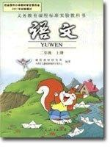
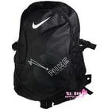
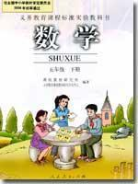
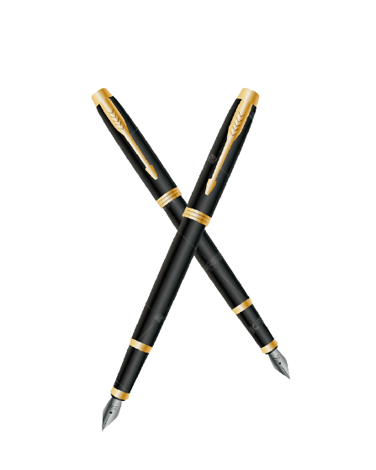
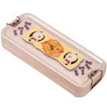
Presentation
—What’s these/those? —They're …
—Are they your ...? —Yes, they are mine./No, they aren't, they're his/hers.
pencils
books
schoolbags
rulers
erasers
dictionaries
pens
pencil boxes

Slide 7
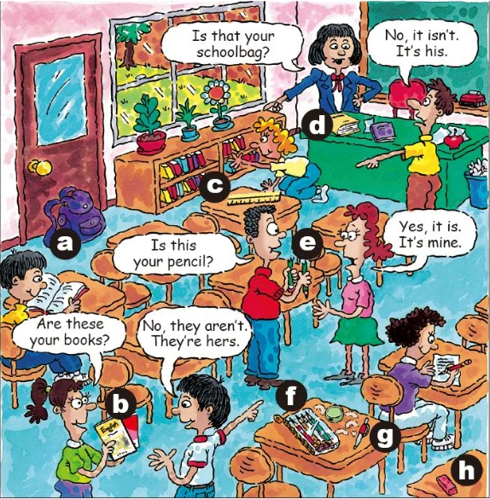
Presentation
1a Match the words with the things in the picture.
1. pencil __
2. pen __
3. books __
4. eraser __
5. ruler __
6. pencil box __
7. schoolbag __
8. dictionary __
e
g
b
h
c
f
a
d

Slide 8
Presentation
1b Listen and number the conversations(1-3).
A: Is this your pencil?
B: Yes, it is. It’s mine.
3
A: Is that your schoolbag?
B: No, it isn’t. It’s his.
2
A: Are these your books?
B: No, they aren’t. They’re hers.
1

Slide 9
Presentation
Listen and fill in the things you hear.
Conversation 1: _____________
Conversation 2: _____________
Conversation 3: _____________
books
schoolbag
pencil

Slide 10
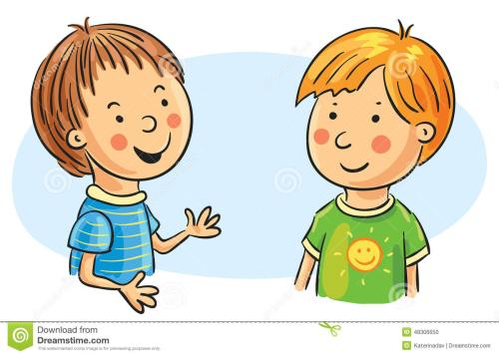
Presentation
1c Practice the conversations above with your partner. Then make your own conversations.
my pencil
Is this your eraser?
Yes, it is. It’s mine.
No, they aren’t. They’re his.
Are these your pencils?
his pencils

Slide 11
Language points
1. Is this your pencil?
含be动词的一般疑问句
（1）结构：Be动词(am/is/are)+主语+其他?
（2）肯否回答：Yes, 主语+be动词(am/is/are).
否定回答：No, 主语+be动词(am/is/are)+not.
（3）一般疑问句主语是this, that, these, those，
回答时用it指代this/that；用they指代these/those。

Slide 12
Language points
—Is this an English book? 这是一本英语书吗？
—Yes, it is. 是的，它是。
—Are those his books? 那些是他的书吗？
—No, they aren’t. 不，它们不是。

Slide 13
Language points
①—这是你的橡皮吗？ — ___ _____ your eraser?
—不，它不是。 — No, ___ _____.
②—那是你的字典吗？ — ___ ____ your dictionary?
—是的，它是。 — Yes, ___ ___.
③ —这些是你的铅笔吗？ — _____ _____ your pencils?
—不，它们不是。 — No, _____ ______.
Is this
it isn’t
Is that
it is
Are these
they aren’t

Slide 14
Language points
2. They’re hers.
名词性物主代词
hers在此处作名词性物主代词， 意为“她的”，等同于
“her（形容词性物主代词）+名词”。
数/人称 类别 | 单数 |  |  |  |  | 复数
 | 第一 人称 | 第二 人称 | 第三人称 |  |  | 第一 人称 | 第二 人称 | 第三 人称
名词性物主代词 | mine | yours | his | hers | its | ours | yours | theirs
含义 | 我的 | 你的 | 他的 | 她的 | 它的 | 我们的 | 你们的 | 他/她/它们的

Slide 15
Language points
—Is this your eraser?
—Is that your pencil?
—No, it isn’t. It’s his.
—No, it isn’t. It’s hers.
=his eraser
=her pencil
—Are these your dictionaries?
—Yes, they are.They’re mine.
=my dictionaries

Slide 16
Exercise
用所给词的适当形式填空
1. —Is that (she) schoolbag? —Yes, it is.
2. This isn’t Tom’s pen. It’s (I) .
3. —Are these your pencils?
—Yes, __________ (it) are.
4. These keys are __________ (Bob).
5. —Are these your _________ (book)?
—No, they are _______ (he).
her
mine
they
Bob’s
books
his

Slide 17
Homework
1. Copy the key words in 1a for three times.
2. Make up two similar conversations according to 1b, and translate them into Chinese.

