Slide 1
R·九年级全一册
Unit 8 It must belong to Carla.
第二课时

Slide 2
Lead in
Whose notebook is this?
It must be Tom's, because his name is on it.

Slide 3
I lost my book, I think somebody must have picked it up.
What's wrong with you?

Slide 4
Language points
一、pick up 拿起；捡起
1. 结构：动词+副词
注意：当其宾语是名词时，该名词既可位于up之后，也可位于pick与up 之间；当其宾语是代词时，该代词必须位于pick与up之间。

Slide 5
2. pick up的其他意思：
（开车）接人
I’ll pick you up at the station.
（偶然）学会
I picked up some words of Greek.

Slide 6
二、情态动词
1. 情态动词不能表示正在发生或已经发生的事情，
只表示期待或估计某事的发生。 2. 情态动词ought和have,后面只能接带to的不定式。

Slide 7
3. 情态动词没有人称、数的变化，即情态动词第三
人称单数不加-s。
4. 情态动词没有非谓语形式，即没有不定式、分词
等形式。

Slide 8
100%
probably true
must
一定
could
20%~80%
possibly true
可能
might
0%
almost not true
不可能
can’t

Slide 9
5. can可表示能力/允许/可能性/怀疑猜测，意为“可以，会，能”；can’t意为“不会，不能，不可以”，还有“不可能”之意。Could为can的过去式，用法与can类似，常用于过去时态中；could还可用于现在时态中表示委婉客气，相当于can；could也可表示惊讶怀疑，不相信。

Slide 10
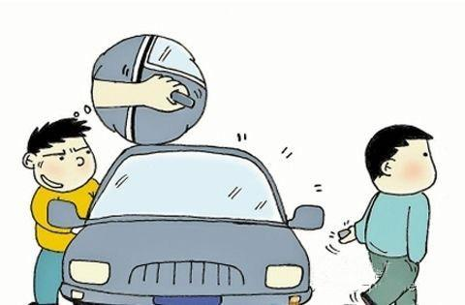
He is honest. He couldn't be a thief.

Slide 11
6. may 意为“也许；可能；可以”，表示不太可能。对may的一般疑问句的回答：
肯定回答一般是：Yes, please./ Certainly./ Sure等
否定回答一般是： No, you can’t/mustn’t.

Slide 12
May I help you?
Sure. I'd like a cup of water.

Slide 13
7. might是may的过去式，与may用法类似，语气比may弱，表示推测的可能性更小，常用于肯定句和否定句中，不用于疑问句中。

Slide 14
I’m not sure. She might be in the laboratory.
Where’s Jane?

Slide 15
Why do you think the man is running?
He could be running for exercise.
情态动词+be+doing sth. 表示对正在发生的事情的推测

Slide 16
Why do you think the girl is crying?
She could be crying for the failing of the exam.
No, her cat died. She might be crying for her dead cat.

Slide 17
Practice
—Is Lisa at home?
—I’m not sure. She _____ be on the way home.
A. can’t B. could
C. should D. need

Slide 18
Summary
情态动词表推测：
can, could, must, may, might.
1. He could be running for exercise.
2. He might be running to catch a bus.
3. Why do you think the man is running?

Slide 19
THANKS

