Slide 1
R·九年级全一册
Unit 3 Could you please tell me where
the restrooms are?
第一课时

Slide 2
Let's guess
bank

Slide 3
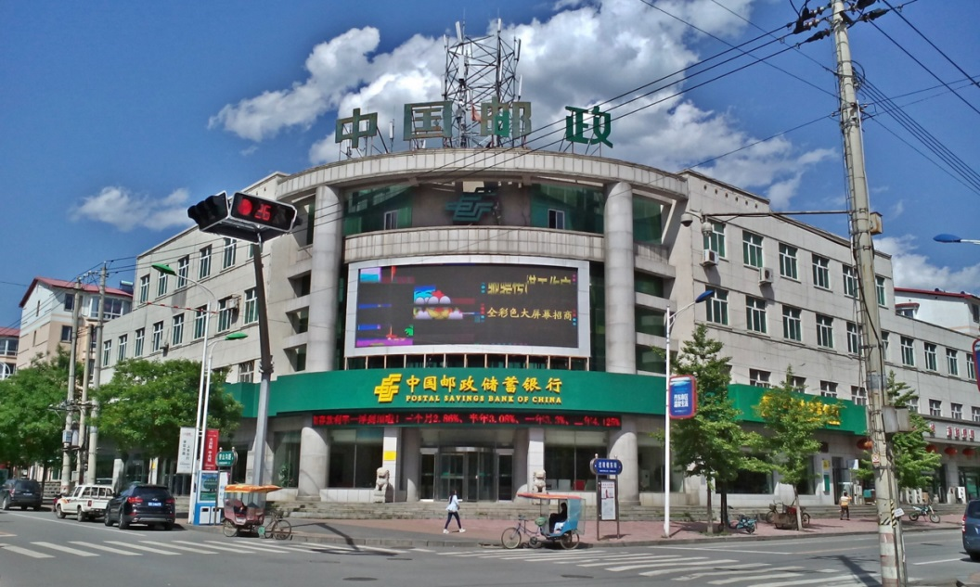
post office

Slide 4
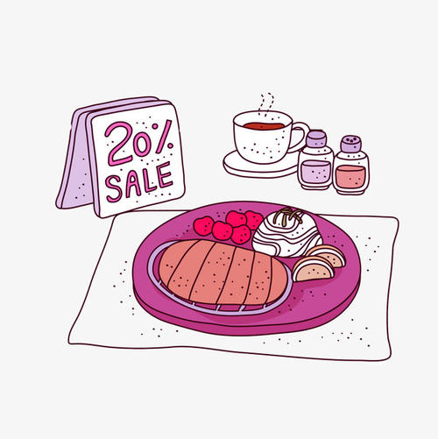
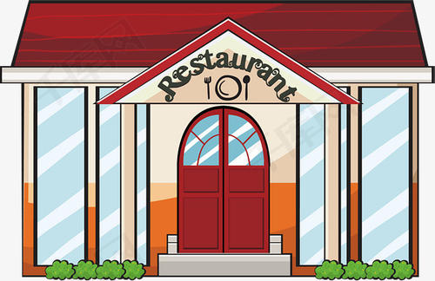
restaurant

Slide 5
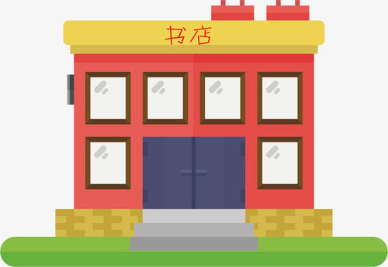
bookstore

Slide 6
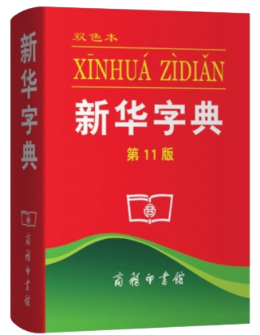
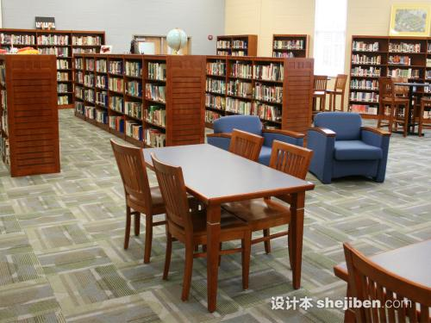
library

Slide 7
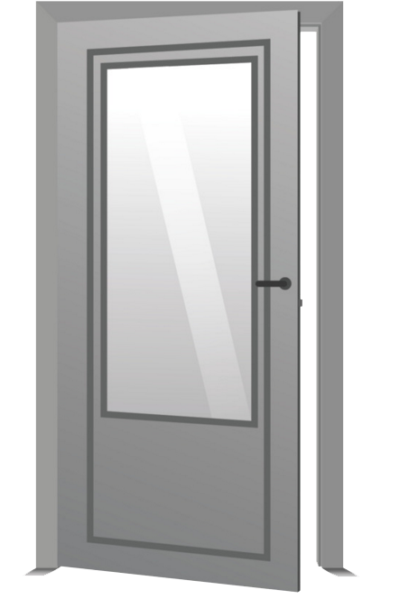
restrooms

Slide 8
Where can I get some information?
You can get some information in a library.

Slide 9
Excuse me, could you tell me where I can buy some stamps?
You can buy some stamps in a post office.

Slide 10
Language points
一、could的用法
could 在此不表示过去， 而是表示委婉的语气。
Could you please + 动词原形+…?
请你做……好吗？

Slide 11
Excuse me, could you tell me where I can get some money?
You can get some money in a bank.

Slide 12
Excuse me, could you tell me where I can buy a book?
You can buy a book in a bookstore.

Slide 13
Which question is more polite?
Could you please tell me how to get to the post office?
How to get to the post office?

Slide 14
表示委婉语气的句型：
1. Could you do sth.?
2. Would/Will you please do sth.?
3. Would you like to do sth.?
状元成才路
状元成才路
状元成才路
状元成才路
状元成才路
状元成才路
状元成才路
状元成才路
状元成才路
状元成才路
状元成才路
状元成才路
状元成才路
肯定回答：Sure. /Of course. /No problem. /I’d love to.
否定回答：Sorry, …(说明理由)

Slide 15
Excuse me, could you tell me where I can have dinner?
Sure. There’s a restaurant on Main Street.

Slide 16
Could you tell me how I can get to the restaurant?
Go along Center Street and then turn left on Main Street.
Then you will see the restaurant on the other side of the street.

Slide 17
二、go along 沿着……往前走
on your right 在右边
on your right（left）(side) 在你右边（左边）
on the right(left) side of 在……的右边（左边）

Slide 18
What do they mean?
Turn left.
Turn right.
状元成才路
状元成才路
状元成才路
状元成才路
Go past …
状元成才路
Go / Walk along … until …
状元成才路
状元成才路
状元成才路
状元成才路
状元成才路
状元成才路
状元成才路
状元成才路
next to …
on the right
A
A
B
between … and …

Slide 19
Practice
1. 打扰了，请你告诉我在哪能买到杂志好吗？
_______________________________________
2. 乘电梯到三楼，然后向左拐。
_______ the elevator _______ the third floor, then
______ ______.
Excuse me, could you please tell me where I can get a magazine?
Take
to
turn left

Slide 20
Summary
1. Where can I get some information?
2. Excuse me, could you tell me where I can buy some stamps?
3. You can buy some stamps in a post office.

Slide 21
THANKS

