Slide 1
Section B
(1a-2e)

Slide 2
教学目标：
语言知识目标：
1) 能掌握以下单词：travel, agent, expert,
keep…to oneself, themselves, teenager,
normal, unless, certainly, wallet, worried,
mile, angry, in the end, understanding,
careless, mistake, himself, careful, advise,
solve, step, trust, experience, in half, halfway

Slide 3
2) 能掌握以下句式结构：
① ─What do you think I should do?
Can you give some advice?
─I think I should go to college.
② But If I go to college, I’ll never become
a great soccer player.

Slide 4
Words and expressions
travel
agent
expert
keep … to oneself
teenager
normal
v.&n.旅行；游历
n.代理人；经纪人
n.专家
保守秘密
n.青少年
adj.正常的；一般的

Slide 5
Words and expressions
useless
certainly
wallet
mile
angry
understanding
conj.除非；如果不
adv.无疑；肯定；当然
n.钱包
n.英里
adj.发怒的；生气的
adj.善解人意的；体谅人的

Slide 6
Words and expressions
careless
mistake
himself
careful
advise
solve
step
adj.粗心的；不小心的
n.错误
pron.他自己
adj.小心的；细致的
v.劝告；建议
v.解决；解答
n.步；步骤

Slide 7
Words and expressions
trust
experience
in half
halfway
else
v.相信；信任
n.经验；经历
分成两半
adj.&adv.在中途；部分地做
adv.别的；其他的

Slide 8
Revision
选词填空。
meeting, video, chocolate, taxi,
upset, advice, organize
1. If you walk there, you’ll be late for the
________.
2. If they watch a _______ at the party,
some students will be bored.
3. I don’t know what to do, can you give me
some ________?
meeting
video
advice

Slide 9
4. What will happen if she _________ a
soccer game on Saturday?
5. If she doesn’t come home on time, her
parents will be ________.
6. If it rains tomorrow, we’ll take a
_______ there.
7. If he eats too much _________, he’ll be
very heavy.
organizes
upset
taxi
chocolate

Slide 10
New words
travel v.& n. 旅行；游历
e.g. Children under five usually travel free
on train.
五岁以下的孩子乘火车通常是免费的。
agent n. 代理人；经纪人
e.g. Mr. Lin is an agent for APPLE.
林先生是苹果公司的代理人。

Slide 11
Lead-in
Some important things in our life.
be happy
go to college

Slide 12
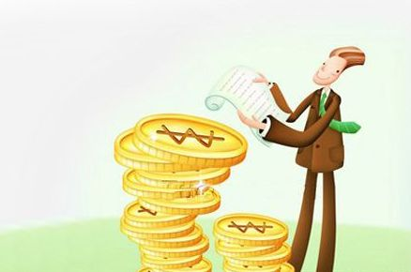
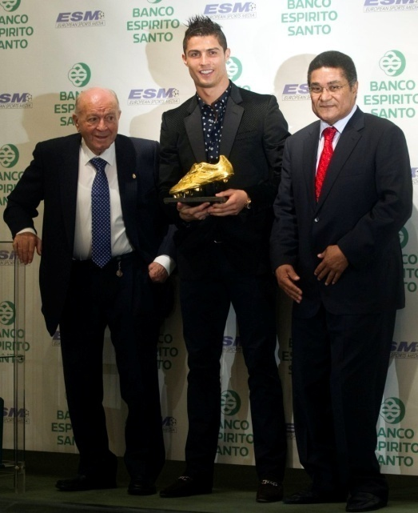
make a lot of money
be famous
travel around the world
get an education

Slide 13
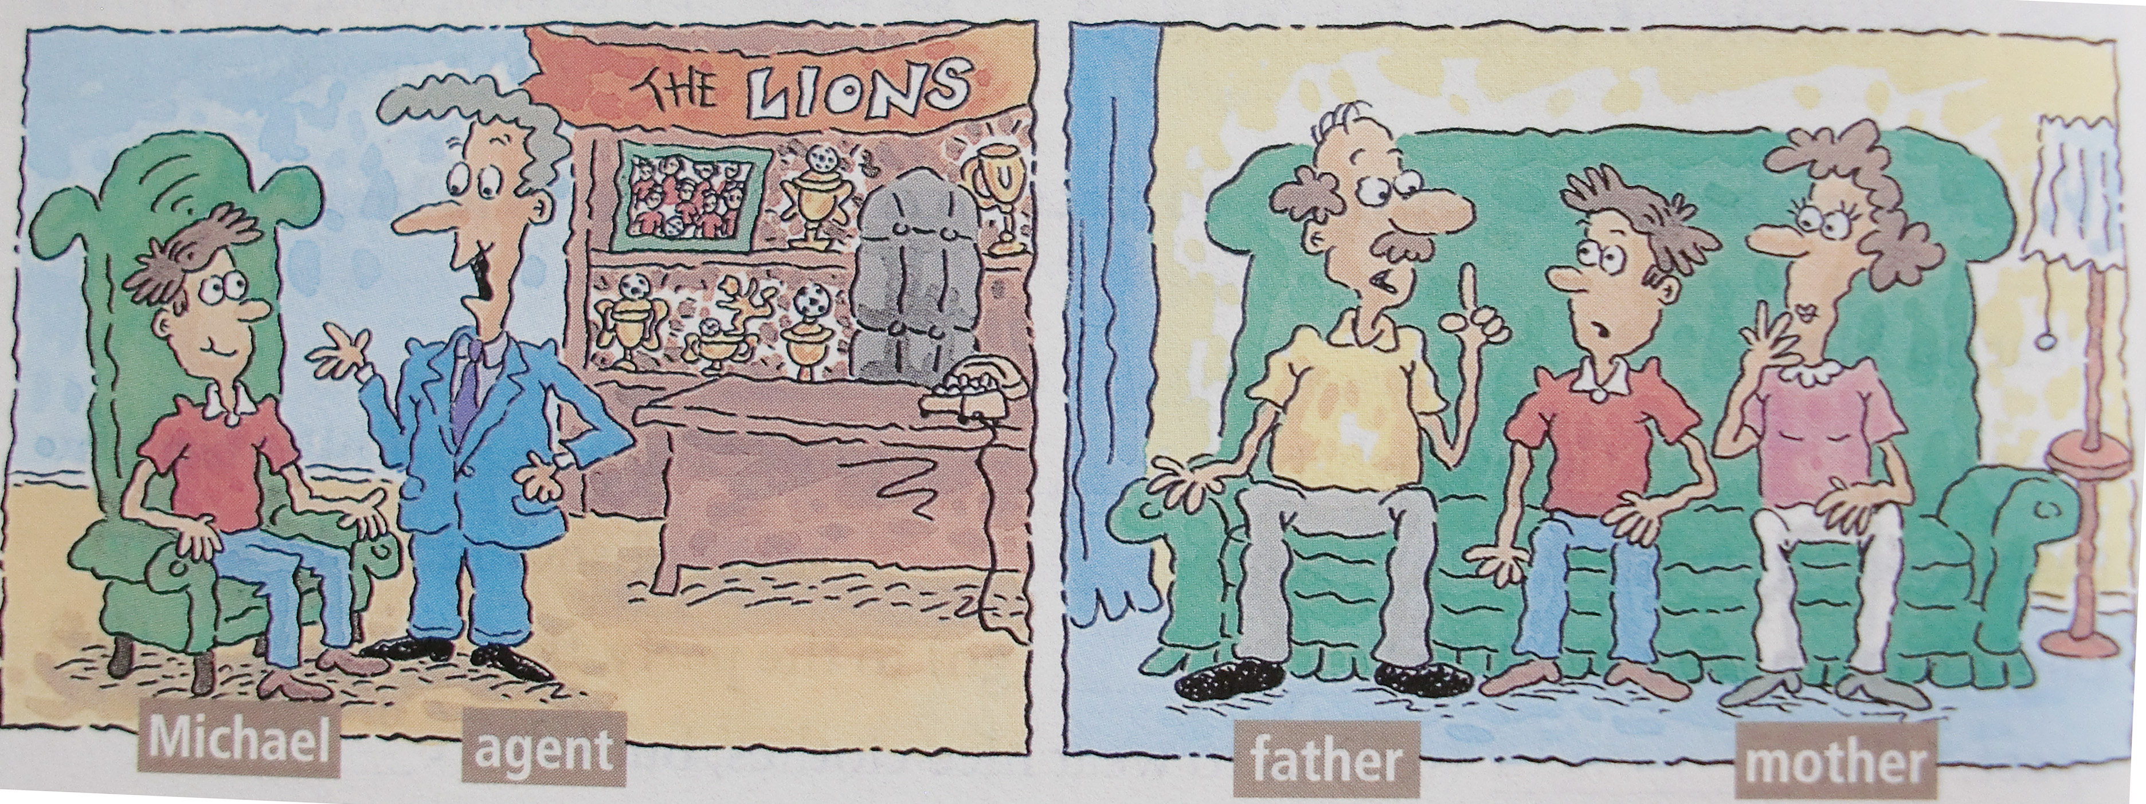
Which of the things below are the most important to you? Circle three things.
1a
be happy travel around the world

Slide 14
go to college make a lot of money
be famous get an education

Slide 15
1b
Listen. Look at the list in 1a. Write A before each thing the soccer agent talks about and P before each thing Michael’s parents talk about.
P
be happy
travel around the world
go to college
make a lot of money
be famous
get an education
A
P
P
A
P

Slide 16
1c
Listen again. Complete the sentences.
1. If you join the Lions, _______.
2. If you become a Lion, ________.
3. And if you work really hard, ______.
4. If you become a soccer player, ______.
5. But if I don’t do this now, ______.

Slide 17
you’ll be famous.
b. I’ll never do it.
c. you’ll become a great soccer player.
d. you’ll never go to college.
e. you’ll travel around the world.
Check the answers:
1c, 2e, 3a, 4d, 5b

Slide 18
Pair work
Student A is Michael. Student B is his friend. Student B, give Student A advice.
What do you think I should do? Can you give me some advice?
I think you should go to college.
But if I go to college, I’ll never become a great soccer player.

Slide 19
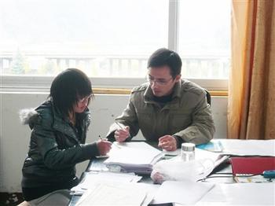
2a
Discuss
What kinds of things do you worry about? Who do you usually go to for help?
I’m not good at math. I usually worry about it.
I usually go to my math teacher for help.

Slide 20
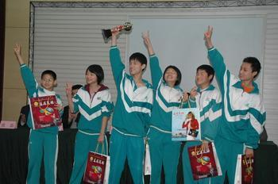
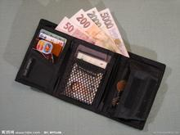
New words
teenager n.
（13～19） 青少年
wallet n. 钱包
mile n. 英里
e.g. It’s a mile’s way from my home to
school. 从我家到学校有一英里。

Slide 21
expert n. 专家
normal adj. 正常的；一般的
e.g. It was a normal summer night.
那是一个寻常的夏夜。

Slide 22
unless conj. （=if not）除非；如果不
e.g. You’ll be late unless you go at once.
如果你不立即走，你会迟到。
understanding adj. 善解人意的；体谅人的
e.g. Mr. Li is a very understanding person.
李先生是一位很善解人意的人。

Slide 23
himself pron. 他自己
themselves pron. 他（她、它）们自己
宾格或物主代词+ self/selves → 反身代词
e.g. The old man taught himself English.
那位老人正在自学英语。
certainly adv. 当然；行；无疑；肯定
e.g. It’s certainly a good suggestion.
这无疑是一个好建议。

Slide 24
angry adj. 生气的；发怒的
be angry with sb. 对某人生气
e.g. Mr. Miller was very angry with Tom.
米勒老师对汤姆很生气。
mistake n. 失误；错误
make a mistake/make mistakes 犯错误
e.g. She made mistakes again and again.
她三番五次地犯错。

Slide 25
careful adj. 细致的；精心的；慎重的
反义词
careless adj. 粗心的；不小心的
e.g. He is a careful driver. He’s never
careless in driving.

Slide 26
keep…to oneself 保守秘密
advise v. 劝告；建议
advise（动词）→advice （名词）建议
advise sb. to do sth. 建议某人做某事
e.g. The doctor advised me to give up
smoking.
医生建议我戒烟。

Slide 27
solve v. 解决；解答
e.g. He’s trying to solve the problem.
他正努力解决这个问题。
trust v. 相信；信任
e.g. Trust the honest boy.
相信那个诚实的孩子。
step n. 步；步骤
e.g. What is the first step?
第一个步骤是什么？

Slide 28
experience n. 经验；经历 （不可数）
e.g. He has no experience at all.
他完全没有经验。
halfway adv. 在中途；部分地做(或达到)
e.g. She lost her way halfway to the zoo.
她在去动物园的路上迷路了。
in half 分成两半
e.g. She cut the cake in half.
她将蛋糕切成两半。

Slide 29
2b
Reading
Look at the statements and then read the passage quickly. Which statement expresses the main idea of the passage?
a. If people have problems, they should
get advice from an expert.
√
b. If people have problems, they should talk
to other people.
c. If people have problems, they should
keep them to themselves.

Slide 30
Read the passage again and answer the questions. Discuss your answers with a partner.
2c
1. What is the worst thing to do if you have
a problem?
2. Why didn’t Laura want to tell her parents
about her lost wallet?
3. What is the first thing you should do when
you want to solve a problem?
4. Why can our parents give us good advice
about our problem?

Slide 31
指导
1. It’s to do nothing.
Some people believe the worst thing is to do nothing.
2. She was afraid to tell her parents. Laura once lost her wallet, and worried for days. She was afraid to tell her parents about it.

Slide 32
3. It is to find someone you trust to talk to. He thinks the first step is to find someone you trust to talk to.
4. Because they have more experience than us.
Students often forget that their parents have more experience, and are always there to help them.

Slide 33
2d
Fill in the blanks with the phrases in the box.
discuss your problems
tell her parents
unless you talk
run away from
talk to someone
share her problems
to do nothing

Slide 34
Students often have a lot of problems
and worries. Laura Mills thinks the worst thing is _____________. She thinks you’ll feel worse if you don’t ______________ about your problems. Laura remembers that she once lost her wallet and was afraid to _____________ about it. Now she believes you cannot feel better _______________ to someone.
to do nothing
talk to anyone
tell her parents
unless you talk

Slide 35
She says she will always __________________ in the future. Robert Hunt agrees with Laura. He thinks you should not _______________ your problems, but you should try to solve them. If you cannot talk to an expert like Robert, you can ____________________ with your parents because they have a lot of experience.
share her problems
run away from
discuss your problems

Slide 36
Language points
1. If people have problem, they should
keep them to themselves.
keep 意为 “保留；保存”，keep them
to themselves 意为 “把问题（烦恼）
埋在心底，不向他人倾诉”。
e.g. You can keep the toy if you like.
要是你喜欢那个玩具的话，可以把
它留下。

Slide 37
2. She just kept thinking, “If I tell my parents,…”
此句中，keep 表示“（使……）保持（某种状态或关系）；一直……”，后面接动词时，该动词要用-ing形式，形成 keep doing……结构。
e.g. It kept raining for a week.
雨一直下了一周。

Slide 38
3. Laura once lost her wallet, and worried for days.
once用作副词时，意为“曾经；一度；从前”。它是一个不确定的时间副词，其位置一般是在行为动词之前，系动词之后。
e.g. Once he lived in America, but now
he lives in England. 他曾经生活在
美国，但现在他生活在英国。

Slide 39
4. They got her a new wallet and asked her to be more careful.
get 意为“买”，相当于buy，但不如后者正式。
e.g. Could you get me a ticket, please?
请给我买张票好吗？

Slide 40
5. It is best not to run away from our
problems. We should always try to
solve them.
try to do sth. 努力做某事
e.g. Please try to finish this work in thirty
minutes. 请尽量在30分钟完成这项工作。

Slide 41
try doing sth. 表示“尝试做某事”。
e.g. Why didn’t you try riding a bike to
go to school? 为什么不试着骑车去学校呢？
try to do sth. 表示 “试图干……”，强调付出努力，但不一定成功；try doing 表示 “尝试做……；做……试试”，含有 “看结果如何” 之意。

Slide 42
e.g. — I usually go there by train. — Why not _________ by boat for a
change? A. to try going B. trying to go C. to try and go D. try going

Slide 43
6. In English, we say that sharing a
problem is like cutting it in half.
1) share 表示“分享；分担”。
e.g. share a room with someone
(与某人同住一个房间)
2) cut…in half 表示“把……切成两半；
把……一切为二”，in half/halves 是一
种固定结构，介词in表示状态。
e.g. Please cut the apple in half.

Slide 44
7. So you’re halfway to solving a problem just by talking to someone about it!
1) be halfway to …表示“完成了或做了事情的一部分”，这里的to是介词。
e.g. We’re still only halfway to finishing
the homework.
我们才仅仅完成了一部分作业。

Slide 45
2) by 在此表示方式，意为 “通过（……办法，方式）”。
e.g. We can learn English by singing
English songs.
我们可以通过唱英文歌来学英语。

Slide 46
Homework
1. Read the passage again after class.
2. Work on 2e. Ask three students the
following questions. Take notes of
their answers.

