Slide 1
R·九年级全一册
Unit 7 Teenagers should be allowed to choose their own clothes.
第二课时

Slide 2
Lead in
Parents are normally our much-loved persons in our life.

Slide 3
But sometimes they may be very strict with us.
What family rules do you think should be changed?

Slide 4
I should be allowed to get up late sometimes.

Slide 5
We should be allowed to eat some ice-cream.

Slide 6
Teenagers should be encouraged to make their own decisions.

Slide 7
We may be allowed to take photos if we don’t use a flash.

Slide 8
Language points
含情态动词的被动语态用来说明某个被动性动作所反映出的感情和态度。初中阶段的常见情态动词有：can, may , need , must , should等。
谓语部分含有情态动词的被动语态的构成是：
情态动词+be+过去分词
状元成才路
状元成才路
状元成才路
状元成才路
状元成才路
状元成才路
状元成才路
状元成才路
状元成才路
状元成才路
状元成才路
状元成才路
状元成才路

Slide 9
一、被动转变方法
1. 将主动语态的宾语变成被动语态的主语。
2. 将含情态动词的主动句式变成被动句式，即： “情态动词+动词原形”变成“情态动词+be+过去分词”，然后再在其后加“by+主动句中的主语(人称代词用宾格)”。by短语也可省略。

Slide 10
You should finish your homework first.
Your homework should be finished (by you) first.

Slide 11
This magazine can be taken home (by you).
You can take this magazine home.

Slide 12
二、句式结构
含情态动词的疑问句、否定句的变化均需借助于情态动词完成。
一般疑问句: 直接将被动语态的陈述句中的情态
动词提前。
Must this task be finished at once?
这项任务必须立即完成吗？

Slide 13
注意: 含情态动词的被动语态的一般疑问句的回答，应保留原情态动词，但must表“必须”时，其否定回答应用needn’t；need表“必要”时，其肯定回答应用must。如：

Slide 14
Must my exercise book be handed in now?
Yes, it must.

Slide 15
Must my book be returned tomorrow?
No, it needn’t.
You can keep it for two months.

Slide 16
2. 特殊疑问句: 由特殊疑问词加上被动语态的
一般疑问句构成。
3. 否定句: 在情态动词后面加上not或never即可，
但must表“必要” 时否定式为needn’t。

Slide 17
This task needn’t be finished at once.
When must this task be finished?

Slide 18
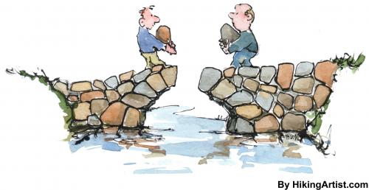
4. 反意疑问句: 借助情态动词构成附加疑问部分。
如：
This bridge can be built next year, can’t it?
这座桥明年能建成，是吗？

Slide 19
Practice
—Have you finished your project?
—Not yet. I’ll finish it if I _______ ten more
minutes.
A. give B. am given
C. will give D. will be given
B

Slide 20
Teenagers ________________ to choose their own clothes.
应该允许青少年选择他们自己的服装。
_____ these books _________ out of the reading room?
可以把这些书带出阅览室吗？
When ______ the work __________ ?
这些工作必须什么时候完成？
should be allowed
Can
be taken
must
be finished

Slide 21
Summary
情态动词被动语态：
转变方法
①将主动语态的宾语变成被动语态的主语。
②将含情态动词的主动句式变成被动句式。
特殊疑问句；否定句；反意疑问句。

Slide 22
THANKS

