Slide 1
Unit 8
How do you make a banana milk shake?

Slide 2
Section A
(2c-3c)

Slide 3
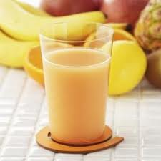
Please recall…
How do you make a banana milk shake?
First, peel the banana.
Next, put the bananas in the blender.
Then, pour the milk into the blender.
Finally, turn on the blender.

Slide 4
How do you make fruits salad?
First, wash some kinds of fruits such as apples, pears, grapes and so on.
Then, cut them up and put them into a big bowl.
Next, pour some yogurt into the bowl.
Finally, mix them up.

Slide 5
Pair work
Ask and answer questions about how to make fruit salad.
2c
A: Let’s make fruit salad.
B: OK, good idea. How much yogurt
do we need?
A: One cup.
B: How many apples do we need?
A: Let me think… We need two apples.
B: OK, and how much…

Slide 6
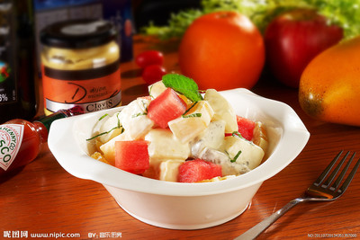
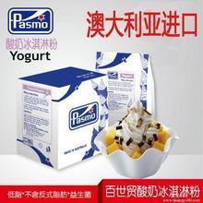
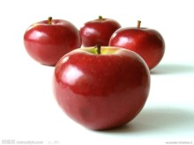
Have a try
A: Let’s_____ fruit salad.
B: OK, good idea. _________
do we need?
A: One cup.
B: And _________
do we need?
A: Let me think… We_____ two apples.
B: OK, is that all?
A: Yeah,let’s start.
make
How much
how many
need

Slide 7
Role-play the conversation.
DO you know Russian soup?
How do you make
Russian soup?

Slide 8
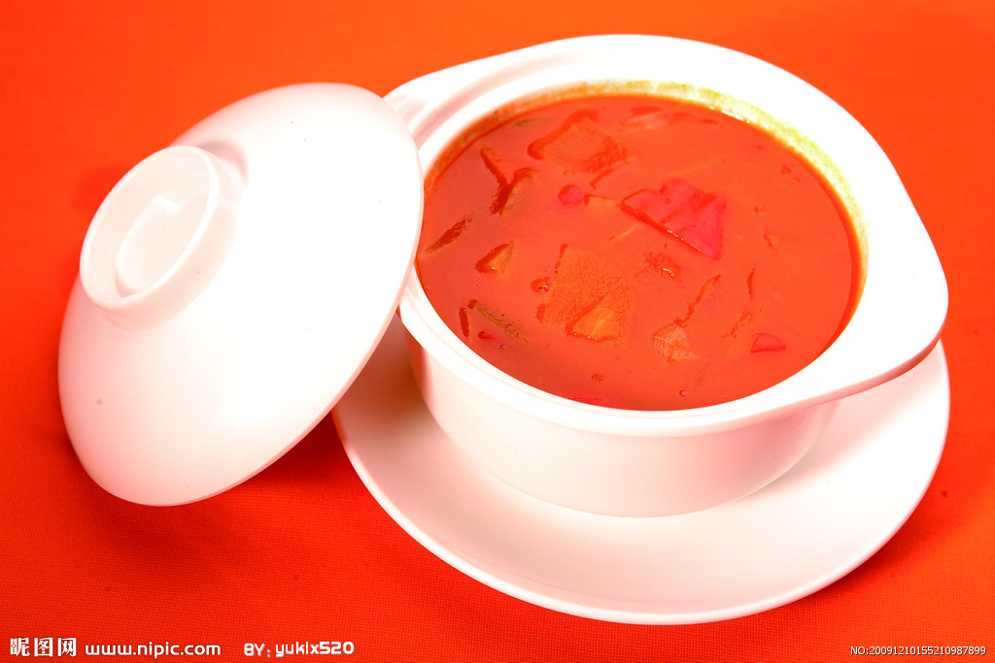
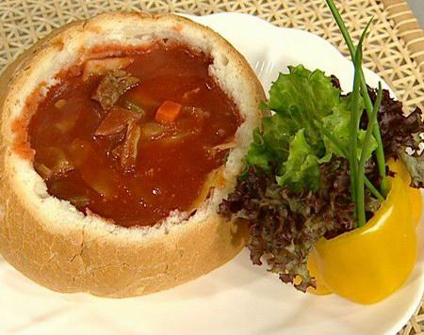
美食介绍：罗宋汤，著名的汤羹类美食菜谱。罗宋汤是在俄国和波兰等东欧国家处处可见的一种羹汤，在美国和其他西方国家也很常见。从俄国和波兰等东欧国家移民出来的犹太人是这种汤在世界各地的主地传播者，纽约市北郊一带犹太人居住相对集中的一个区域曾被人们称为罗宋汤带或罗宋汤圈。Borscht 是这种汤在犹太语中的写法，在俄罗斯，这种汤的写法是Borsch，这来源于这种汤的主要成分甜菜（Beet 或 Parsnip）在俄语中的名称-Borsch。
后来经过许多演变，罗宋汤除了主要成分甜菜之外，在汤中通常还加有圆白菜和土豆等其他蔬菜，有的里边还会有肉，其做法更是不拘一格。这是因为这种汤并不是某个大厨师的发明，在过去的俄罗斯，这是普通人糊口的主要食物之一，所以怎么做主要取决于家里有什么东西。通常，是反映所有的东西都放进去。这种汤既可以在冬天热喝，又可以在夏天里冷用。一般在吃之前，要在罗宋汤上面点缀一点泡沫状的酸奶油和莳萝香菜。又酸又甜是种羹汤的一大特点。
俄罗斯的英语为RUSSIA，指的是俄国式的。于是上海的文人把来自俄罗斯的汤音译为“罗宋”。
罗宋汤嘛，是罗宋人（俄罗斯人）常喝的，所以叫罗宋汤。
在十月革命时候，有大批俄国人辗转流落到了上海，他们带来了伏特加，也带来了俄式的西菜，上海第一家西菜社就是俄国人开的。这道汤，就是从俄式红菜汤演变而来，俄式红菜汤辣中带酸，酸甚于甜，上海人并不习惯。后来受原料采办以及本地口味的影响，渐渐地形成了独具海派特色的酸中带甜、甜中飘香、肥而不腻、鲜滑爽口的罗宋汤。

Slide 9
Reading
Read the conversation and fill in the chart below.
2d
one | cabbage
one
three
four
five
some

Slide 10
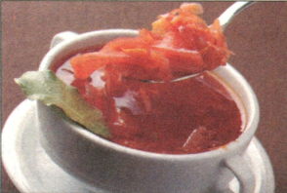
2d Role-play the conversation.
Anna: Sam, I want to make Russian soup for
a party on Saturday. Can you tell me
how?
Sam: Sure. First, buy some beef, one cabbage,
four carrots, three potatoes, five
tomatoes and one onion. Then, cut up the
vegetables.
Anna: What’s next?
Sam: Next, put the beef, carrots and potatoes into a pot and add
some water. After that, cook them for 30 minutes. Then,
add the cabbage, tomatoes and onion and cook for another
10 minutes.
Anna: Ok, that’s it?
Sam: No, one more thing. Finally, don’t forget to add some salt.

Slide 11
Reading
Read the conversation and fill in the chart below.
2d
one | cabbage
one
three
four
five
some
onion, cabbage
potatoes
carrots
tomatoes
beef

Slide 12
How do you make Russian soup?
1. First, buy some beef, one cabbage, four
carrots, three potatoes, five tomatoes
and one onion.
2. Then, cut up the vegetables.
3. Next, put the beef, carrots and potatoes
into a pot and add some water.
4. After that, cook them for 30 minutes.

Slide 13
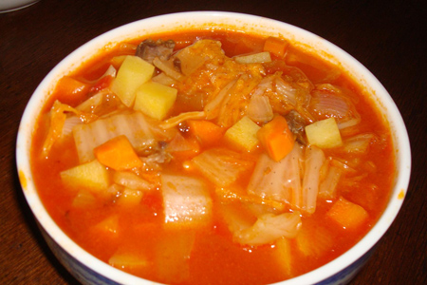
5. Then add the cabbage, tomatoes and
onion and cook for another 10 minutes.
6. And don’t forget to add some salt.

Slide 14
Language points
1. How many bananas do we need ？
How many 是疑问词, “多少”, 后面跟复数名词。
询问多少人或物的句型是：
How many +复数名词 + 一般疑问句?
e.g. How many boats can you see？
How many apples would you like？
How many books are there on the desk？

Slide 15
2. Turn on the blender．
打开搅拌器。
(1) 这是一个祈使句, 又叫无主句, 表示命令、请求等语气的句子叫做祈使句。其否定形式是在前面加上 don’t 构成。
e.g. Sit down, please. 请坐。
Please don’t sit down．请不要坐下。
Put it away, please．请把它拿走。
Please don’t put it away．请不要把它拿走。

Slide 16
(2) turn 作动词时, 表示“转 (弯); 翻转”, 后加介词
短语/ 副词 (作状语) 。
常见短语： turn on /off 开/关 (收音机, 电灯等)
turn in 交出, 上交
turn...into... (使) 变成, 翻译成
turn over 翻转
e.g. Please turn on /off the blender.
请打开/关上搅拌器。
Turn in your papers, please.
请把试卷交上来。
Water can turn into ice.
水可变成冰。

Slide 17
3. First cut up three bananas, three apples
and a watermelon. Finally mix it all up.
以上两句话中的短语cut up和mix up都是
由“动词 + 副词”构成的。
“动词 + 副词”构成的短语, 若其后所接
宾语为名词, 名词可放在副词之后, 也可
放在动词和副词之间; 若其后所接宾语
为代词, 代词通常放在动词和副词之间。

Slide 18
e.g. Please mix up the fruits / mix the
fruits up. 请将这些水果混合在一起。
We need two apples. Please cut them up.
我们需要两个苹果, 请把它们切碎。

Slide 19
4. put…into…
e.g. He put some sugar into the coffee.
有用的词组：put away 把……放好
put down 放下
put up 举起
put on 穿上
put off 拖延

Slide 20
5. one more thing 另外一件事情 another ten minutes 再多十分钟
“数字+ more + 物品” 指“另外的……”。
“another + 数字 + 物品” 指“另外的……”。
当数字为one时，常与more连用或只用
another。
e.g. Give me two more hamburgers.
再给我两个汉堡。

Slide 21
The boys rode another two hours. 那些男孩子们又骑了两个小时。
6. forget to do sth. 忘记（去）做某事
e.g. Don’t forget to close the windows.
不要忘记关上窗户。

Slide 22
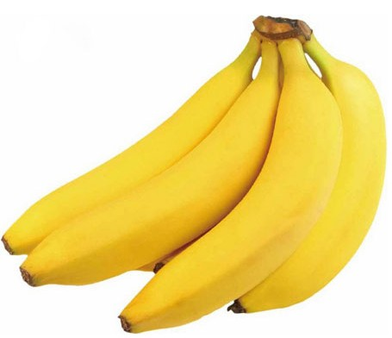
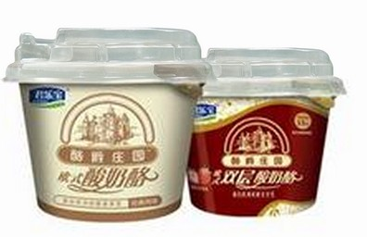
可数
Pair work
—How many bananas do we need?
—We need three bananas.
—How much yogurt so we need?
—We need one cup of yogurt,
不可数

Slide 23
Grammar Focus
根据课本内容，完成下列句子。
1. 你怎样做香蕉奶昔？
_____ do you _____ a banana milk shake?
2. 首先，将香蕉剥皮。
______, _____ the bananas.
3. 接下来，将香蕉放入果汁机中。
____, _____ the bananas in the blender.
4. 然后，将牛奶倒进果汁机中。
_____, _____ the milk ____ the blender.
How make
First peel
Next put
Then pour into

Slide 24
5. 最后，打开果汁机。
______, _______ ___ the blender.
6. 我们需要多少香蕉？
______ _____ bananas do we need?
7. 我们需要三只香蕉。
We ______ three _________.
8. 我们需要多少酸奶？
_____ _____ yogurt do we need?
9. 我们需要一茶杯。
We need ___ ____ ____ yogurt.
Finally turn on
How many
need bananas
How much
one cup of

Slide 25
Language points
1. How many bananas do we need？
我们需要多少香蕉？
How many 是疑问词, 表示“多少”,
后面需跟复数名词。
询问多少人或物的句型是：
How many +复数名词 + 一般疑问句。

Slide 26
e.g. How many boats can you see?
你能看到多少只船?
How many apples would you like?
你想要几个苹果?
How many books are there on the desk?
桌上有多少本书?

Slide 27
2. How much 对不可数名词进行提问,
表示“多少”, 后面跟不可数名词。
e.g.— How much honey do we need?
我们需要多少蜂蜜?
— We need one teaspoon of honey．
我们需要一茶匙蜂蜜。

Slide 28
How much rice do you want？
你想要多少大米？
How much money do you have？
你有多少钱？
注意: money 是不可数名词。

Slide 29
3. 可数名词有单数和复数两种形式，如：
bananas, tomatoes。
不可数名词没有单、复数形式；
可数名词单数前面可用不定冠词a (an)；
不可数名词前不能有a (an)；
可数名词复数可用 a few, many 等修饰；
不可数名词则用 a little, much 等修饰。

Slide 30
询问可数名词的“多少”，用how many;
询问不可数名词的“多少”，用 how much。
英语中个体名词是可数名词, 它们所表示的
人或物可以用数来计数。
如：banana, apple, blender, watermelon …
物质名词一般是不可数名词, 它们所表示的
事物不能用数来计数。
如：milk, yogurt, honey…

Slide 31
4. 英语中量的表达方法分为三种类型：
① 表示容器的名词 + of
a cup of tea, three bottles of milk.
② 表示单位的名词 + of
a piece of paper
seven piles of rice (七堆米)
③ 其他词 + of
some of the apples

Slide 32
Grammar
如何问答名词的数量
1. 询问不可数名词的数量：
_________ + 不可数名词 ……?
How much
2. 回答不可数名词的数量：
___________ + 不可数名词
一杯 ________; 一碗 __________
数量词
a cup of
a bowl of
3. 询问可数名词的数量：
__________ + 可数名词……?
How many

Slide 33
对画线部分提问。
1. We need three cups of sugar.
_____ ______ sugar do we need?
2. They need ten tomatoes for the soup.
_____ ______ tomatoes do they need?
3. The T-shirt is twenty dollars.
_____ _____ is the T-shirt?
4. We have six bottles of juice.
____ ______ bottles of juice do you have?
How much
How many
How much
How many

Slide 34
New words
1. machine n. 机器；机械装置
e.g. Do you know how to handle this
machine?
你知道如何操作这个机器吗？
2. dig v. 掘（地）；凿（洞）挖（土）
e.g. It takes a lot of time to dig a well.
挖一口井要花费很多时间。

Slide 35
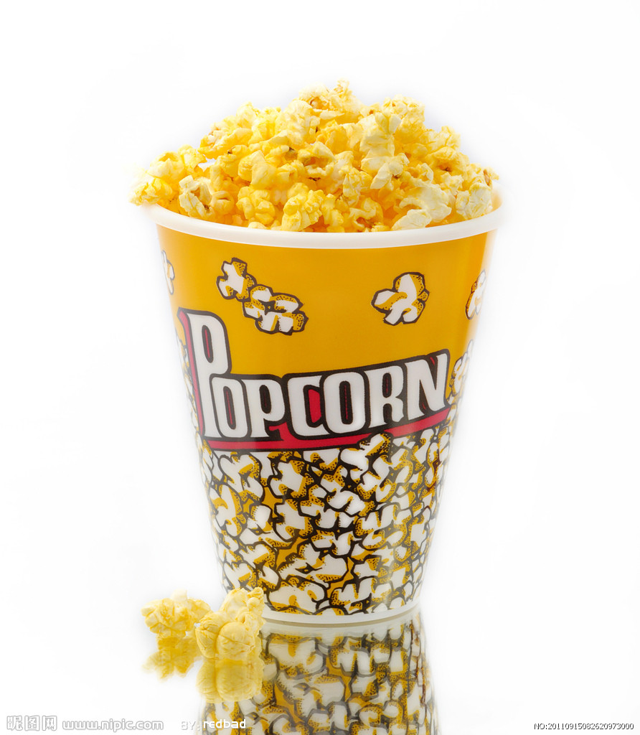
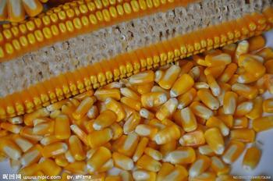
3. hole n. 洞；孔；坑
e.g. There is a hole in the wall.
在墙上有个洞。
4. corn n. 玉米；谷物
popcorn n. 爆米花

Slide 36
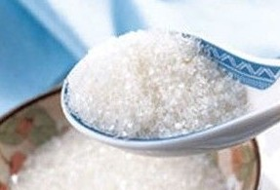
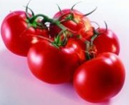
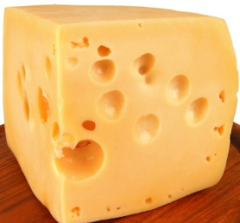
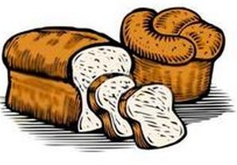
3a Circle the correct word in each question.
1. How ( much /many) bananas do we need?
2. How (much / many) sugar do we need?
3. How ( much / many) bread do we need?
4. How ( much / many) tomatoes do we need?
5. How ( much /many) cheese do we need?

Slide 37
3b Complete the questions and answer. Then match them.
First, put the popcorn into the popcorn popper.
Next turn on the popper.

Slide 38
Next pour the popcorn into the bowl.
Then put salt on the popcorn.

Slide 39
Finally eat the popcorn.

Slide 40
b
1.______do you make popcorn?
2.___________corn do you need?
3.______ do we do next?
4.___________salt do we need?
5.Now can we eat it?
How
a
How much
d
What
e
How much
c
Half a cup.
b.______ , put the corn into the popcorn machine.
c. Yes, we can!
d. Next, _____on the machine. ______, add the salt.
e. Just one spoon.
First
turn
Finally

Slide 41
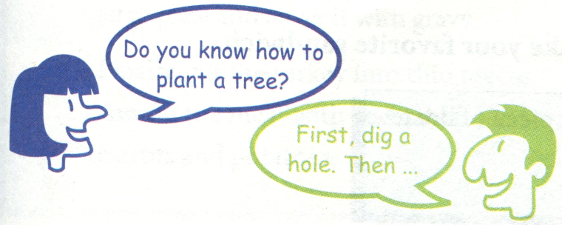
3c Write how to do one of the following things. Then tell your partner how to do it.
plant a tree
make egg noodles
wash clothes
get a book from the library

Slide 42
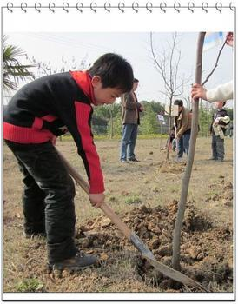
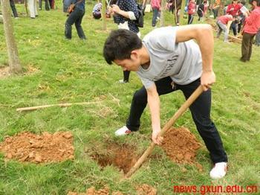
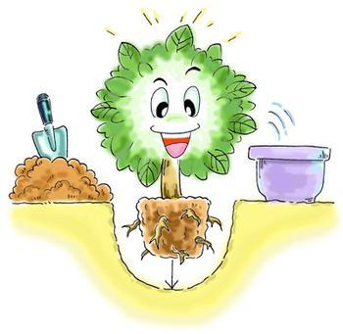
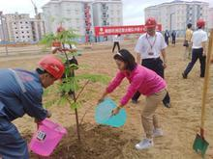
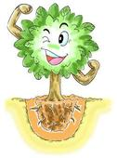
Example
Put the tree in the hole.
Put the soil back into the hole.
Dig a hole.
It’s OK now.
Water the tree.

Slide 43
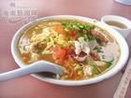
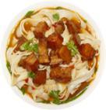
2
A. First, put the water into the pot.
B. Next, put the noodles into the pot and
cook for ten minutes.
C. How many noodles do we need?
D. How much water do we need?
E. How do we make egg noodles?
F. What do we do next?
G. Five bowls.
H. Half a kilo.
I. Finally, put the egg into the pot and cook for
another five minutes.
6
7
3
1
5
4
8
9
Example

Slide 44
总结
1、用祈使句表达说话者的要求:
Peel the bananas.
Pour the milk in the blender.
2、用 first, next, then……等来表达顺序:
First, cut up the bananas; then…; next…; last…

Slide 45
Exercise
单项选择。
1. Can you help me cut ______ the potatoes?
A to B into C for D up
2. Please bring me ______ .
A two cup of coffee B two cup of coffees
C two cups of coffees D two cups of coffee
3. First, ______three oranges.
A peeling B peel C peels D to peel
4. Can the girl ______ a salad by herself ?
A make B makes C making D made
5.I want to make a banana milk shake. Please tell me,
______ milk do I need, and ______ bananas do I need?
A how much; how many B how many; how many
C how much; how much D how many; how much

Slide 46
根据括号内所给单词的适当形式填空。
1. How _______ (more) yogurt do we need?
2. He can drink three cups of _____ (juice).
3. How many _____________ (watermelon) do you
want?
4. Let’s _______(make) banana and apple milk shake.
5.How many people ______(be) there in your town?
6. He often ________________ (turn) the TV when he comes home.
much
juice
watermelons
make
are
turns on

Slide 47
对画线部分提问。
1. There is an apple in the picture.
_____ ____ in the picture?
2. There is an apple in the picture.
How _______ ______ ______ there in the
picture?
3. This book is five dollars.
_____ _____ is this book?
What is
many apples are
How much

Slide 48
Homework
1. 复习Grammar Focus中的内容。
2. 从3c中选择一个活动项目，用英语将其过程描写出来。注意正确运用表示顺序的词汇：first, next, then, after that, finally。

