Slide 1
Unit 5

Slide 2
Unit 5
Why do you
like pandas?

Slide 3
Section A 1
1a-2d

Slide 4
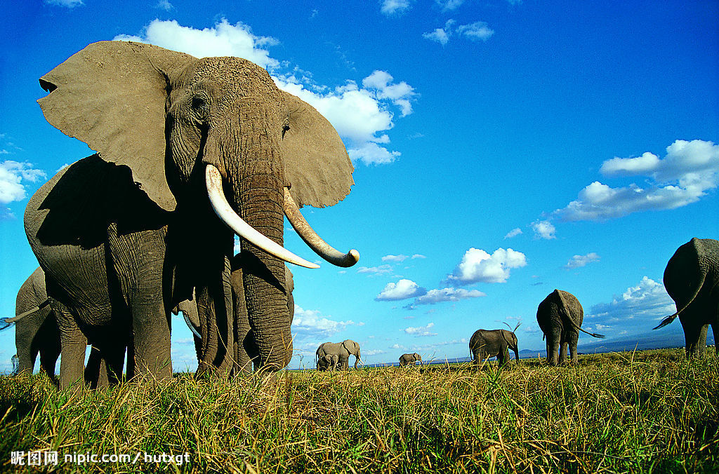
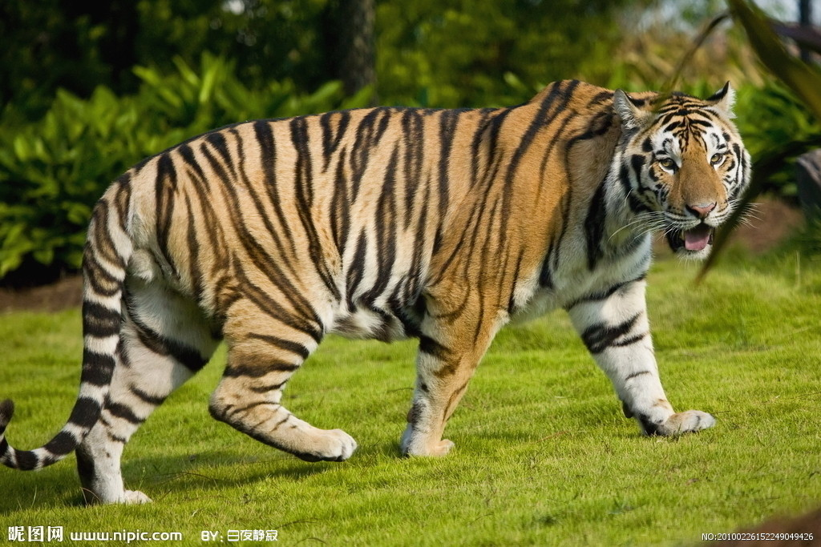
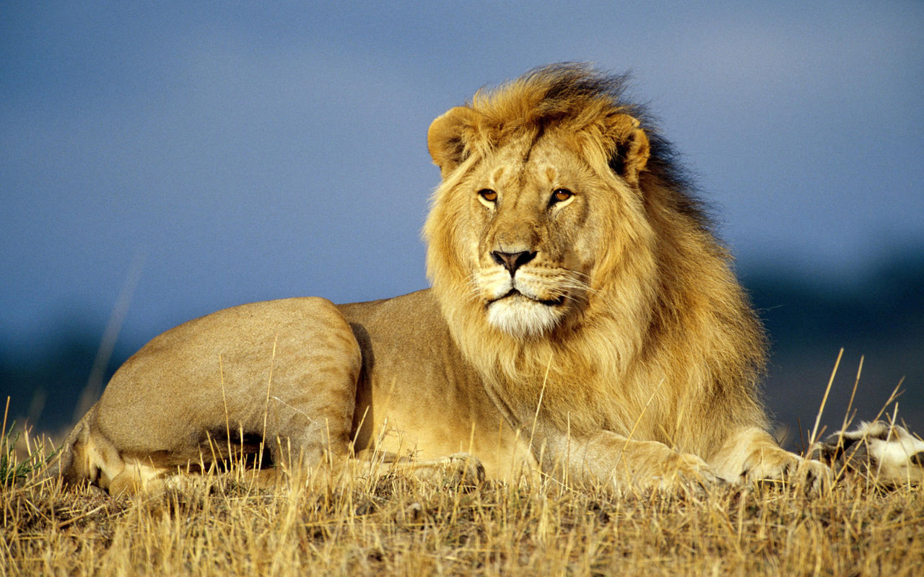
New words
tiger n. 老虎
elephant n. 大象
lion n. 狮子
panda n. 熊猫

Slide 5
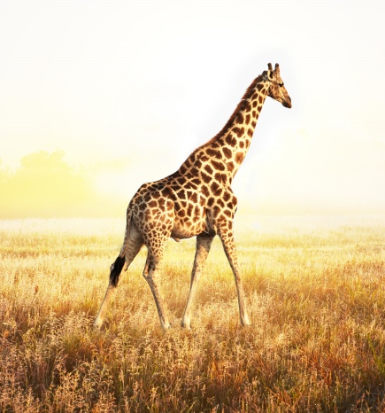
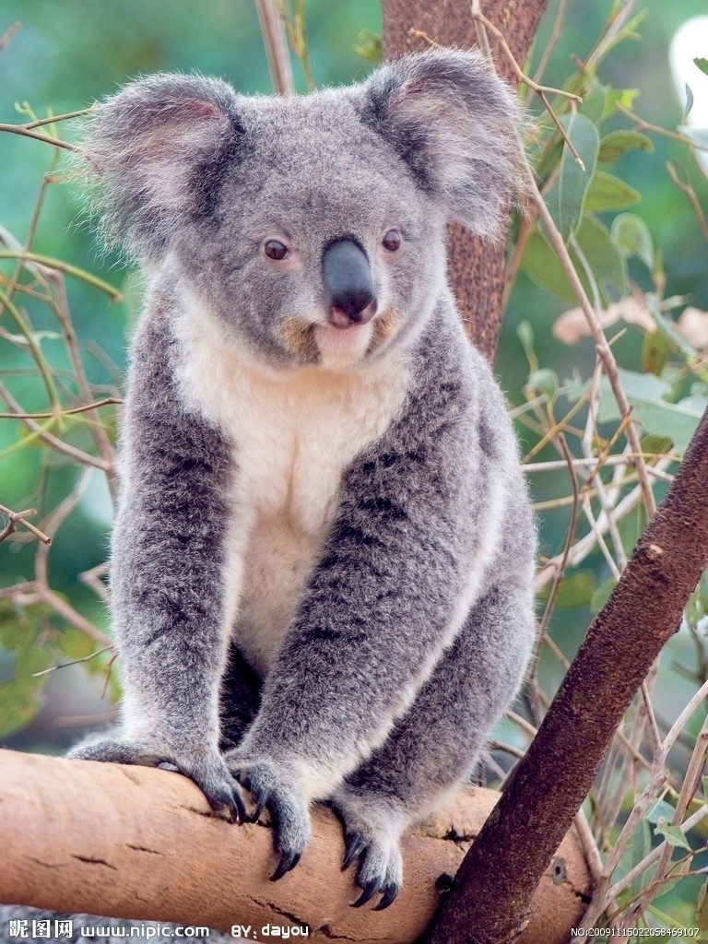
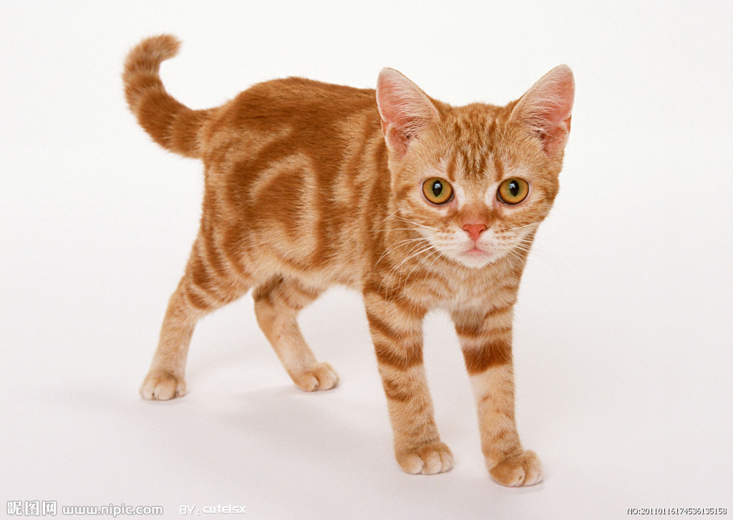
koala n. 袋鼠
giraffe n. 长颈鹿
We’re all animals.
animal n. 动物
No, I’m a pet.
cat n. 猫
pet n. 宠物

Slide 6
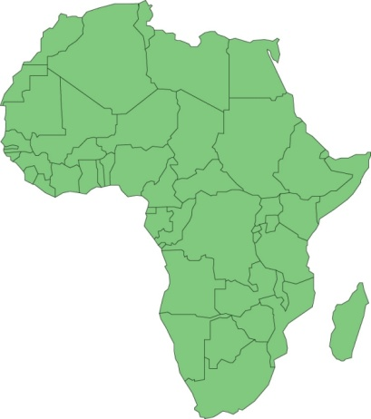
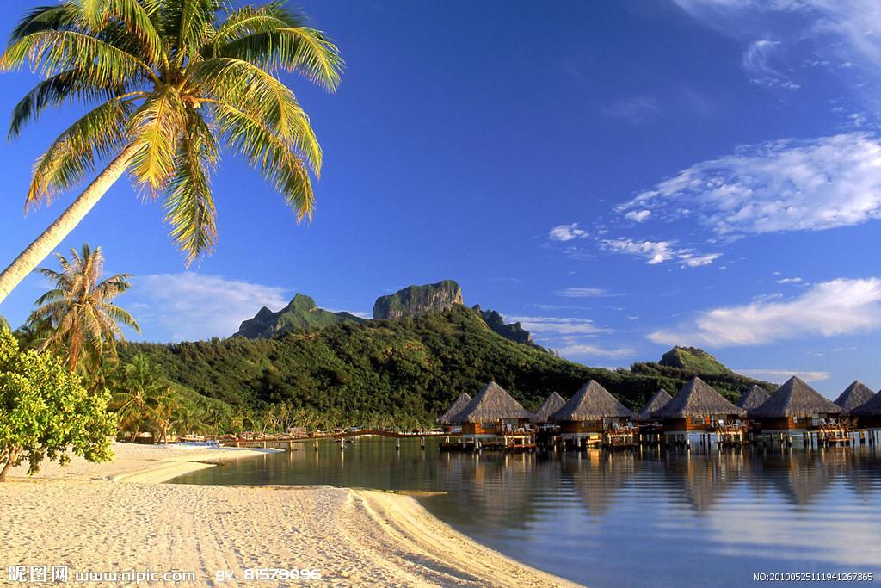
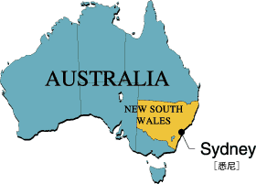
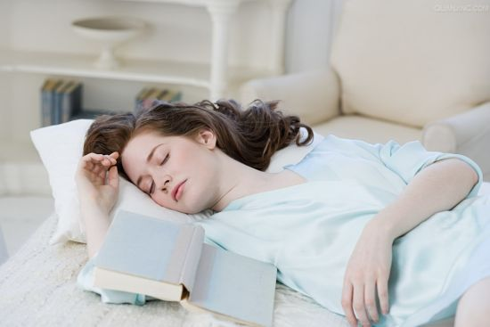
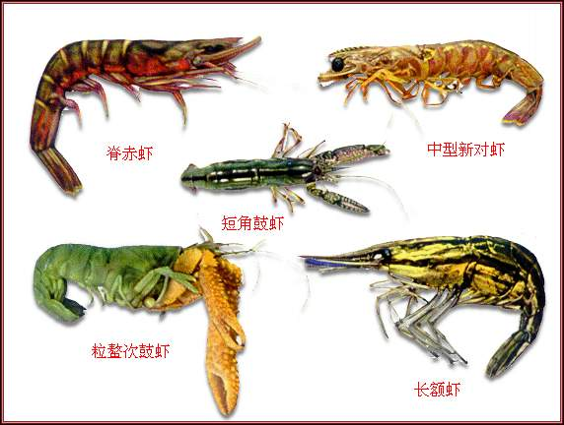
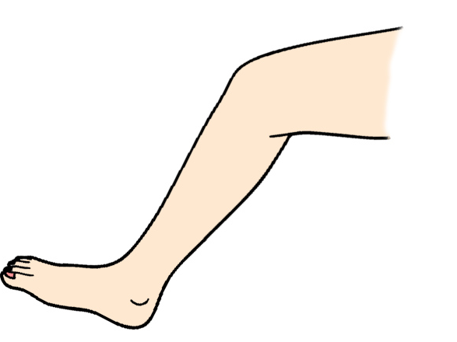
south adj. 南方的；n. 南方
Australia n. 澳大利亚
Africa n.
非洲
leg n. 腿
sleep n.&v. 睡觉
kind n. 种类

Slide 7
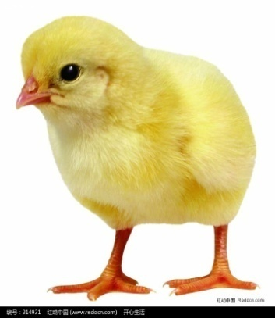
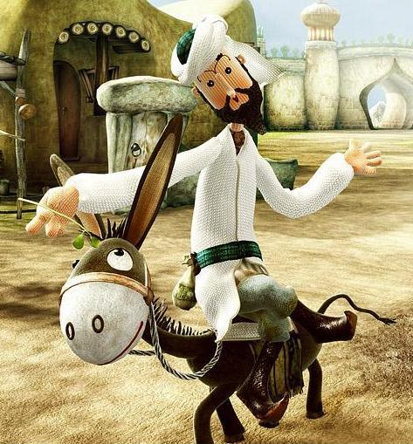
cute adj. 可爱的
lazy adj. 懒散的
beautiful adj. 美丽的
clever adj. 聪明的

Slide 8
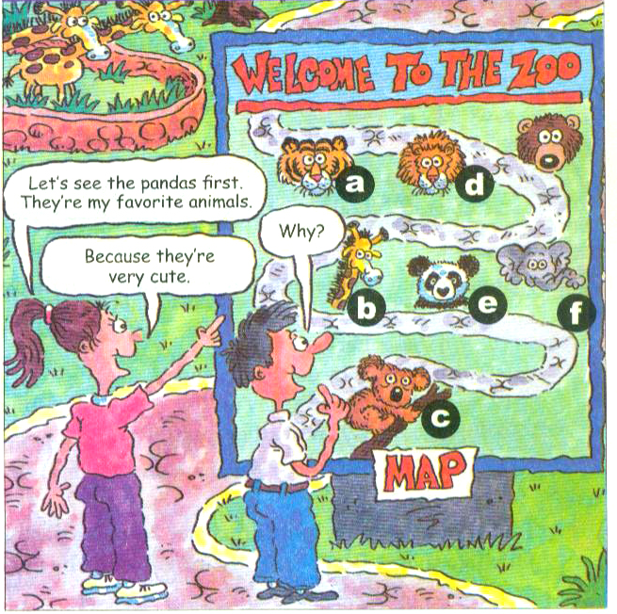
Match the words with the animals in the picture.
1a
tiger ___
elephant ___
koala ___
panda ____
lion ____
giraffe ____
a
f
c
e
d
b

Slide 9
Listen and check the (√) the animals you hear in 1a.
Listening
1b
tiger ___
elephant ___
koala ___
panda ____
lion ____
giraffe _____
√
√
√

Slide 10
猜猜看!
Guess what animal it is.
It’s a panda.

Slide 11
It’s an elephant.

Slide 12
It’s a lion.

Slide 13
It’s a tiger.

Slide 14
It’s a koala.

Slide 15
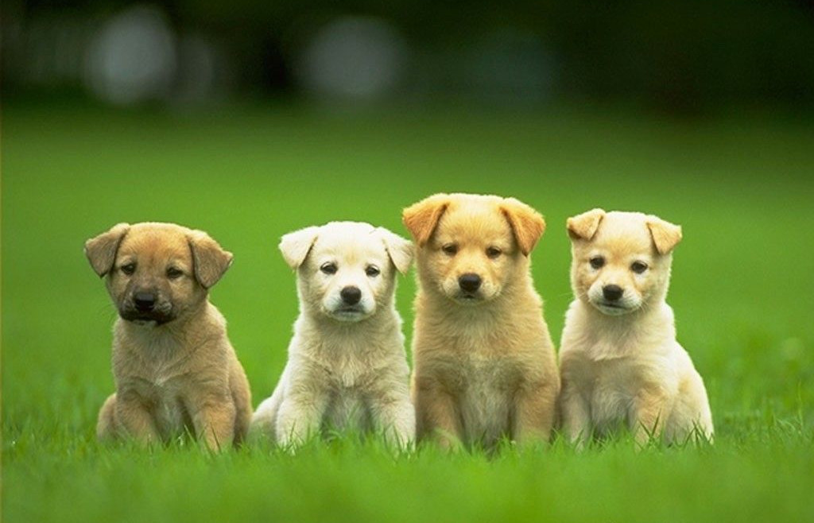
Presentation
Why do you like dogs?
Because they’re friendly.
Where are lions from?
They’re from South Africa.

Slide 16
Pairwork
Practice the conversation with your partner. Then make conversations about the other animals in 1a. Use the words in the box.
1c
cute interesting fun smart lazy beautiful

Slide 17
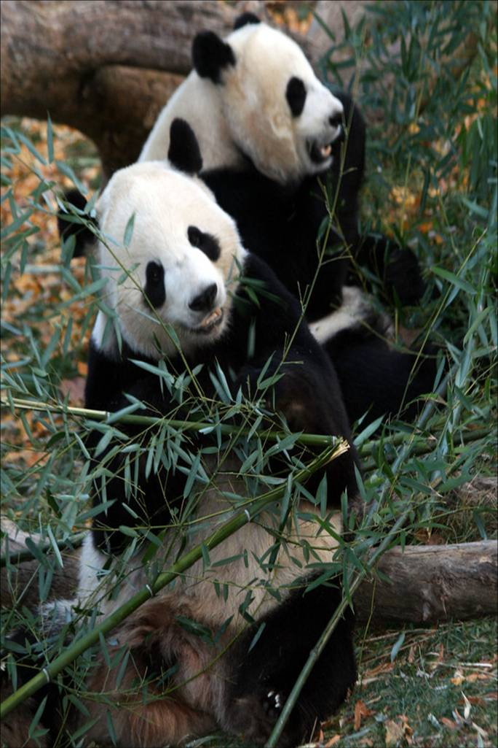
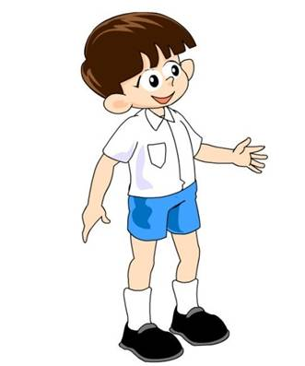
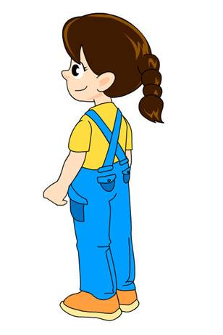
cute interesting fun smart lazy beautiful
Let’s see the pandas first.
Why do you want to see them?
Because they’re very cute.

Slide 18
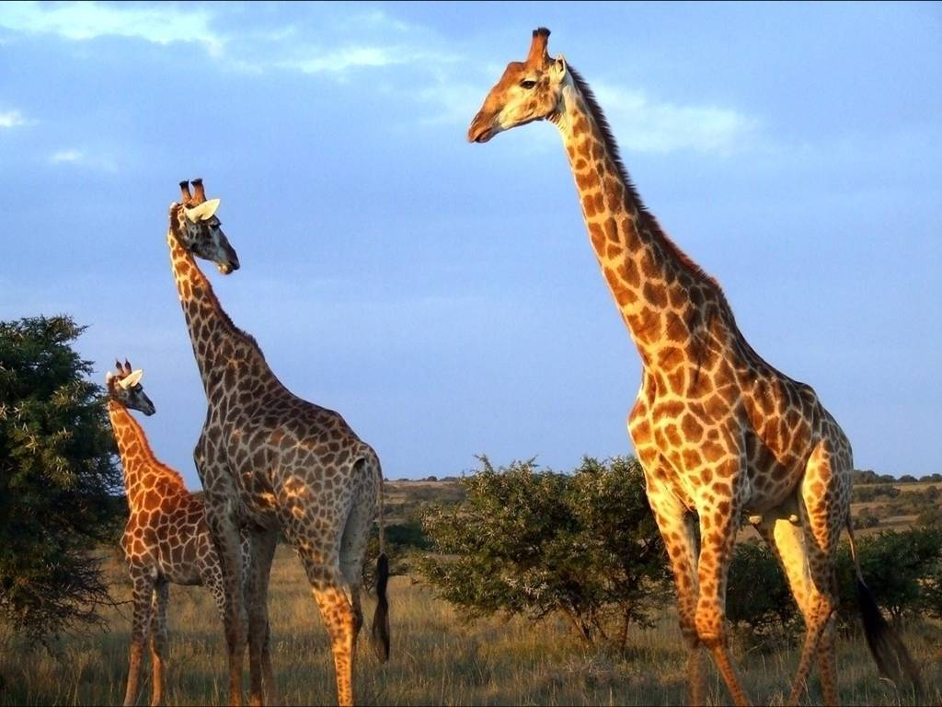
cute interesting fun smart lazy beautiful
Let’s see the ________ first.
Why do you want to see them?
giraffes
Because they’re very __________.
beautiful

Slide 19
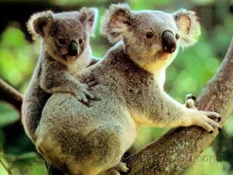
cute interesting fun smart lazy beautiful
Let’s see the ______ first.
Why do you want to see them?
koalas
Because they’re very _________.
interesting

Slide 20
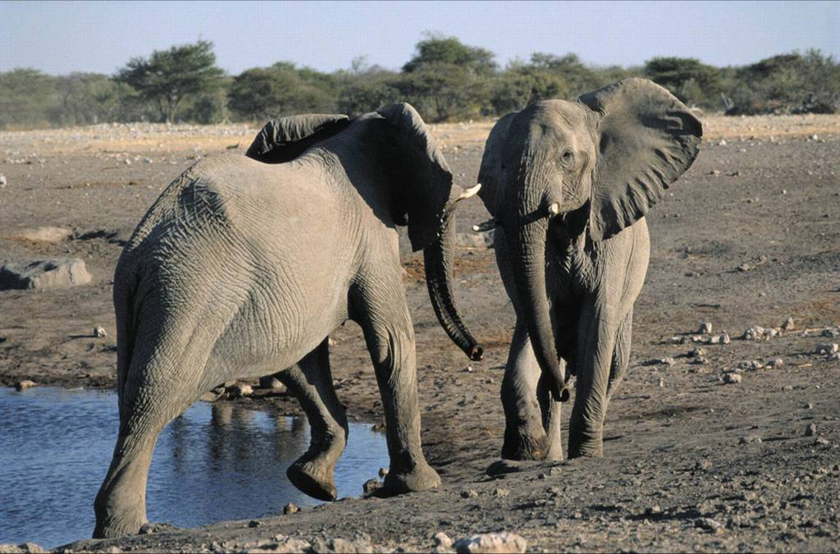
cute interesting fun smart lazy beautiful
Let’s see the _________ first.
Why do you want to see them?
elephants
Because they’re very _______.
smart

Slide 21
Listening
Listen and write the animals you hear. Draw a line from the animals to the description words and the countries they are from.
2a

Slide 22
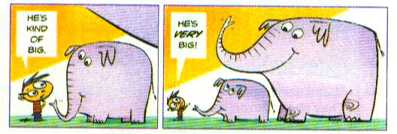
Animals | Description words | Countries
1. _________ | really scary | Australia
2. _________ | kind of interesting | South Africa
3. _________ | very cute | China
pandas
koalas
lions

Slide 23
2b
Listen again. Complete the conversation with the words in 2a.
pandas
Julie: Let’s see the _______.
John: Why do you like them?
Julie: Because they’re _______ interesting.
John: Where are they from?
Julie: They’re from ______.
kind of
China

Slide 24
Pairwork
Talk about the other two animals in 2a with a partner. Do John and Julie like them? Do you like them? Why or why not?
1c

Slide 25
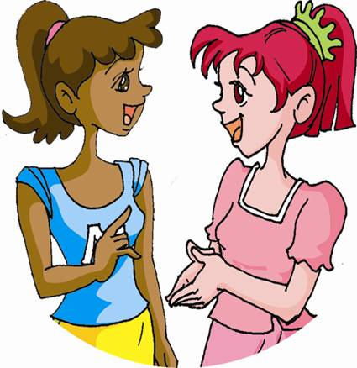
Well, I like koalas.
Why do you like them?
Because they’re very cute and they are from Australia.

Slide 26
Well, I don’t like lions.
Why don’t you like them?
Because they’re really scary.
Most of them are from South Africa.
Where are they from?

Slide 27
Reading
2d
Read the conversation in 2d and answer the questions.
Does Peter have a pet?
______________________________
2. What can Dingding do?
_______________________________
_______________________________
Yes, he does.
He can walk on two legs. He can dance, too.

Slide 28
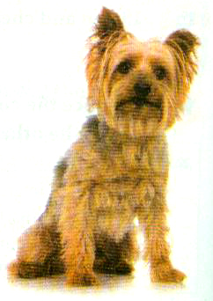
3. What pet does Jenny’s mom have?
________________________________
4. Does Jenny like the cat? Why?
___________________
___________________
She has a cat.
No, she doesn’t. Because it’s very lazy.

Slide 29
2d
Role-play the conversation.
Jenny: Your dog is really cute, Peter!
Peter: He’s my new pet, Dingding. He’s
very smart.
Jenny: Really? What can he do?
Peter: He can walk on two legs. He can
dance, too.
Jenny: Wow!
Peter: Does you family have a pet?

Slide 30
Jenny: My mom has a big cat, but I
don’t like her.
Peter: Why don’t you like the cat?
Jenny: Well, because she’s kind of
boring. She sleeps all day, and
her name is Lazy.
Peter: Haha, then that’s a good name
for her!

Slide 31
Language points
1. Why don’t you like her?
Why don’t you + 动词原形，还 是 一种提建议的句型。 意为“为什么 不……呢？” 例如：
Why don’t you take a walk? 你为什么不去散步呢？

Slide 32
Why don’t you drink some tea? 为什么不喝点茶呢？
“Why don’t you + 动词原形” 的同义句可以说：
Let’s … 例如：
Let’s take a walk. 让我们去散步吧。
Let’s drink some tea.
让我们喝点茶吧。

Slide 33
小试身手
1. Let’s play volleyball after school. (改 为同义句)
_____ _____ you play volleyball after school?
2. Let’s join the music club. (改为同义 句)
____ ______ you join the music club?
Why don’t
Why don’t

Slide 34
2. He can walk on two legs.
walk on… 表示“用某种方式行走”。
例如：
walk on one’s hands
表示“用手倒立行走”
walk on one’s knees
表示“跪着走；跪着向前挪动”

Slide 35
The children like to walk around the house on their hands and knees.
孩子们喜欢手脚并用在房子里爬来爬去。

Slide 36
3. Well, because she’s kind of boring.
kind of 有几分…… 相当于一个副词，后面多跟形容词 。例如：
They’re kind of scary. 他们有点可怕。
The pandas are kind of cute.
熊猫有点可爱。

Slide 37
【拓展】
kind 作名词意为“种类”
a kind of … 一种……
What kind of bread do you like?
你喜欢哪种面包？
kind还可构成短语all kinds of ...，意为“各种各样的”。
My grandpa has all kinds of stamps.
我爷爷有各种各样的邮票。

Slide 38
小试身手
我不喜欢看电影，因为它有点无聊。
________________________________ ________________________________
2. 他们有两种类型的书包。
________________________________
3. 杰克有点懒惰。
________________________________
I don’t like movies, because it’s kind of boring.
They have two kinds of schoolbags.
Jack is kind of lazy.

Slide 39
Exercise
将下列句子译成英语。
1. 让我们先去看老虎吧。
____________________________
2. 那些大象来自哪里？
____________________________
Let’s see the tigers first.
Where are the elephants from?

Slide 40
3. 你为什么不喜欢牛奶？
____________________________
那只懒猫整天睡觉 。
____________________________
因为狮子有点吓人。
____________________________
Why don’t you like milk?
The lazy cat sleeps all day.
Because lions are kind of scary.

Slide 41
Homework
总结所学过的动物的名称，用英语写出来。
缩写一个小对话来讨论一下你所喜欢的动物及原因。

Slide 42
Good-bye, everyone.

