Slide 1
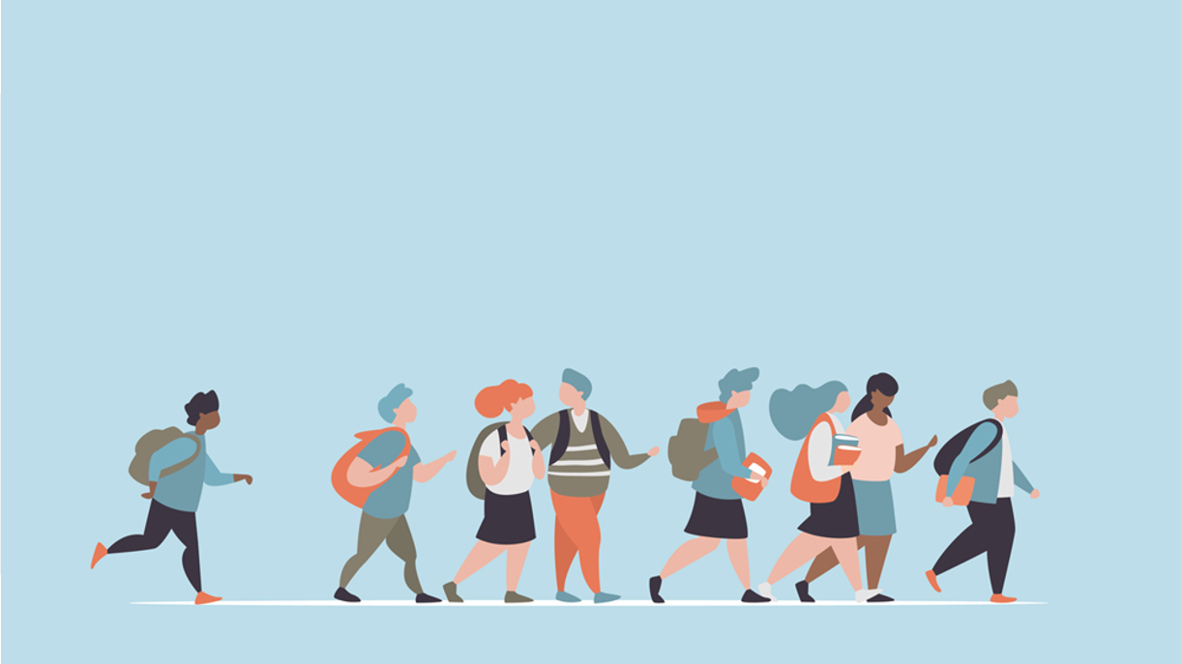
R·九年级全一册
Unit 10 You’re supposed to shake hands.
第三课时

Slide 2
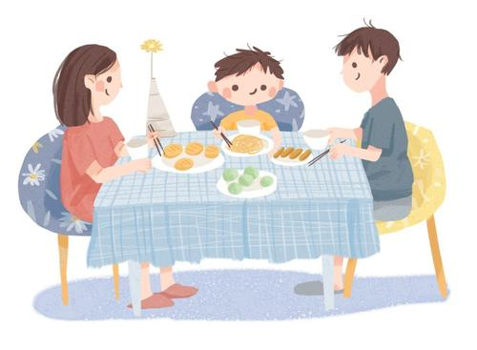
Lead in
Talk about the differences between a Western meal and a Chinese meal.

Slide 3
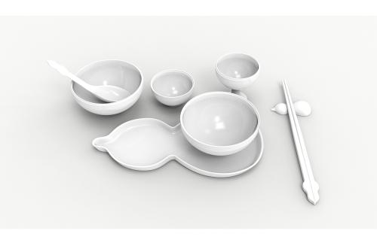
People use chopsticks and spoons at a Chinese meal.

Slide 4
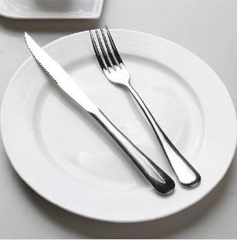
People use a knife and fork at a Western meal.

Slide 5
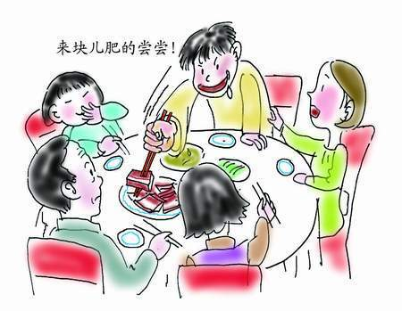
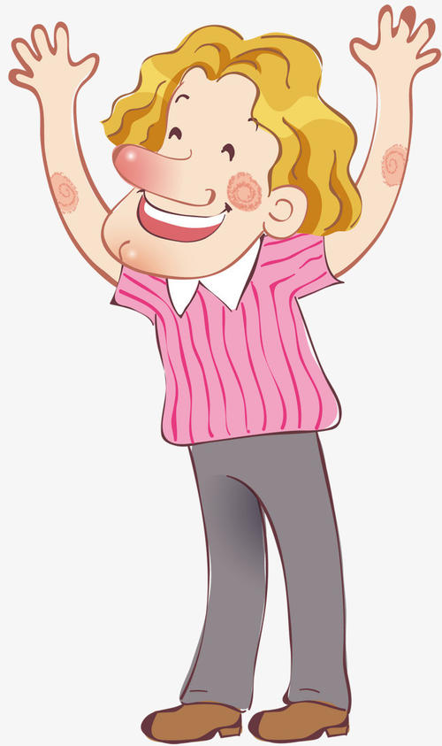
Language points
You shouldn't start eating first if there are older people at the table.
You should start eating last if there are older people at the table.

Slide 6
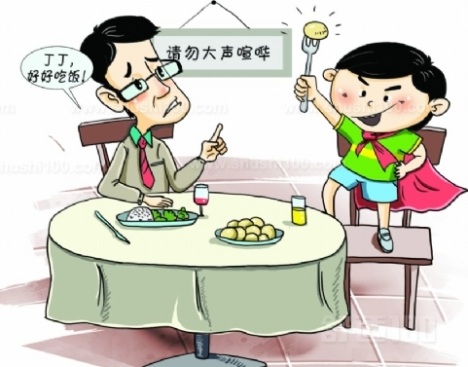
It is impolite to talk loudly.
It is polite to speak in a low voice.

Slide 7
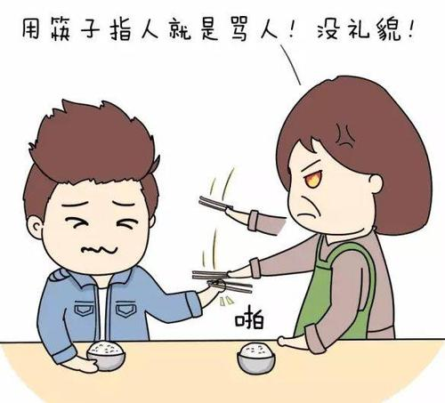
You are not supposed to point at anyone with your chopsticks.
You're supposed not to point at anyone with your chopsticks.

Slide 8
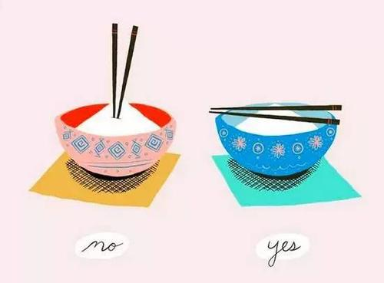
You are not expected to stick your chopsticks into your food.
You're supposed to put your chopsticks well.

Slide 9
Let's talk
Compare the table manners in France and China in your group. How are they the same or different? Make a list.
VS

Slide 10
Example
You’re not supposed to put your bread on your plate. You’re supposed to put it on the table.
You’re not supposed to eat anything with your hands except bread, not even fruit. You have to cut it up and eat it with a fork.

Slide 11
except 除……之外(后面的成分不包括在内)
besides 除……之外还(后面的成分包括在内)
You’re not supposed to eat anything with your hands except bread.
面包可以吃

Slide 12
They go out of their way to make me feel at home.
go out of one’s way to do sth. 竭尽全力做……
make sb. feel at home 使某人感到宾至如归

Slide 13
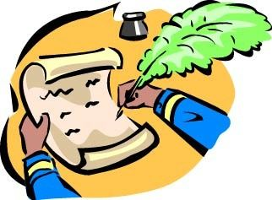
Let's write
Write a letter to your pen pal to give him/ her suggestions on how to behave properly in China.

Slide 14
When you’re eating at the table...
称呼
正文(建议)
In our house, you’re supposed to...
署名
When you go out with people...

Slide 15
Useful expressions
You are supposed to ... / You are not supposed to...
You should/shouldn’t ...
It’s polite/impolite to...
You are allowed to...
You aren’t allowed to ....
You can/could/can’t/couldn’t...

Slide 16
THANKS

