Slide 1
Unit 12

Slide 2
Unit 12
What did you do
last weekend?

Slide 3
Section A 1
1a-2d

Slide 4
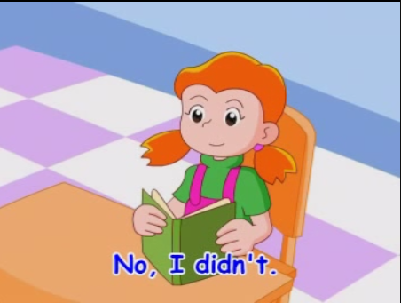
Let's watch and learn!

Slide 5
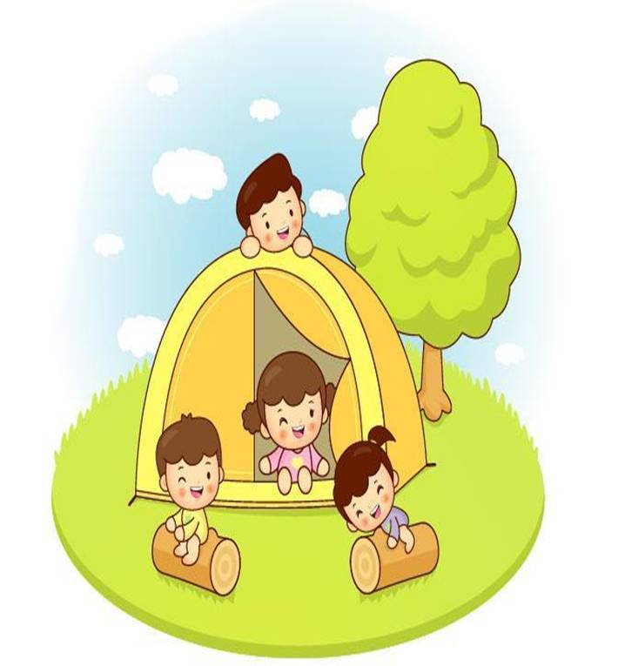
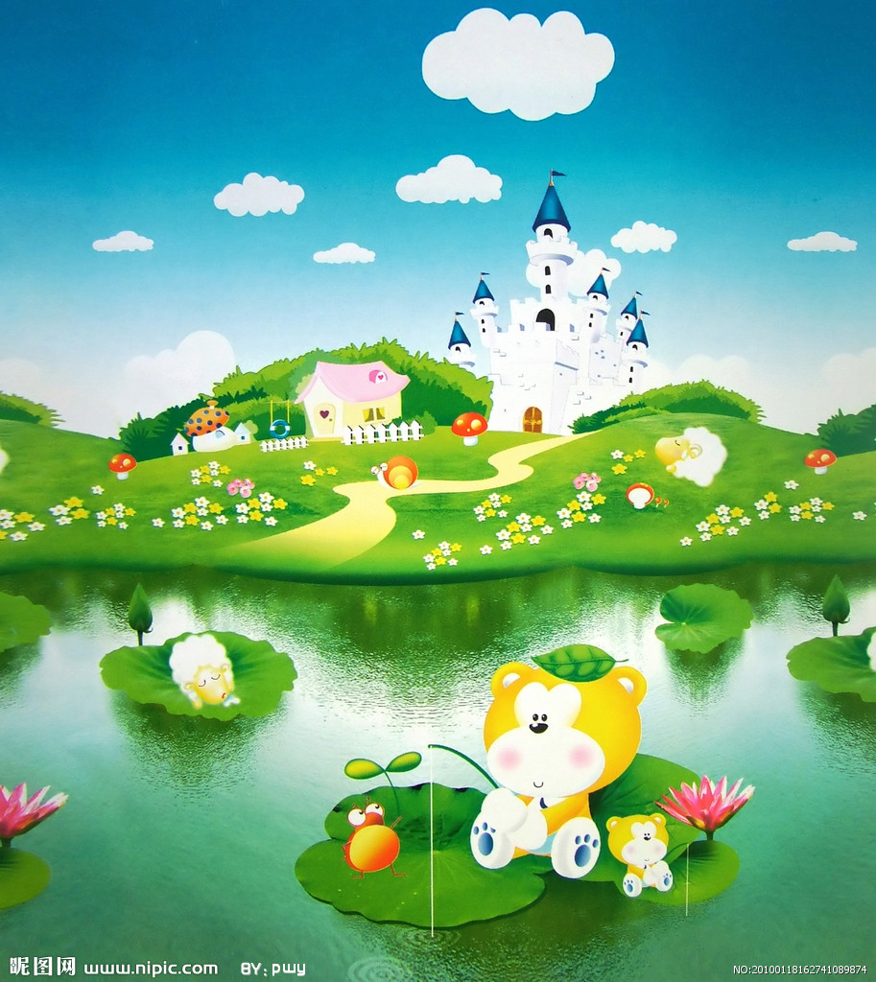
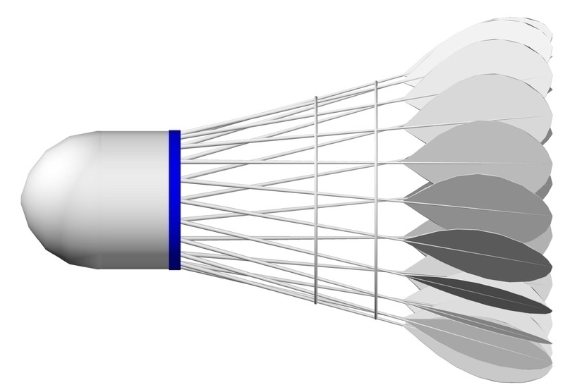
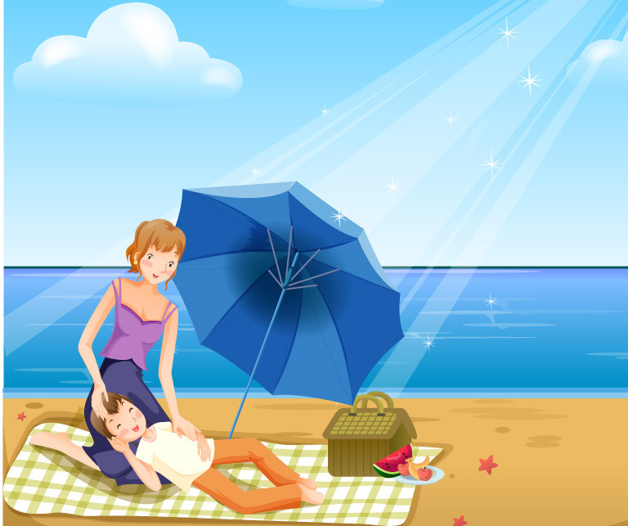
New words
camp v. 扎营；搭帐篷
lake n. 湖；湖泊
beach n.
沙滩；海滩
badminton n.
羽毛球运动

Slide 6
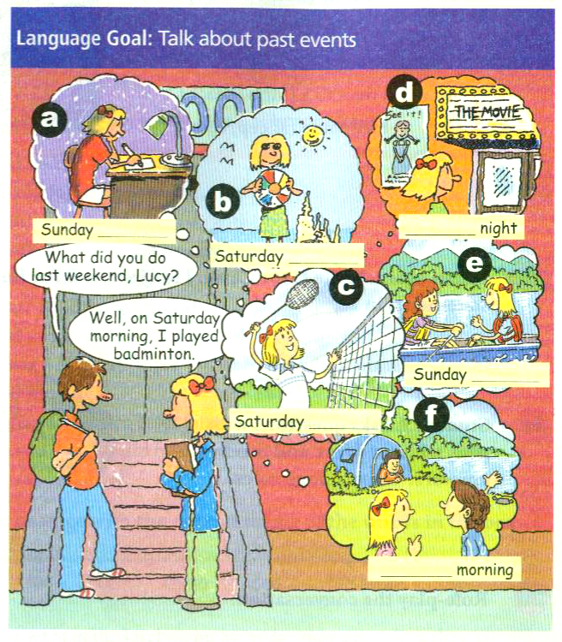
Match the activities with the pictures [a-f].
1a
1. did my homework __
2. went to the cinema __
3. went boating __
4. camped by the lake __
5. went to the beach __
6. played badminton __
a
d
e
f
b
c

Slide 7
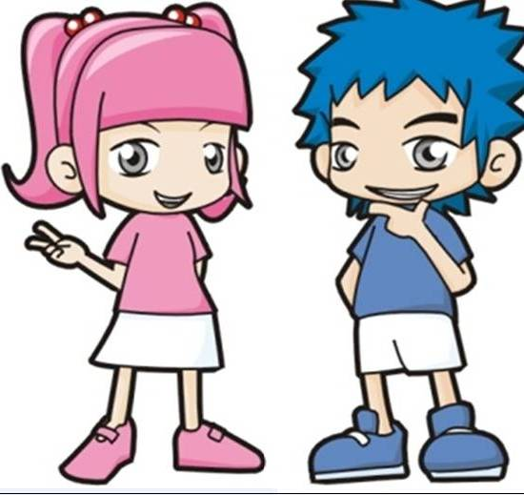
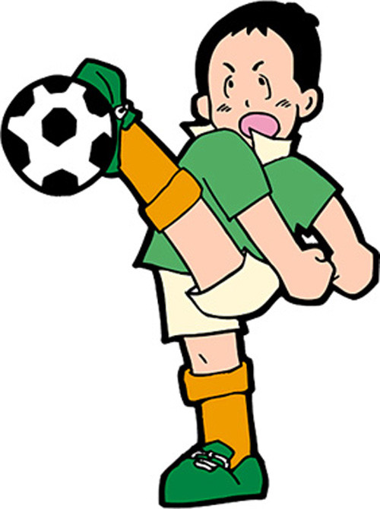
Presentation
What did you do last weekend, Li Lei?
Well, on Saturday morning, I played soccer.

Slide 8
Listen and write the day, morning, afternoon or night below each picture.
Listening
1b

Slide 9
Saturday night
Sunday night
Saturday afternoon
Sunday afternoon
Saturday morning
Sunday morning

Slide 10
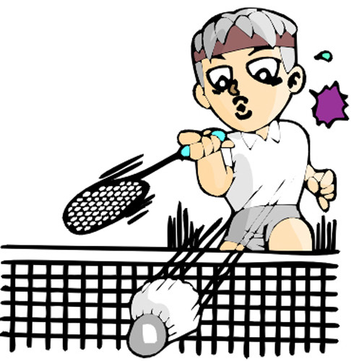
Guessing game!
What did he do?
He played badminton.

Slide 11
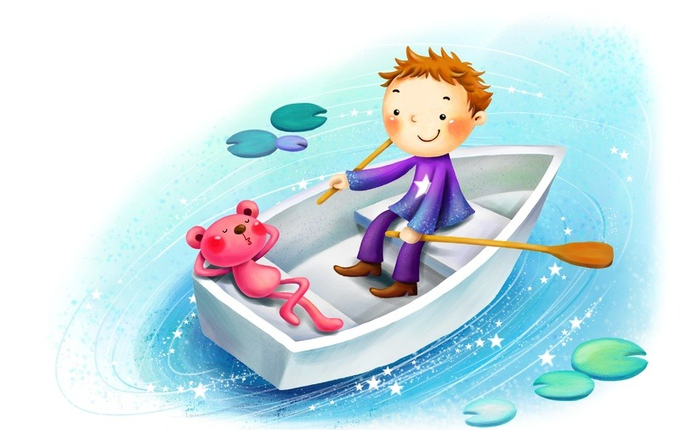
What did he do?
He went boating.

Slide 12
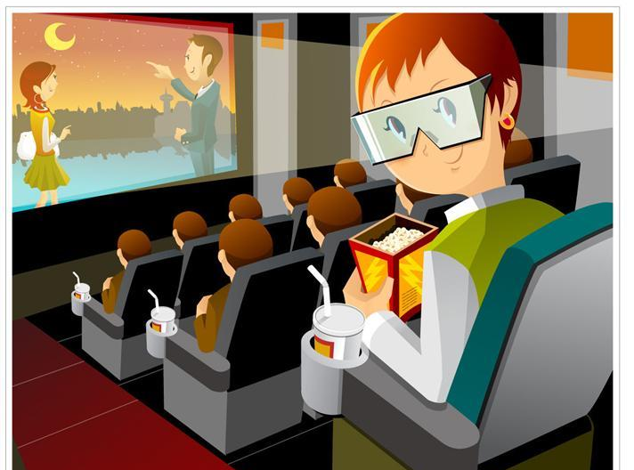
What did he do?
He went to the cinema.

Slide 13
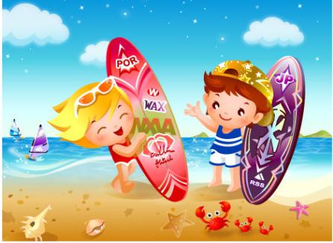
What did they do?
They went to the beach.

Slide 14
What did they do?
They went fishing.

Slide 15
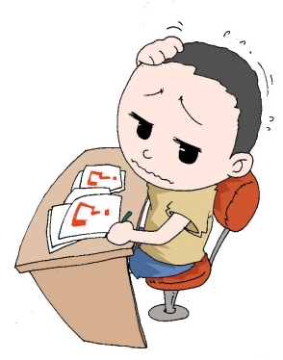
What did he do last weekend?
He did his homework.

Slide 16
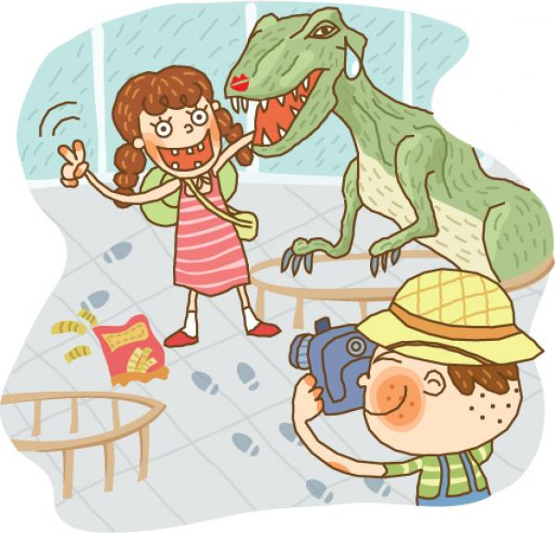
What did they do last weekend?
They visited a history museum.

Slide 17
Pairwork
Role-play. Student A is Lucy. Student B asks Lucy about her weekend.
1c

Slide 18
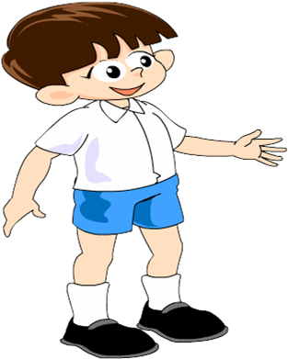
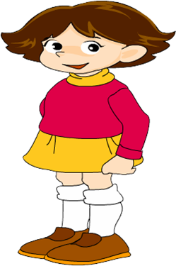
What did you do last weekend, Lucy?
Well, on Saturday morning, I played badminton.
What did you do on Saturday afternoon?
I went to the beach.

Slide 19
What did you do on Saturday night?
I went to a movie.
What did you do on Sunday morning?
I went boating with my friends.

Slide 20
What did you do on Sunday afternoon?
I camped by the lake.
What about Sunday night?
I did my homework at home.

Slide 21
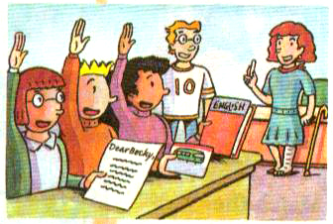
Listening
Listen and underline the words you hear.
2a
1. I visited my (aunt / grandma).
2. I did my (homework / sports).
3. I studied for the (English / math) test.
4. I went to a (farm / beach).
5. I fed some (sheep / cows).
________
_________
_______
_____
_____

Slide 22
Listen again. Write C for Carol, J for Jack or B for Becky next to the statements in 2a.
2b
1. ___ I visited my grandma.
2. ___ I did my homework.
3. ___ I studied for the English test.
4. ___ I went to a farm.
5. ___ I fed some cows.
B
B
C
J
J

Slide 23
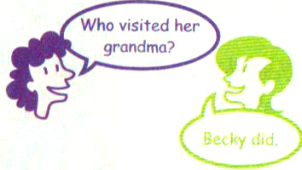
Pairwork
Student A asks questions with who, what or where and Student B answers. Then change roles.
2c

Slide 24
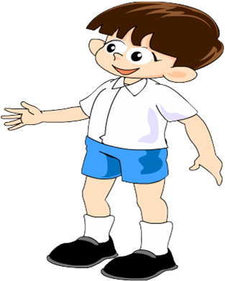
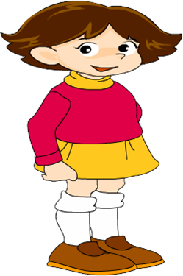
Who stayed at home last weekend?
Carol. I think.
He studied for his English test.
What did he do?

Slide 25
Where did Jack go last weekend?
He went to the farm.
What did he do there?
He fed some cows there.

Slide 26
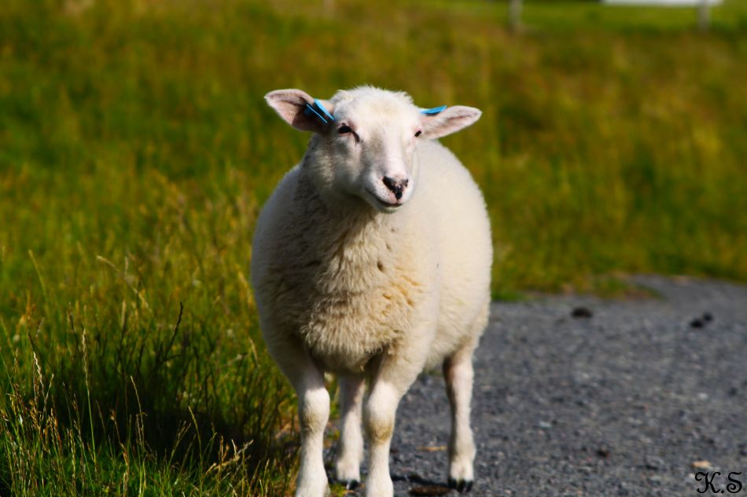
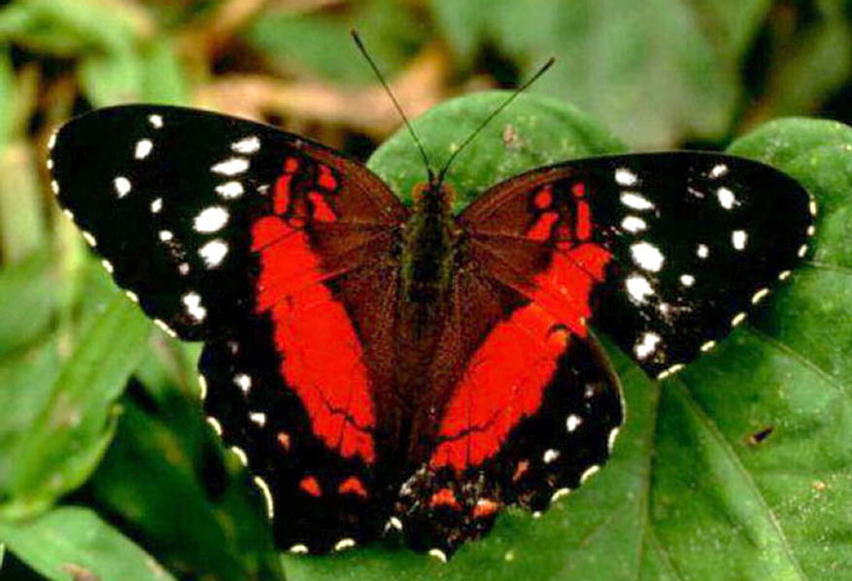
New words
sheep n. 羊；绵羊
butterfly n. 蝴蝶
visitor n.
游客；
访问者
natural adj. 自然的

Slide 27
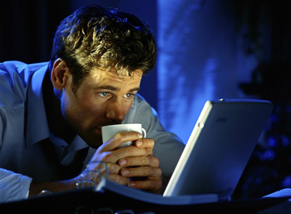
stay up late
深夜不睡；熬夜
tired adj.
疲倦的；疲劳的

Slide 28
Reading
Read the conversation and answer the questions.
2d
How was Lisa’s weekend?
______________________
2. Where did Lisa work as a guide? _____________________________
It was great.
At the Natural History Museum.

Slide 29
3. What did she do there?
_____________________________
_____________________________
4. Why is Paul tired now?
_____________________________
_____________________________
She told the visitors about the butterflies and their living habits.
Because he stayed up late to watch the soccer game.

Slide 30
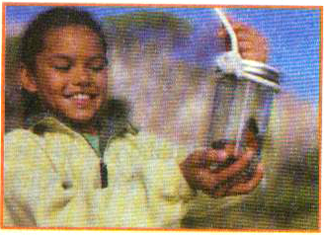
Role-play
2d
Role-play the conversation.
Paul: Hi, Lisa. How was
your weekend?
Lisa: Great. Thanks.
Paul: What did you do?
Lisa: I worked as a guide at the Natural History Museum.

Slide 31
Paul: Really? How interesting!
Lisa: Yeah, it was fun. They have a butterfly house with over 200 kinds of butterflies! I told the visitors about them and their living habits. Did you have a good weekend?
Paul: Yeah, it was good, but I’m kind of tired now. I stayed up late to watch the soccer game.

Slide 32
Language points
1. sheep 名词，意为“绵羊”。它是单复数同形的单词，当它作主语时谓语动词的单复数形式要根据它在句中的意思来确定。类似的单词还有deer (鹿), Chinese (中国人)等。例如：
Look, there are three sheep eating grass under the tree. 看! 树下有三只羊在吃草。

Slide 33
2. I worked as a guide at the Natural History Museum.
我在自然历史博物馆里做导游的工作。
句中的as是介词，意为“作为；当作”。如：
My sister works as a nurse in a hospital.
我妹妹在一家医院当护士。

Slide 34
【运用】
将下面的句子翻译成英语。
你在一所中学当老师吗？
__________________________________________________________
Do you work as a teacher in a middle school?

Slide 35
3. How interesting! 多么有趣啊！
这是一个感叹句，句子结构为：
How + 形容词或副词 + （主语 + 谓语）！ 例如：
How interesting the book is!
那本书太有趣了！

Slide 36
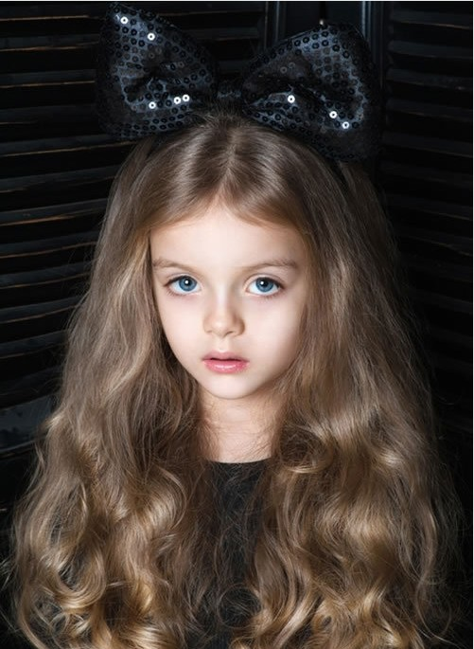
4. They have a butterfly house with over 200 kinds of butterflies!
句中的with是介词，意为“有；带有”。如：
Who is the girl with long blonde hair?
那位金色长发的女孩是谁？

Slide 37
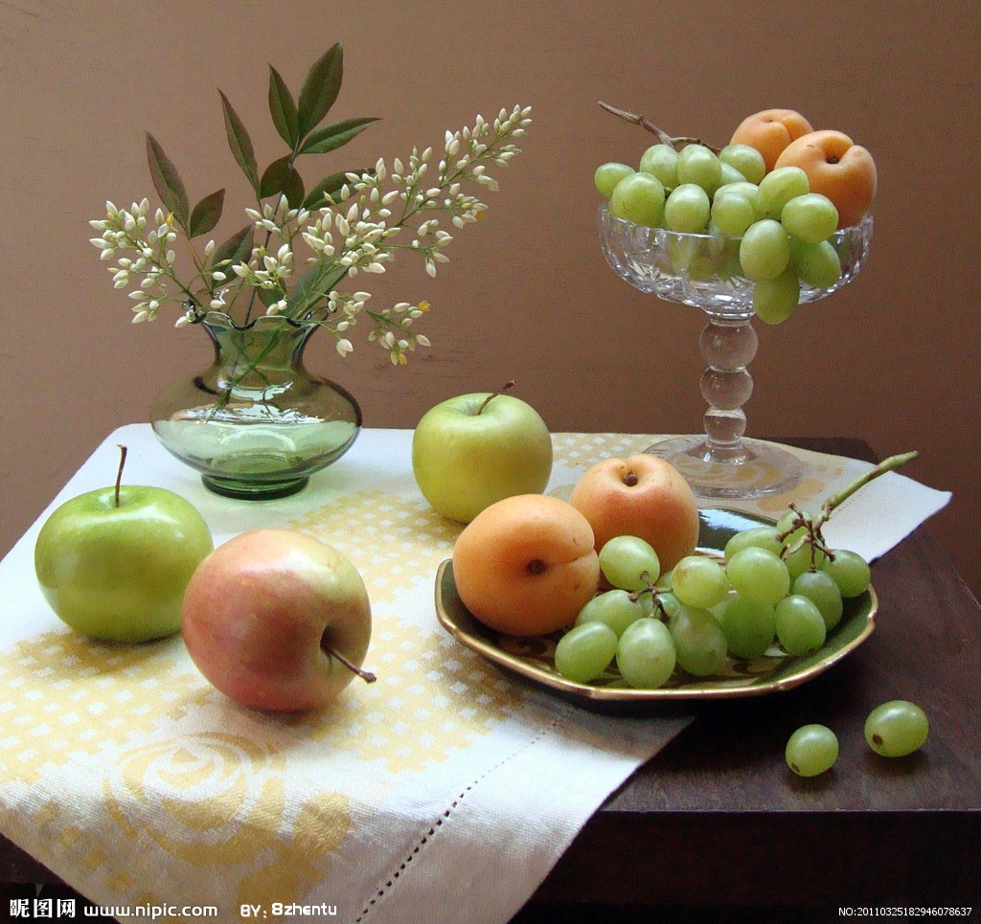
句中的kind是名词，意为“种；类”，是可数名词。如：
There are three kinds of fruits on the table.
桌子上有三种水果。

Slide 38
【链接】与kind有关的短语有：
a kind of “一种；某种(不明确的东西)”， kind of “有点”，many / different / all kinds of “各种各样的”。
【运用】将下列句子翻译成汉语。
(1) It is a kind of animal with long ears and small eyes.
__________________________________
它是一种长耳朵小眼睛的动物。

Slide 39
(2) There are five kinds of books in the library.
________________________________
(3) My uncle bought a house with a big garden.
________________________________
图书馆里有五种书。
我叔叔买了一幢带有大花园的房子。

Slide 40
5. I stayed up late to watch the soccer game.
stay up 意为“熬夜；深夜不眠” 。例如：
Don’t stay up late. It’s bad for your health.
不要熬夜，这对你的健康不好。
Let’s stay up to see the New Year.
咱们别睡觉，迎接新年的到来吧。

Slide 41
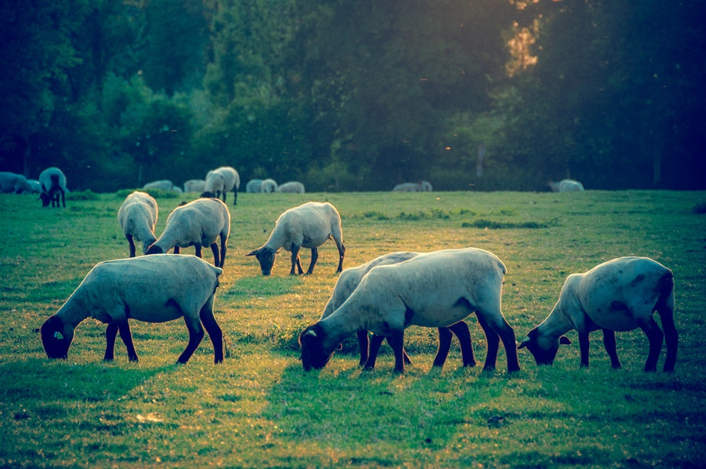
小试身手
看图补全对话。
— Hi, Li Lei. _____ ____ your weekend?
— Not bad. I _____ ___ the farm, and ____ a big ______.
How was
went to
saw
sheep

Slide 42
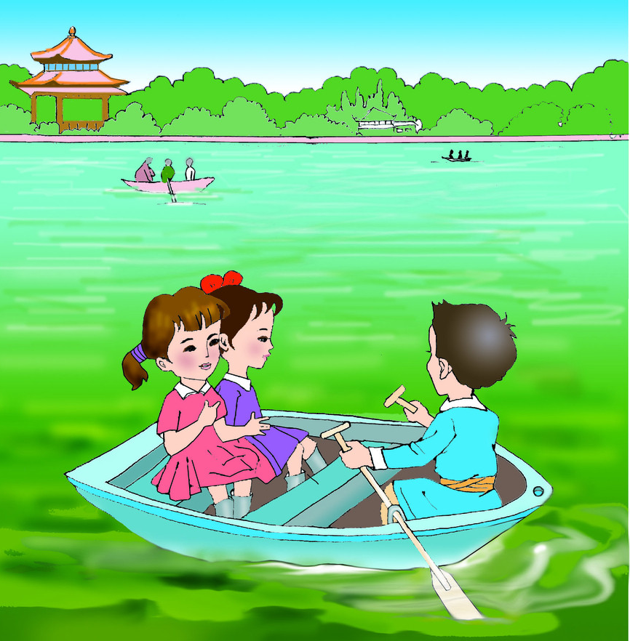
— Really? Sounds ___________.
— What did you do, Wu Lin?
— Well. I _____ ________ with my friends in the afternoon. And I _______ ___ late to do my __________ last night.
interesting
went boating
stayed up
homework

Slide 43
Homework
复习一般过去式的构成方式，并总结其变化规律。
回顾所学的周末/业余活动的词组；并用它们来造几个句子。

