Slide 1


Unit 9
Can you come to my party?
Section B (3a-3b)

Slide 2

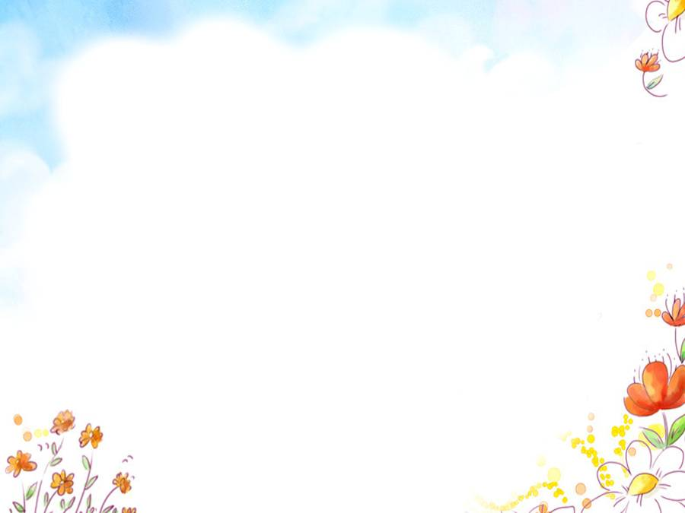
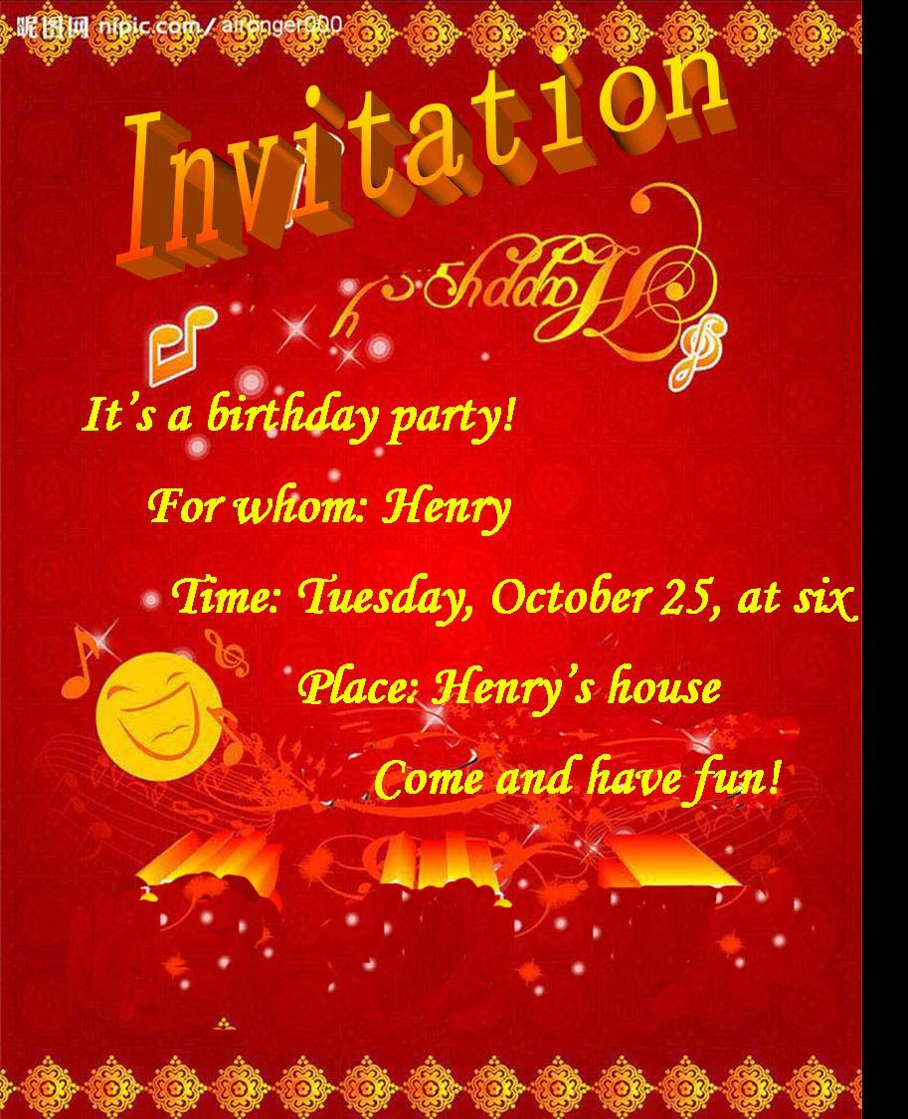

Slide 3
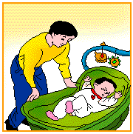

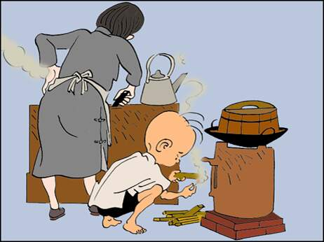

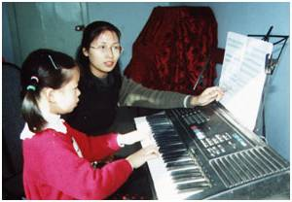

Pairwork
A: Can you come to his party?
B: When is it?
A: Today\ Tomorrow\ Next week. On Monday\…
B: Sure, I’d love to.
\I’m sorry, I can’t. I have to…
\I’m + ing

Slide 4
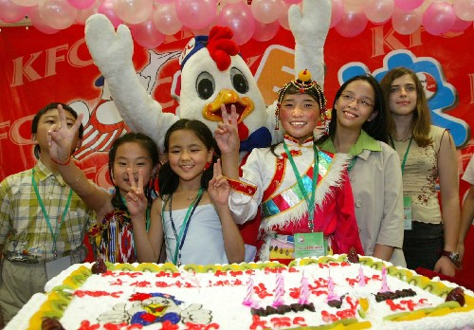

Memory Game
Can they come to his party?
Henry's friends

Slide 5

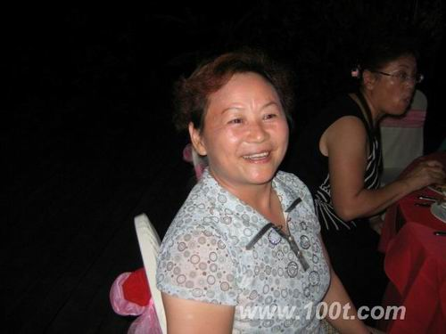

Can she come to his party?
Sure, she'd love to.

Slide 6
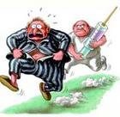
Can he come to his party?
No, he can’t. He has to…

Slide 7

Can she come to his party?
No, she can’t. She has to…

Slide 8
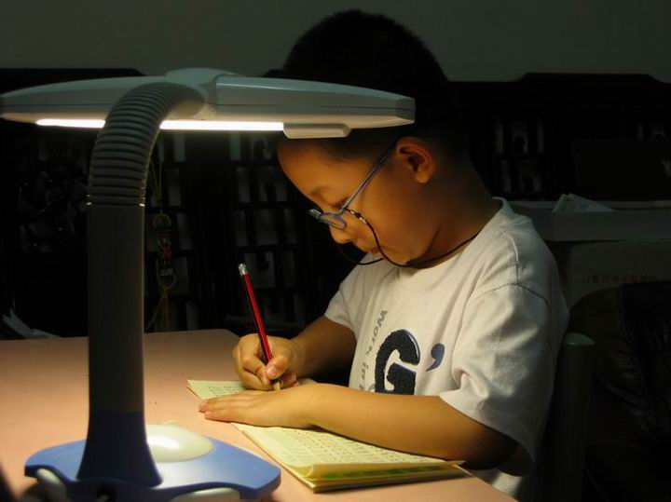
Can he come to his party?
No, he can’t. He has to…
化 学 测 验
chemistry test

Slide 9

Can he come to his party?
No, he can’t. He has to ….
soccer training.
足球训练

Slide 10

Can he come to his party?
No, he can’t. He is …

Slide 11
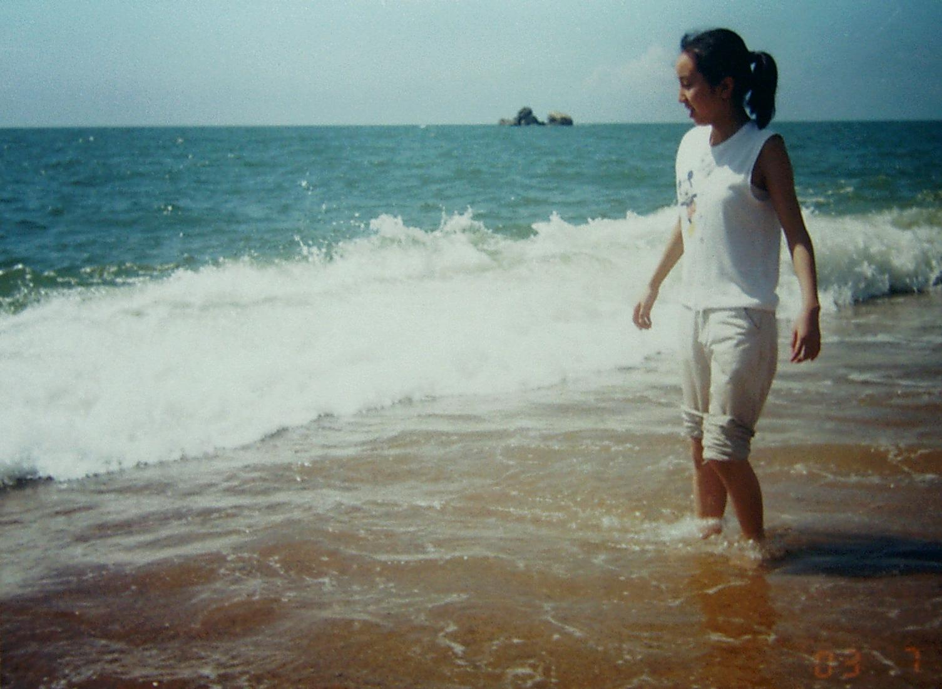
Can she come to his party?
No, she can’t. She is …

Slide 12
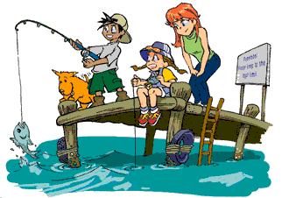
Can they come to his party?
No, they can’t. They are…

Slide 13

3a 1. Read as quickly as you can.
Can Sonia visit Henry this week?
Yes No

Slide 14
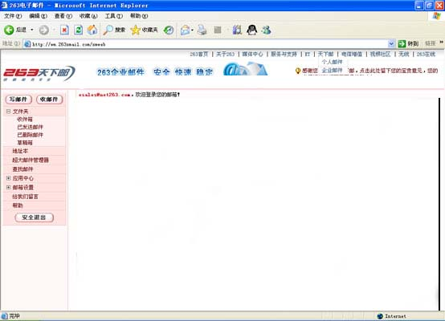
Hi Henry,
Thank you for your invitation.I’m sorry I can’t visit you this week. I am really busy.This evening I’m going to my cousin’s birthday party. And tomorrow, I have to go to the dentist.(Yuck!) On Wednesday, I have a tennis training with the school team. And I have to study for my chemistry test on Thursday. On Friday evening, I’m going to the movies with some friends. Can you come to the movies with us on Friday?
Write soon.
Sonia

Slide 15

3a .Read ,then fill in the blanks and answer.
Sunday
Monday
Tuesday
Wednesday
Thursday
Friday
Saturday
have nothing to do
go to her cousin’s birthday party
go to the dentist
have tennis training
study for her chemistry test
go to the movies
have nothing to do
When does Sonia have nothing to do?
→ On Sunday and Saturday.

Slide 16
Read carefully, then fill in the blanks.
Hi Henry,
Thank you for your ________. I’m sorry I can’t ________ you this week. I am really ________. This evening I’m going to my cousin’s ______ ________. And tomorrow, I _______ ________ go to the dentist. On Wednesday, I have ______ _______ with the school team. And I have to ______ ________
my chemistry test on Tuesday. On Friday evening, I’m going to _____ _______ with some friends. Can you come to the movies with us on Friday?
Write soon.
Sonia
invitation
visit
busy
birthday
party
have
to
tennis
training
study
for
the
movies

Slide 17
Retell the passage
Sunday
Monday
Tuesday | go to the dentist
Wednesday
Thursday
Friday
Saturday
go to my cousin’s birthday party
have tennis training
study for my chemistry test
go to the movies with some friends
Thank you for your invitation. I’m sorry I can’t visit you this week. I am really busy. This evening I am …
Can you come to the movies with us on Friday?

Slide 18

3b Fill in the blanks
Hi Henry,
Thanks a lot for the invitation. I’m sorry I can’t visit next week.
On Monday , I have to ______________________.
On Tuesday, I’m ___________________________with my friends. On Wednesday, I have to __________ my dad. On Thursday, I’m studying for _____________. And on Friday, ________________ on vacation with __________. Please call me after the vacation.
Tony
go to the doctor
having soccer training
exercise with
an English test
I’m going to Hawaii
my dog

Slide 19

Show time!

Slide 20
Dear Jack:
Thank you very much for your invitation. I really want to watch the movie with you tomorrow evening. I 1 the movie is exciting. But I 2 go with you. You know my parents work in Beijing. They come back once a week. I have to live with my grandmother. She is 3 in bed. She is very old and I worry about her. So I have to look after her at home. Also, I 4 study for my exams. I think you can ask Tom to go to the movie with you. I think he has nothing to do because he wanted me to play soccer yesterday. I am really 5 . I am sure to go with you another time.
Write soon
1.( ) A.hear B.listen C.look
2.( ) A.can B.can't C.will
3.( ) A.ill B.illness C.bad
4.( ) A.have B.have to C.has to
5.( ) A.happy B.sorry C.relaxed
Mary
A
B
A
B
B

Slide 21
Let's discuss !
Why did Sonia and Tony write the e-mails to Henry ?
What do you think of Sonia and Tony?

Slide 22
To be a polite(有礼貌的) man

Slide 23
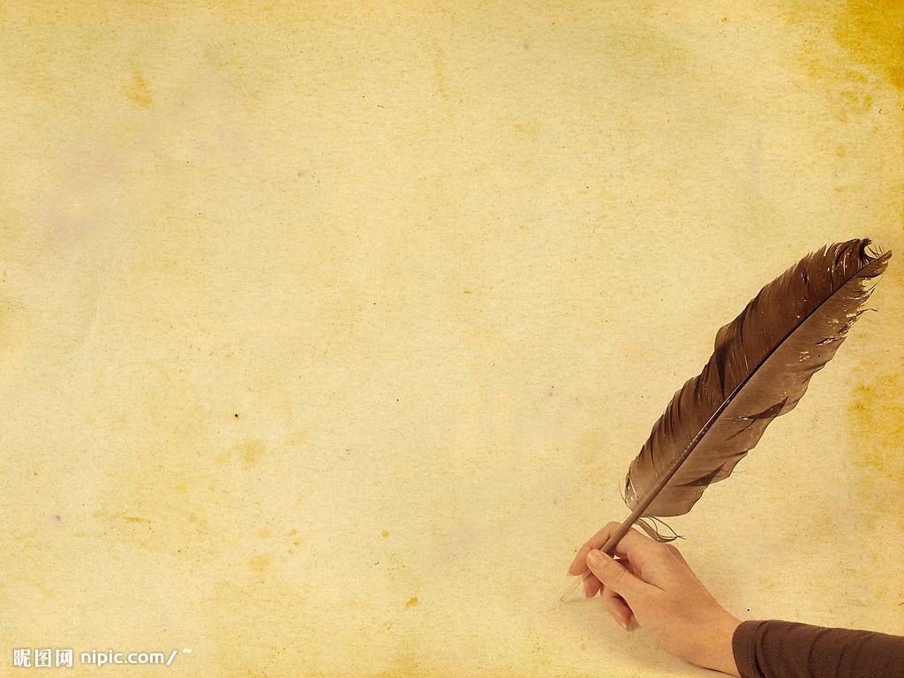
Write an e-mail to a friend. Say why you can’t visit him or her next week.
Sunday | go bike riding
Monday | have tennis training
Tuesday | have a piano lesson
Wednesday | visit my grandma
Thursday | go to a movie
Friday | see a dentist
Saturday | exercise
Hi __________,
Thanks for the invitation. I’m sorry I can’t visit next week.
_______________________________________________________________________________________________________________________________________________________________________
______________________________________________________
Write soon.
_________

Slide 24
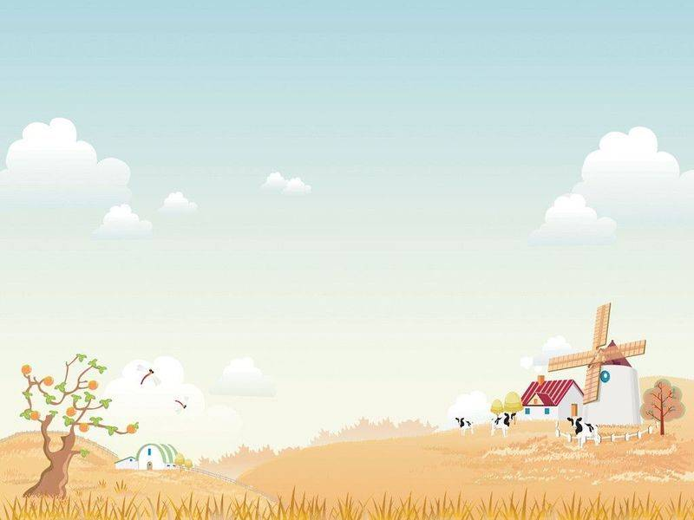
Thank you for listening!
Goodbye!

