Slide 1
R·九年级全一册
Unit 2 I think that mooncakes are delicious!
第一课时

Slide 2
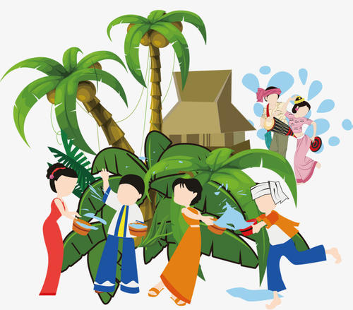
Lead in
You can play with water happily on the streets. If people throw water at you, you’ll have good luck.
The Water Festival

Slide 3
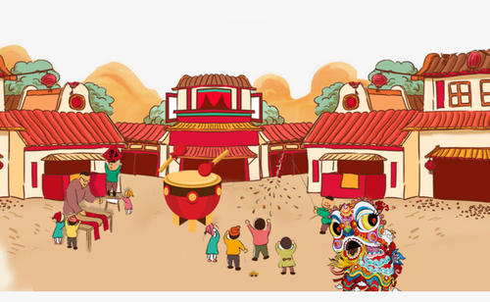
When can we see the scene in the picture?
The Chinese Spring Festival, the 1st day of the first lunar month

Slide 4
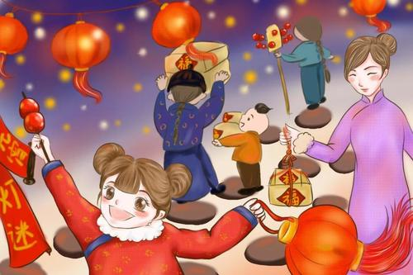
When can we see many lanterns?
Lantern Festival,
the 15th day of
the first lunar month

Slide 5
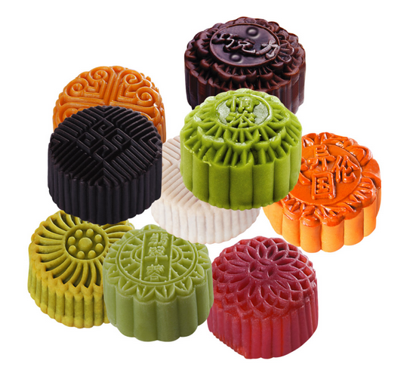
Say the festival shown in the picture.
The Mid-Autumn Day

Slide 6
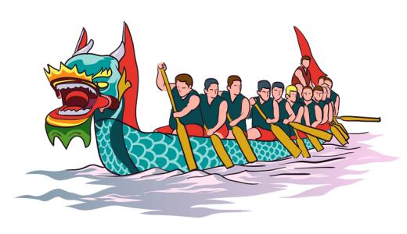
This festival is best known for the dragon-boat races.
The Dragon Boat Festival

Slide 7
一、go to …for a/one’s vacation 去……度假
go for a vacation
go on vacation
度假还没有开始，在计划中
去度假
在度假
度假正在进行

Slide 8
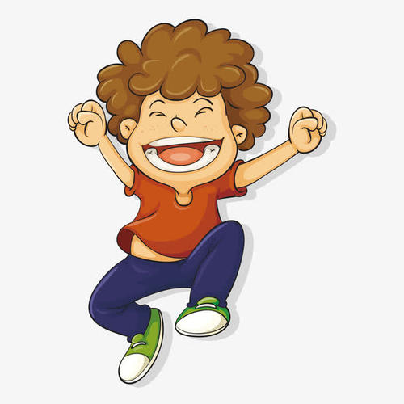
I'm going on my vacation.
What are you doing ?

Slide 9
I went to Singapore for my vacation.
Where did you go on your vacation?
Sounds like fun.

Slide 10
二、Sounds like fun. 听起来很有趣。
省略了it这个形式主语，完整的句子是：
It sounds like fun.
sound like 听起来像

Slide 11
It sounds like a nice book.
I learn a lot from Harry Potter.

Slide 12
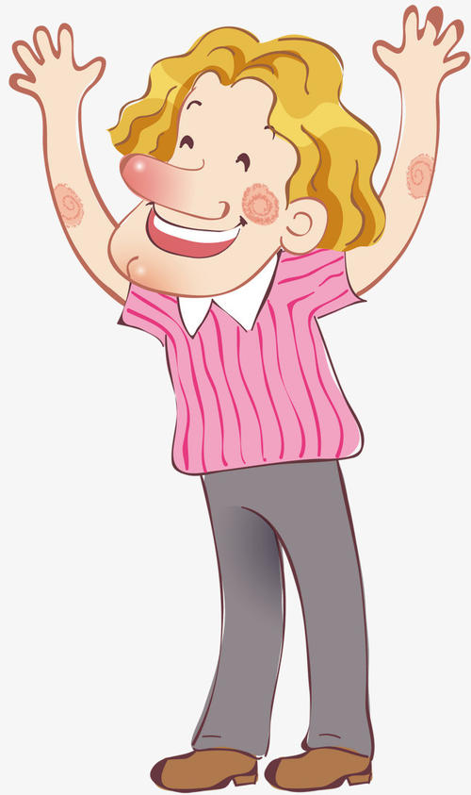
I went to Hong Kong and met Jackie Chan.
How about your vacation?
Wow, it sounds like a dream.

Slide 13
三、感官动词 + like
feel like 摸起来像
smell like 闻起来像
look like 看起来像
taste like 尝起来像

Slide 14
What do you like
best about the Dragon
Boat Festival?
What a great day (it is)!
I love the races.
I think that they’re
fun to watch.

Slide 15
四、感叹句
感叹句是表示赞美、惊叹以及喜怒哀乐等强烈感情的句子。通常由what, how引导。

Slide 16
表达感叹时，how与形容词、副词连用；what则必须与名词连用。

Slide 17
1. What+ a/an+(adj.)+n.(单数)+(主+谓)+…!
2. What+(adj.)+n.(复数/不可数)+(主+谓)+…!

Slide 18
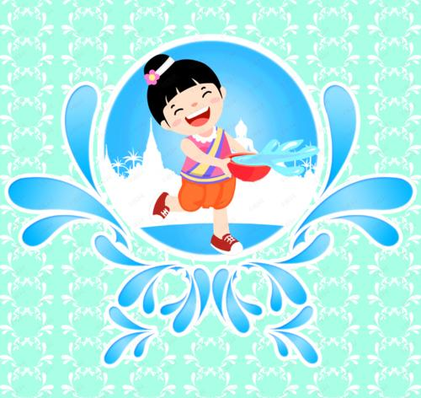
Try to compare:
The Water Festival is fun.
What fun the Water Festival is!
谓语
主语

Slide 19
3. How+ adj.+ a/an+ n.+主+谓+…!
4. How+(adj./adv.)+主+谓+…!

Slide 20
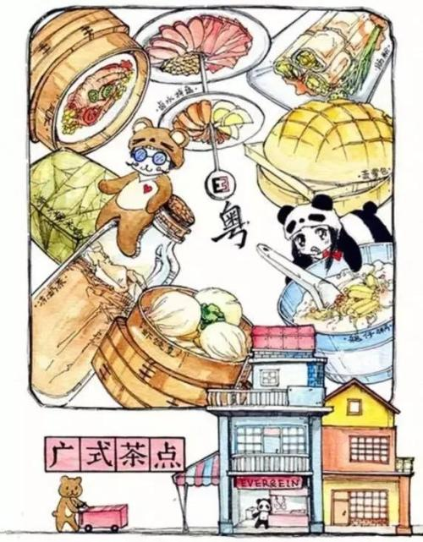
The food is delicious in Hong Kong.
How delicious the food is in Hong Kong!
主语
谓语
状语

Slide 21
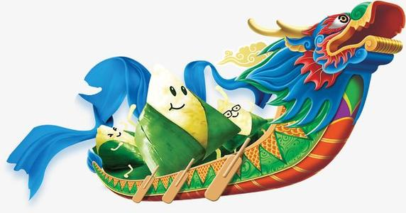
The dragon boat teams were fantastic.
How fantastic the dragon boat teams were!
主语
谓语

Slide 22
Practice
C
1. ______exciting sport it is!
A. What B. What a
C. What an D. How
2. how / exciting / races
3. what / interesting / city
How exciting the races were!
What an interesting city!

Slide 23
Summary
1. What do you like about…?
What do you like best about the Dragon Boat Festival?
2. What a great day!
3. How + adj. /adv. + 主 + 谓！
How fantastic the dragon boat teams were!

Slide 24
THANKS

