Slide 1
Unit7
Will people have robots?
Reading & writing

Slide 2
Learning aims
1. 熟读并能正确拼读本节新词。
2. 学会正确应用will预测十年后的生活。

Slide 3
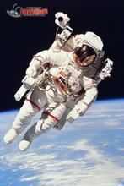
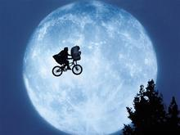
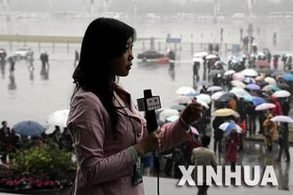
加油啊！
A: What will you be in ten years?
B: I’ll be a\ an…
A: What will you do in ten years?
B: I’ll…

Slide 4
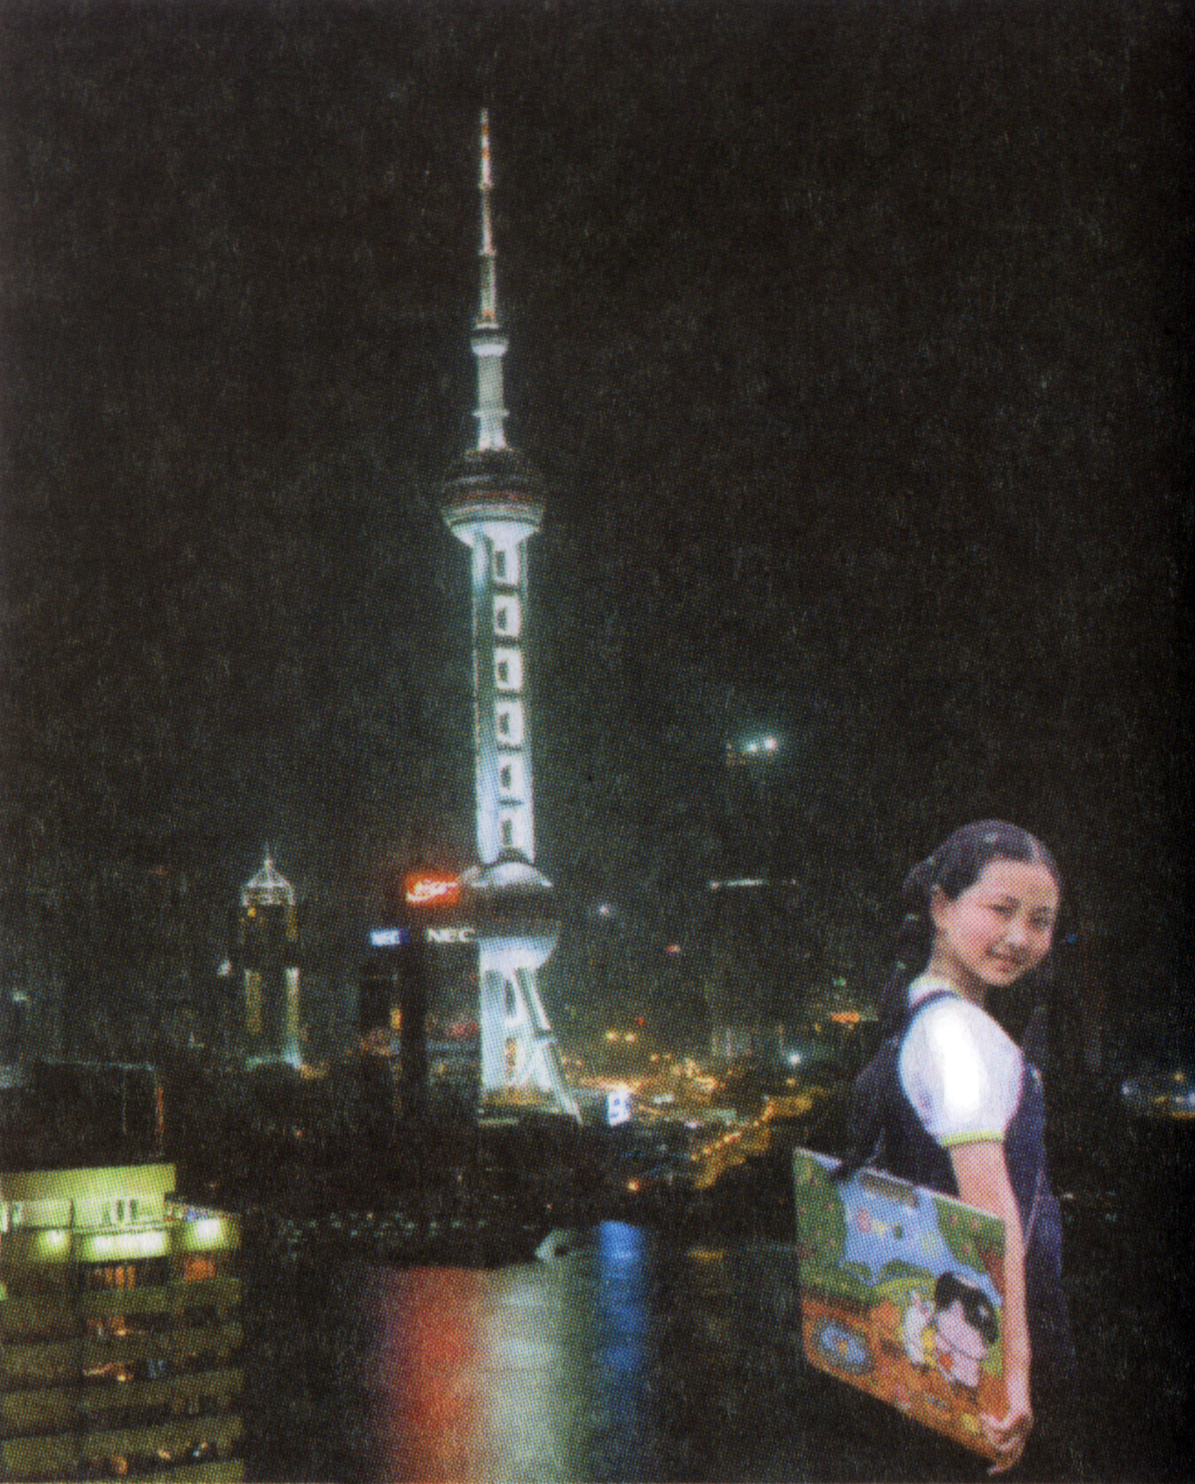
自学指导一
2分钟浏览文章,获取大意
The main idea of this article is_______.
A. I’m going to be a reporter.
B. I’ll live in Shanghai.
C. my life in ten years.
D. I’ll go to Hang Kong and Australian.
√

Slide 5
默读课文5分钟。
自学指导二
要求：回答时不要看书!
1. What will she be in ten years?
She will be a reporter.
2. Who will she meet?
She will meet lots of interesting people.
3. What will she have?
She will have pets.
4. Why can’t she have any pets now?
Because her mother hates them and their apartment is too small.
5. What sports will she play?
Skating and swimming.

Slide 6
自学指导三
Read again and fill in the chart in 3a. (3分钟) 完成课本3a下方表格
Ming in ten years.
Job | Pets | Sports | Places | Clothes
reporter | many①_______ pets, parrot | skating, ②____ | Shanghai, Hong Kong, ③________ | A______, dress more ⑤_____
different
④
suit
swimming
Australia
casually

Slide 7
自学指导四 深化阅读
1. 看谁读的既流利又准确？
(听别人读的同时标出你容易读错的单词)
2. 小组长领读、纠正发音
3. 前后位把这篇文章互读一遍
(圈出你容易读错的单词,可以请教组长或老师)

Slide 8
自学指导五
合上课本,写出下列单词的适当形式。
看谁能得满分? (10分)
In ten years, I think I ① (be) a reporter. I ② (live) in Shanghai. As a reporter, I think I ③ (meet) lots of interesting people. I think I ④ (live) in an apartment with my best friends, because I don’t like living alone. I ⑤ (have) pets. In ten years, I⑥ (have) many different pets. During the week I⑦ (look) smart, and probably ⑧ (wear) a suit. On the weekend, I ⑨ (be) able to dress more casually. I think I ⑩ (go) to Hong Kong on vacation, and one day I might even visit Australia.

Slide 9
新知探究
由“____+动词______”构成的一般将来时表将来某个时间要发生的动作或存在的状态,常与表示将来的时间状语连用,如: tomorrow, next week\year, in+时间段。。
will
原型
1.十年后,我将成为一位宇航员。 In ten years, I ____ _____ an astronaut.
will be
2. 哪个国将赢得下一届世界杯?
Which country_____ _____the next world cup?
will win
3. 张红认为十年后她将在电脑公司上班。
Zhang Hong ________she______ _______ in a
computer company.
thinks
will work
4. 在周末我将能够穿的更随意些。
I think I’ll be able to dress more casually.
5. 明天天气将会怎么样？
What will the weather be like tomorrow?

Slide 10
回顾思考
1. 本节单词还有哪些不会？
2. Can you use “will” to talk about your life in ten years.

Slide 11
达标检测题
一、听力填表（每空2分，共10分）
… I think I’ll be a ①_________.
…I think I’ll live in an _②__________with my best friends, because I don’t like living ③_________.
…I can’t have any pets now because my mother ④_______them and …
…and one day I might even visit ⑤________.
reporter
apartment
alone
hates
Australia

Slide 12
二、动词填空（每空1分，共10分）
will be
In ten years, I think I ① (be) a reporter. I’ll live in Shanghai, because I went to Shanghai last year and ② (fall) in love with it. I think it’s really a beautiful city.
As a reporter, I think I ③ (meet) lots of interesting people. I think I ④ (live) in an apartment with my best friends, because I don’t like living alone. I’ll have pets.
I ⑤ (not have) any pets now because my mother
⑥ (hate) them, and our apartment is too small. So in ten years, I’ll have many different pets. I might even keep a pet parrot! I’ll probably go skating and ⑦ (swim) every day. During the week I’ll look smart, and probably
⑧ (wear) a suit. On the weekend, I ⑨ (be) able to dress more casually. I think I’ll go to Hong Kong on vacation, and one day I ⑩ (may) even visit Australia.
fell
will meet
will live
can’t have
hates
swimming
will wear
will be
might

Slide 13
五分钟写作
要求：5分钟后上交作文.
In ten years, I think I’ll be a … ________________________________________________________________________________________________________________________________________________________________________________________________________________________________________________________________________________________________________________________
书写要工整哦！

Slide 14
See you！

