Slide 1
Unit 3 Environmental protection
Period 1 Reading and Thinking
选择性必修三
人教版（2019）

Slide 2
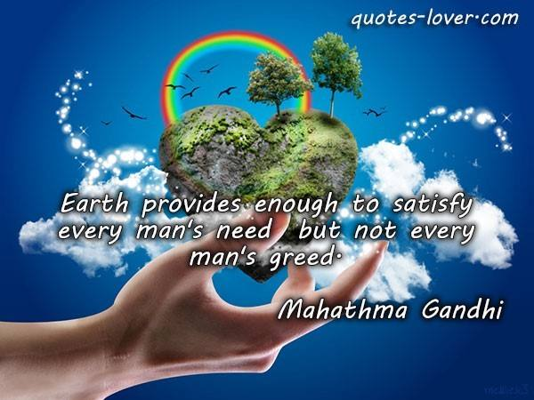
Lead in
Look at the picture and read the quote.
地球所提供的物质财富,
足以满足每个人的需求，
却不足以满足每个人的贪欲.

Slide 3
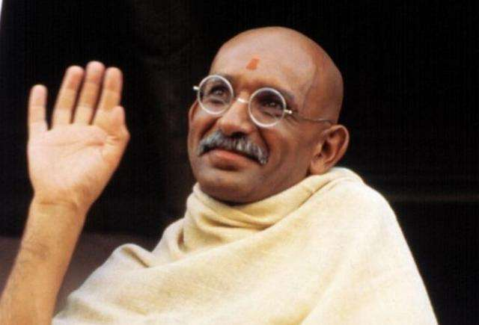
Lead in
Who is the man in the picture?
He is commonly known as the “Father of the Nation" in India, also being called "Bapu”，meaning father. He is known for many other popular and inspiring sayings, such as:
•The future depends on what we do in the present.
•Be the change you want to see in the world.
Mohandas K. Gandhi (1869-1948)

Slide 4
Lead in
Look at the picture and discuss some questions
How do you understand the quote?
The environment of the earth, i.e., nature, has evolved to provide enough to satisfy the basic needs of all living things within it, including mankind.However, nature cannot provide enough to satisfy everyone's greed, because greed is a desire that can never be satisfied.

Slide 5
Lead in
Look at the picture and discuss some questions
How is it related to the theme of the unit?
The quote is used here to suggest that consumption powered by greed is a prime cause of environmental degradation.

Slide 6
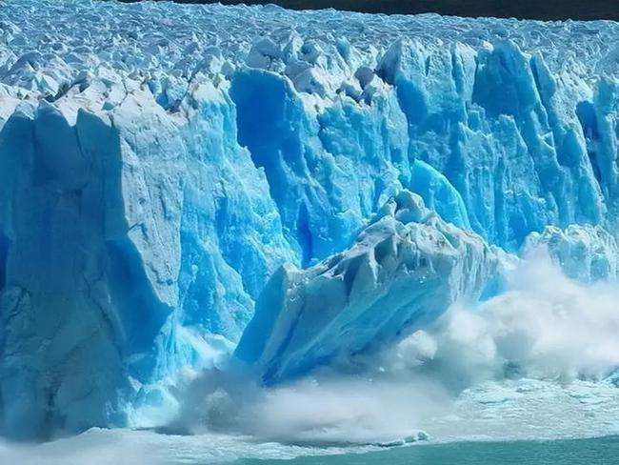
Lead in
Look at the picture and discuss some questions
What do you think this photo was taken?
What does this photo make you think of?
I think this photo was taken in either the Arctic or Antarctica, as those places have large ice sheets like this.
The photo makes me think of the problem of global warming.

Slide 7
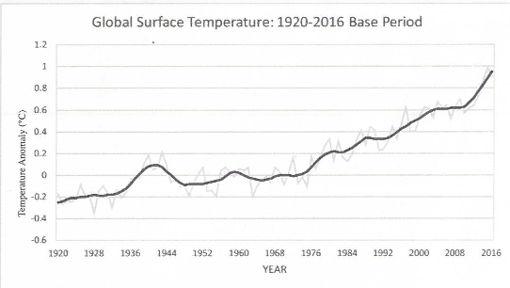
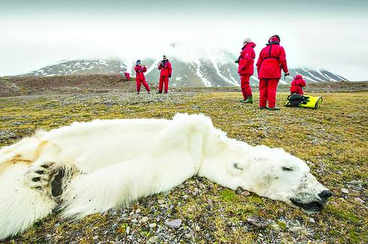
Look at the title and pictures and discuss the questions
Pre-reading
1. What kind of reading passage is it? How do you know?
It’s an exposition.The authors sometimes use some graphs or diagrams in their essays in order to convince their readers. These graphs and diagrams often come from scientific research reports and other reliable resources.
2.Who are the target readers?
Researchers, climate experts or students.

Slide 8
Look at the graph and answer the question.
Pre-reading
1.What is the graph about?What information
can you get from?
2.In which year did the temperature start to increase quickly? Why?
3.What do you think may have caused the global temperature rise?

Slide 9
Look at the graph and answer the questions.
Pre-reading
1.What is the graph about?
2.What information can you get from?
The graph shows the change in the Global Surface Temperature between 1920 and 2016.
It shows the temperature anomaly, which shows how much the temperature has risen above what it would usually be at a base level.

Slide 10
Pre-reading
Look at the graph and answer the questions.
3.In which year did the temperature
start to increase quickly? Why?
4.What do you think may have caused the global temperature rise?
In 1992. Since then, the modernization of industrial technology has accelerated, living standards have risen, and greenhouse gas emissions have increased.
I think it’s caused by increased greenhouse gas emissions and air pollution.

Slide 11
Pre-reading
Look at the picture and answer the questions.
1. Have you ever seen the photo before?
I haven't seen this photo, but I have seen photos like it.
2.What might be the story behind it ?
The story is that the polar bear starved to death because it could not find enough to eat.

Slide 12
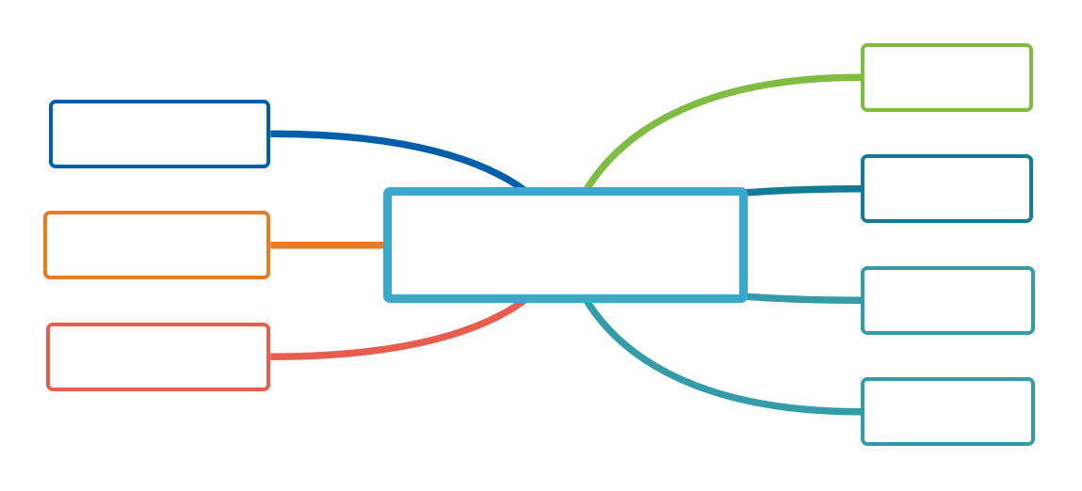
What other consequences may global warming
bring about?
Brainstorm
animals dying
natural
disasters
the rise of
the sea level
extreme weather
gobal warming
unpredictable future of human
economic losses
coastal cities submerged

Slide 13
Reading
Listne to the tape,divide the structure of the article and complete the general idea of each part.
Part | Paragraph | Main idea
1 |  | The ___________of dramatic climate change that had an impact on Earth's ecology
2 |  | The __________ of the increase in the global average surface temperature
3 |  | The______________ of the rise in temperature
4 |  | The ____________to reducing greenhouse gas emissions
1-2
evidence
3
cause
4
consequences
5
solutions

Slide 14
Read the first and second paragraphs and answer the questions.
Reading
1.What happened to the polar bear in the photo?
2.Why did the writer write about it?
The polar bear in the photo died of starvation.
The writer wrote about it because it showed one of the effects of rising temperatures due to climate change.

Slide 15
Read the first and second paragraphs and answer the questions.
Reading
3.Can you use your words to describe how climate change have influenced the polar bear's life?
climate change
low sea-ice levels
bears could not hunt
its dead body found
starved to death
had to travel greater distances to find food

Slide 16
Reading
Read the third paragraph and analyse the structure of it.
keeping Earth’s climate warm and habitable
natural
greenhouse effect
Greenhouse effect
man-made
greenhouse effect
causing Earth’s temperature to rise quickly if too much heat energy is trapped

Slide 17
Reading
Read the third paragraph and answer the questions.
4.Why is the “natural”greenhouse effect important and necessary?
5.What are the consequences of high greenhouse gas emissions?
The "natural" greenhouse effect is important because it warms the Earth9s surface and keeps it habitable.
High greenhouse gas emissions lead to more heat energy being trapped in the atmosphere and rising temperatures.

Slide 18
Reading
Learn the tips and answer the questions.
Draw a diagram
Diagrams are very useful tools that can be used to brainstorm ideas,map out processes, show cause and effect relationships,explain a new idea or concept, and so on.
When you read an essay about scientific issues, you can try drawing a diagram,which will not only allow you to visualise the problems more clearly but also can help demonstrate your creative thinking and problem-solving.
6.What is a diagram? Have you ever seen any diagrams in your physics or geography coursebooks?
Diagrams are used to brainstorm ideas,map out processes, show cause and effect relationships,explain a new idea or concept, and so on.
Yes, I have.

Slide 19
Reading
Learn the tips and answer the questions.
Draw a diagram
Diagrams are very useful tools that can be used tc brainstorm ideas,map out processes, show cause and effect relationships,explain a new idea or concept, and so on.
When you read an essay about scientific issues, you can try drawing a diagram,which will not only allow you to visualise the problems more clearly but also can help demonstrate your creative thinking and problem-solving.
7.When do authors use diagrams in their writing? What's the benefit of using diagrams?
When explaining about scientific issues, authors can try drawing a diagram.
It will not only allow you to visualise the problems more clearly but also can help demonstrate your creative thinking and problem-solving.

Slide 20
Reading
Read the third paragraph and find out the information related to Activity 3.
● The "natural"greenhouse effect refers to the fact that heat from the sun enters the atmosphere and warms Earth's surface as short-wave radiation.
The heat is released back into space at longer wave lengths.
● Greenhouse gases in the atmosphere, such as methane and carbon dioxide, trap some of the heat,keeping Earth's climate warm and habitable.

Slide 21
Reading
Read the third paragraph and create a diagram describing how the greenhouse effect works.
Heat released
back into
space
Reflected
sunlight
Sunlight
Heat reflected
back to
Earth’s
surface
Earth
Atmosphere

Slide 22
Reading
Read the fourth paragraph and analyse the structure of it.
example
extreme rainstorms,
heat waves
The rise in
temperature
extreme weather/
natural disasters
led to
serious damage,
costing human lives,
economic losses
results

Slide 23
Reading
Read the fourth paragraph and answer the questions.
8.Why did the author mention the climate scientists'warning?
The author mentioned the climate scientists’ warning because it is essential that we take action and so it needs to be brought to everyone's attention.

Slide 24
Reading
Read the fourth paragraph and answer the questions.
9.What examples of extreme weather and disasters do you know? Can you make a list?
There are sadly many examples of extreme weather and disasters I know of, such as the extreme rainfall in France and the drought in East Africa in 2014. There were also heatwaves on nearly every continent due to climate change.

Slide 25
Reading
Read the fifth paragraph and answer the question.
10.What is the author's purpose of writing this text?
11.How can individuals reduce "carbon footprint”?
The author’s purpose is to inform the reader and inspire them to do whatever they can to deal with this problem.
By restricting the amount of carbon dioxide our lifestyles produce.

Slide 26
Reading
Read the fifth paragraph and answer the question.
12.Do you think climate change is the result of human activity? Give your reasons .
13.What writing techniques does the author use in order to achieve his/her purpose?
I do think that climate change is the result of human activities because the majority of scientists also think so, and also because global temperatures have followed the rise in global emissions and population.
Use charts, examples, explanations,questions,
comparisons, and leave a question at the end of your essay.

Slide 27
Post-reading
Discuss the question in groups.
1. Do you think climate change is the result of human activity? Give your reasons.
2. Who do you think should take responsibility for dealing with climate change? What can we do?

Slide 28
Post-reading
Work in groups. Complete the tasks.
1. Do you think climate change is the result of human actity? Give your reasons.
I do think that climate change is the result of human activities because the majority of scientists also think so, and also because global temperatures have followed the rise in global emissions and population.

Slide 29
Post-reading
Work in groups. Complete the tasks.
2. Who do you think should take responsibility for dealing with climate change? What can we do?
I think we all need to take responsibility for dealing with it. Individuals can change their behaviour and try to reduce their carbon footprint, while companies and governments can do the same on the larger scale.Here is a mind map about the measures to pay attention to it：

Slide 30
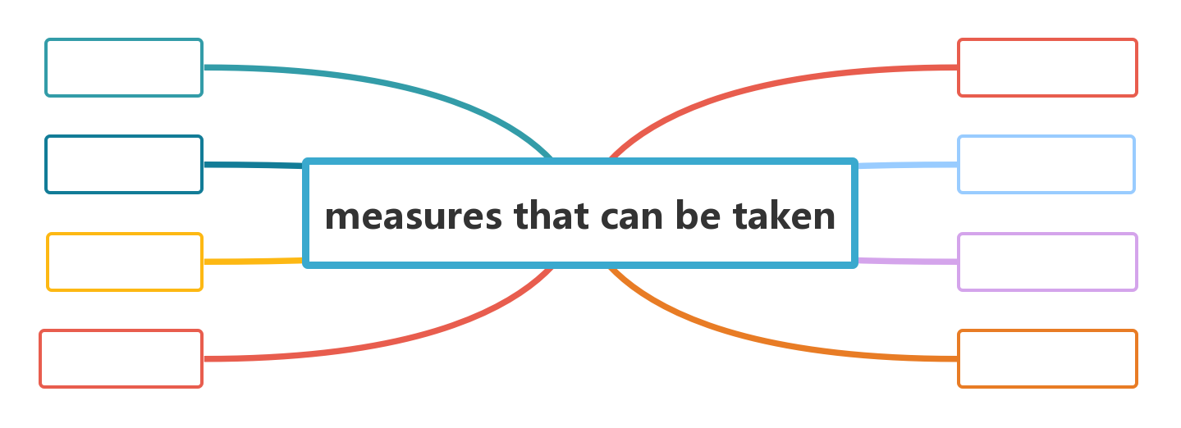
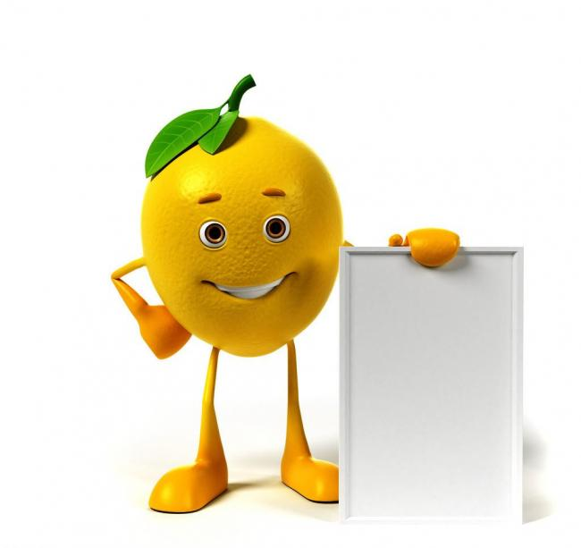
Post-reading
Complete the mind map.
take public
transport
buy the recycled
products
buy things that are economic with energy
recycle bottles/
paper/plastic bags
give people a voice on the planet’s future
giving people a voice on the planet’s future
be LOHAS (lifestyles of health and sustainability )
switch off lights at
homes and businesses
for an hour

Slide 31
Important words
Language points
1.starve 考查热度★★
【热点品味】starve vi. &vt. (使)挨饿； 饿死；缺乏……的
【教材原句】An expert who has studied polar bears for many years said that from the position of its dead body, the bear appeared to have starved and died.一位研究北极熊多年的专家说，从它尸体的位置看，这只熊似乎是挨饿而死的。
【实例品读】
She’s starving herself to try to lose weight.
她正在用节食的方法减轻体重。
These animals will starve to death if not given food soon.
这些动物不赶快喂些食物就会饿死。

Slide 32
Language points
Important words
【热点归纳】
starve to death 饿死
starve for sth. 渴望获得某物；缺乏
starve to do sth. 渴望做某事
starvation n. 饿死
【考点精练】 单句语法填空
①They’ll either die from the cold or starve __________ death.
②When will the dinner be ready? We ______________ (starve).
③He looks forward to the day when no one will die of _____________ (starve).
to
are starving
starvation

Slide 33
Important words
Language points
2.release 考查热度★★
【热点品味】release vt. &n. 排放；释放；发布
【教材原句】 The heat is released back into space at longer wave lengths.热量以较长的波长释放回太空。
【实例品读】
The contraction of muscles uses energy and releases heat.
肌肉的收缩消耗能量并且排放热量。
When is the best moment to release the date of the election to the newspapers?
什么时候是向报界透露选举日期的最好时机？

Slide 34
Language points
Important words
【热点归纳】
release a book/ a new film 发行书/新影片
release information 透露消息
release from 从……释放
release… of 解除，使放出
release to 向……发行
【考点精练】 单句语法填空
①The patient asked the doctor to give him something that would release him _______ his pain.
②The prisoner has served his sentence and ________________ (release) tomorrow.
③On the peak, she burst into tears, ____________ (release) all her emotions.
from
will be released
releasing

Slide 35
Important words
Language points
3.sustain 考查热度★★★★
【热点品味】sustain vt. 维持；遭受；承受住
【教材原句】
Without this process, Earth could not sustain life.
没有这个过程，地球就无法维持生命。
【实例品读】
They had sufficient food to sustain life.
他们有足够维持生命的食物。
The company sustained losses of millions of dollars.
公司遭受了数百万元的巨大损失。

Slide 36
Language points
Important words
【热点归纳】
sustain the injury 受到伤害
sustain life 支撑生活
sustain losses 蒙受损失
sustainable adj. 可持续的；合理利用的
【考点精练】 完成句子
①The problem was how to get enough food ________________.
问题在于如何找到足够的食物维持生命。
②The branches could hardly __________________________.
树枝已很难支撑水果的重量。
to sustain life
sustain the weight of fruit

Slide 37
Important words
Language points
4. trend 考查热度★★★
【热点品味】trend n. 趋势；趋向；动向
【教材原句】 Climate scientists have warned that if we do not take appropriate actions, this warming trend will probably continue and there wil be a higher price to pay. 气候科学家警告说，如果我们不采取适当的行动，这种变暖趋势可能会继续下去，并将付出更高的代价。
【实例品读】
The underlying trend of inflation is still upwards.
通货膨胀的潜在趋势仍然是上升的。
The youth like to follow the latest trends in fashion.
年轻人喜好追求最新的流行款式。

Slide 38
Language points
Important words
【热点归纳】
set a/the trend 开风气之先，带领新潮流
follow the trend 赶时髦
the trend in… ……的时尚
the trend of… ……的形势
the trend to… ……的倾向
【考点精练】 完成句子
①The event ____________________ public opinion.
这件事改变了舆论的趋向。
②There is __________________ earlier retirement.
提早退休者有增加的趋势。
changed the trend of
a growing trend to

Slide 39
Important words
Language points
5.restrict 考查热度★★★★
【热点品味】restrict vt. 限制；限定；束缚
【教材原句】We as individuals can also reduce our"carbon footprint" by restricting the amount of carbon dioxide our lifestyles produce.作为个人，我们也可以通过限制生活方式产生的二氧化碳量来减少我们的“碳足迹”。
【实例品读】
In a move to restrict imports, the government raised custom duties.
政府在限制进口的措施中提高了关税。
Recent laws have tended to restrict the freedom of the press.
新法例有限制新闻自由的趋势。

Slide 40
Language points
Important words
【热点归纳】
restrict to 把……限制〔控制，保持〕
restricted adj. 有限的，受限制的
restriction n. 限制规定；限制法规；约束
【考点精练】 单句语法填空
①Access to the club is restricted _____ members only.
②I restrict myself to __________ (smoke) two cigarettes a day.
③The government has agreed to lift __________ (restrict) on press freedom.
完成句子④Their policy was to ____________________.
他们的政策是限制我们的发展。
⑤ The number of students per class _________________ 40．
每个班的学生人数被限定为40人。
to
smoking
restrictions
restrict our growth
is restricted to

Slide 41
Important phrases
Language points
1. refer to 考查热度★★★★
【热点品味】提到，谈及，说起；查阅；有关，针对
【教材原句】The "natural"greenhouse effect refers to the fact that heat from the sun enters the atmosphere and warms Earth's surface as short-wave radiation.“自然”温室效应是指太阳的热量以短波辐射的形式进入大气层，使地球表面变暖。
【实例品读】She always referred to Ben as “that nice man”.
她总是称本为“那个大好人”。
“In fact，tradition also refers to the things that have been developing and that are still being created，”he said.
他说，事实上，传统也指一直在发展的和仍正在被创造的东西。

Slide 42
Language points
Important phrases
【热点归纳】
(1)refer to… as… 把……称作……
refer… to… 将……送交给……(以求获得帮助等)
(2) reference n. 言及；提及；参考；查阅
(3)辨析：refer to/look up在表示“查阅”之意时，refer to后多接参考资料(字典，书籍等)；look up多接查询的内容。
【考点精练】 单句语法填空
①While giving the English speech, one is not allowed to refer _____ the notes.
②You’d better write down the phone number of that restaurant for further ____________ (refer).
to
reference

Slide 43
Important phrases
Language points
2.result in 考查热度★★★★
【热点品味】 导致
【教材原句】 Continued greenhouse gas emissions will result in further warming and long-lasting changes to the global climate.
持续的温室气体排放将导致进一步变暖和全球气候的长期变化。
【实例品读】
The talks resulted in reducing the number of missiles.
谈判结果削减了导弹数量。
The accident resulted in three people being killed.
这一事故导致三人死亡。

Slide 44
Language points
Important phrases
【热点归纳】
result in“导致”与lead to“导致”同义，且in与to皆为介词，两短语可互换。
result from 因……而引起；因……而导致
as a result 结果；因此(作状语)
as a/the result of 由于……；因为……
without result 毫无结果
【考点精练】单句语法填空
①His laziness resulted in his failure；that is to say, his failure resulted _______ his laziness.
②As we all know, success results _______ hard work and failure often lies _____ laziness.
from
from
in

Slide 45
Important sentences
Language points
1.There is no doubt that ... ......是毫无疑问的。 考查热度★★★★
【教材原句】There is little doubt that Earth is getting warmer and warmer (see the graph).毫无疑问，地球正变得越来越暖和(见图)。
【句式分析】
句中There is no/little doubt that… 表示“毫无疑问；无疑”，后接一个that引导的同位语从句。
当doubt前有否定词修饰时，其后常接that引导的同位语从句；
当doubt前无否定词修饰时，其后常接whether引导的同位语从句。
此外，There is doubt后也可以接介词about/as to引导的短语。

Slide 46
Language points
Important sentences
【实例品读】
There is no doubt that our team will win the match.
毫无疑问，我们队将赢得比赛。
There is some doubt whether Peter will come on time.
彼得是否会按时来还是个问题。
【思维拓展】
There is no question… ……是没有问题的。
There is no reason… 没有理由……
There is no need/hope/possibility that… 没有必要/希望/可能……
It’s no wonder that… 难怪……
It’s no good/use doing… 做……没有好处/用处。

Slide 47
Language points
Important sentences
【考点精练】 单句语法填空
①There is little doubt _______ it is vital for us
to deal with e-waste properly.
②There is some doubt __________we should
direct our attention at the fundamental question.
③He doubted _____________ he would learn
anything valuable from Marie.
④(2021·高考甲卷)I have no doubt _______ the little one will be out and about exploring and playing every day.
⑤If you have any doubt ________ your health, you’d better consult your doctor at once.
that
whether
whether/if
that
about

Slide 48
Important sentences
Language points
2.现在分词作结果状语 考查热度★★★★
【教材原句】Greenhouse gases in the atmosphere, such as methane and carbon dioxide trap some of the heat, keeping Earth’s climate warm and habitable.大气中的温室气体，如甲烷和二氧化碳，会吸收一些热量，使地球的气候温暖宜居。
【句式分析】
句中keeping Earth’s climate warm and habitable作结果状语。现在分词作结果状语往往表示必然结果或者顺理成章的结果；而不定式作结果状语往往表示没有想到的结果。
I got to the station, only to be told that the train had left.
我赶到火车站，不料被告知火车已开走了。

Slide 49
Language points
Important sentences
【实例品读】
When he was a little boy, his parents died, leaving him an orphan.
在他很小的时候父母就去世了，他成了孤儿。
It has been raining for several weeks, causing the roads to be destroyed.
大雨下了几周，导致路被毁掉。
【考点精练】 单句语法填空
①The setting sun was reflected on the river, _________ (make) everything along the banks look all the more beautiful.
②He kept trying on thing after another，only _________ (fail) each time.
making
to fail

Slide 50
Important sentences
Language points
3.现在分词作结果状语 考查热度★★★★
【教材原句】Without this process，Earth could not sustain life.
没有这个过程，地球就不能维持生命。
【句式分析】
此句为虚拟语气句，without引起虚拟语气。
Without this process＝If there were not this process，
是一个与现在事实相反的虚拟条件句。
后面的句子使用了would be表示与现在事实相反的结果。
【实例品读】
Without water, fish wouldn’t live.
没有水，鱼不能活。
Without your help, we would have failed.
如果没有你的帮助，我们肯定会失败的。

Slide 51
Language points
Important sentences
【思维拓展】
很多情况下表示虚拟的假设并不用条件从句表示出来，而是通过上下文，利用but for，or，otherwise等介词(短语)或连词来表示，这就是所谓的含蓄虚拟语气。
But for your help, I would have failed the exam.
要不是你的帮助，我考试一定会不及格的。
【考点精练】 完成句子
①I was not listening to the teacher，or else I _______________________ his questions.我没听老师讲课，不然我就回答他的问题了。
②Without air，there ____________ any living things on the earth.
没有空气，地球上就不会有生物。
would have answered
wouldn’t be

Slide 52
Exercise
单词拼写
1．You can’t see your sister _________ (挨饿)without trying to help her!
2．__________ (放开) the dog. He has been chained up for hours.
3．Running costs are coming down because of cheaper _______ (燃料).
4．Will this light shelf __________ (承受)the weight of all these books?
5．The rise in violent crime is a disturbing new ________ (趋势).
starve
Release
fuel
sustain
trend

Slide 53
Exercise
单词拼写
6．I listen to the sports news ____________ (广播) on the radio station every day.
7．The long skirt ___________ (限制了) her movements.
8．The government must make new ___________ (政策) to reduce unemployment.
9．We must ________ (抓住) all opportunities to accelerate development.
10．Buses run _____________ (频繁地) from the city to the airport.
broadcast
restricted
policies
seize
frequently

Slide 54
Exercise
课文语法填空
There is little doubt that Earth 1.____________ (get) warmer and warmer. The “man-made”greenhouse effect has contributed to the climate change.
There is strong and comprehensive evidence that the rise in temperature has led to 2.___ increase in extreme weather and natural 3.____________ (disaster) worldwide，not only causing serious damage，but also costing human lives. Climate scientists have warned that 4._____ we do not take appropriate actions, this warming trend will 5.___________(probable) continue and there will be a higher price to pay.
is getting
an
disasters
if
probably

Slide 55
Exercise
课文语法填空
Continued greenhouse gas emissions will result6._____ further warming and long-lasting changes to the global climate，7.________ requires the attention of people all over the world. Governments need to consider making policies and taking appropriate actions and measures 8.___________ (reduce) greenhouse gas emissions.
We as individuals can also reduce our “carbon footprint” by 9.________ (restrict) the amount of carbon dioxide our lifestyles produce. It is our 10.________________(responsible) to seize every opportunity to educate everyone about global warming, along with its causes and impacts, because this is the most serious issue affecting all of us on this planet.
in
which
to reduce
restricting
responsibility

Slide 56
Do the exercises on
Page 75 of Workbook.

